Slide 1
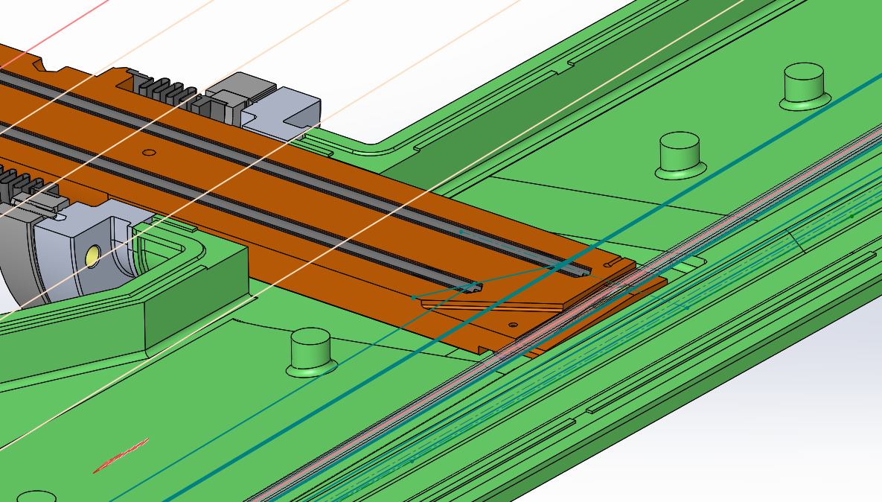
SRTU ABSORBERS SAFETY MARGINS
Th. Brochard
On behalf of the EBS Accelerator Team

Slide 2
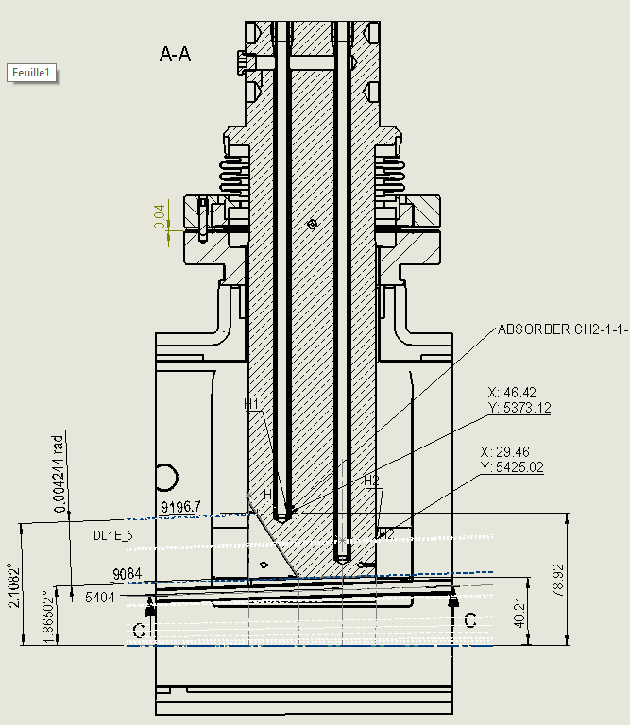
ABS – CH2 HELICAL
 | On energy | Off energy
Source | DL1E_5 | DL1E_5
Distance [mm] | 9196 | 9196
Beam Pos. [µm] | 0 | -23
Beam angle [µrad] | 0 | 112
Beam displacement [mm] | 0 | 1.0
Abs. margin [mm] | 5 | 4
Mechanical margins [mm] | 2 | 2
Remain margin [mm] | 3 | 2

Slide 3
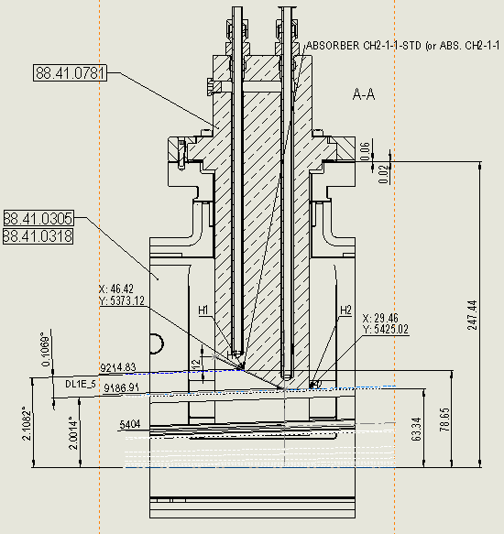
ABS – CH2 1/1 STANDARD
 | On energy | Off energy
Source | DL1E_5 | DL1E_5
Distance [mm] | 9215 | 9215
Beam Pos. [µm] | 0 | -23
Beam angle [µrad] | 0 | 112
Beam displacement [mm] | 0 | 1.0
Abs. margin [mm] | 5 | 4
Mechanical margins [mm] | 2 | 2
Remain margin [mm] | 3 | 2

Slide 4
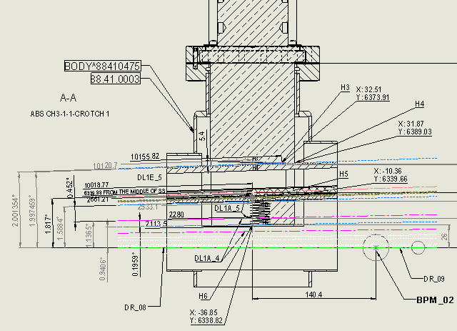
ABS – CH3 1/1
 | On energy | Off energy
Source | DL1E_5 | DL1E_5
Distance [mm] | 10155 | 10155
Beam Pos. [µm] | 0 | -23
Beam angle [µrad] | 0 | 112
Beam displacement [mm] | 0 | 1.1
Abs. margin [mm] | 5.4 | 4.3
Mechanical margins [mm] | 2 | 2
Remain margin [mm] | 3.4 | 2.3

Slide 5
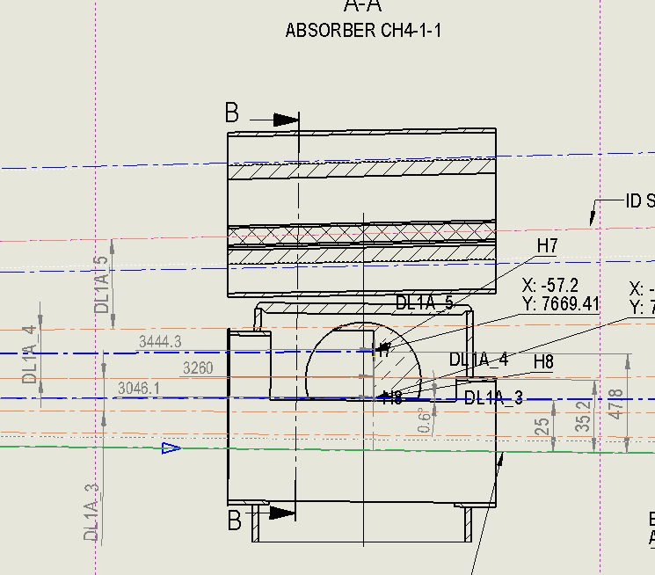
ABS – CH4 1/1
 | On energy | Off energy
Source | DL1A_4 | DL1A_4
Distance [mm] | 3444 | 3444
Beam Pos. [µm] | 0 | -24
Beam angle [µrad] | 0 | -106
Beam displacement [mm] | 0 | -0.4
Abs. margin [mm] | 6 | 6
Mechanical margins [mm] | 2 | 2
Remain margin [mm] | 4 | 4

Slide 6
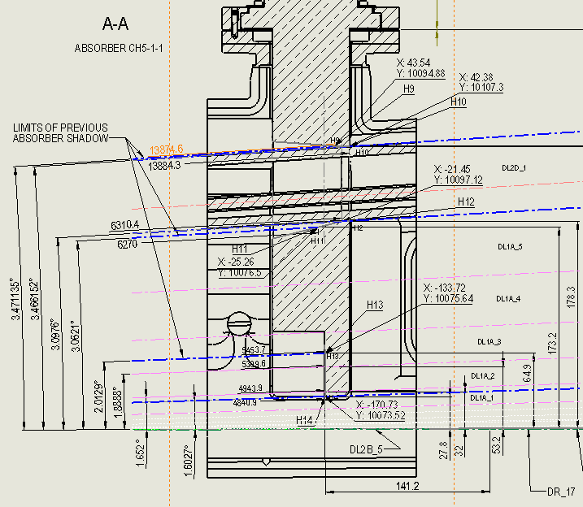
ABS – CH5 1/1
 | On energy | Off energy
Source | DL1A_3 | DL1A_3
Distance [mm] | 5454 | 5454
Beam Pos. [µm] | 0 | -74
Beam angle [µrad] | 0 | -176
Beam displacement [mm] | 0 | -0.9
Abs. margin [mm] | 7 | 7
Mechanical margins [mm] | 2 | 2
Remain margin [mm] | 5 | 5

Slide 7
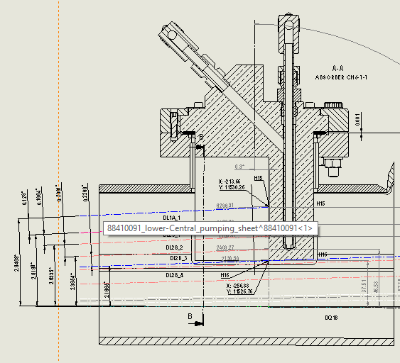
ABS – CH6 1/1
 | On energy | Off energy
Source | DL1A_1 | DL1A_1
Distance [mm] | 6298 | 6298
Beam Pos. [µm] | 0 | -239
Beam angle [µrad] | 0 | -267
Beam displacement [mm] | 0 | -1.7
Abs. margin [mm] | 7 | 7
Mechanical margins [mm] | 2 | 2
Remain margin [mm] | 5 | 5

Slide 8
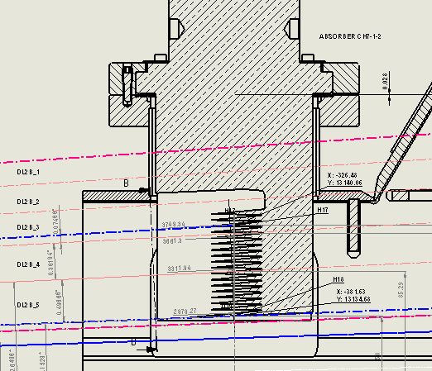
ABS – CH7 1/2
 | On energy | Off energy
Source | DL2B_3 | DL2B_3
Distance [mm] | 3750 | 3750
Beam Pos. [µm] | 0 | -175
Beam angle [µrad] | 0 | 172
Beam displacement [mm] | 0 | 0.6
Abs. margin [mm] | 5 | 5
Mechanical margins [mm] | 2 | 2
Remain margin [mm] | 3 | 2.4

Slide 9
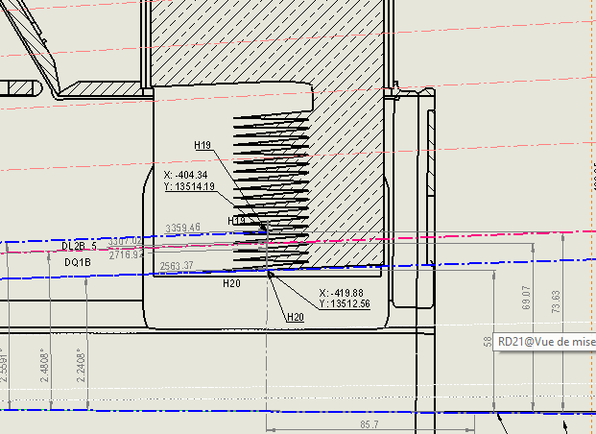
ABS – CH7 2/2
 | On energy | Off energy
Source | DL2B_5 | DL2B_5
Distance [mm] | 3360 | 3360
Beam Pos. [µm] | 0 | -91
Beam angle [µrad] | 0 | 57
Beam displacement [mm] | 0 | 0.2
Abs. margin [mm] | 7 | 7
Mechanical margins [mm] | 2 | 2
Remain margin [mm] | 5 | 4.8

Slide 10
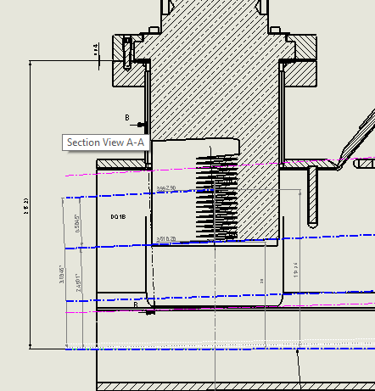
ABS – CH8 1/2
 | On energy | Off energy
Source | DQ1B | DQ1B
Distance [mm] | 3993 | 3993
Beam Pos. [µm] | 0 | -67
Beam angle [µrad] | 0 | 117
Beam displacement [mm] | 0 | 0.5
Abs. margin [mm] | 5 | 5
Mechanical margins [mm] | 2 | 2
Remain margin [mm] | 3 | 2.5

Slide 11
ABS – CH8 2/2
 | On energy | Off energy
Source | DQ1B | DQ1B
Distance [mm] | 4120 | 4120
Beam Pos. [µm] | 0 | -67
Beam angle [µrad] | 0 | 117
Beam displacement [mm] | 0 | 0.5
Abs. margin [mm] | 7 | 7
Mechanical margins [mm] | 2 | 2
Remain margin [mm] | 5 | 4.5

Slide 12
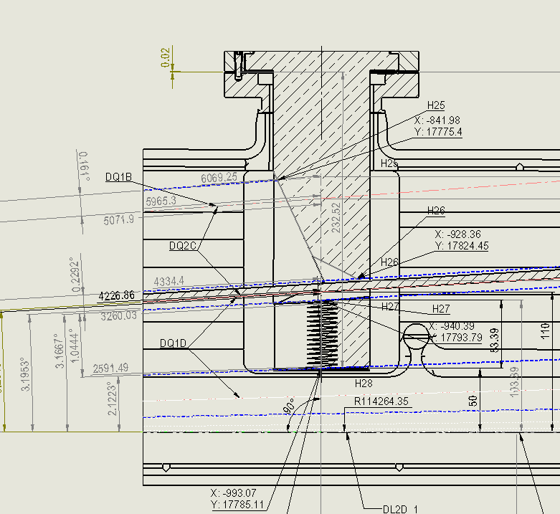
ABS – CH9 1/2
 | On energy | Off energy
Source | DQ1B | DQ1B
Distance [mm] | 6069 | 6069
Beam Pos. [µm] | 0 | -67
Beam angle [µrad] | 0 | 117
Beam displacement [mm] | 0 | 0.7
Abs. margin [mm] | 5 | 5
Mechanical margins [mm] | 2 | 2
Remain margin [mm] | 3 | 2.3

Slide 13
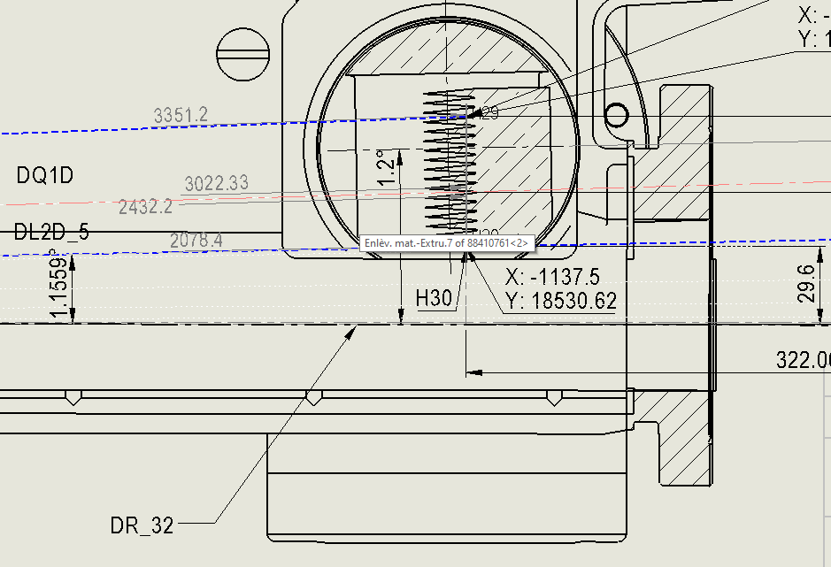
ABS – CH9 2/2
 | On energy | Off energy
Source | DQ1D | DQ1D
Distance [mm] | 3351 | 3351
Beam Pos. [µm] | 0 | -145
Beam angle [µrad] | 0 | 294
Beam displacement [mm] | 0 | 1.0
Abs. margin [mm] | 10 | 10
Mechanical margins [mm] | 2 | 2
Remain margin [mm] | 8 | 7

Slide 14
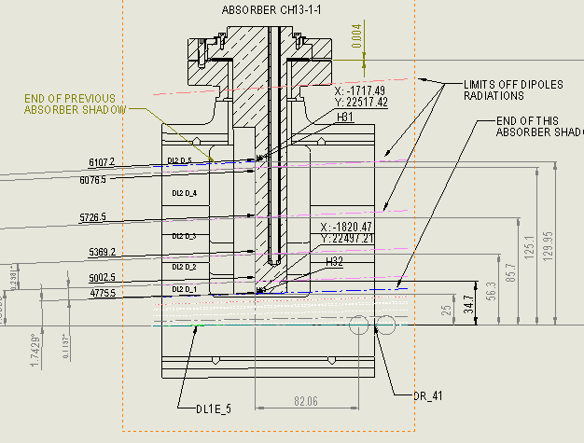
ABS – CH13 1/1
 | On energy | Off energy
Source | DL2D_5 | DL2D_5
Distance [mm] | 6107 | 6107
Beam Pos. [µm] | 0 | -86
Beam angle [µrad] | 0 | 35
Beam displacement [mm] | 0 | 0.2
Abs. margin [mm] | 5 | 5
Mechanical margins [mm] | 2 | 2
Remain margin [mm] | 3 | 2.8

Slide 15
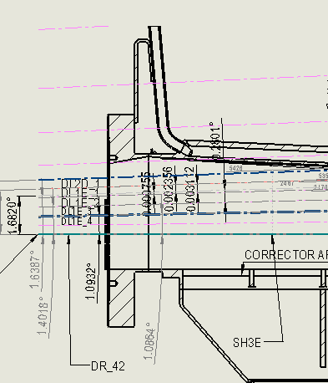
ABS – CH14 1/1 - ENTRY
 | On energy | Off energy
Source | DL2D_1 | DL2D_1
Distance [mm] | 5426 | 5426
Beam Pos. [µm] | 0 | -251
Beam angle [µrad] | 0 | -216
Beam displacement [mm] | 0 | +1.2
Abs. margin [mm] | 5 | 5
Mechanical margins [mm] | 2 | 2
Remain margin [mm] | 3 | 3

Slide 16
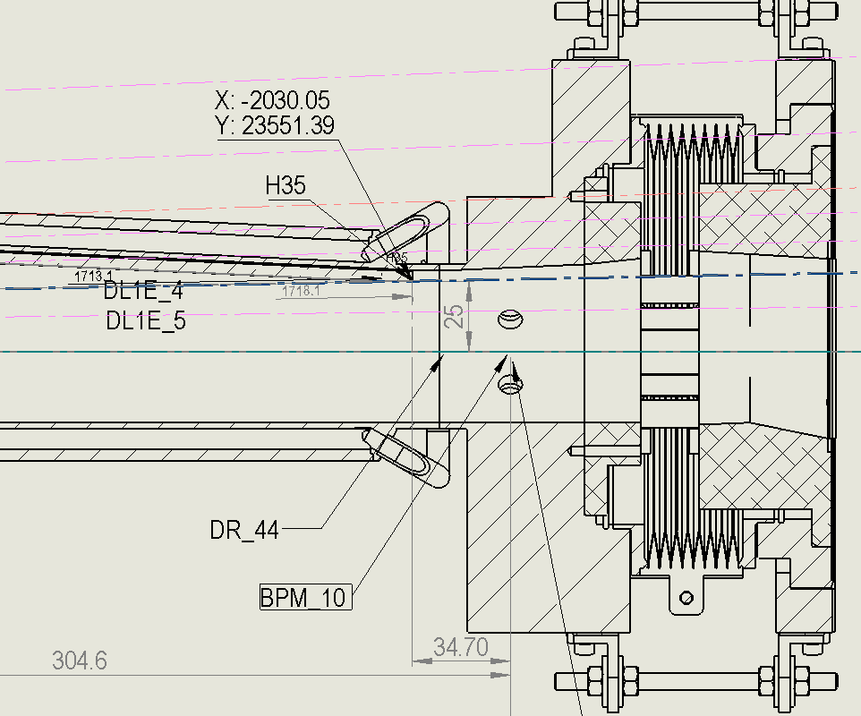
ABS – CH14 1/1 - EXIT
 | On energy | Off energy
Source | DL1E_4 | DL1E_4
Distance [mm] | 1713 | 1713
Beam Pos. [µm] | 0 | -75
Beam angle [µrad] | 0 | 181
Beam displacement [mm] | 0 | 0.03
Abs. margin [mm] | 5 | 5
Mechanical margins [mm] | 2 | 2
Remain margin [mm] | 3 | 3

Slide 17
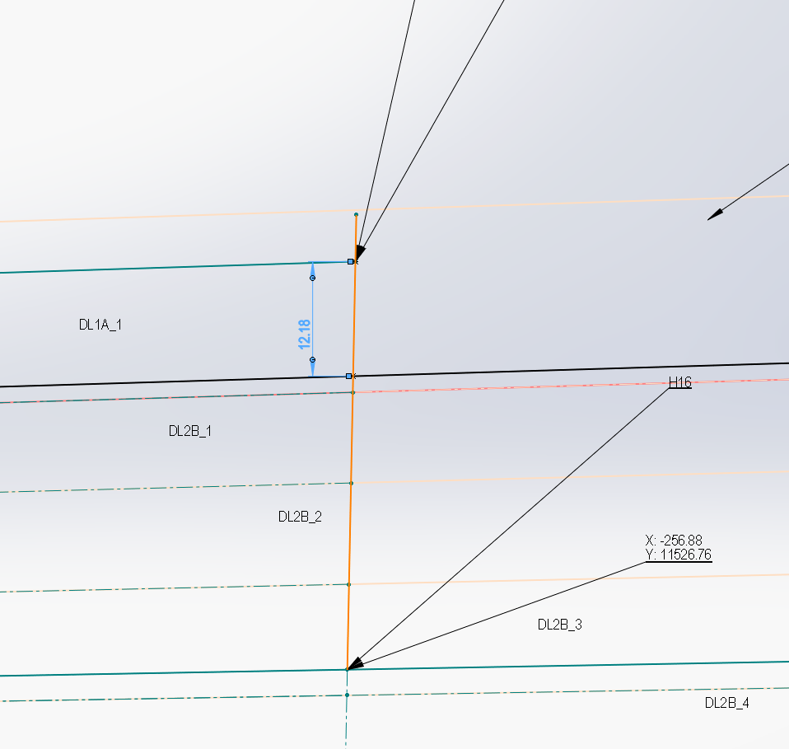
ABS – CH6 1/1 - EXIT
 | On energy | Off energy
Source |  | QD5B
Distance [mm] | 3625 | 3625
Beam Pos. [µm] | 0 | -418
Beam angle [µrad] | 0 | 472
Remain margin [mm] |  | 12
All radiations produced by QD5B
Absorbed by ABS CH6 1/1

Slide 18
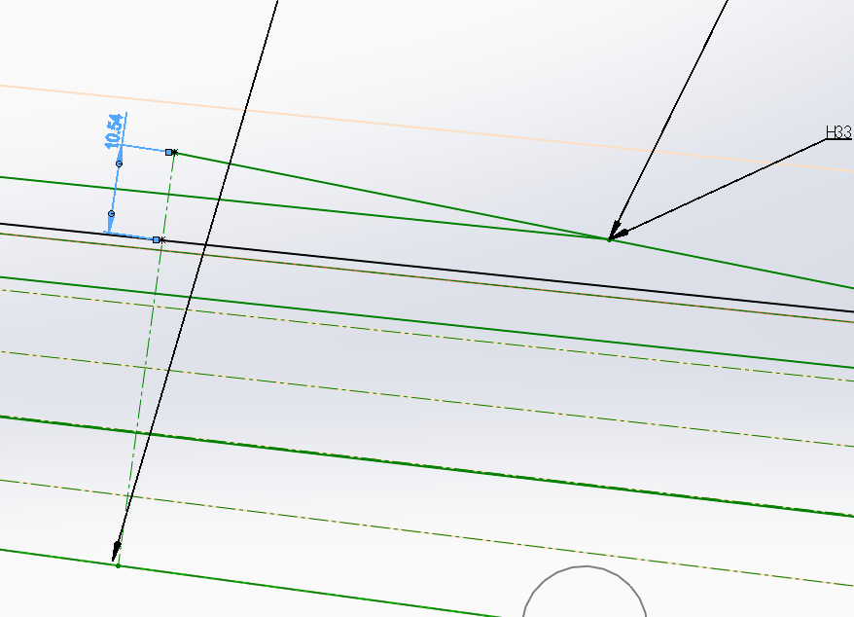
ABS – CH6 1/1 - EXIT
 | On energy | Off energy
Source |  | QD3E
Distance [mm] | 3625
Beam Pos. [µm] | 0 | -426
Beam angle [µrad] | 0 | 475
Remain margin [mm] |  | 10
All radiations produced by QD3E
Absorbed by ABS CH14

Slide 19
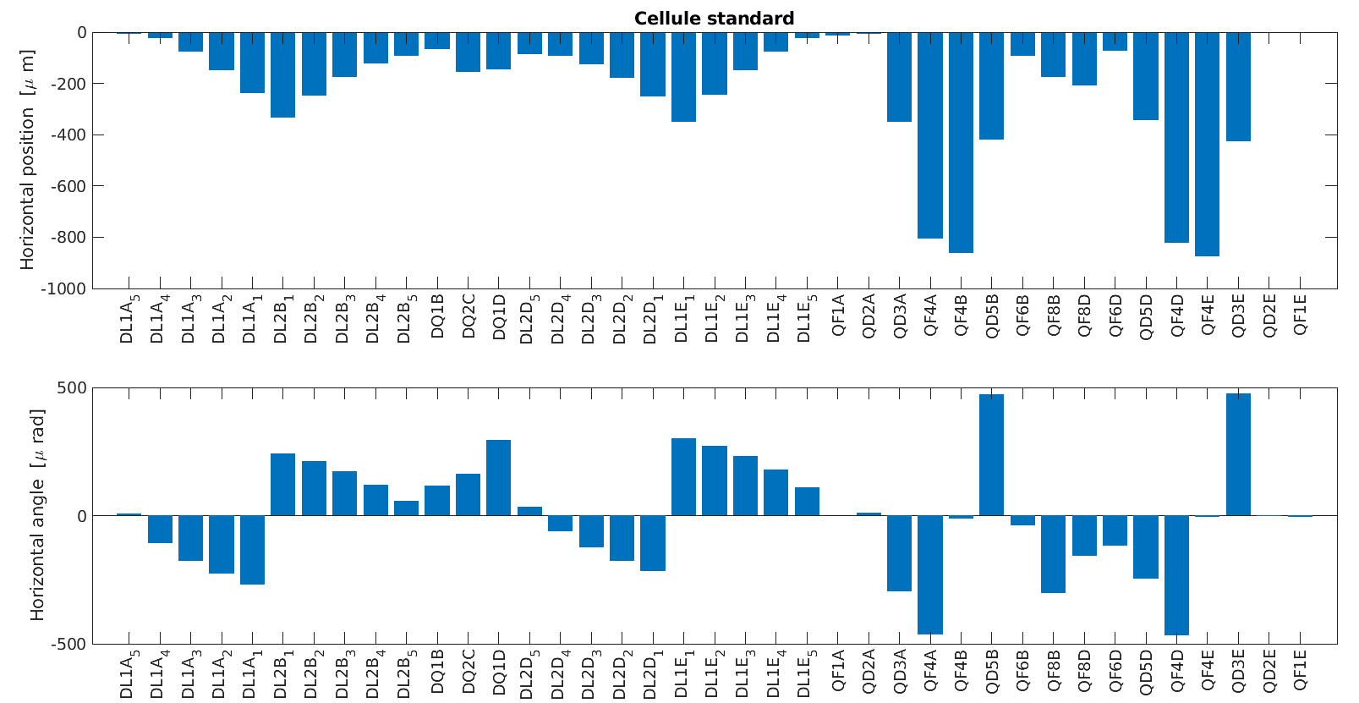
BEAM DEVIATIONS – OFF energy

