Slide 1
Why the application FILO should be replaced and a draft proposal for its refurbishment and improvement
The statements in this presentation are work in progress.
If there is no interest in this activity, the work will stop immediately.
S.M.Liuzzo, June 2022

Slide 2
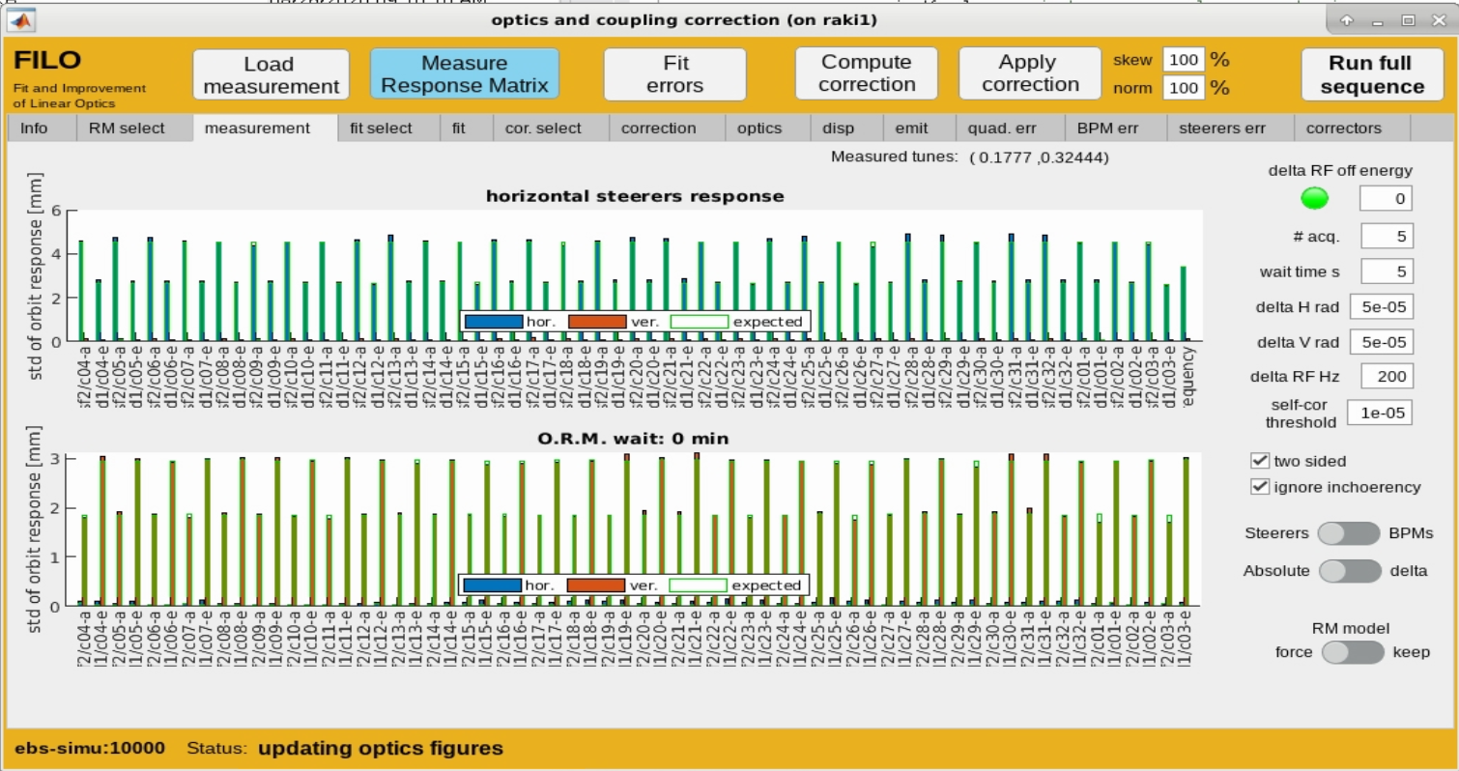
The FILO APPLICATION

Slide 3
FILO present ISSUES
MATLAB APPDESIGNER == BAD CHOICE
SLOW GRAPHICS, freezing application
difficult use in CTRM (only on grappa, only on ubuntu20.04, only matlab 2020b)
NOT User Friendly, even with Wizard mode, too many accessible unnecessary/expert paramenters
BPM Cell01 #07 to be disabled for FAST RM, Steerer SH1A Cell09 often not good.
Not possible to remove a Steerer from a measurement that has already been taken (it has to be removed before the measurement).
Bricolage to recover interrupted measurements
Must look at matlab command line in some cases (Ex: measurement does not start, matlab display Waiting for FOFB to start, the user has to start by hand FOFB that is likely in fault)
Some application parameters stay available even when they should not be modified anymore
Graphics of output fit parameters and measured/fit/corrected quantities difficult to read, slow to plot
Graphics of present vs proposed correction not easy to read
Frequent AT updates require frequent modifications (several in 2021-2022, for off-energy)
Binary application file, only visible in matlab appdesigner, no diff possible in git. Complicated debug in CTRM.
+ all the issues in gitlab
+ missing features such as Analytic RM, measurement of BPM reading error to weight the fit, etc etc..
+ missing history of fitted parameters/corrections
MATLAB PARALLEL == BAD CHOICE

Slide 4
FILO present structure
Contains (almost) all the Tango DS Attributes used. Used also by other applications used for commissioning, but not anymore
Matlab
+
Tango
ringcontrol
sr.model class
by L.Farvacque
Gets the present lattice model from the optics folder. Difficult code and not user friendly. A simple file load would be enough. More actions on the lattice are done in the CTRM application (fit tunes and chroma to present ones).
slow RM measurement
Improved matlab version of Old SR code. Among other, Self-steering and matlab file saving are implemented. Measures also dispersion and emittances.
Fast RM measurement
Fast 96 SH steerer RM with FOFB. Tango DS and Jdraw app. by B.Roche
generic FITTING
Allows to fit normal and skew quadrupoles, BPM and correctors gains and rotations etc… Send Large Jacobian computations on cluster or grappa.
Same classes used for optics correction (RDTs)
plotting functions
Visualize measurement, optics fit, correction parameters
CTRM Application
Allow user to chose almost any possible parameter for measurement, fit, plot, correction. Wizard mode. Switch Fast/Slow. User messages. Etc etc…

Slide 5
Code interdependence device states / selection
ringcontrol
Disabled/Frozen BPMS, steerers, quadrupoles
sr.model class
by L.Farvacque
RM measurement
Excluded after RM measurement (presently possible only from code not via application)
generic FITTING
plotting functions
CTRM Application
User excluded BPMS, steerers, quadrupoles

Slide 6
Code interdependence Lattice model
ringcontrol
Device names, injection bump, etc…
sr.model class
by L.Farvacque
Ideal lattice model, on- or off- energy, indexes in lattice,
RM measurement
generic FITTING
plotting functions
CTRM Application
Model with measured Tune and Chroma.

Slide 7
Code interdependence FIT
ringcontrol
sr.model class
by L.Farvacque
RM parameters
Theoretical RM
AT Lattice
RM measurement
Measured RM
Jacobian computation and storage
generic FITTING
Plot resulting optics, fit parameters values, fit quality, corrections etc…
plotting functions
CTRM Application
Model with measured Tune and Chroma.
AT Lattice
BPM/Steerers
Fit variables
Correction variables

Slide 8
FILO upgrade to Tango DS + JAVA interface
Closely related devices involving Beam dynamics aspects
OpticsDS
x4
RingSimulatorDS modified.
+ ability to stop/start magnets monitoring for each individual magnet dynamically
+ simulated tune/orbit/chroma DS in CTRM or simply disable writing to simulated devices.
OrbitResponseMatrixDS
x3
Missing, but not extremely difficult. Can be inspired on past code.
Python + pyAT + Tango
FitDS
x?
Missing. Potentially difficult.
CorrectionDS
x?
Missing. First version rather simple. More complicated DS (RDT correction) should be easier to prepare given the above structure.
Historically done by Beam dynamics but could be outsourced:
ACU + Operation + Beam dynamics
CTRM Application
RM Application
Could be a jdraw initially as for FastRM, to be later developed
FIT Application
Optics display Application

Slide 9
FILO possible code separation / re factoring
Start from the existing Optics Calculator DS or RingSimulator DS
match tune to measured
match chroma to measured
quad and skew from SR (for absolute correction computation, if optics are stable)
sextupoles and octupoles from SR
Records reference optics name
off-energy shift in RF frequency* and mark ideal RF in RF cavity element? This is the location to store the Off-energy information
presently frozen/disabled BPM/Steerers/Quadrupoles/Sextupoles
provides optics parameters (optics, dispersion, RDTs, mcf. etc… not to compute them again)
save lattice file and parameters in matlab/python format
command to simulate an ORM measurement with identical settings to the one given by OrbitResponseMatrixDS (see later)
Give access to all “fit-able” lattice Errors (relative or absolute)
Theory parameters available via OpticsDS-THEORY instance
Stores a date of last update (to certify synch among different instances)
ringcontrol
OpticsDS
sr.model class
by L.Farvacque
x4 instances:
Theory
fitted-errors (with results from optics fit)
corrected (fitted-errors + computed correction)
on-line (corrected + delta corrections compared to date of last update, or enabled RingSimulator mode)
fitted-errors could contain (as for the old ESRF SR) the absolute values of the SR correctors (simply enabling the RingSimulator DS features), and then the absolute fitted error. At last try this lattice was not stable.
As a consequence on-line would be a complete absolute lattice model. Usable for continuous optics monitoring in CTRM
* Possible since AT “3.0” (never tagged, it really does not exist. AT2.0 after May 2021 == AT 3.0)
Pseudo - Digital TWIN

Slide 10
FILO possible code separation / re factoring
New DS for Response matrix measurement featuring:
Fast / Slow RM (scale factors, conversion, different beam requirements)
Check that correct beam requirements are met (current, autocor, fofb, WN, filling pattern, RF frequency shift, … )
Available list of steerers/BPMs used for RM
Self-steering
Measurement of BPM reading error / incoherency
Measurement of emittances (WN off)
Measurement of dispersion
Measurement of tunes
Keep net separation among BPM H and V and Steerers H and V
Shows progress of measurement and magnets names
Provides vectorized RM+dispersion+tunes for FitDS (see later)
Allows measurement “abort” and “resume”
Remembers if the measurement is
fast or slow,
the steerers/bpms used,
the state of bpms and steerers at the time of measurement,
the off-energy state
Allows to visualize the data and navigate through it to mark in the measurement bad BPMs and Steerers (information later used by FitDS)
Data saved in /machfs/MDT/…./resp…
RM measurement
OrbitResponseMatrixDS
3 instances:
On energy
Off energy + delta
Off energy - delta
RM Application

Slide 11
FILO possible code separation / re factoring
New DS for fit of Response matrix. FitDS Features:
Uses OpticsDS lattice and OrbitResponseMatrixDS to compute reference RM for fit
Allows to chose among a large, potentially evolutive, list of fit parameters: quadrupoles, BPM/Steerers errors, dipole errors, RF, etc… All these parameters are selectable individually (ex excluding a
Allows to further chose which part of the measured RM to use (exclude BPMS/Steerers that are part of the measured RM)
Make uses OpticsDS and OrbitResponseMatrixDS list of disabled/exluced bpm/steerers
Fit by family
Allows to define weighting of the different parts of an OrbitResponseMatrixDS measurement
Provides arrays sorted along the ring (if applicable) of the fitted errors
Provides fast ways (grappa, ASD cluster) to compute the Jacobian and save it
Proposes a set of likely to be removed BPMs/Steerers
Data saved in /machfs/MDT/…./resp… /fit…
Fitted model parameters available via OpticsDS-FITTED-ERRORS instance
generic FITTING
FitDS
JacobianDS ?
To separate all lattice dependent part? May require to double many of the attributes/features of FitDS
+ Fit absolute errors on a lattice including the present correctors in the SR, as for the old ESRF SR. if optics are stable.
NOECO_FitDS
Future developments for sextupole corrections
FIT Application
Obtain the best ever optics model DS

Slide 12
FILO possible code separation / re factoring
New DS for the computation of correction based on FitDS resulting lattice:
Uses FitDS lattice to compute a correction
If the correction scheme accepts it, it allows to chose a subset among all correctors.
Provides fast ways (grappa, ASD cluster) to compute the Jacobian and save it
Data saved in /machfs/MDT/…./resp… /cor…
Correction parameters available via OpticsDS-CORRECTED instance
CorrectionDS
Initially simply a minus sign on the fitted errors (no sub-selection allowed fit-locations == cor-locations)
Then RDT correction, and others at wish
Then NOECO correction, based on off-energy instances of OrbitResponseMatrixDS

Slide 13
FILO possible code separation / re factoring
New Java (?) Application(s). Featuring:
Prompts user to select Attributes and execute Commands of OpticsDS instances, OrbitResponseMatrixDS and FitDS.
Selects Fast/slow
Selects on/off energy (if NOECO will become usefull)
Display interactively Attributes of OpticsDS instances, OrbitResponseMatrixDS and FitDS.
Display interactively Optics parameters from OpticsDS instances
Display measured quantities (tune, chorma, dispersion, RM) compared to theoretical ones from OpticsDS
Display/Select/Change data location
Chose optics
Allows to Apply a correction
Allows to save a given Measurement-Fit set of parameters
Allows to recall previous measurements to observe the data perform a new Fit and compute a new correction
Error reporting
Two different application instances can open two different measurement/fit/corrections for visual comparison
CTRM Application
plotting functions
CTRM Application
RM Application
FIT Application
Optics display Application

Slide 14
Conclusion
The FILO application was developed in 2020, and it is already showing ageing and bad choices.
A full refurbishment to Tango + pyAT would bring:
Better code maintainability
More stable use in CTRM
Simple use by operators and non experts.
Better exploitation of computing resources
Continuous monitoring of the expected optics
Easier access to beam parameters
Better faster more reactive visualization and user interface experience
Same structure could work for the booster and TL2 optics (ideally, work scales less then linearly)
Time and experts are needed. About 2FTE (1BD 1ACU) for about 3 months would be needed for a first prototype. Other 1FTE for 6 months to finalize. This estimate is for 100% time devoted to this activity. Excludes Meeting, Holidays, Operation, MDTs etc...
Many thanks to B.Vedder for fruitful discussions pointing out: 1) the need to split the code and 2) the courage to start over when the code has become too bad to be fixed.

Slide 16
Features to keep
application(s) working in simulator and real control system
Save/load application settings

