Slide 1
BlueSky & Automating Deployment at the APS
Eric Codrea

Slide 2
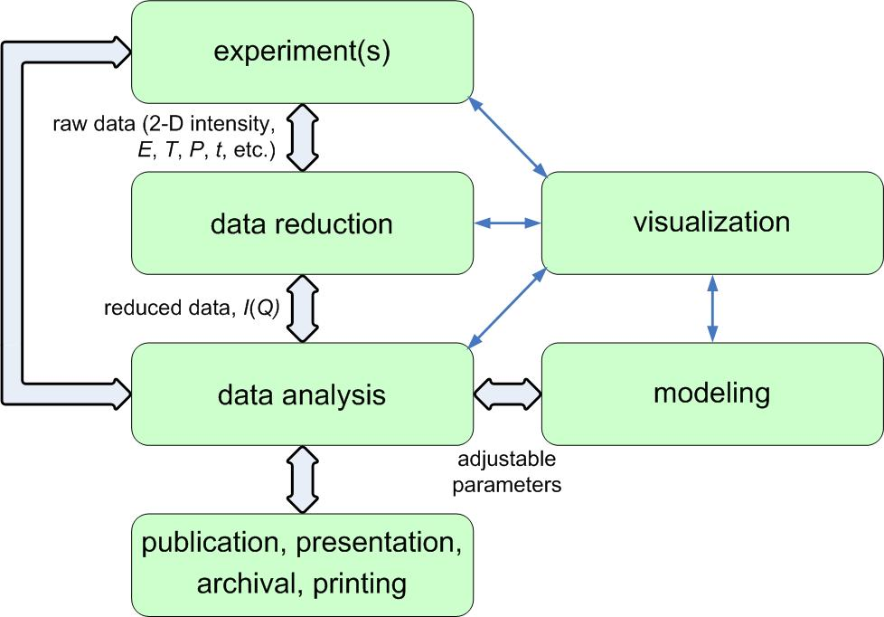
The Scientific Workflow
A major component of any modern scientific instrument is its suite of support software
Control systems
Data acquisition activities
Data visualization
Data analysis

Slide 3
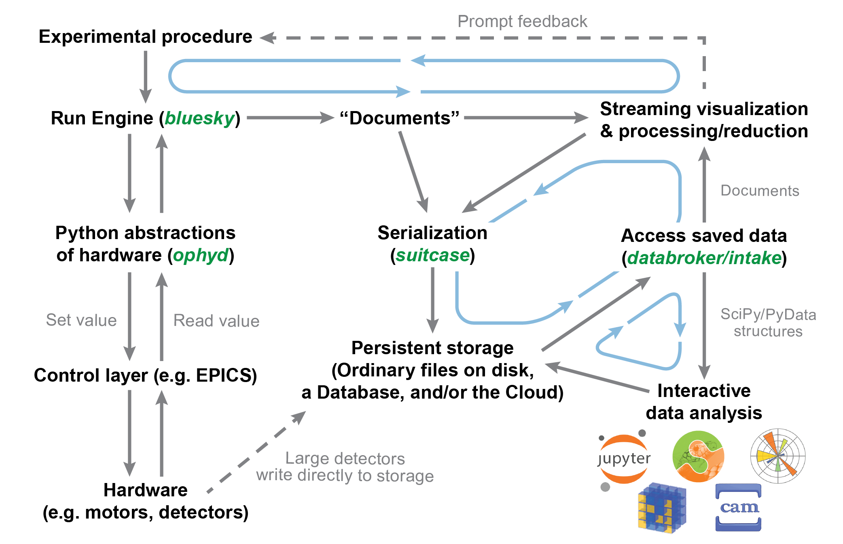
Why Bluesky?
All the reasons why we’re transitioning
Accessibility:
Based on Python
Allows for inter-disciplinary teams due to common language
Integration
Automated workflows (data management, ESAF system)
Rich libraries of tools
Better integration with modern equipment (e.g. area detectors)
Features
Lots of prebuilt devices (No need to reinvent the wheel)
Handles both multi-dimensional and asynchronous, event-based data sources
Data can be saved in any format
Expansion
Easy to add new features due to open-source nature
Can be integrated with any Python programming implementation

Slide 4
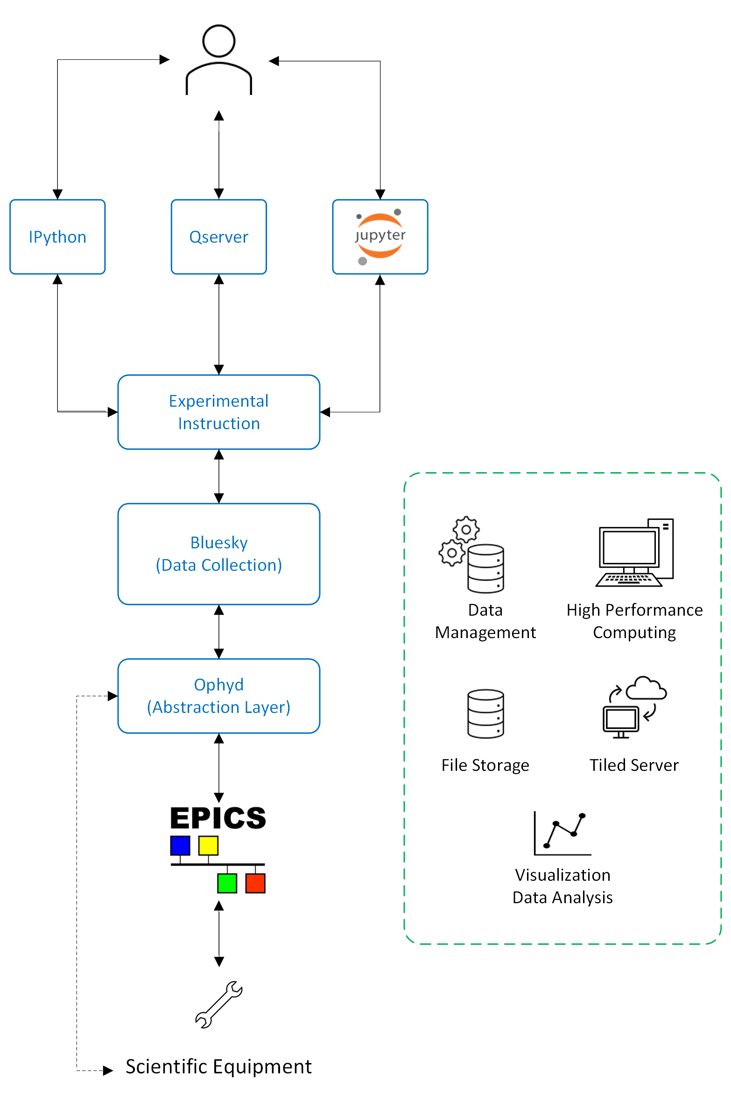
Different… but same
The Vision for Deployment at the APS
Experimental Variance at the APS
HEDM
XPCS
ISN (ptychography)
USAXS
Deposition Lab
Spectroscopy
The science requires different approaches but the tools for execution are the same
Allows for high customization, while keeping minimal changes to deployment structure.
Same structure creates community knowledge
Unified backend for enhanced frontend

Slide 5
Different… but same
UI/UX
The Vision for Deployment at the APS
Experimental Variance at the APS
HEDM
XPCS
ISN (ptychography)
USAXS
Deposition Lab
Spectroscopy
The science requires different approaches but the tools for execution are the same
Allows for high customization, while keeping minimal changes to deployment structure.
Same structure creates community knowledge
Unified backend for enhanced frontend
INSTRUCTIONS
PRODUCT
ABSTRACTION
HARD TO SOFT INTERFACE

Slide 6
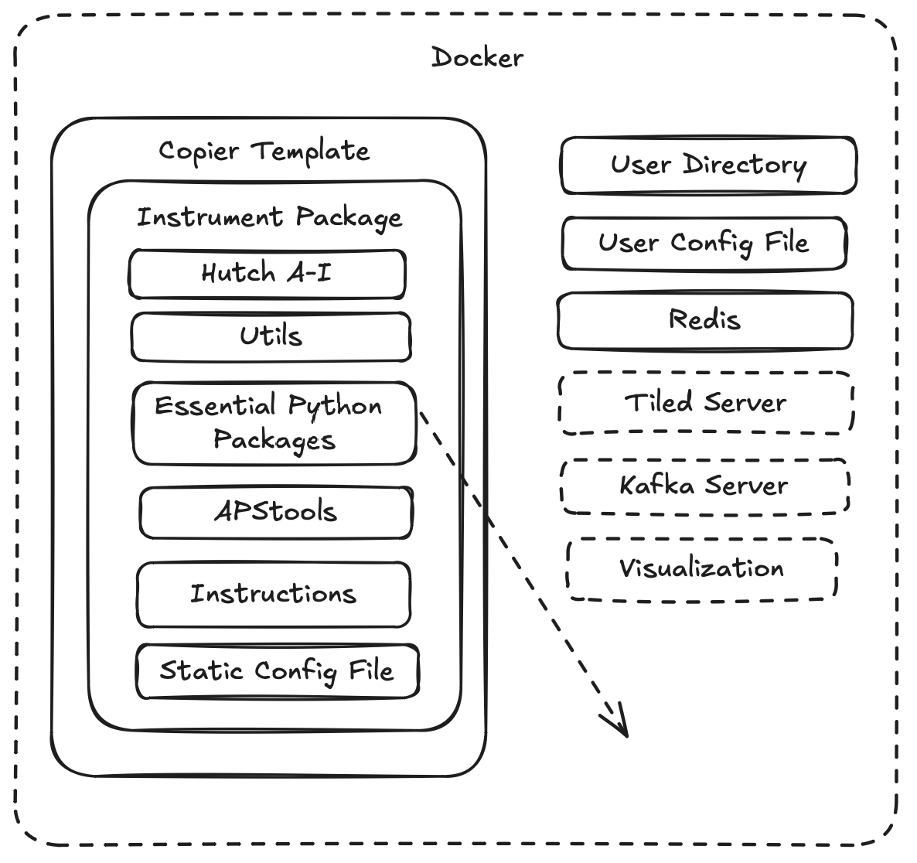
How to make this work?
The need for a deployment structure that scales
What we currently have:
A copier template for a minimal installation of the APS Bluesky Deployment
YAML File creates package
Instrument Package for the beamline containing all essential requirements
Simulated Detectors & Motors
IPython & Qserver Startup scripts
What we are building towards:
Docker container to have all requirements in isolated environment
Kafka Server
Tiled Server
Standardized Visualization Tools

Slide 7
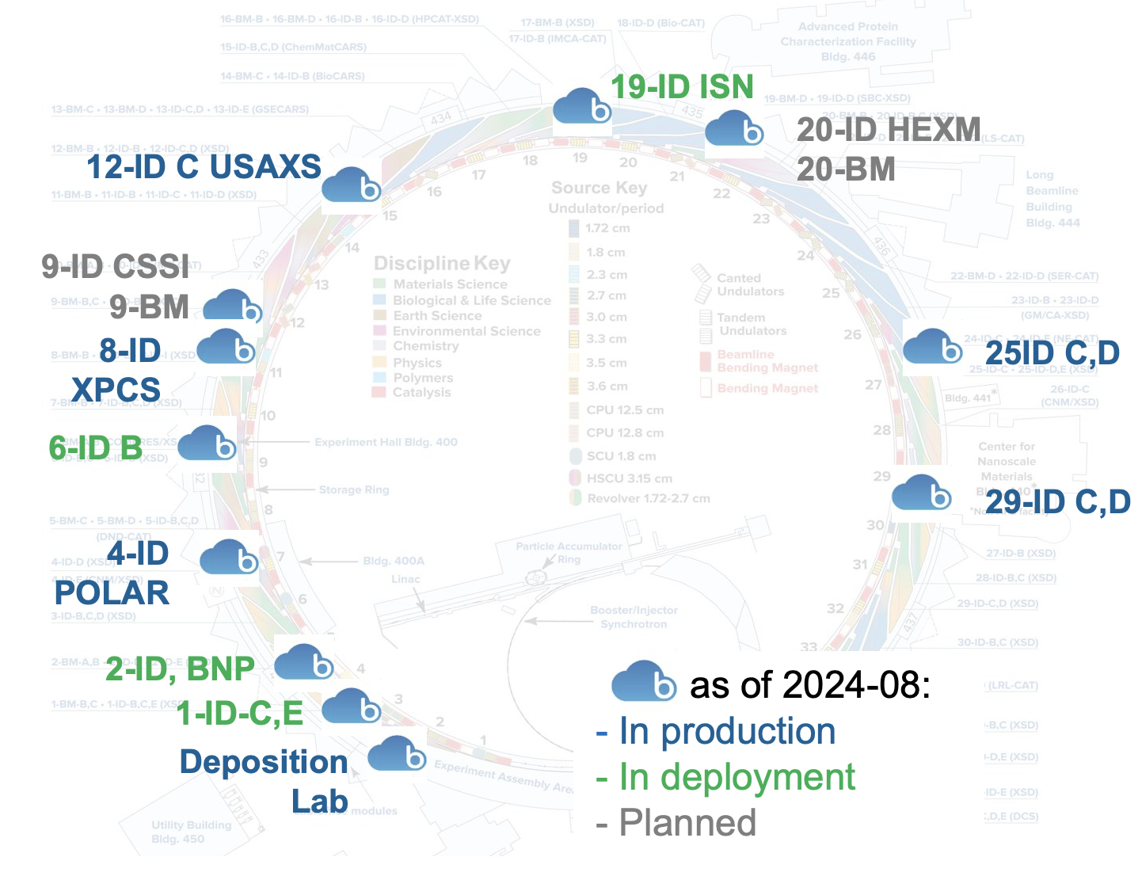
More Deployments, More Problems
The need for a deployment structure that scales
Number of beamlines
Running on Bluesky: 6
Deploying to run on Bluesky: 4
Planned to run on Bluesky: 4
Total number of beamlines to run on Bluesky at the APS: 14
Copier makes it easy to make changes in multiple locations if the same base template is used
A lot of Beamline Scientists have frameworks that they are more comfortable with
SPEC

Slide 8
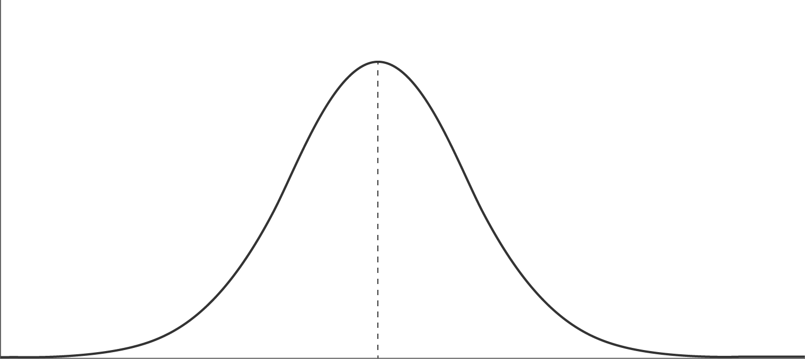
Eric, help me!
You’ve got Bluesky…Now what?
Current Resources
Apstools documentation
Devices & plans to be used across APS
Bluesky Training
Training Manual
Bluesky team
Why do we need to supplement?
Due to software novelty, domain expertise is rare
Documentation must compensate for expertise
Documentation must be dense enough, without being overwhelming
Number of users
Just enough
Documentation is too sparse to be worth checking
Documentation is too overwhelming to find what I need
Density of Documentation

Slide 9
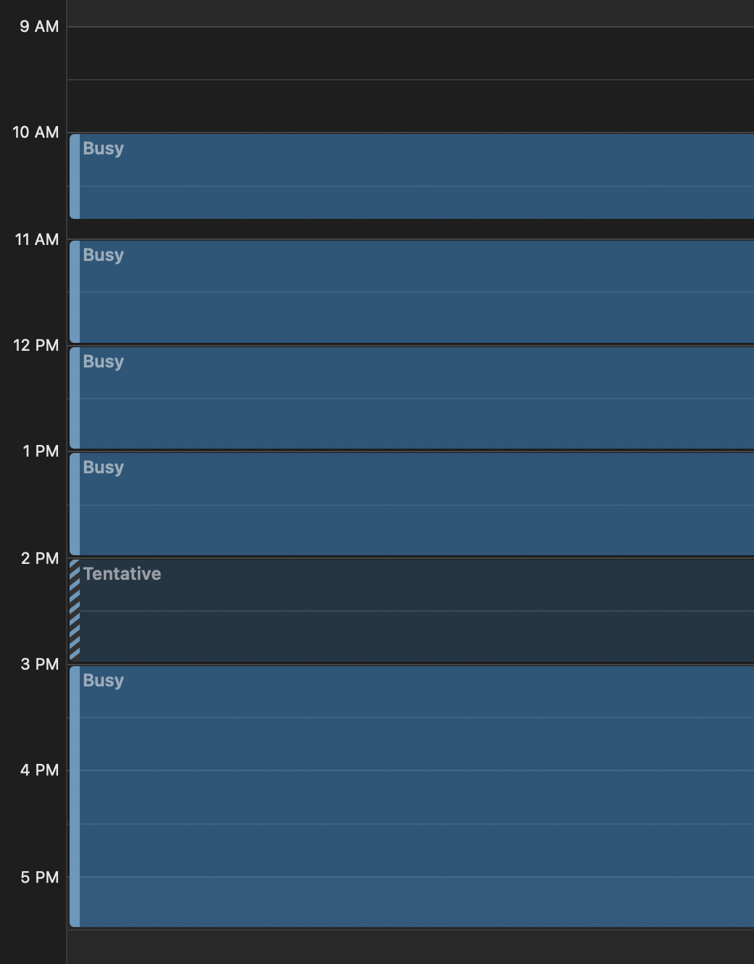
Eric, help me!
You’ve got Bluesky…Now what?
Current Resources
Apstools documentation
Bluesky Training
Bluesky team
Why do we need to supplement?
Long term, beamline scientists need to be able to debug without BC team members always present
Time spent in support is not time spent in development
Screenshot of Bluesky Team Members Schedule

Slide 10
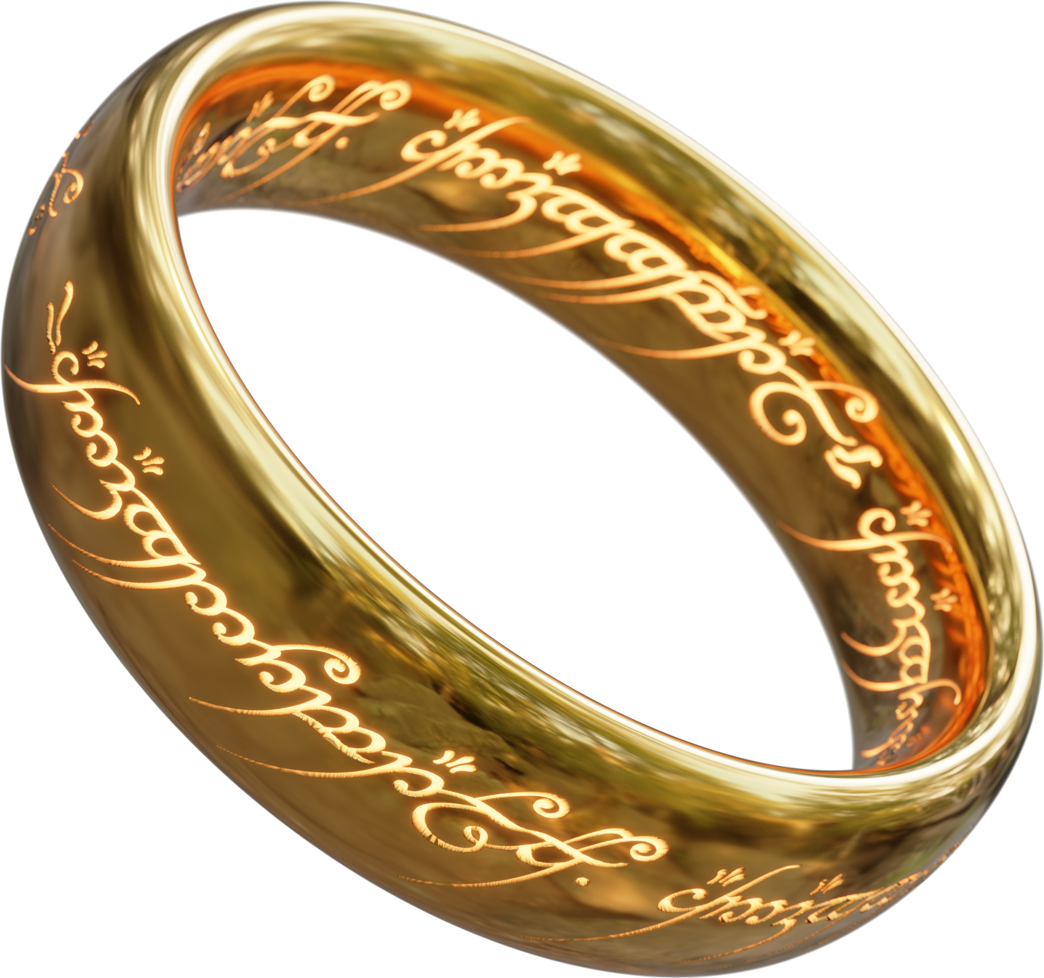
Beamtime is stressful
Everything is on fire
When you’re operating in emergency mode you need have limited choices:
Documentation is a fire extinguisher
No one wants a hard to use fire extinguisher!
People don’t know stuff of the top of their head, so they call beamline experts
BeamTIME is too precious of a resource: you can't waste it trying to figure out how to do what you need to do

Slide 11
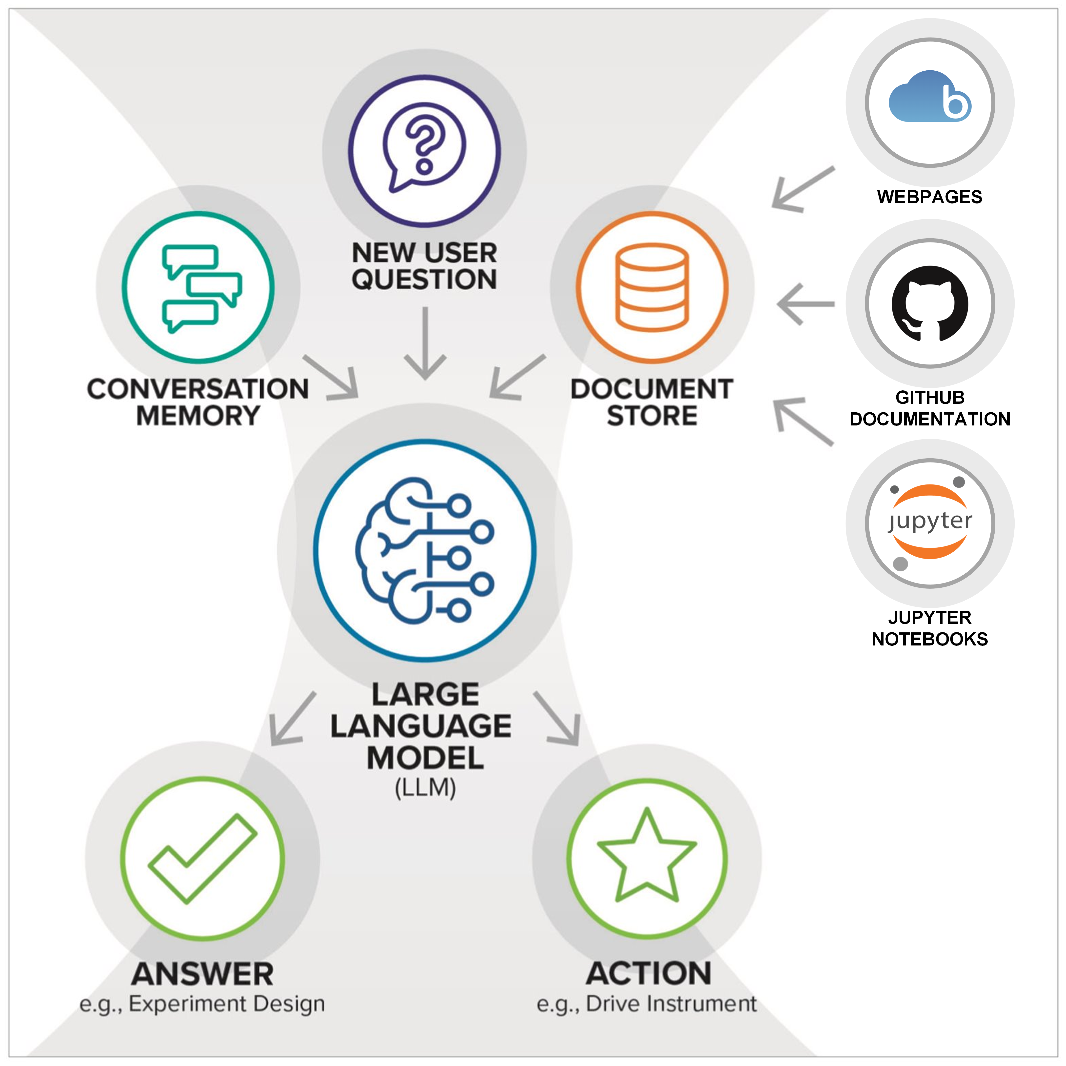
CALMS OVERVIEW​
A Scientific Companion
Key components:
LLM (closed or open-source)
Document store:
Pre-computed embeddings of scientific documentation
User can also add their documents
Conversational memory
Access to tools
Web UI for user interaction

Slide 12
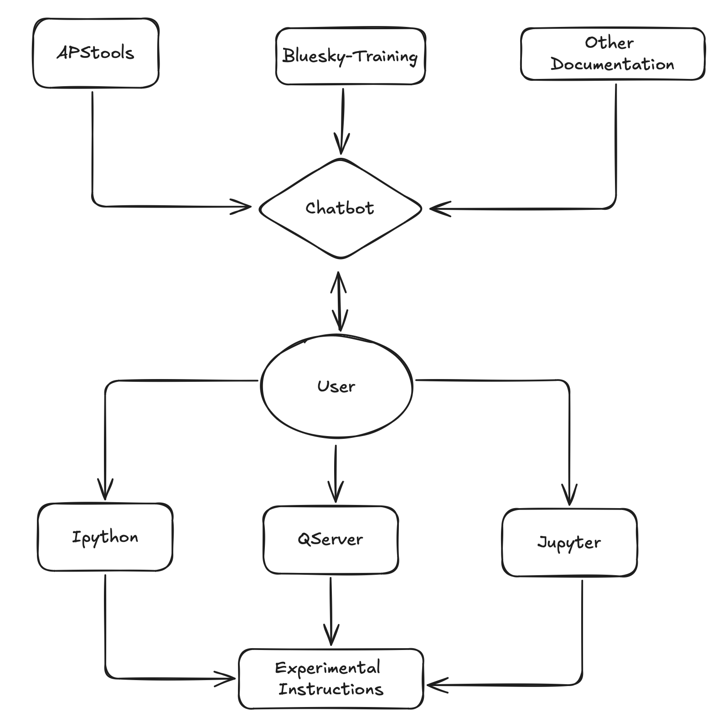
Calms & Bluesky
Integrating Language Models with Bluesky
LLM to be integrated with Bluesky for experimental instruction building
Reduces learning curve for using Bluesky framework by answering user questions
Can aid researchers in creating devices or plans with no Bluesky domain expertise
Can provide answers without need to scour extensive documentation
Long Term Goal:
Allows chaining multiple steps together, with minimal code to execute device actions
ex: “Measure maximum surface area of sample, and mesh scan that area”

Slide 13
Calms and Bluesky
Examples of use cases
Are there any Kohzu monochrometer devices I can use in apstools?
GPT 4o | CALMS
Falsely believed no classes for such a device and attempted to create its own Ophyd device | Successfully found the Ophyd device class inside of APS Tools

Slide 14
Calms and Bluesky
Examples of use cases
Are there any Kohzu monochrometer devices I can use in apstools?
Follow up: How can I use the kohzu device?
GPT 4o | CALMS
Attempted to create an Ophyd device that had components for translation, rotation, and nothing else | Provided Code snippet with how to instantiate class and import path, as well as example commands

Slide 15
Calms and Bluesky
Examples of use cases
Are there any apstools plans I can use to align my beam with my sample?
GPT 4o | CALMS
Had no idea about any actual plans within APStools and hallucinated results to provide answers | Found the function within APStools called lineup and gave arguments needed to use said function. Said that if using Qserver use lineup2, since lineup does not work with it (correct)

Slide 16
Conclusion
Bluesky offers a versatile and efficient framework for managing diverse scientific workflows at the APS, allowing for both standardization and customization.
Templates are a great way to distribute the same package structure without having one central package due to different user need
Integration with CALMS and the use of language models streamline the learning curve, making it easier for users to operate without extensive domain knowledge.
Future Vision
Implement Docker & Improve template for quicker beamline commissioning
Enhance documentation for more in depth problem solving

Slide 17
Acknowledgements
Bluesky Contributors:
Pete Jemian
Fanny Rodolakis
Rafael Vescovi
LLM Team:
Mathew Cherukara
Michael Prince

Slide 18
Questions?

