Slide 1

Paul Quinn
Paul.quinn@stfc.ac.uk
The state of AI/ML in
X-ray and Neutron science (Sept 2024)
Notes:
The abstract pattern can be removed or repositioned if required. Be careful to ‘Send to Back’ so that it does not obscure any important information.

Slide 2
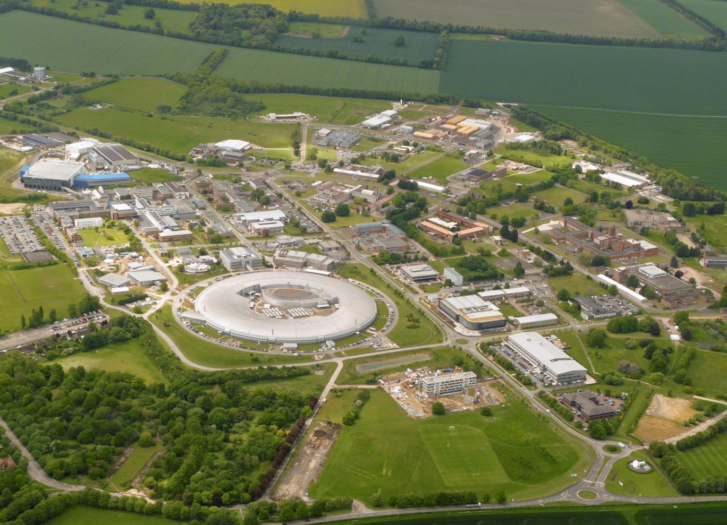
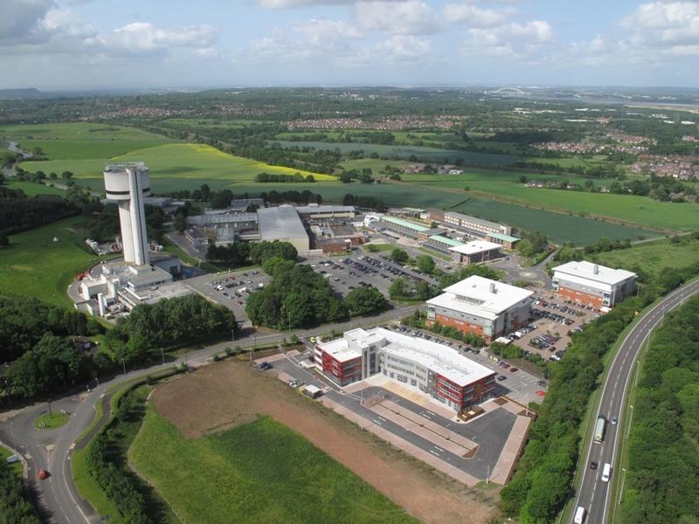
Harwell and Daresbury Campus
The Rosalind
Franklin
Institute
STFC Scientific computing
ISIS
Central
Laser
Facility
National Quantum Computing Centre
Hartree Centre
STFC Scientific computing
RCaH
RAL
Diamond Light Source
RAL Space
Rutherford Appleton Laboratory
REUDI
CLARA
Notes:
eBIC is the Uks national facility for cryo electron microscopy, and is an associated facility to DLS, which is the Uks national synchotron facility. DLS was opened in 2007, is currently in the third phase of construction with 32 operational beamlines.
DLS has a total of 12,000 registered users, with over 9,000 user visits per year and over 100 industrial users paying for proprietary use of the equipment.
Diamond light source is located on the harwell research complex, which also contains many other national facilities including a neutron source (ISIS), Central laser facility, CCP-4 and CCP-EM, as well as the European Space Agency.

Slide 3
Themes
PSDI
CoSeC
Computational Engineering
ALC
Computational Biology
Computational Maths
AI for Science
Materials Modelling
Data Engineering
Cyber Security
Open Science
Software Engineering
Platforms and Services
Infrastructure
Programmes

Slide 4
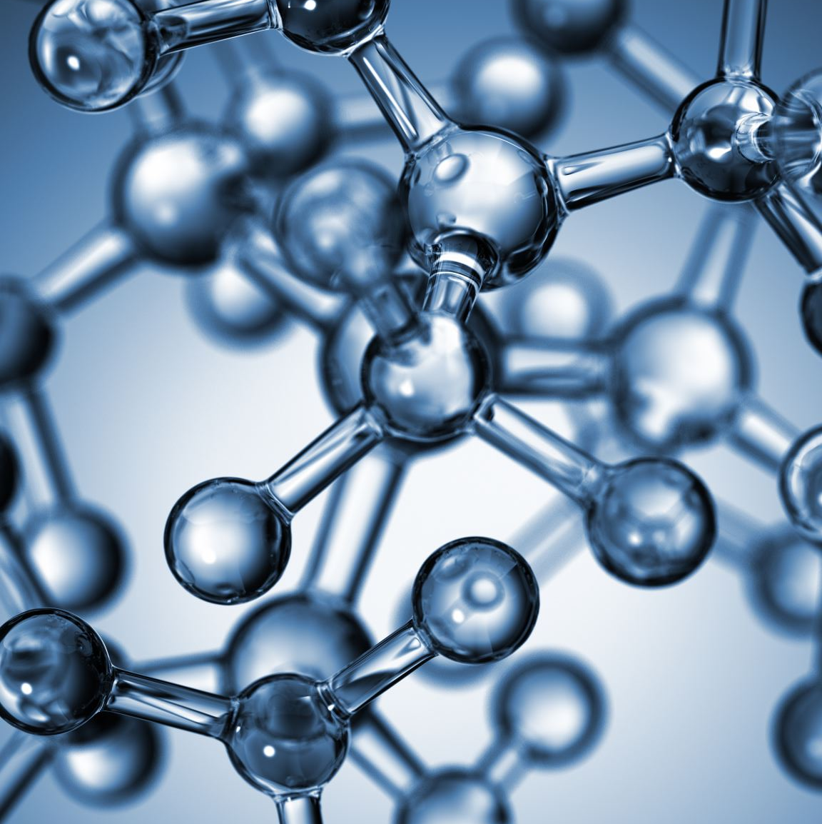
Purpose
To maximise the scientific impact of the STFC large facilities – CLF, Diamond, ISIS
Vision
Transformative impact through challenge-driven collaboration
Mission
To create and deliver innovative scientific computing solutions to drive scientific and operational impact at large facilities.
Ada Lovelace Centre
A centre of expertise in scientific computing

Slide 5
What is the Ada Lovelace Centre ?
Intended Impact
Facilitate a shift in understanding derived from data, advance scientific measurements, transform or enhance the interpretation of data across and within the science areas of the facilities.
Advance facility operations or improve the scientific data lifecycle, to benefit to facility users, their communities and the facilities themselves.
Coordination, collaboration and sharing within and across SCD and the facilities to tackle science and computing challenges.

Slide 6


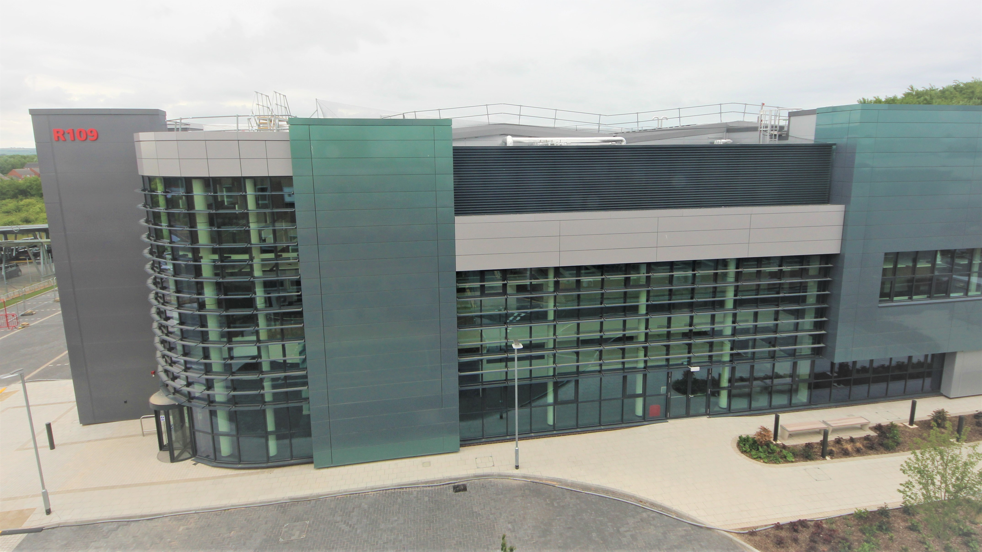
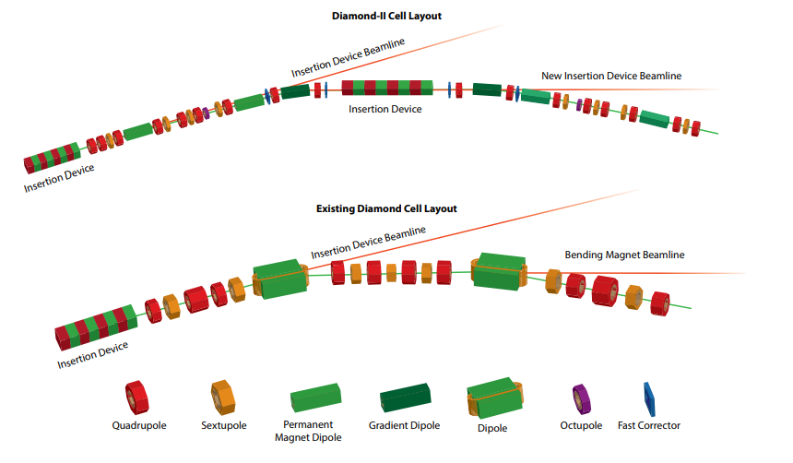


New Facilities and Upgrades
UK XFEL
CLF HiLUX upgrades to Ultra and Artemis
CLF-EPAC
PetaWatt laser and X-ray source
  x10-100 fold increases in power, flux, brightness
  Faster Timescales
  New instruments/techniques
Diamond-II - - Diamond Light Source
Relatvistic Ultrafast Electron Diffraction & Imaging
ISIS The Endeavour Programme (stfc.ac.uk)
6

Slide 7

X-ray ptychographic tomography on biotissue
DEVELOPMENT | RESOLUTION (nm) | VOLUME (μm³) | TIME
State of the art | 120 | 80x70x20 | 23 h
Diamond-II | ~50 | 250x250x63 | ~45 min
+ CPMU | ~40 | 370x325x92 | ~15min
+Multilayer | <25 | 800x700x200 | ~1.5 min
+ KB mirrors | <15 | 1720x1500x430 | <10 s
Numbers indicate the gain in one parameter with respect to the state of the art when keeping the other two parameters constant. Figures based on SLS state of the art at cSAXS
Bottlenecks -
Manual process requiring an expert – lots of unprocessed data and complexity
Tomography min 2000 projections – 5 mins per projection to reconstruct - 8 gpus - 1 day to reconstruct. (fully optimized gpu code)
S. Shahmoradian et al.,
Sci. Rep. 7 (2017) 6291

Slide 8
Software/Data Facility User Challenge
Pioneers
Expert Users
Non-Expert Users
Large User Communities
Point me to the answer
We have a common goal and need a shared approach
I can work out the answer, I can develop a model
Let’s work on the problem

Slide 9
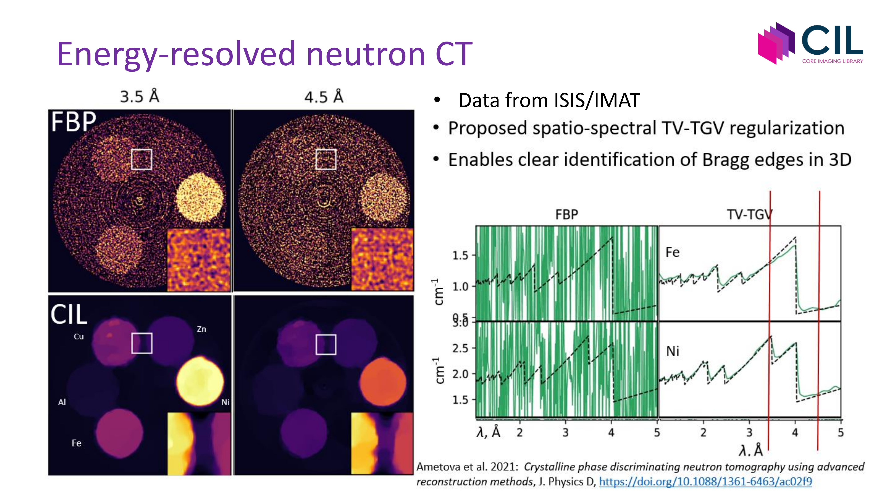

Slide 10
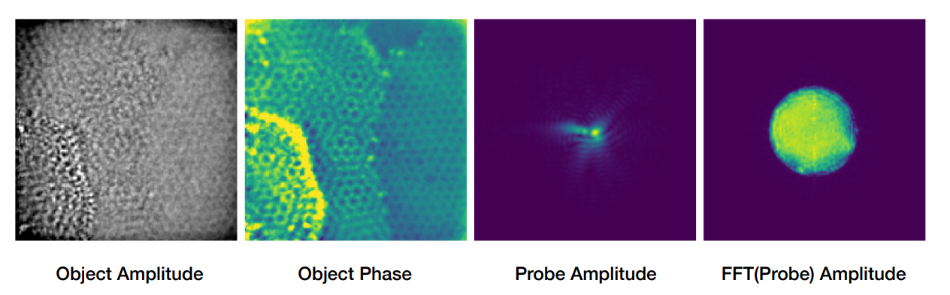
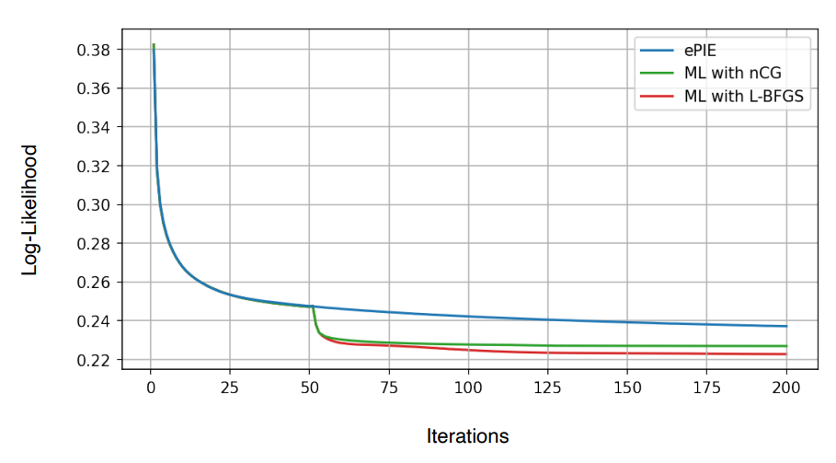
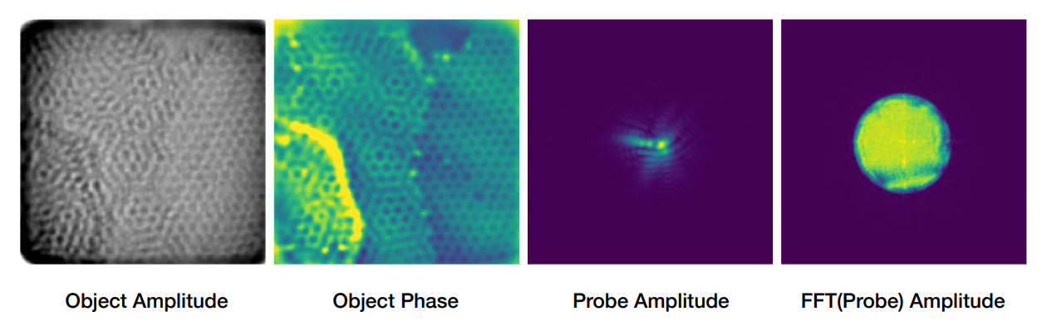
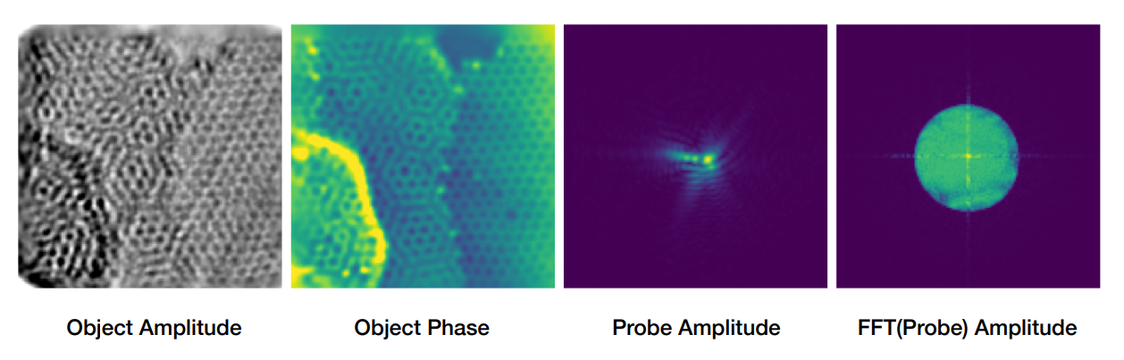
Ptychography
ePIE
Nonlinear Conjugate Gradients
L-BFGS

Slide 11
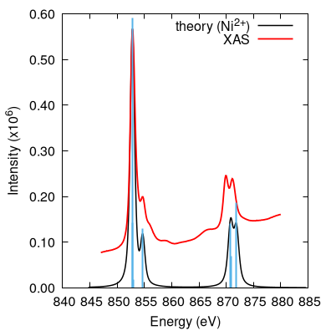
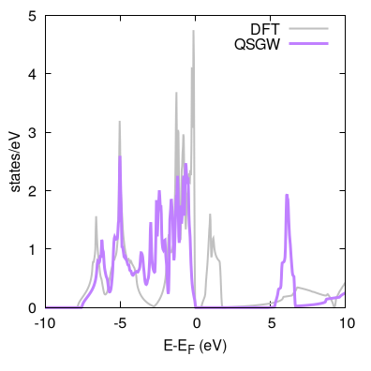

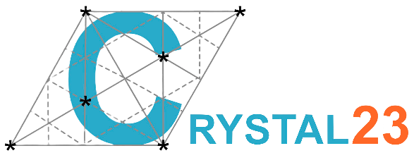
Crystal field excitations
Spatially localised excitations involving strongly correlated d- or f-electrons
Key to interpreting spectroscopies such as INS, XPS, XAS & RIXS
Competing Coulomb, spin-orbit and ligand-field effects
NiO crystal field
e_{g}
Ni 3d
t_{2g}
‘ionic’
O 2p
‘covalent’
Advanced many-body methods implemented in Questaal and Crystal

Slide 12
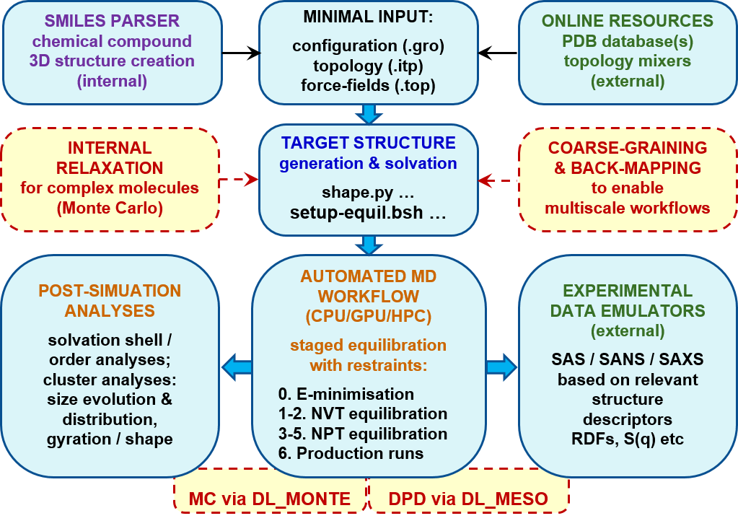
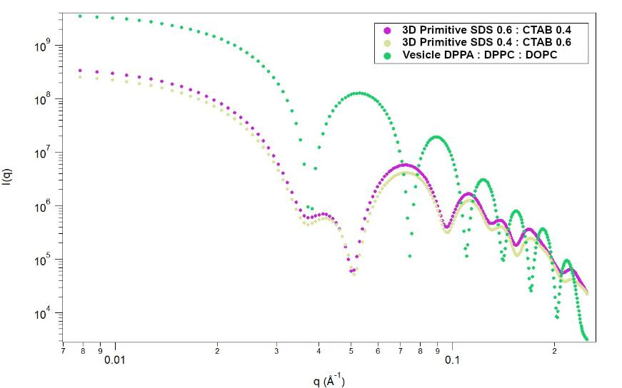
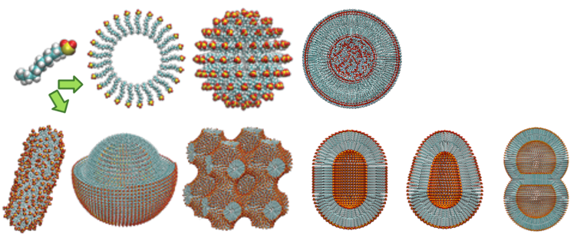
Soft Matter simulations, analysis and link to SANS/SAXS - Shapespyer
Project overview
Generation, simulation & analyses
of pre-equilibrated molecular structures
for functional soft matter research
Target structures / trajectories
for academic and industrial R&D;
Linking with SANS, SAXS experiments
Provide automated workflows
Python library, APIs, Bash scripts
Partners / collaborators:
Maggie Holme, Chalmers, Sweden
Hanna Barriga, Karolinska Institutet, Sweden
Tom Headen, ISIS, UK
SasView Team, International
www.scd.stfc.ac.uk/Pages/Shapespyer.aspx
gitlab.com/simnavi/shapespyer
Andrey Brukhno (Co-I), Computational Chemistry, SCD
PI: James Doutch, ISIS, Co-I’s: Tim Snow, Diamond, Michael Seaton, John Purton, SCD
12

Slide 13
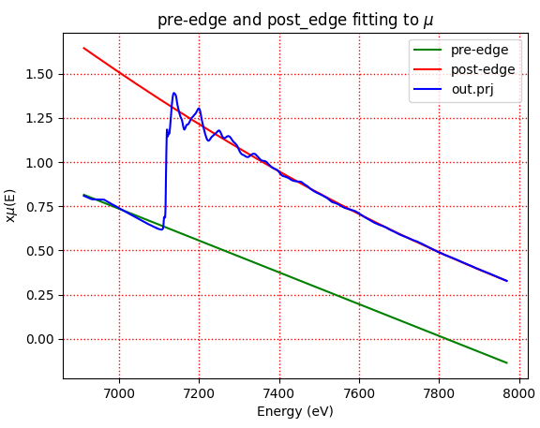
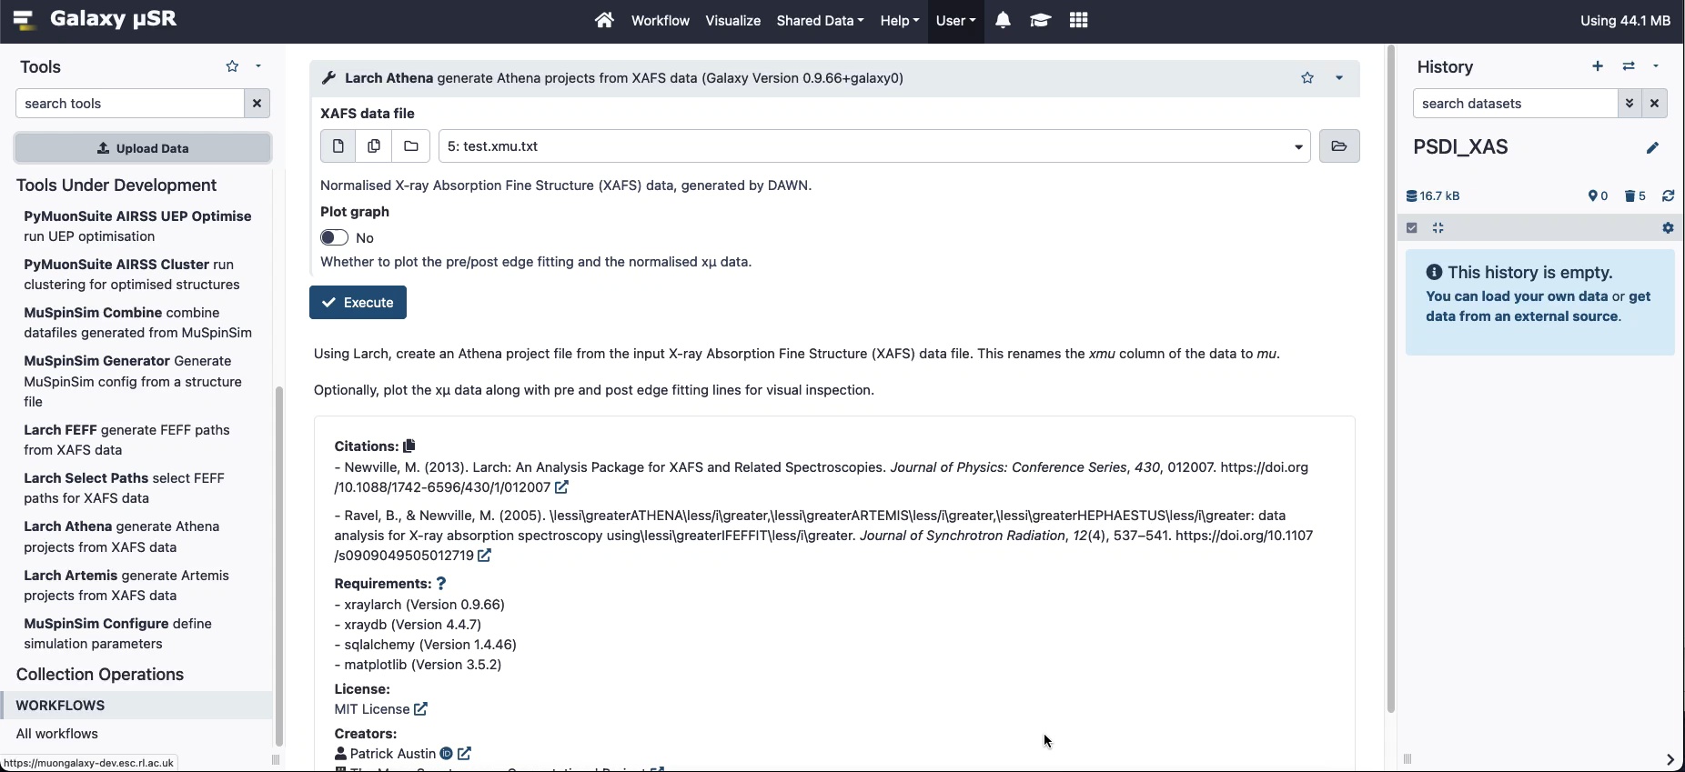
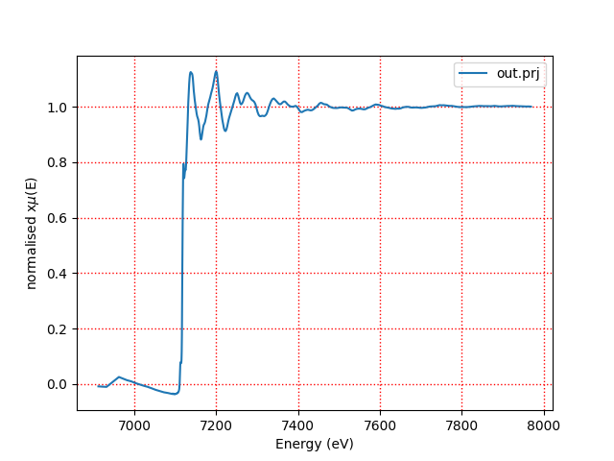
Process and Normalise XAS with Larch Athena in Galaxy
Processed data
EXAFS: Extended X-ray Absorption Fine Structure
Normalised data
Larch Athena

Slide 14
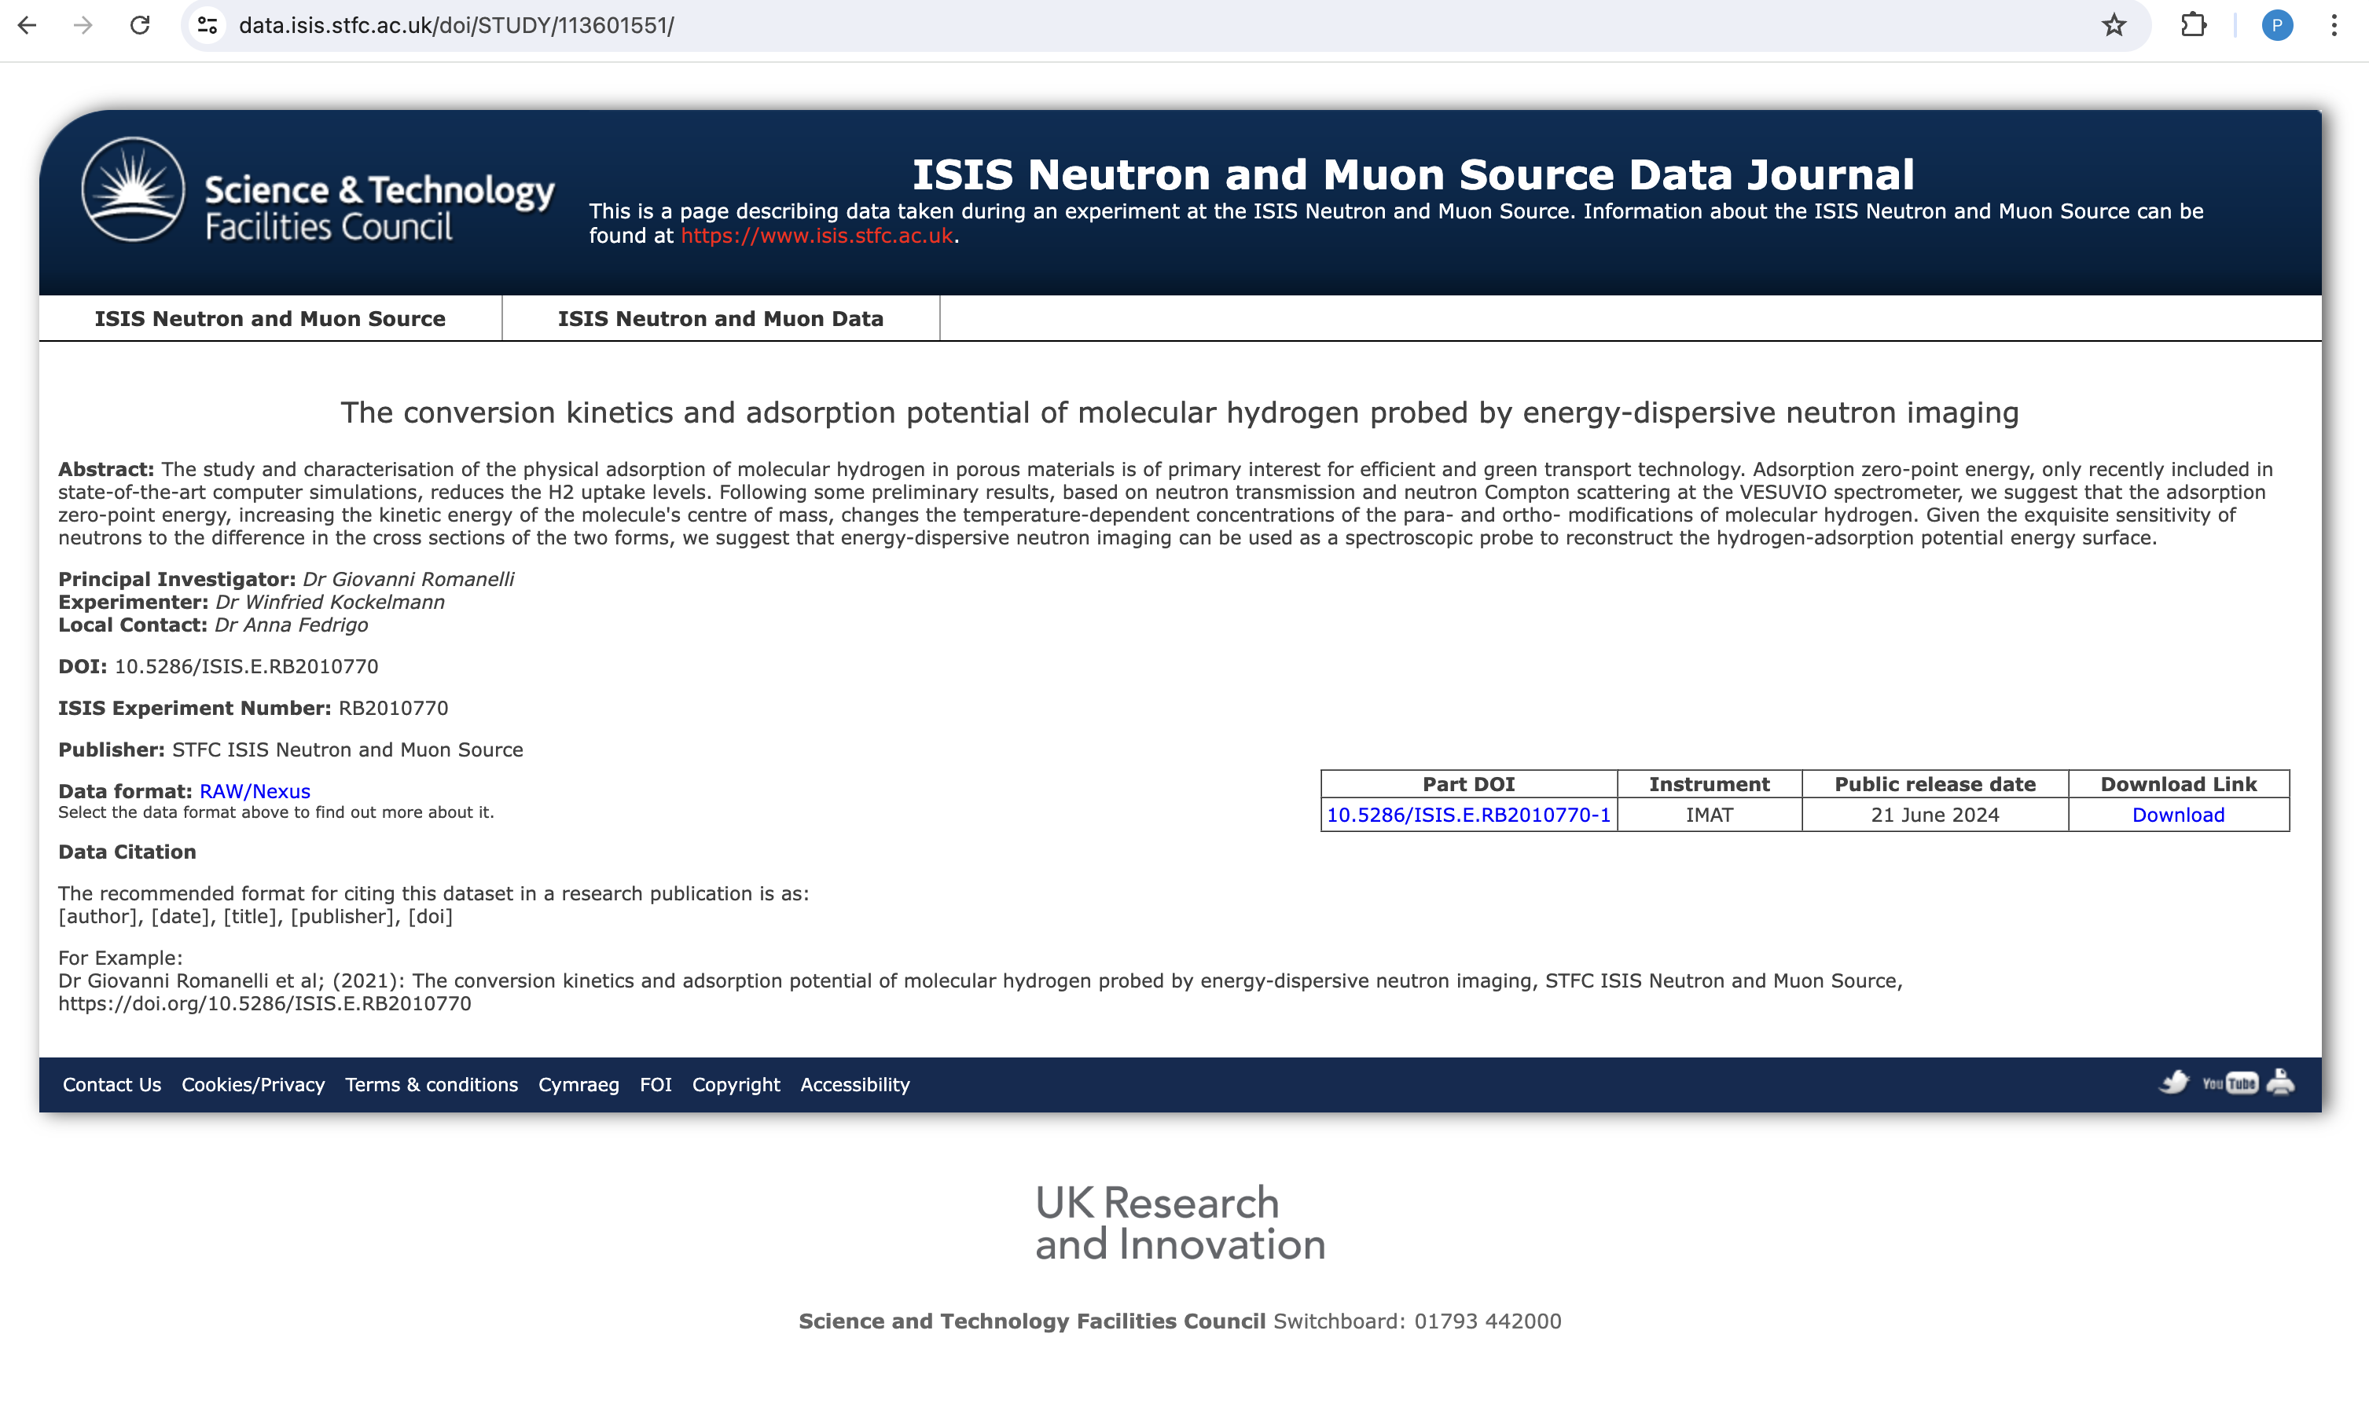
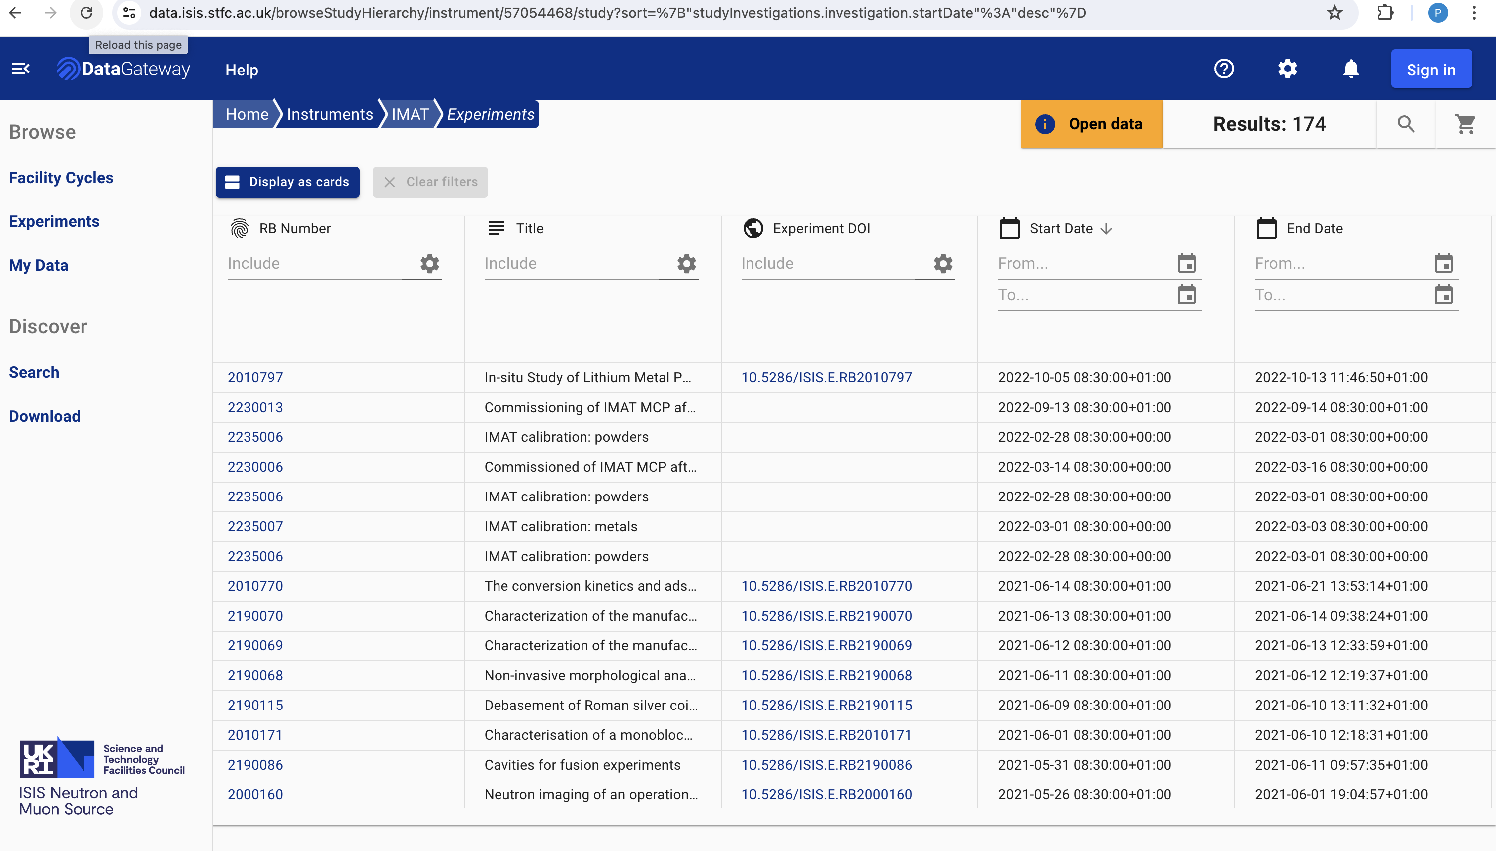

Slide 15
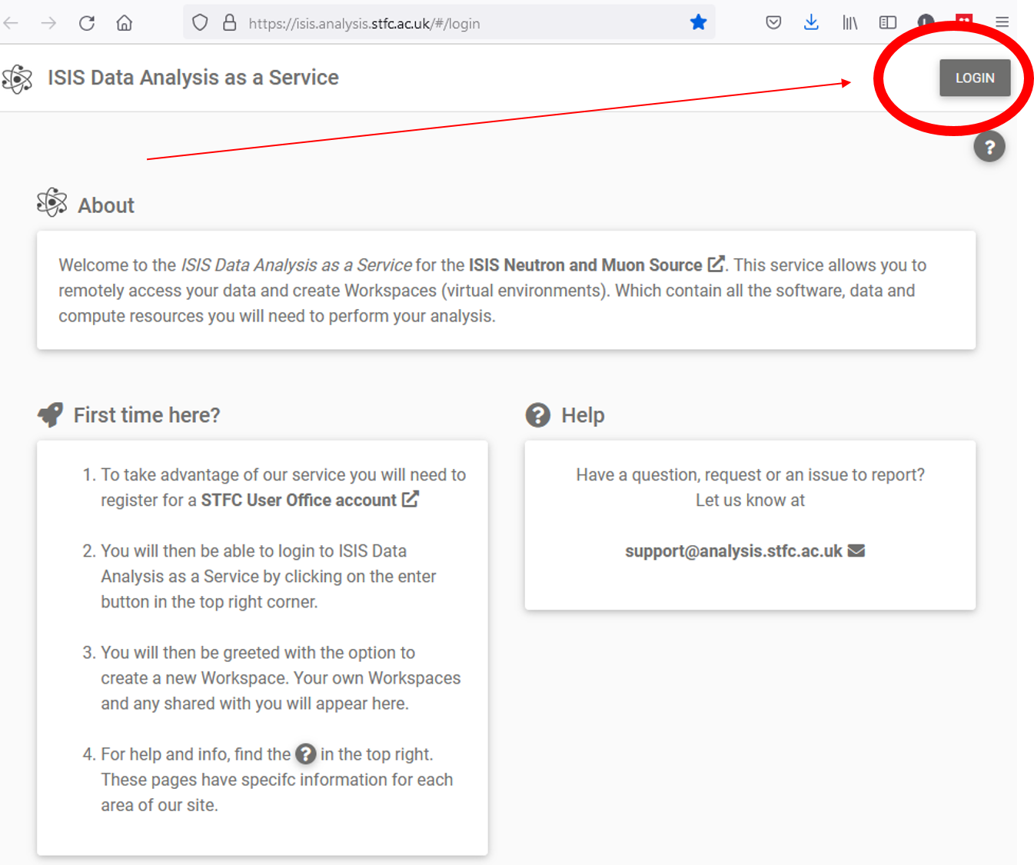
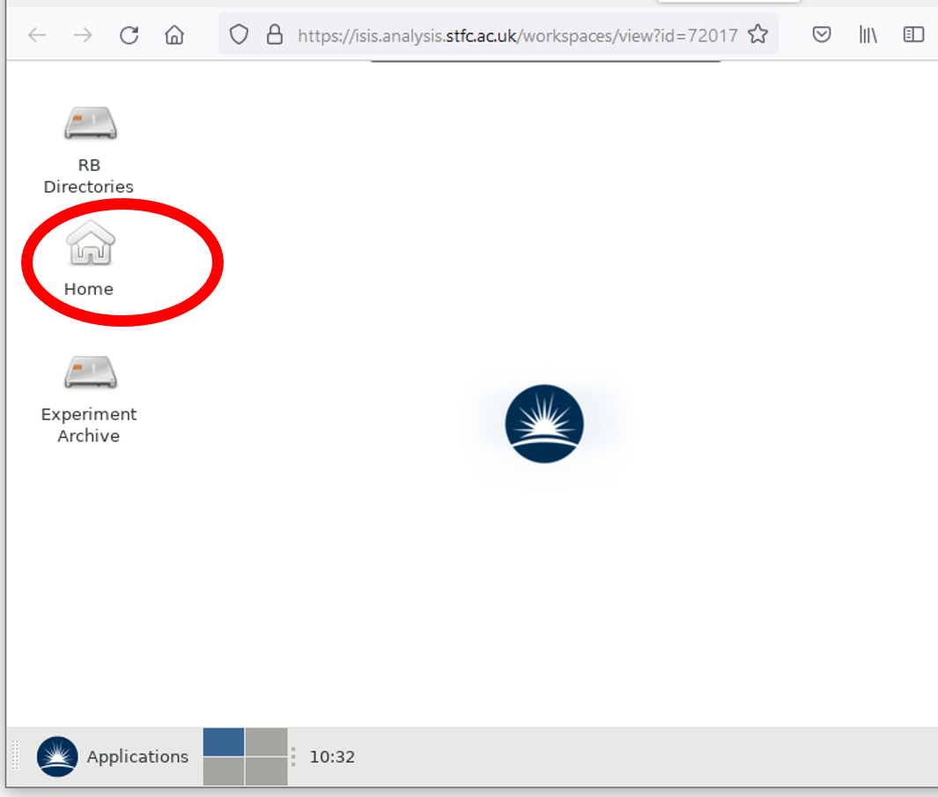
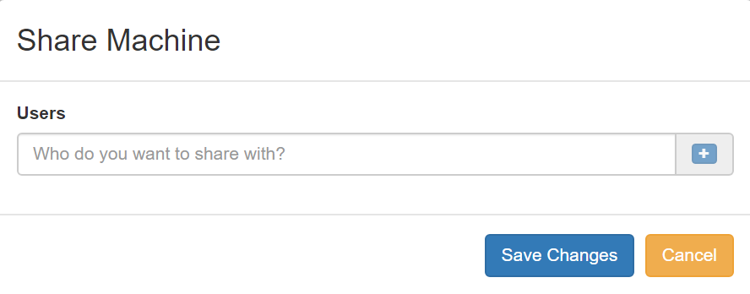
DAaaS – Data Analysis as a Service
VM environment setup for a beamline with compute, apps and data for a user analysis
Available for training courses

Slide 16
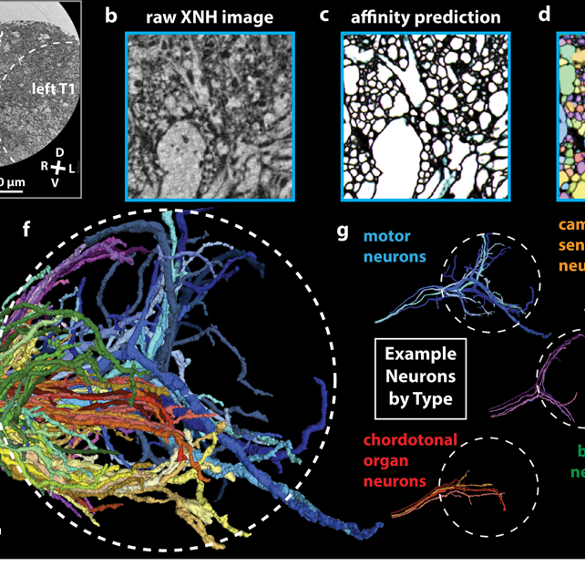
An exciting time !
New facilities
New approaches delivering new science
New communities/Non-expert users
Data deluge and analysis challenges

Slide 17
Many similar initiatives to integrate approaches
ANL - X-ray & Neutron Scientific Center for Optimization, Prediction, & Experimentation (XSCOPE)
SLAC - (ILLUMINE) - Intelligent Learning for Light Source and Neutron Source User Measurements Including Navigation and Experiment Steering
CNRS - PEPR DIADEM (Integrated Devices for Accelerating the Deployment of Emerging Materials).
BIG-MAP – Battery 2030+
ROCK-IT - Helmholtz

Slide 18
ALC Themes\Strengths
Strengths of ALC and the facilities
Advanced Imaging
Computational biology
Combination of facilities and overlaps in activities
Strengths of ALC
Theory and Simulation
Mathematics and AI for science and technology
Platforms and services for the facilities data lifecycle
Wide range of expertise

Slide 19
The AI Implementation Challenges
Data
“I don’t have enough data”, “I don’t have the metadata to do anything sensible”
“I have data” – but very small volumes
Accuracy /Explainability
“Machine learning isn’t accurate enough – I need an artefact free result, and conventional approaches are more robust“
Automation
“If you fully automate my community will lose their knowledge in this area”
Why us AI method Y which has an X hit rate when a conventional analysis will work ?

Slide 20
The AI Implementation Challenges
The AI hammer
Skip past math and jump to AI – not every problem needs AI
Carbon footprint
We will have to cost the AI/ML process – and training is expensive.
Reproducibility/Re-use
“I tried X model from this paper, and it didn’t work very well”
“I read this paper, and we should be doing this…”. is it worth trying?

Slide 21
Science Case/Need
Is this a maths problem?
Gaps
>50% of the project - data
Get Data
Triaging and Prototypes
Prepare
Validation
Train
Monitor
Beamline Commissioning
Production

Slide 22
AI and Facilities
Expanding the reach of simulation
  Measurement to Structure using AI
  Guided model building and generic models
  Accelerated simulation (accelerated solvers)
  Expanded simulation capabilities (time scales, length scales)
Foundation Models
LLM’s - Supporting experiments with text to action and guidance
Streamlined data to knowledge
AI supported or automated data analysis workflows,
Inference driven analysis
Data fusion from multi-technique experiments
Data labelling, segmentation or classification
Transformation
Transformation
Reducing Barriers
High data rate experiments

Slide 23
AI and Facilities
Optimised experiments and Automation
Digital Twins/Surrogates – machine and instruments
Diagnostics – (e.g. RF)
Predictive modelling to support experiments
AI Agents
  Optimised control of motion and instruments
  AI supported data pre-processing
  SMART experiments – optimal experiment design to achieve goals.
  Data cleaning, patching – sparse measurements
AI Infrastructure:
MLOps – validation, model sharing, re-use, continuous learning.
Data curation and curation tools, FAIR data
Embedding AI in every data generation process…
Optimal use of resources
AI Ecosystem
and Culture

Slide 24
Expanding the impact of simulations on experiments

Slide 25
ISIS
  Muon Galaxy: Muon Spectroscopy Computational Project
  Shapespyer: initial trajectories for complex large-scale structures
  MuSSIC: coarse graining for disordered materials
  Automated potential development for MD analysis of spectroscopy
  MDMC – optimising molecular dynamics potentials to dynamical structure factor data
  Molecular modelling for neutron reflectometry
  ABINS (ab-initio interpretation of Inelastic Neutron Scattering Spectroscopy)
DIAMOND
  XPDF – MD – link to ISIS disordered materials
  High Pressure - Help with experiment design – e.g. estimate pressure or temperature where a change occurs
  Spectroscopy - XANES, XPS, ARPES, Terahertz IR, Nano-IR interpretation
CLF
  Spectroscopy - ARPES, Transient states

Slide 26

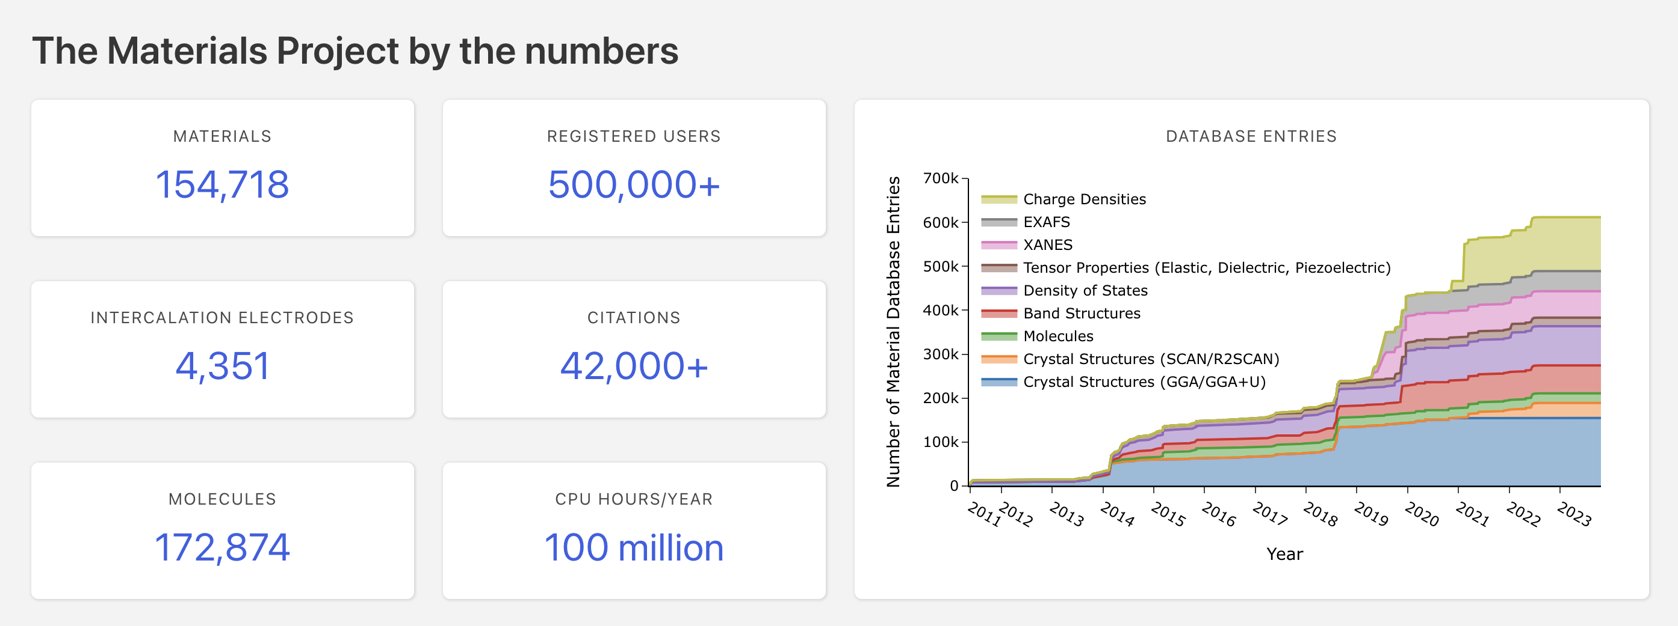
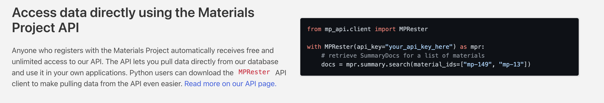
web-based access to computed information on known and predicted
Computationally expensive DFT, TD-DFT calculations

Slide 27
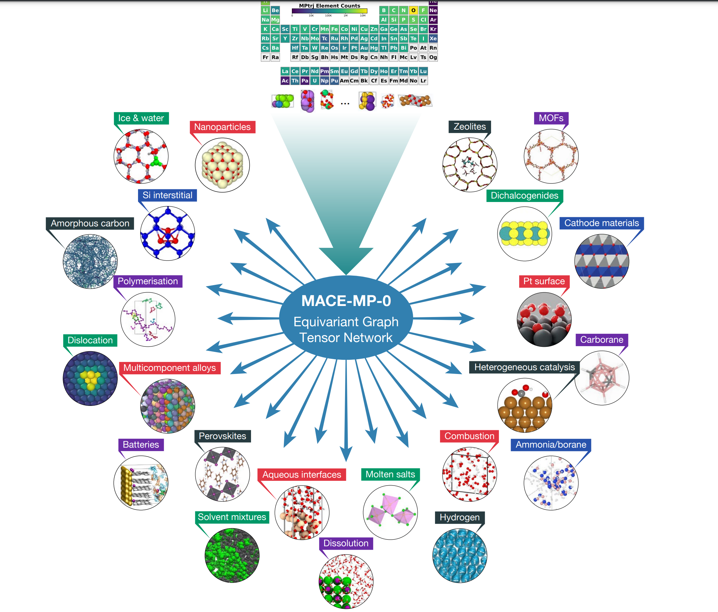


MACE & Foundation models
Machine Learnt Interatomic Potential
Message Passing Equivariant Graph Neural Network
Accuracy of DFT but x10000 speed up
Can be plugged into a number of existing X-ray and Neutron problems
Reproducible and reusable workflows for MLIPs aiida-mlip:
▷ Geometry optimization
▷ Single point calculations
▷ Molecular Dynamics (MD)
MACE_MP_0
https://arxiv.org/abs/2401.00096
Notes:
MACE is a MLIP based on Message passing Equivariant Graph Neural Networks. It is open source and development started in Gábor Csányi's group at University of Cambridge, by Ilyes Batatia(then a master student from ENS Saclay, doing a year abrod). The potential itself is many body, with body order increasing incrementally with each extra message. It is similar in spirit with other MPEGNNs like nequip, but has the advantage to use ACE(Atomic Cluster Expansion) descriptors that gives an initial body order of 4 as opposite to 1 for nequip. That allows capturing physics and chemistry with fewer messages. In practice one can get very good accuracy with 1 or 2 messages, rather than 5-6 in other methods. It is more data efficient and more accurate, than other potential approaches, especially previous generations, based on Behler Parinello approach and its generlasisations as deepmd. In community there are people who managed to get same accuracty using 1% of the training set they used for other potentials, I(Alin), I have the experience of using around 10% of what I needed for Behler Parinello, for MOFs, and getting much better accuracy. It can be used with success for various methods like molecular dynamics, monte carlo, grand canonical monte carlo, geometry optimisation and so on. There are extensions on the way of using the architecture for other types of modelling, eg excited state dynamics(Julya Westmayr Leipzig and Christoph Orter Canada), prediction of Born Effective tensors and other tensors (Karsten Reuter's group in Fritz-Haber in Berlin)
MACE_MP_0 (which is what is rated in matbench), is a foundation model based on MACE, trained against Materials project data, using DFT calculations at PBE level of accuracy. It keeps the DFT accuracy at 10000 times speedup in calculations time. Last December few groups around the world tested its suitability for various applications, resulting in the paper on right hand side. We studied 40 different applications, from liquids, to solids, porous materials, graphene, nanoparticles and with few exceptions, H2 under extreme pressures performed very well. A new version is under development to address the shortcomings we identified.

Slide 28
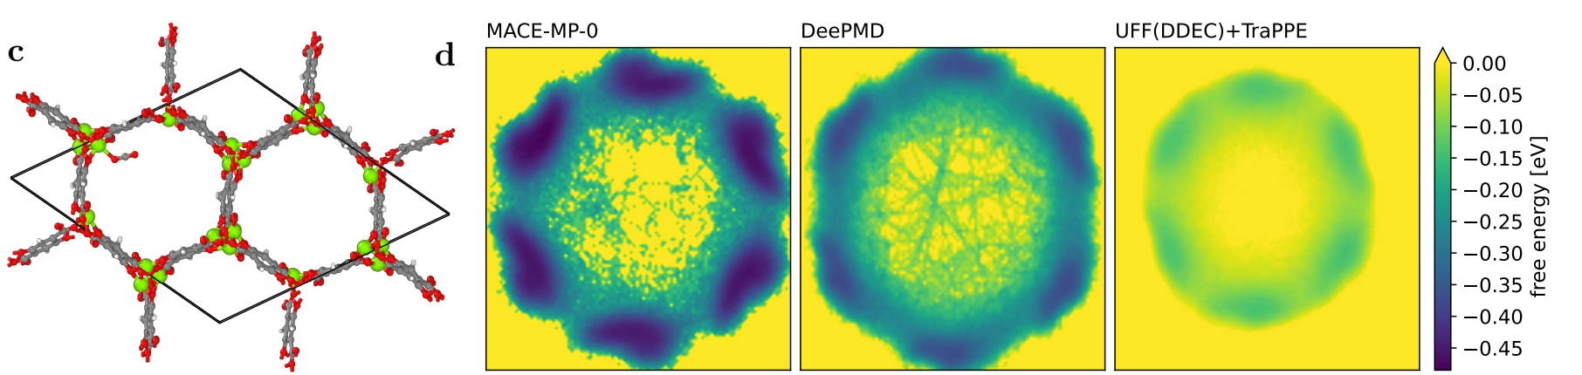
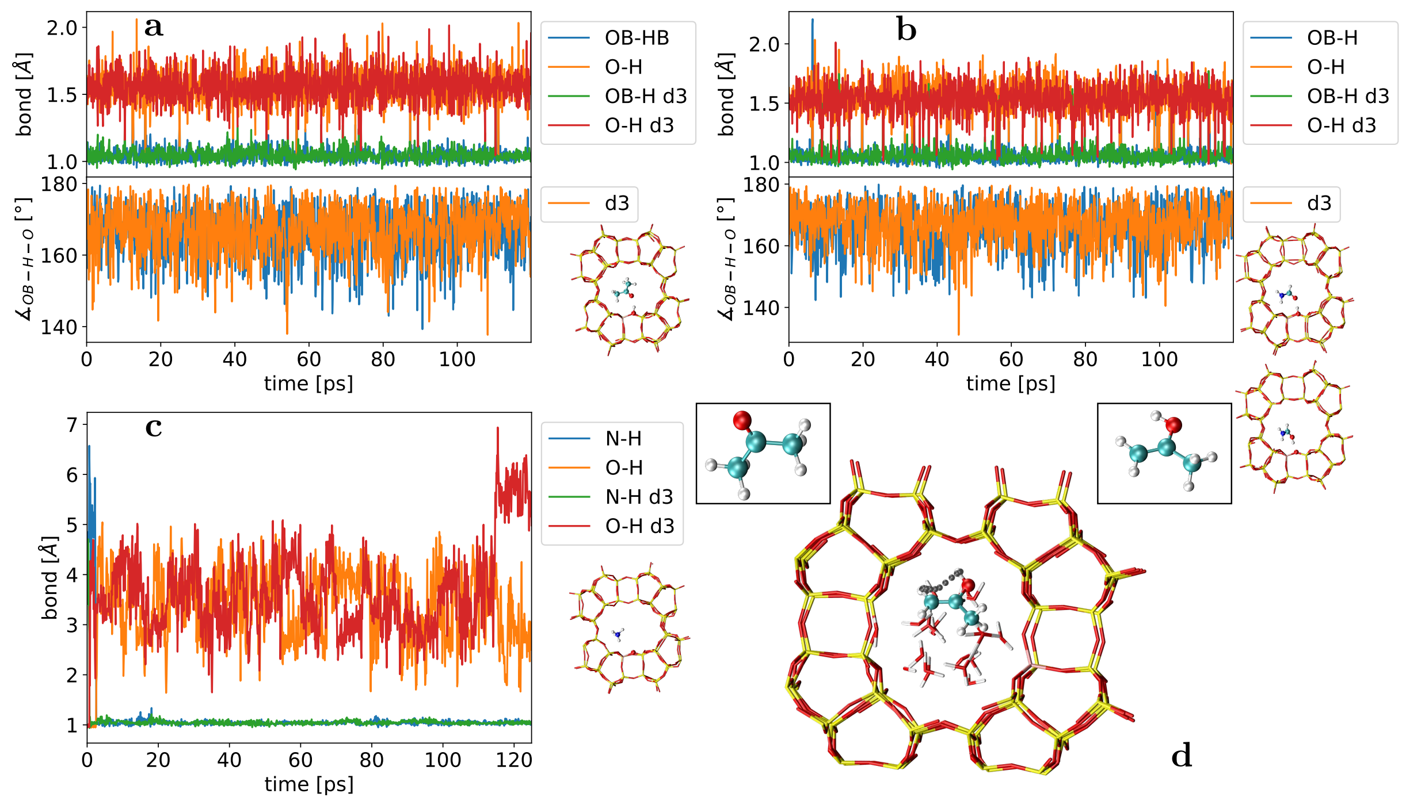
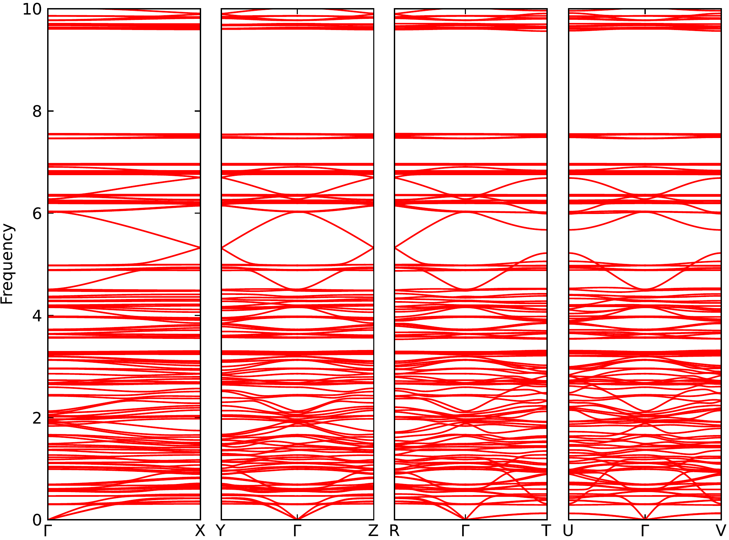
What can you do?
Metal Organic Frameworks – CO2 adsorption in Mg-MOF-74*
CO2- capture in MOFs
Phonon calculations – IRMOF 10, 5min(MACE) vs weeks (DFT)
Deprotonation of small molecules(acetone a, formamide b, NH3 c) in zeolites at Brønstead acid sites*, d) acetone enolization
Other notable applications:
water: Venkat Kapil (UCL) and Angleos Michellides(Cambdridge)
Thermal conductivity: Michelle Simoncelli (Cambridge)
Electrolites for batteries: Ioan Magdau (Newcatle)
Phonons, Kristin Pearson(Berkley)
Notes:
Specifically as success applications (done by me), on the left hand side we have co2 physosorption in MoFs. We managed to model it very well barriers are very similar with what was found by using DFT and special trained ML forcefield. Classical forcefields totally fail to capture this phenomena. Speed is the other advantage, is not only we can compute phonons and get them right, eg IRMOF-10, but we can compute them in 5 min compared with DFT that can be weeks of computations. Not everything is perfect but paper showing how to improve the potentials for mofs and a better potential is in writing. On left hand side we successfully model reactivity in zeolites at Bronstead acid sites, MACE results reproduce much more expensive DFT results. Similar as with MOFs, more in depth benchmarking is being done at the moment.
Other notable applications, study of water by Venkat Kapil, UCL and Angelos Michelides Cambridge, combining with path integral molecular dynamics, thermal conductivity by Michele Simoncelli at Cambridge, showing how something which was very expensive to compute now can be done in hours.

Slide 29
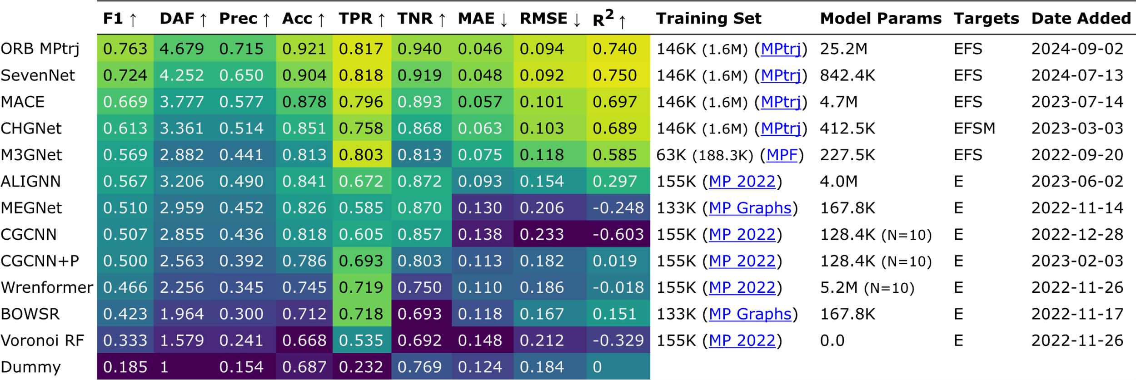
MLIP’s – Materials Bench – open source
A standardized approach to rank ML energy models
Leaderboard - improvements lead to changes every 3-6 months
0.851
“Matbench Discovery — A Framework to Evaluate Machine Learning Crystal Stability Predictions.” arXiv,
August 28, 2023. https://doi.org/10.48550/arXiv.2308.14920.

Slide 30
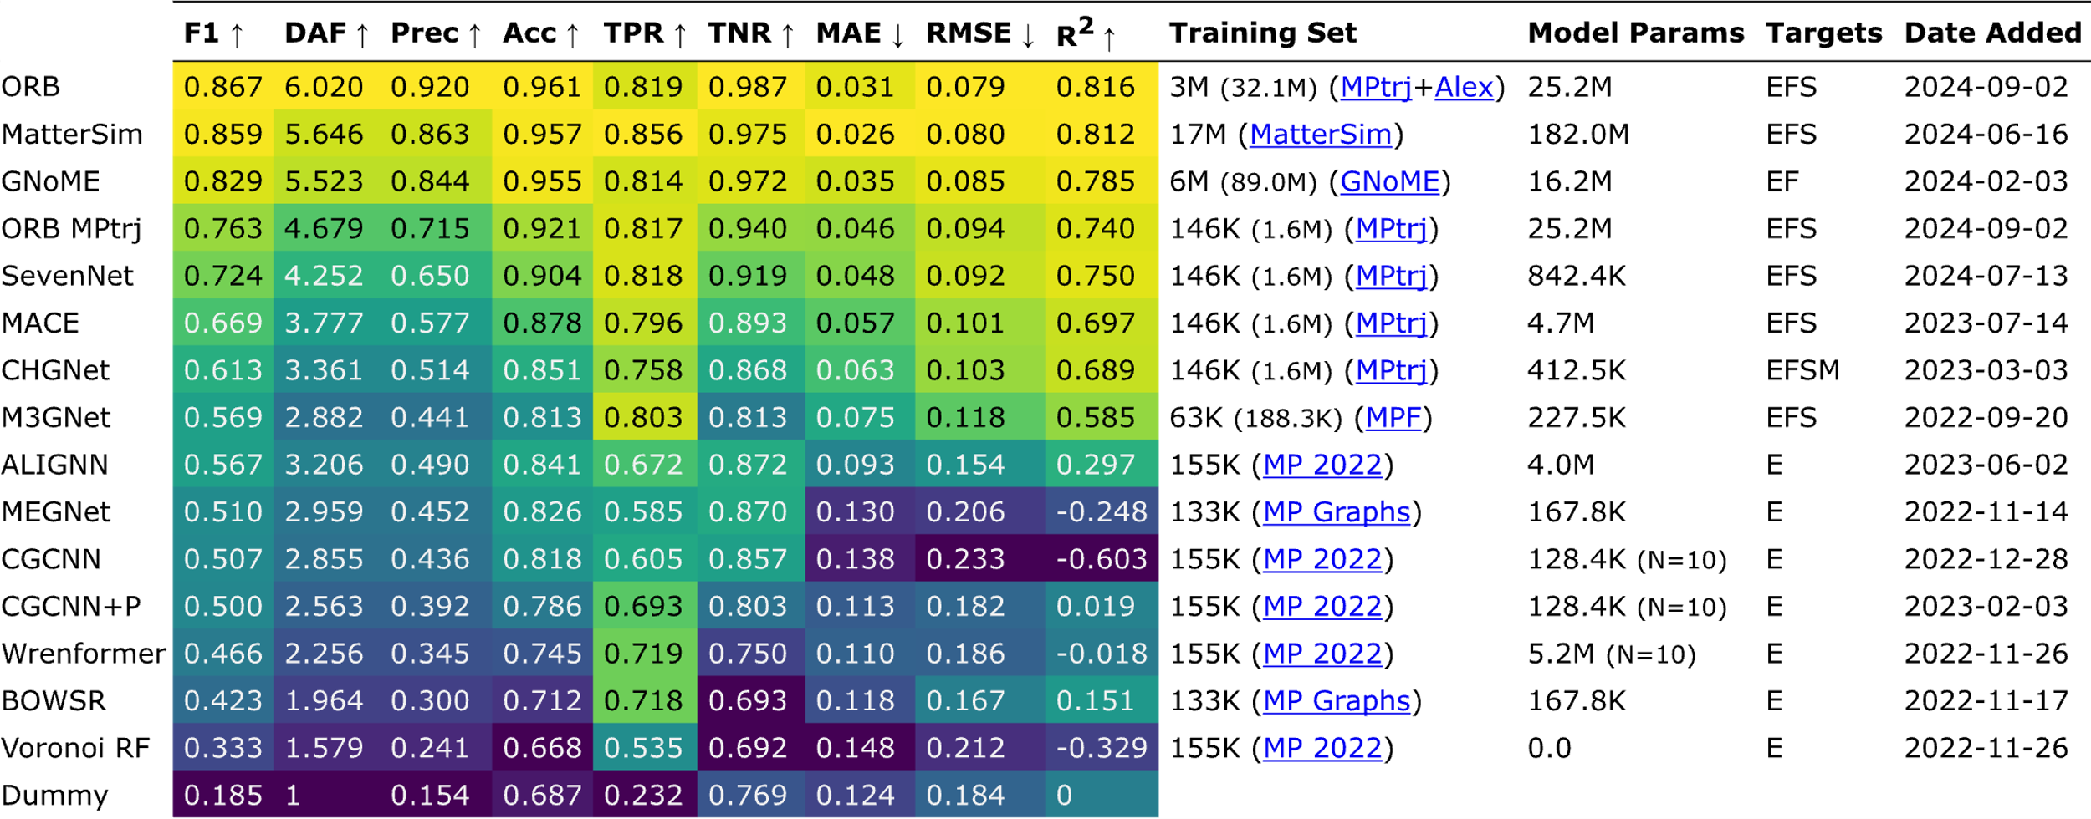
MLIP’s – Materials Bench - commercial
A standardized approach to rank ML energy models
Leaderboard - improvements lead to changes every 3-6 months
0.851
“Matbench Discovery — A Framework to Evaluate Machine Learning Crystal Stability Predictions.” arXiv,
August 28, 2023. https://doi.org/10.48550/arXiv.2308.14920.

Slide 31
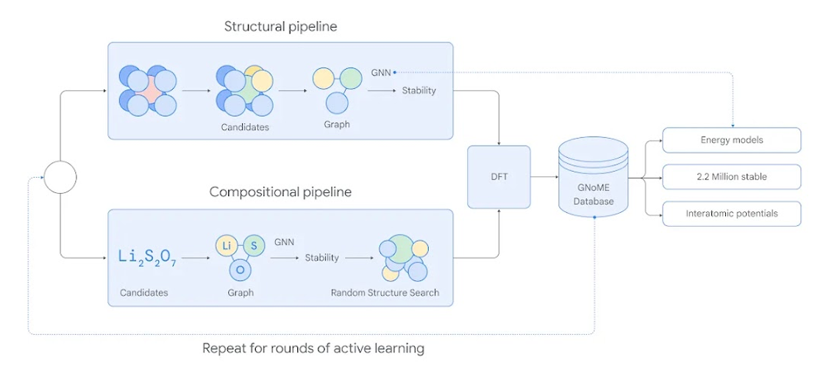

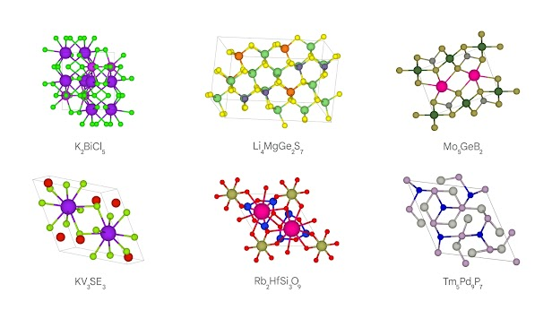
Merchant, A., Batzner, S., Schoenholz, S.S. et al. Scaling deep learning for materials discovery. Nature 624, 80–85 (2023).
https://doi.org/10.1038/s41586-023-06735-9
Notes:
GNoME was originally trained with data on crystal structures and their stability, openly available through the Materials Project. We used GNoME to generate novel candidate crystals, and also to predict their stability. To assess our model’s predictive power during progressive training cycles, we repeatedly checked its performance using established computational techniques known as Density Functional Theory (DFT), used in physics, chemistry and materials science to understand structures of atoms, which is important to assess the stability of crystals.

Slide 32
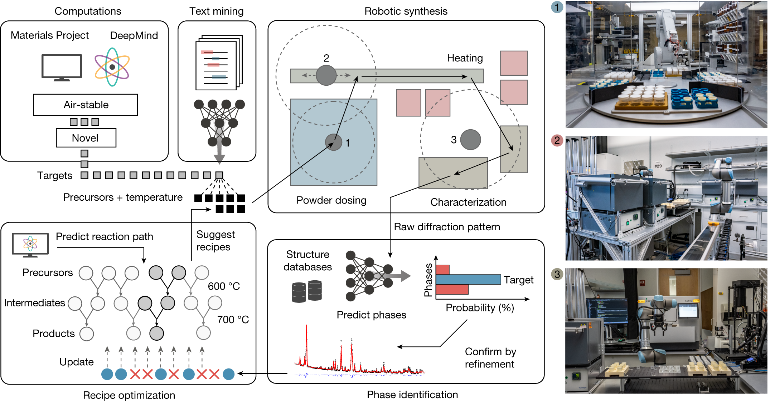
Autonomous materials discovery with the A-Lab.
Based on the
DeepMind
discoveries
Szymanski, N.J., Rendy, B., Fei, Y. et al. An autonomous laboratory for the accelerated synthesis of novel materials. Nature 624, 86–91 (2023). https://doi.org/10.1038/s41586-023-06734-w

Slide 33
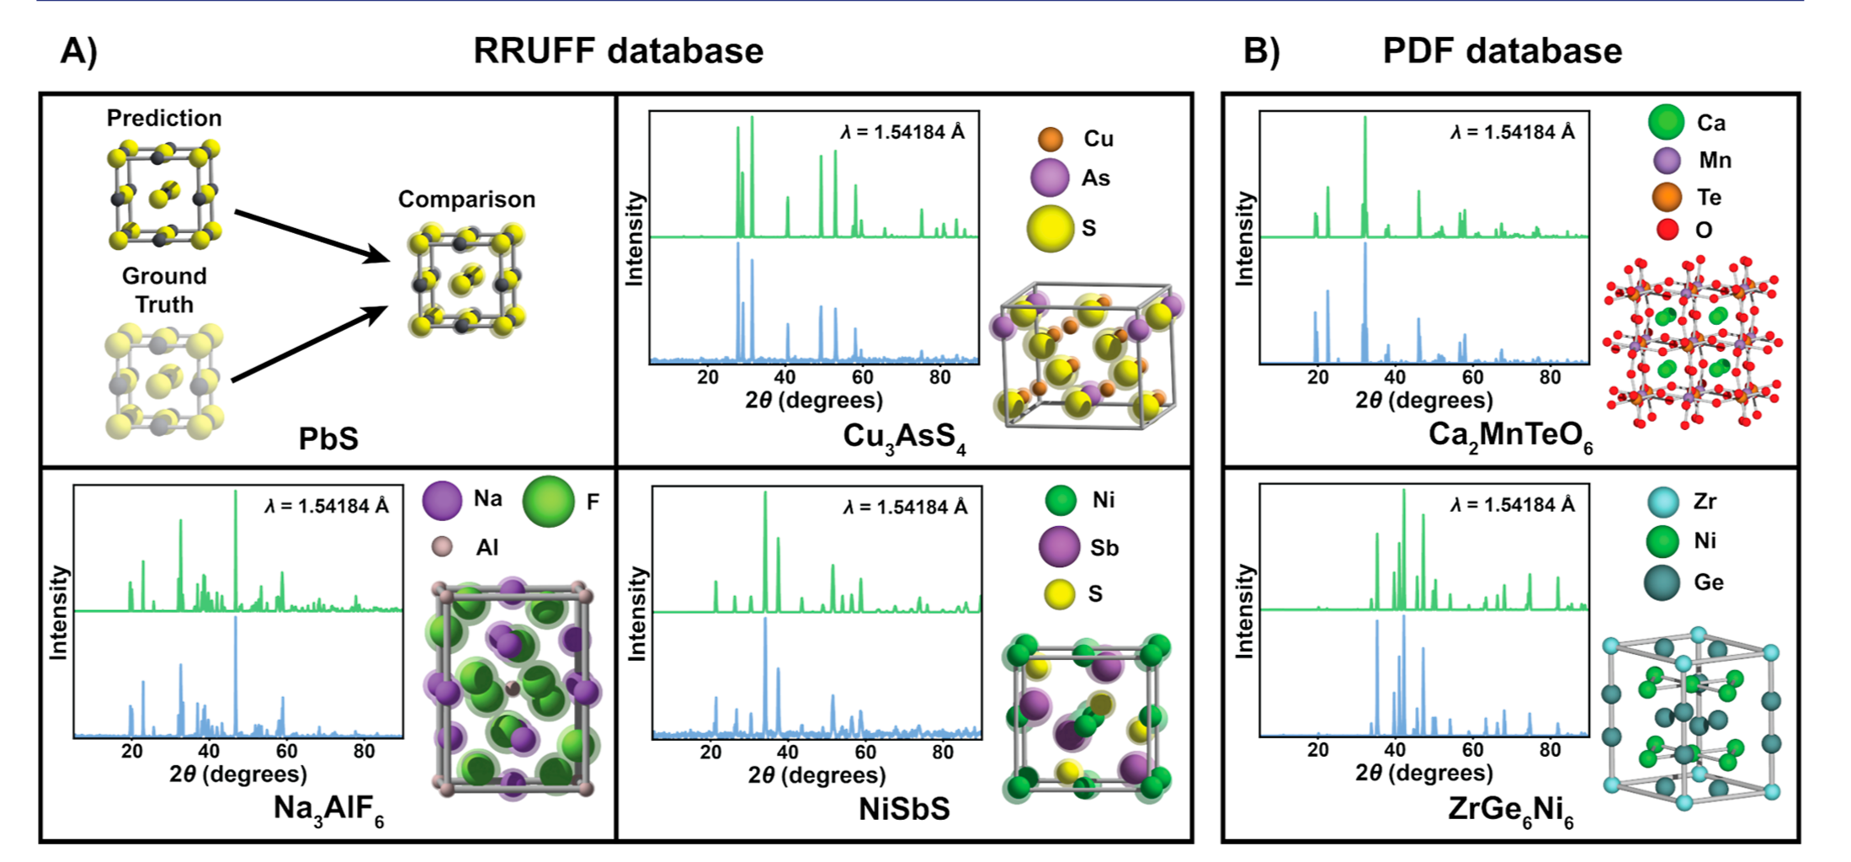
Crystal Structure Determination from Powder Diffraction Patterns with Generative Machine Learning
Not a replacement for Rietveld refinement
A high-quality initial structural model.
Does not explicitly refine preferred orientation, atomic positions, or fractional occupation
Riesel et al - https://doi.org/10.1021/jacs.4c10244

Slide 34
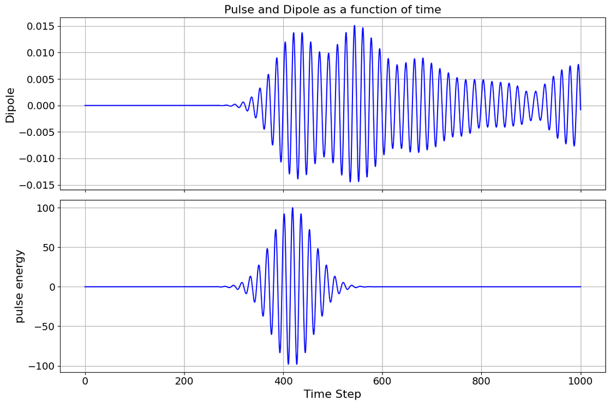
Laser driven system
Benzene is probed with laser pulse.
Laser pulse and dipole moment are sinusoidal.
Width, amplitude and frequency of the pulse vary in the dataset.

Slide 35
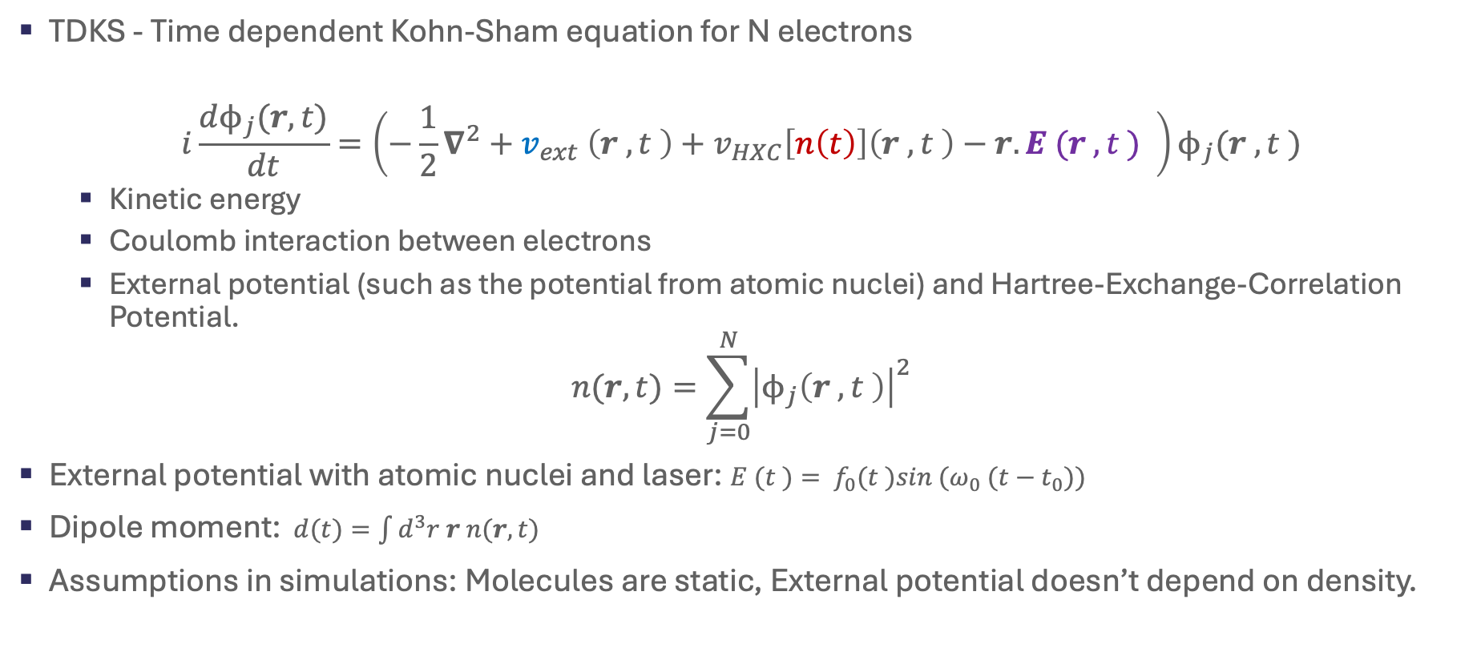
Kohn-Sham equation
TDKS - Time dependent Kohn-Sham equation for N electrons
$$i\frac{dϕ_{j}(r,t)}{dt}=\left(−\frac{1}{2}∇^{2}+v_{ext} \left(r , t \right)+v_{HXC}\left[n\left(t\right)\right]\left(r , t \right)−r. E (r , t ) \right)ϕ_{j}(r , t )$$
  Kinetic energy
  Coulomb interaction between electrons
  External potential (such as the potential from atomic nuclei) and Hartree-Exchange-Correlation Potential.
$$n(r,t)=\sum_{j=0}^{N}{{\left|ϕ_{j}\left(r , t \right)\right|}^{2}}$$
External potential with atomic nuclei and laser: $E (t )= f_{0}(t )sin (ω_{0} (t−t_{0}))$
Dipole moment:$d(t)=\int{d^{3}r r n(r,t)}$
Assumptions in simulations: Molecules are static, External potential doesn’t depend on density.

Slide 36
The literature
Can physics-informed neural networks beat the finite element method?
IMA Journal of Applied Mathematics, Volume 89, Issue 1, January 2024, Pages 143–174, https://doi.org/10.1093/imamat/hxae011
In terms of solution time and accuracy, physics-informed neural networks have not been able to outperform the finite element method in our study. In some experiments, they were faster at evaluating the solved PDE.

Slide 37
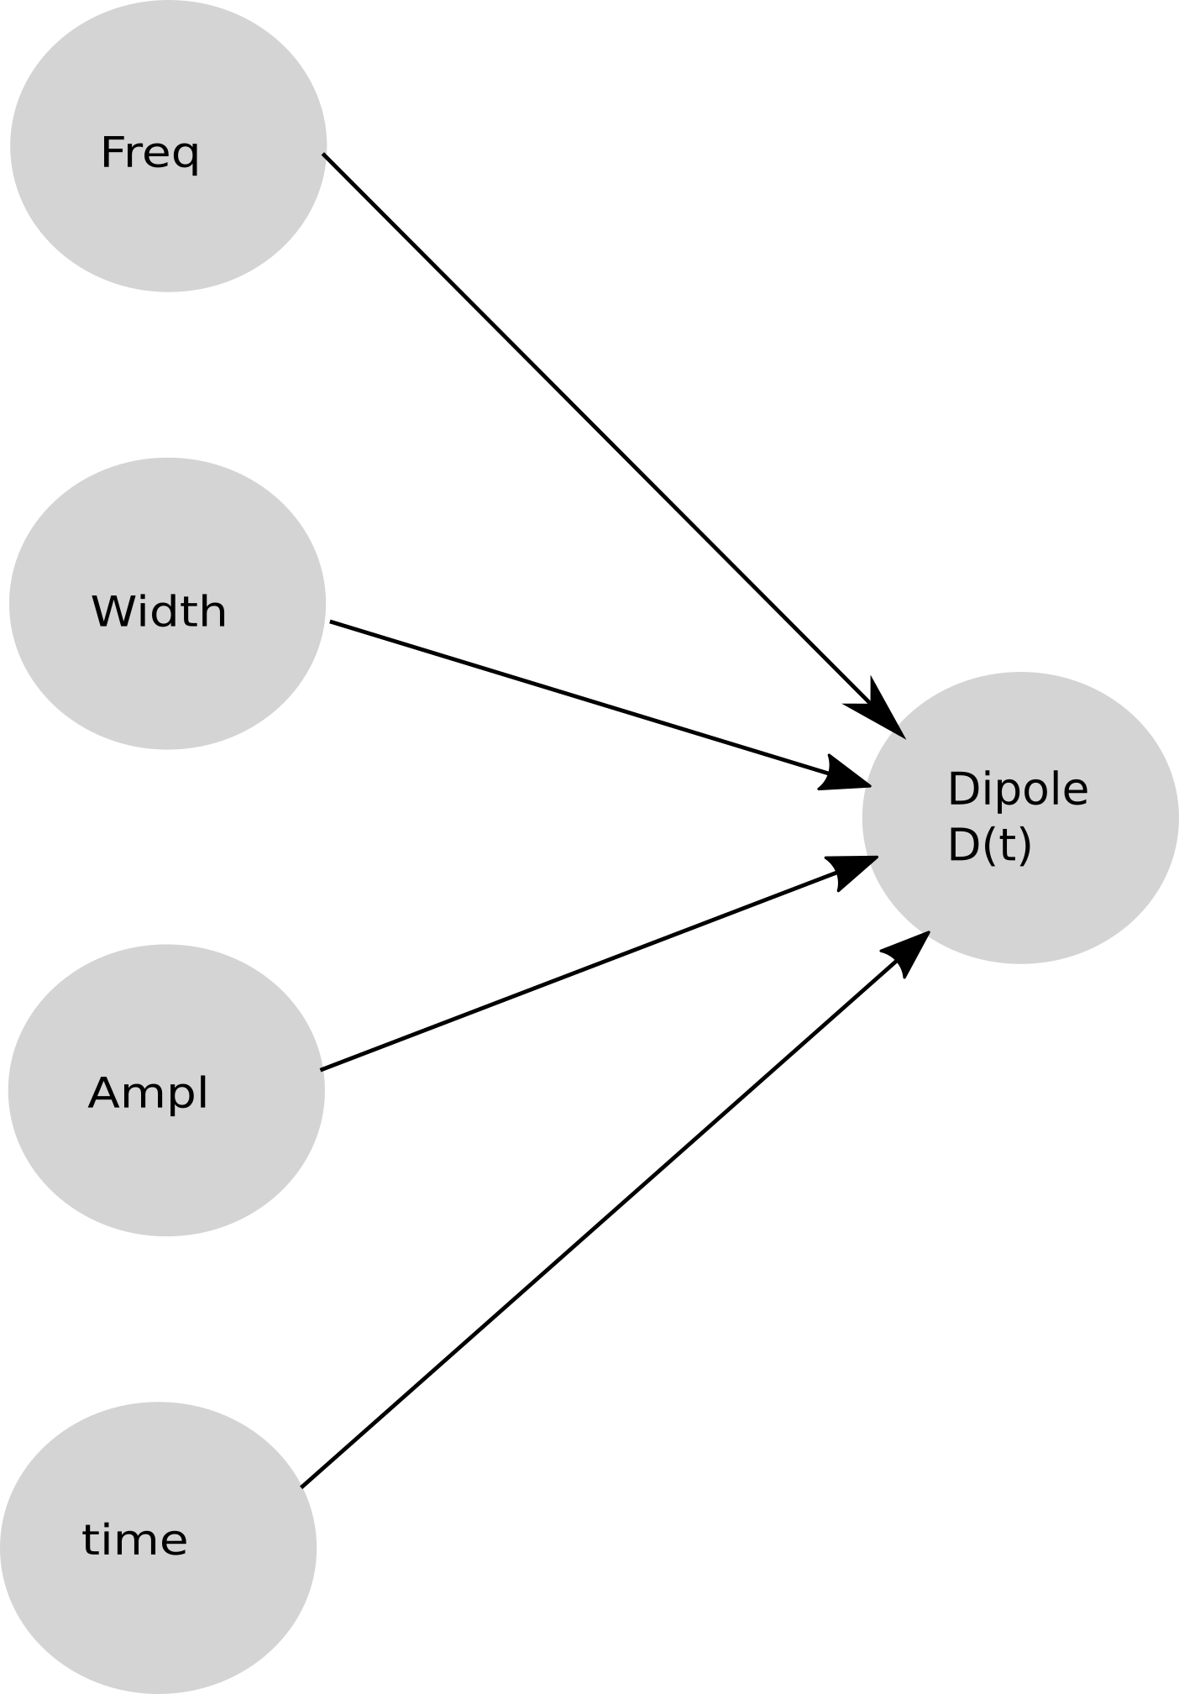
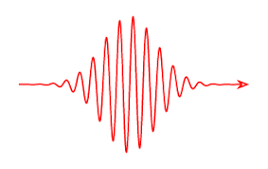
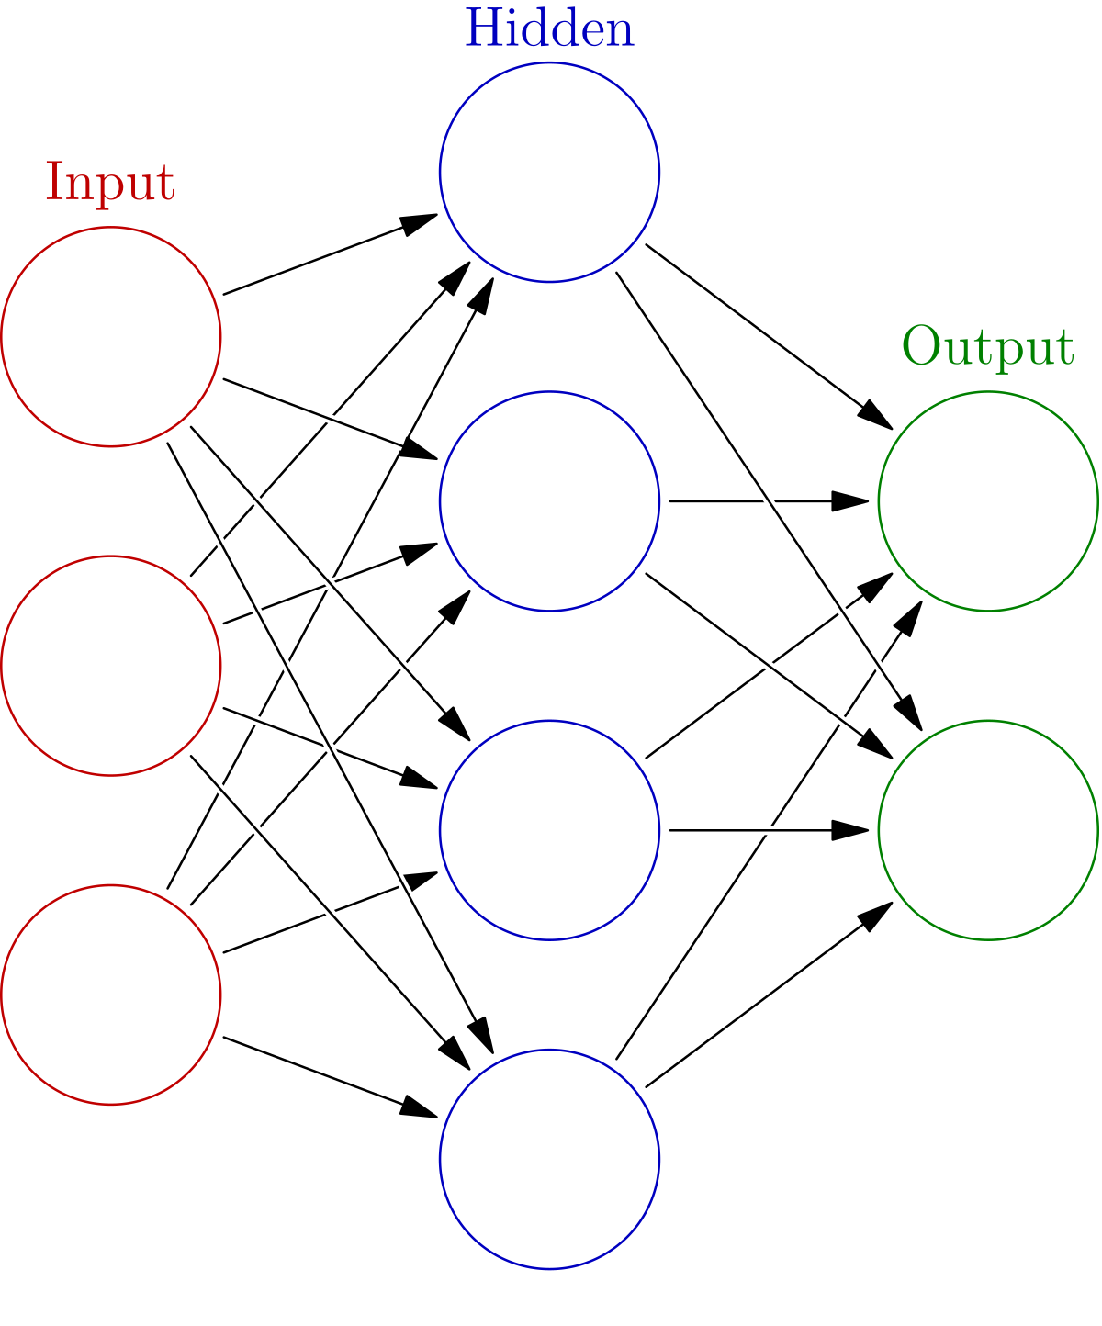
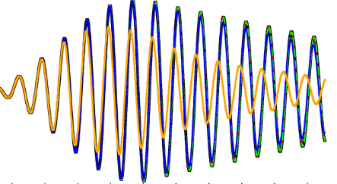
Problem formulation
Build machine learning methodology to predict dipole evolution from laser pulse
Laser pulse
Dipole

Slide 38
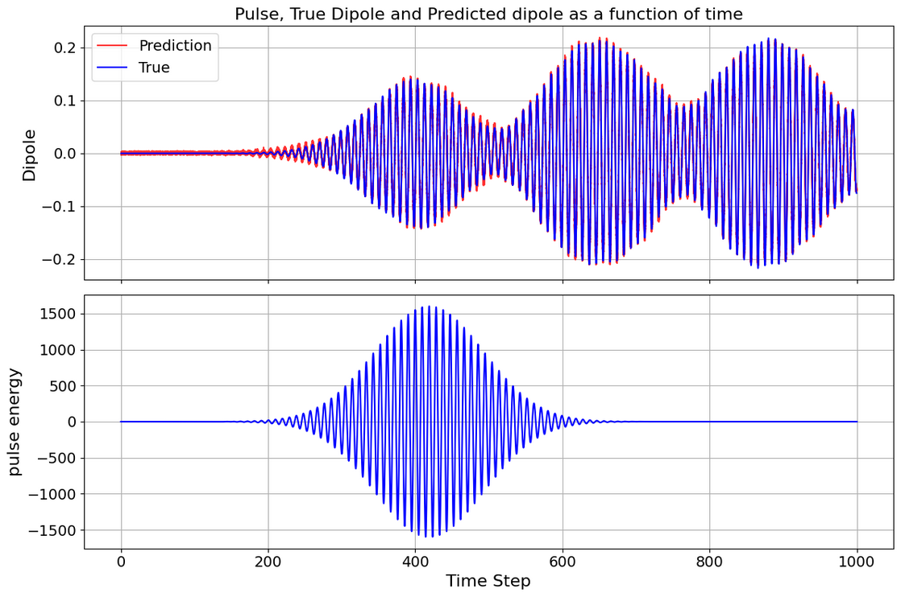
Preliminary results
ML infers dipole as a function of time successfully.
The plot shows 99% correlation between the prediction and true value.
Calculation reduced from days to minutes

Slide 39
Goldilocks – ”This DFT is just right”
DFT
Calculations represent 45% of Archer2 (Tier1 UK service) and are used extensively across Tier2 and university HPC
Computationally expensive
Over or under convergence can be costly.
Can be difficult for non-experts to setup
AI solution
LLM - guide or build an appropriate configuration files for a given code base
Model optimal sampling to determine a parameter of interest to a desired accuracy.

Slide 40
Streamlined data to knowledge

Slide 41
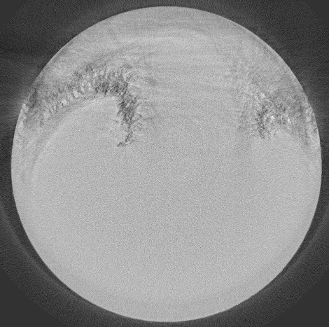
Segmentation and Data fusion of Neutron and X-ray (NX) tomographic data
Segmentation is a key approach to understand a 2D or 3D image by labelling pixels sharing certain characteristics (colour, edge, texture…)
Can ML-based auto-segmentation methods trained on real pictures work well on NX tomography images
NX has
  strong systematic noises across multiple scales
  ultra-low semantic contexts (thus undefined truth for supervised ML)
Semantic segmentation of an image
Micro-cracks
in rock
Stone-egg

Slide 42
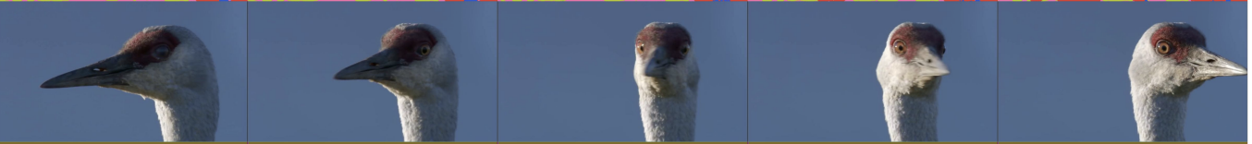
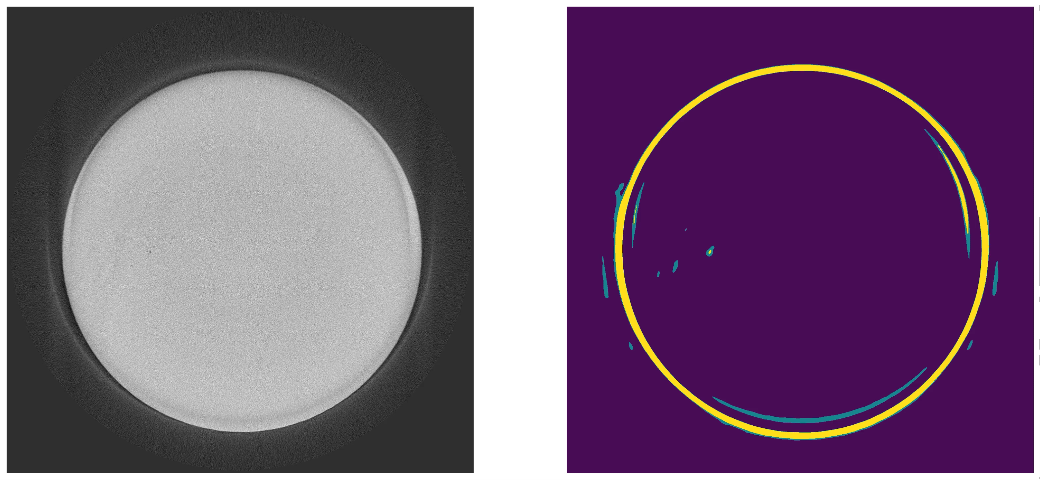

SP-WNet: our deep-learning solution
We develop an unsupervised deep-learning method for image segmentation, called SP-WNet, combing a convolutional neural network (CNN) in pixel space and a graphic neural network (GNN) in superpixel space, capable of taking multiple input modalities (e.g., N & X).
Work better on both real pictures and NX tomographic images.
Train
Infer
Infer
Infer
Fronts (green) and nuclei (yellow) of micro-cracks
Unsupervised training with only 1 image

Slide 43
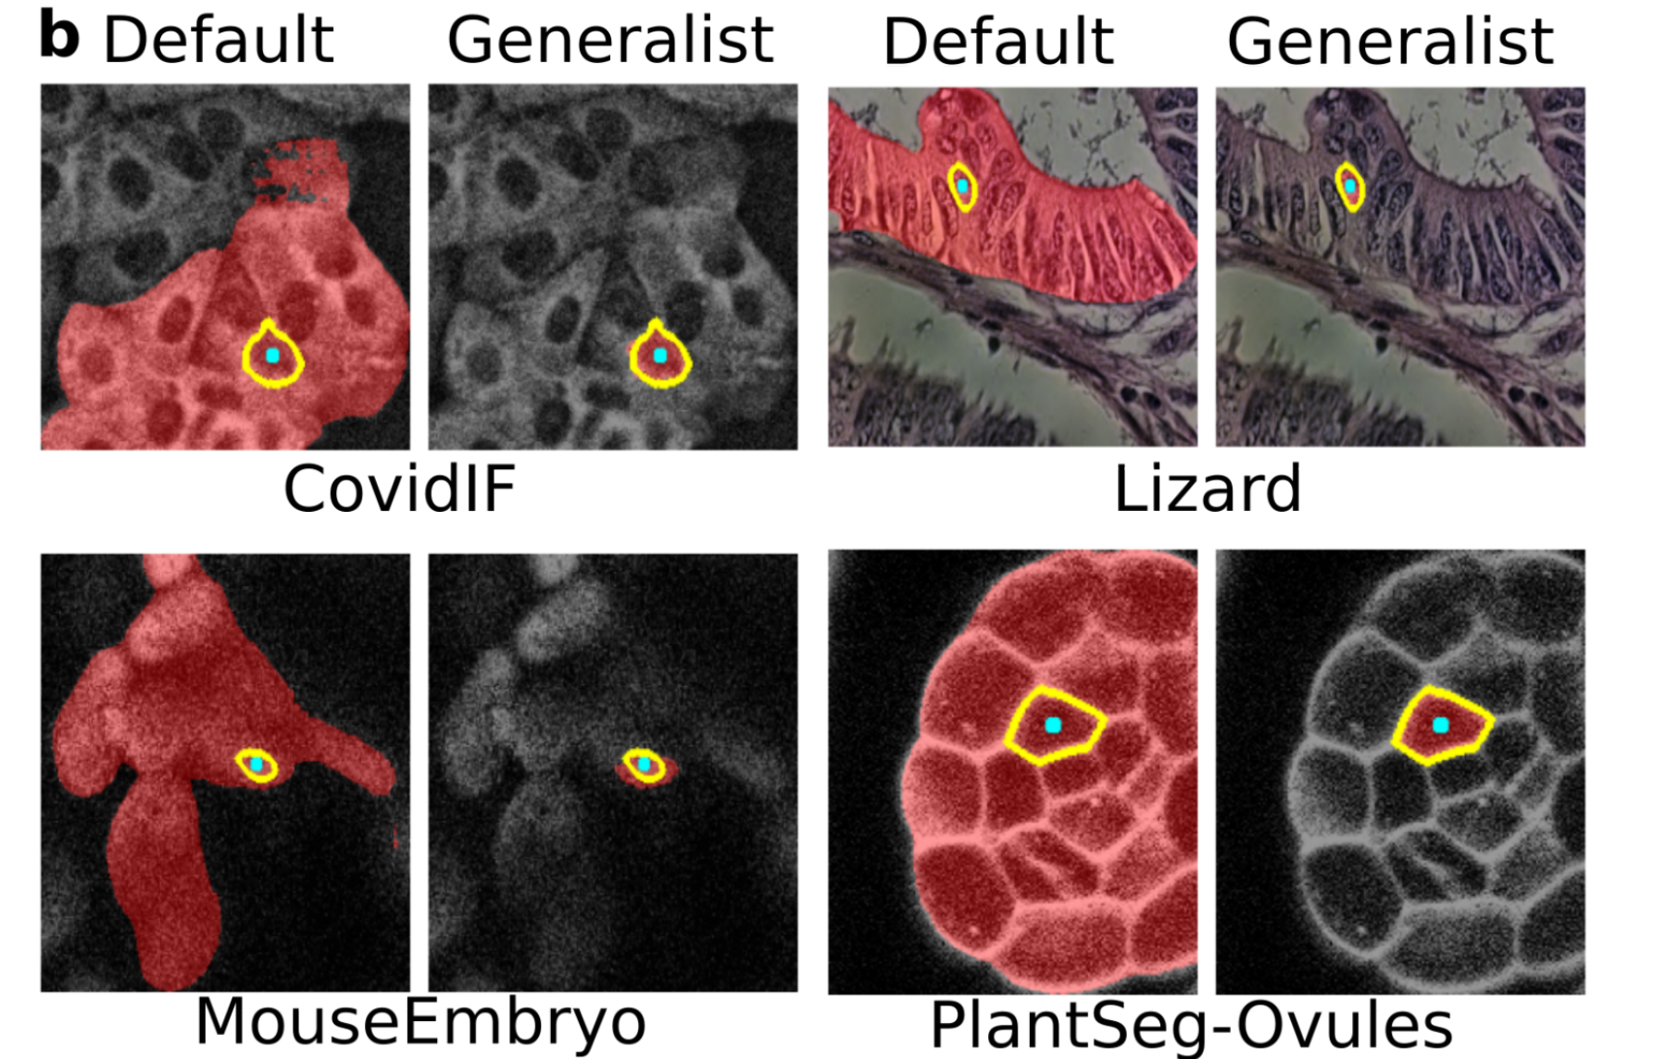
Meta - Segment Anything Model (SAM)
Ok but needs to be fine-tuned against a specific use case
  Medical - https://doi.org/10.1038/s41467-024-44824-z
  Microscopy -- https://doi.org/10.1101/2023.08.21.554208
Performance for X-rays or Neutrons ?
  Can find mixed comments in literature
  Limited availability of labelled training data-sets of sufficient quality in this problem domain to assess or fine tune the vision transformers included in SAM
Archit, A., Nair, S., Khalid, N., Hilt, P., Rajashekar, V., Freitag, M., Gupta, S., Dengel, A., Ahmed, S., & Pape, C. (2023).
Segment anything for microscopy. bioRxiv. https: //doi.org/10.1101/2023.08.21.554208

Slide 44
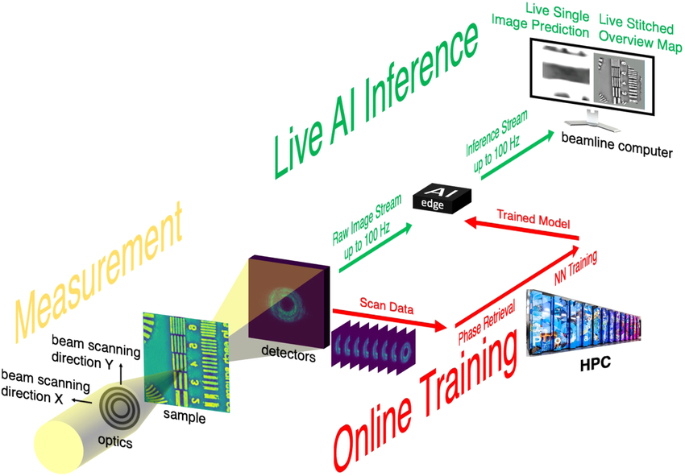
Hybrid Approaches
PtychoNN
Experiment/Sample type specific
Live visualization
“Seed” , Sort, Align, de-noise +
conventional reconstructions to reduce convergence time
ALC working on a probe inference version
Mathew Cherukara https://aip.scitation.org/doi/full/10.1063/5.0013065

Slide 45
Optimised experiments and Automation

Slide 46
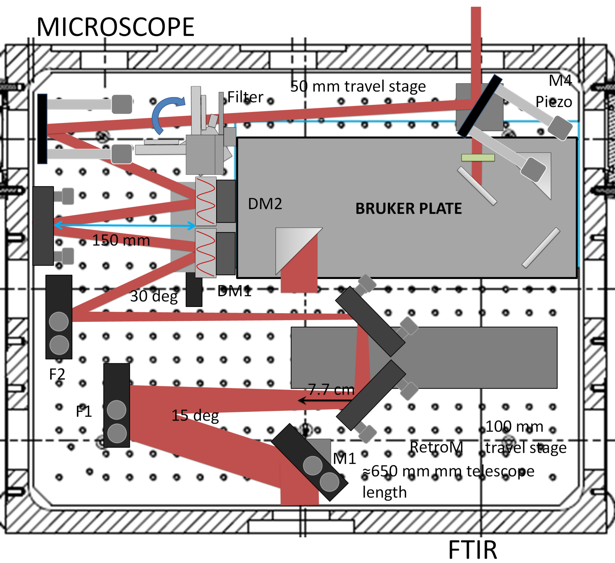

Hardware: Deformable Mirrors plus IR microbolometer
2x DMs
97-actuator
stroke<60μm
flat rms<7nm
Au coating
In vacuum
Azizian et al. SPIE Photonics Europe, 2020 Proc 11351 (2020)

Slide 47











Software: Real Time Optimization vs Digital Models
Actuators Voltages as input
Generative Adversarial Network
Flat top hat
target
Bayesian Algorithm
Digital
model
Surrogate Model
$$γ(v)$$
$$⋮$$
$$⋮$$
$$⋮$$
$v=$ $\left(x, y\right)$
$$p$$
$$⋮$$
$$⋮$$
$$⋮$$
Sensor image as output
$$γ\left(v\right)={\left[\cos\left(2πv\right),\sin\left(2πv\right)\right]}^{T}$$
Notes:
Global Optimization
Two digital models are built to numerically validate the calibration algorithm is not biased.

Slide 48

Bayesian algorithm
Covariance matrix evolutionary algorithm
Bayesian optimisation allows:
Multiobjective optimisation
Compared with ADAM is more robust to the noise
Does not need derivatives
Tends to reach global optima
Hansen, N. (2016). The CMA evolution strategy: A tutorial. arXiv preprint arXiv:1604.00772.

Slide 49



SR Experiments: DM1 optimization

Slide 50
AI Infrastructure and Culture

Slide 51







FAIR data + FAIR workflows

Slide 52
Federated Learning
Central trained model –
Local training - resulting weights are aggregated into a central model
Energy Efficient – spreads load
Minimizes data sharing - only weights shared
Needs community lead projects
Physics Informed ML
Limited data problem
Generalizability problem
Physics informed models

Slide 53
Comments…
Open approaches drive AI development
Open benchmarking and validation drives trust and adoption
Need to strongly couple AI, maths and domain expertise
Generalised models benefit from specific training
Understand the core assumptions and gaps in your training data
Automation needs stable building blocks
  Human in the loop – guided models

Slide 54
Take Home message
Collaboration opportunities with ALC
Working across facilities – looking at common solutions
More work to do but going in right direction
Thanks
Philip Jackson, Lesley Mansfield, Charlotte Matthews
SciML and Materials Modelling Team@Scientific Computing

Slide 55
Questions alc@stfc.ac.uk

