Slide 1
Preferred Practices Through a Project Template
Peter F. Peterson, Chen Zhang, Jose M. Borreguero-Calvo, and Kevin A. Tactac

Slide 2
Software engineers, including those involved in scientific software, often mention that they follow best practices. While sounding like an excellent idea, this is often near impossible. Frequently, there is an opinion on what is the best practice. Some other things, like software licenses and naming conventions, are mostly left to the development team to decide. Our software team has developed preferred practices which are guided by best practices rather than constrained by them. These practices reflect the values and realities of the environments and users of our software. To share these decisions with the team, we created a project template. The project template promotes standardization and enables discussion of how various decisions are implemented. This paper will discuss what information belongs in a project template and the benefits of collecting preferred practices in this way.

Slide 3
Preferred Practices

Slide 4
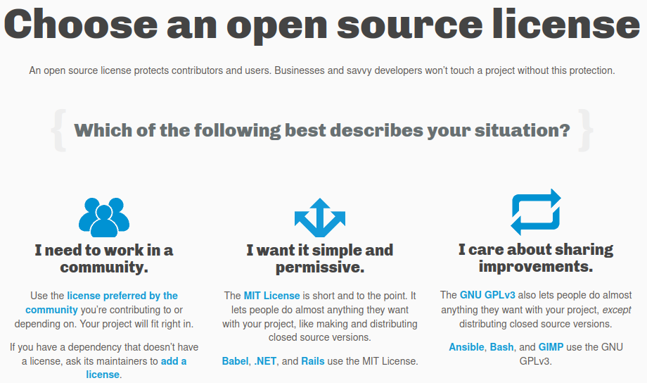

Slide 5
GitHub template repository

Slide 6
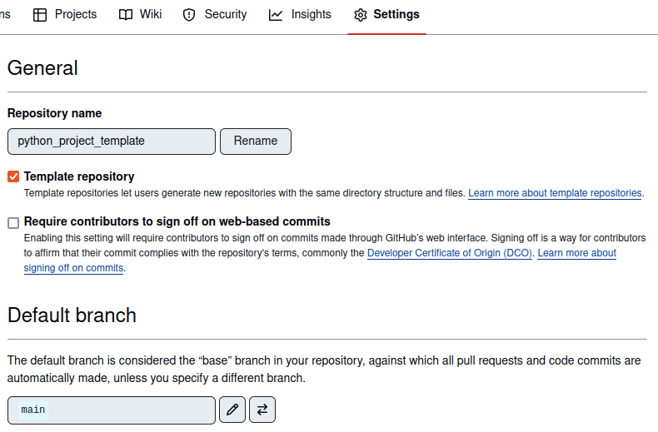

Slide 7
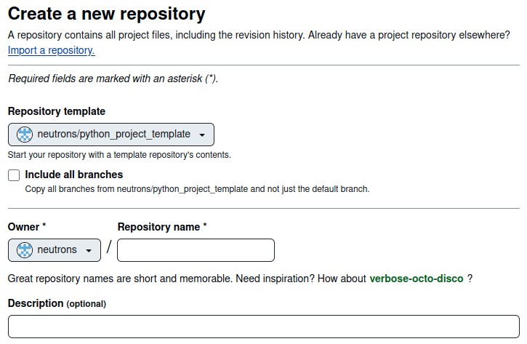

Slide 8
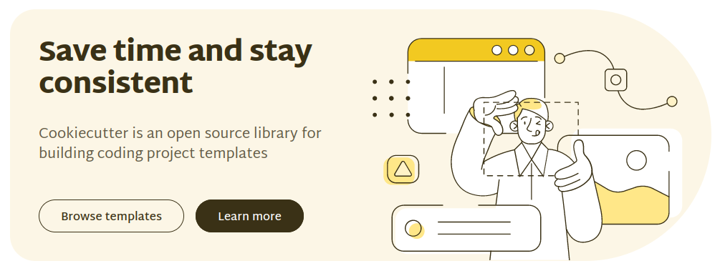

Slide 9
Template contents

Slide 10
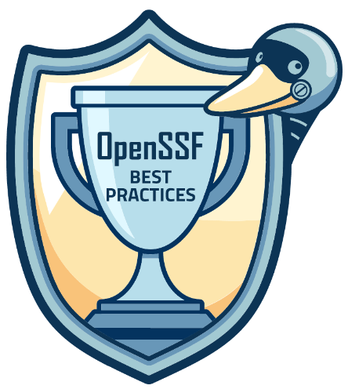
OpenSSF Best Practices Badge
Basics
Change Control
[Bug and Vulnerability] Reporting
Quality
Security
[Static and Dynamic] Analysis
Notes:
Identification, Basic project website content, FLOSS, Documentation
Public VCS, Unique version numbering, Release notes
Bug-reporting process, Vulnerability report process
Working build system, Automated test suite, New functionality testing, Warning flags
Secure development knowledge, Use basic good cryptographic practices, secured delivery against main-in-the-middle attacks, publicly known vulnerabilities fixed
Static code analysis, dynamic code analysis

Slide 11
LFD121 – Developing Secure Software

Slide 12
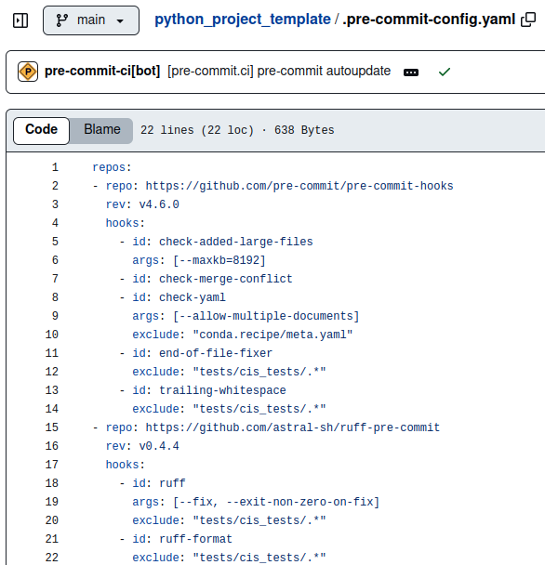
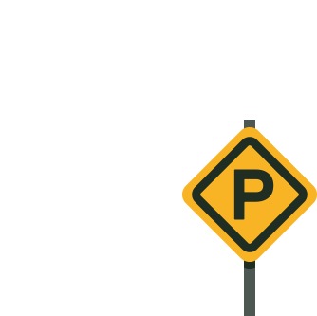
Static analysis configuration

Slide 13
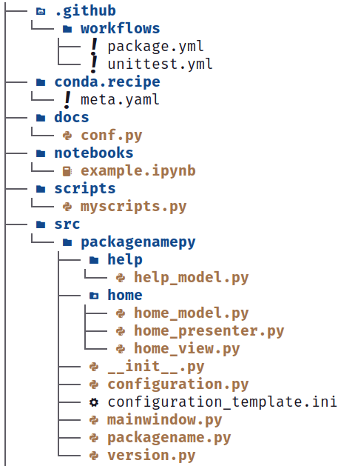
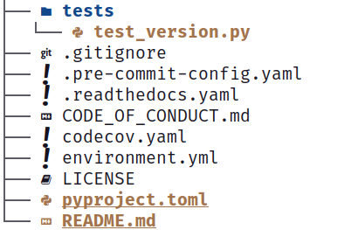
Directory layout

Slide 14
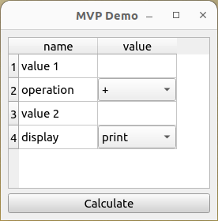
Example GUI – using MVP
Model – underlying functionality – can have multiple
View – display/layout often in a .ui file
Presenter – connects Model and View

Slide 15
How is this used?

Slide 16
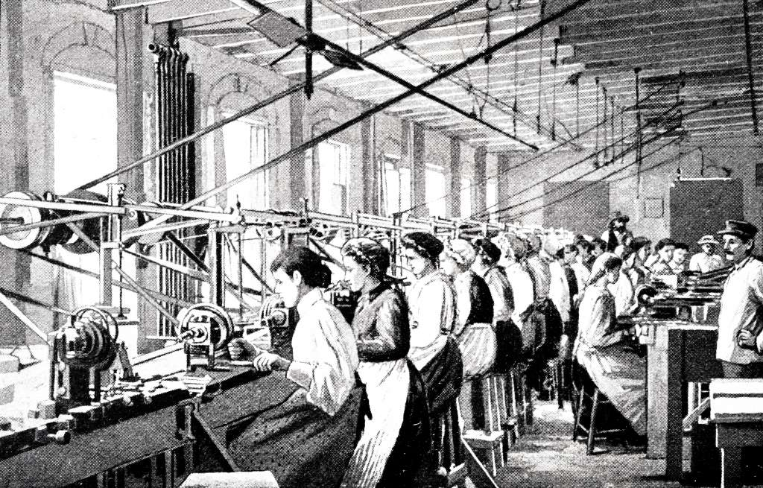
Modernization and Documentation

Slide 17
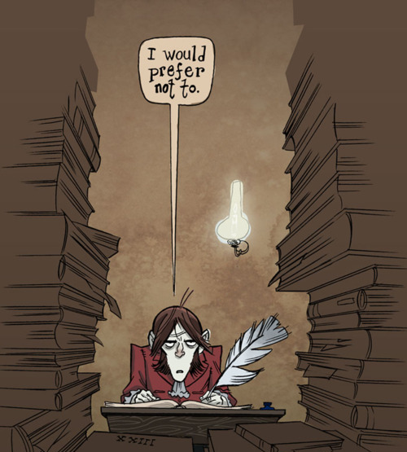
Domain scientists

Slide 18
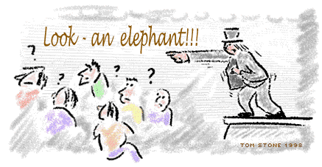
https://github.com/neutrons/python_project_template

Slide 19
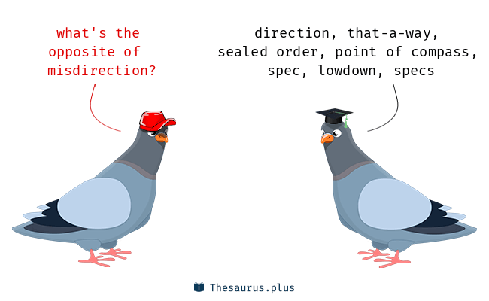
https://github.com/neutrons/python_project_template

