Slide 1



Expanding the Galaxy platform to materials science workflows at STFC
Patrick Austin
patrick.austin@stfc.ac.uk
NOBUGS, 26 Sept 2024
Notes:
In this presentation I’m going to talk about the work we’ve done to expand the Galaxy platform to new, materials science use cases
Specifically, X-ray absorption spectroscopy for catalysis.

Slide 2
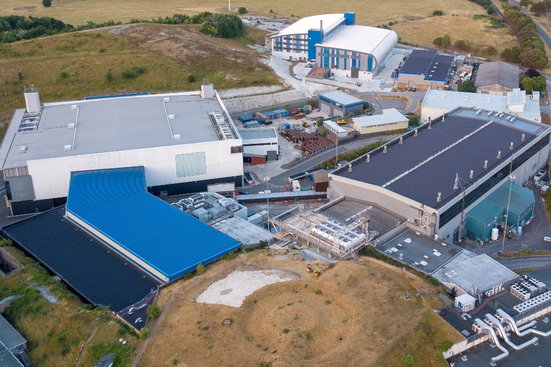
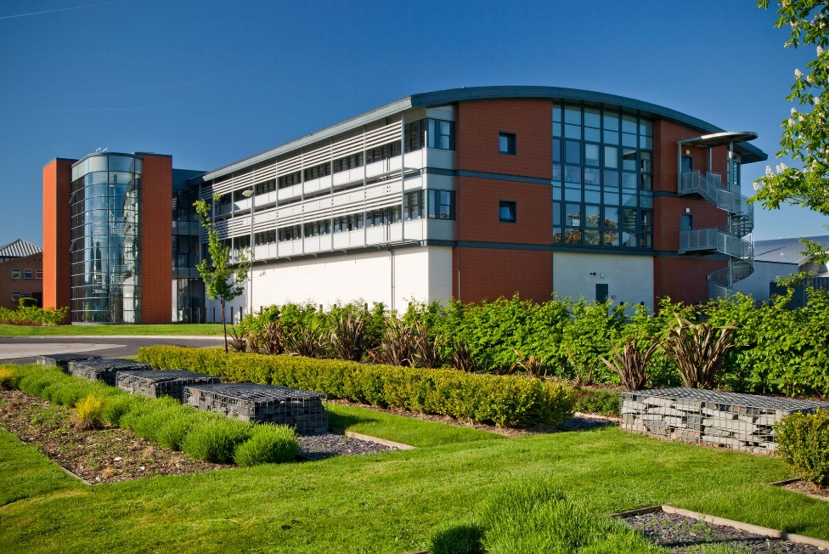


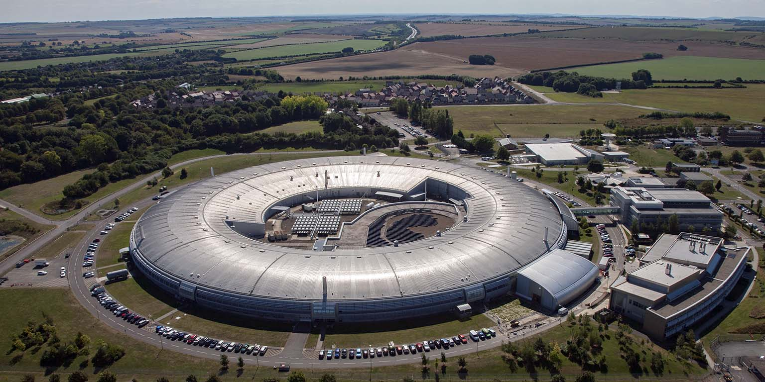

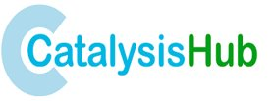

Context
Notes:
For context, I’m software engineer in Scientific Computing Department at STFC in the UK.
Our department supports ISIS and the Diamond Light Source.
There’s software at STFC to manage data and metadata, and support analysis by facility users,
Some is developed/maintained by the facilities themselves and some by us in Scientific Computing.
Today, going to talk about some work we’ve been doing to provide workflow management via the Galaxy platform.
Specifically: for users of the Catalysis Hub doing XAS at DLS

Slide 3

FAIR data objects
Publication:
Plots
High level methodology
Findable
Accessible
Assign DOI
Interoperable:
The data usually need to be integrated with other data.
In addition, the data need to interoperate with applications or workflows for analysis, storage, and processing.
Reusable:
The ultimate goal of FAIR is to optimise the reuse of data.
To achieve this, metadata and data should be well-described so that they can be replicated and/or combined in different settings.
Data object:
Raw (plaintext) data
Normalised data
Assign DOI
Missing:
Intermediate data
Crystal structure files
Parameters
Versions of software used
Provenance between datafiles
Notes:
Our collaborator raised issue of reproducibility of catalysis papers.
Once published, some include their data as supplementary digital objects.
Findable and Accessible from FAIR.
Typically only includes raw or partially processed data.
So difficult for it to be Interoperable and Reusable:
I: references to other data
R: does not capture provenance of the analysis
In practice: it’s difficult for a novice to get the same results from only the raw data.
Highly dependent on expertise and tuning of parameters.

Slide 4
Galaxy
Galaxy is an open-source platform for FAIR data analysis that enables users to:
Use tools from various domains (that can be plugged into workflows) through its graphical web interface.
Run code in interactive environments (RStudio, Jupyter...) along with other tools or workflows.
Manage data by sharing and publishing results, workflows, and visualizations.
Ensure reproducibility by capturing the necessary information to repeat and understand data analyses.
The Galaxy Community is actively involved in helping the ecosystem improve and sharing scientific discoveries.
Notes:
So: what we want is a platform which captures the analysis a user carries out, and enables exporting this information to make it FAIR.
For this, we’re using Galaxy.
Galaxy is an open source, user facing web-based platform:
Workflows can be built from a sequence of individual Galaxy tools
It has support for interactive environments such as Jupyter
Offers sharing of workflows and results with other users
Focuses on making jobs reproducible
Has a supportive community…

Slide 5
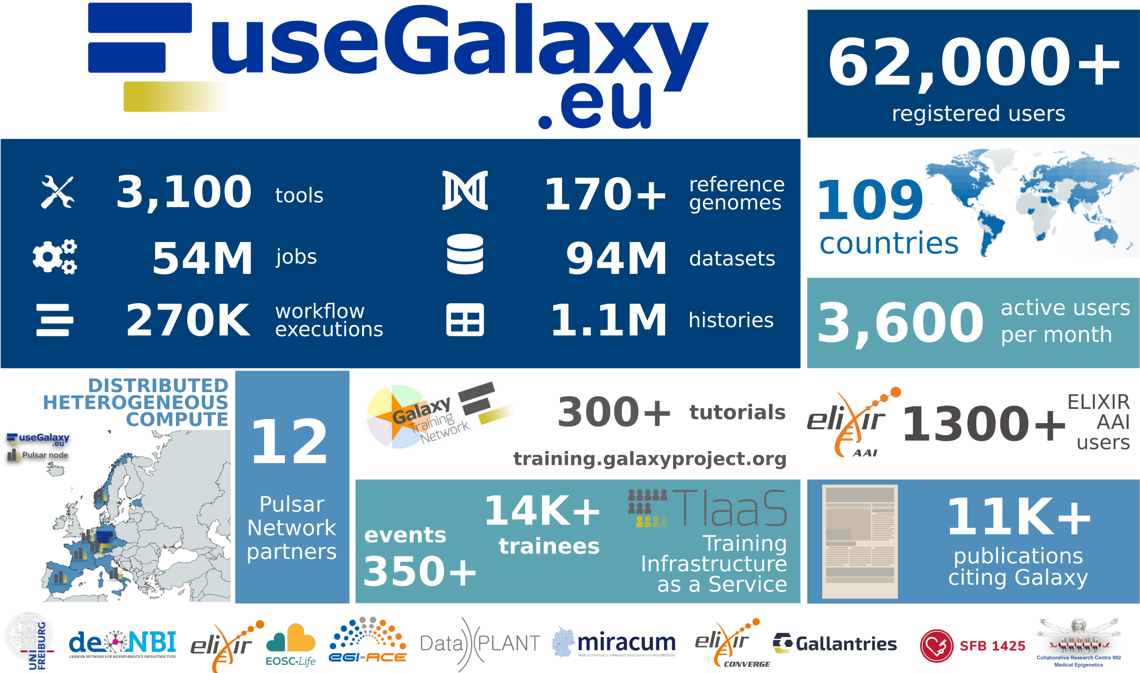
Notes:
A bit more about the Galaxy community, we mostly interact with the EU Galaxy community (US and AUS as well)
Originated in the bioinformatics domain 19 years ago.
Many nice to haves come from the wider Galaxy community:
Training
Access to public instances
Development and maintenance of the core Galaxy functionality
The main things we (STFC) do, is:
Develop tools for our use cases
Run our own (small) instance of Galaxy for these tools
This is supported and funded by an EOSC project, one of the aims is to bring Galaxy to new domains.
Materials science is one of these, alongside astrophysics and climate.

Slide 6
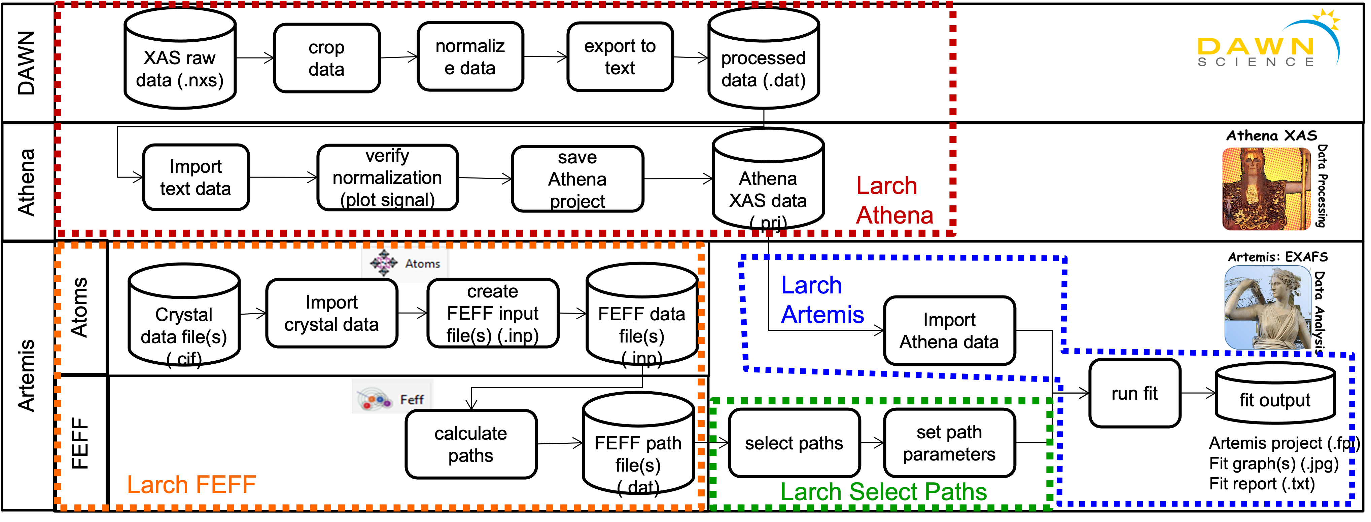
Developing tools
Notes:
So the key question I’m going to answer is: what did it take to apply Galaxy to our use case?
To begin with, identify a specific “workflow”.
For us this was XAS processing done for catalysis experiments.
This conventional workflow normally uses desktop applications written in Perl (Demeter).
There is also a Python implementation of the same functionality (Larch).
Note that the team working on Galaxy at STFC is not (in this case) the developer of the underlying software.
All we do is determine appropriate Galaxy tools to map onto areas of the existing workflow, and develop an interface between Galaxy and the underlying software.
This requires some judgment, but the key things to consider are:
Tools output files
Where in the workflow the user will want to interact

Slide 7
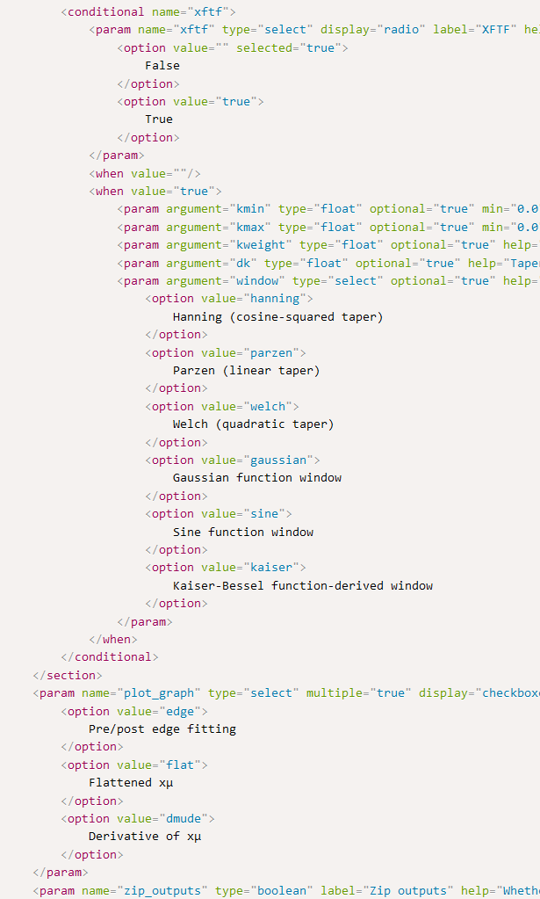
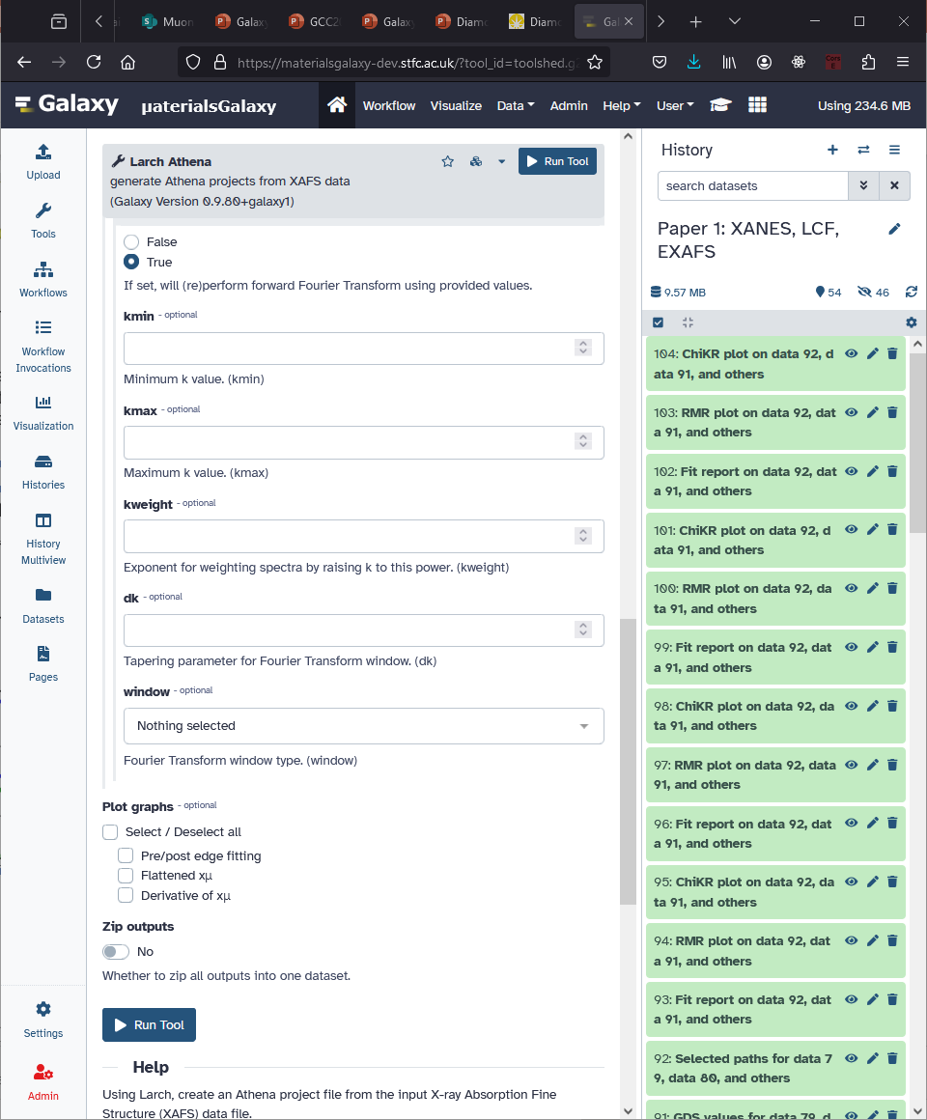
Notes:
GalaxyUI: Form based input for tool, history for files (inputs or outputs)
This happens to be for Athena, but the format is general.
Do this mapping with xml, following the defined schema.
Essentially, builds a form in the web UI with parameters that you want to pass to your tool.
A tool can take any number of files as input, and either operate on them as a collection
or as separate batched jobs.

Slide 8
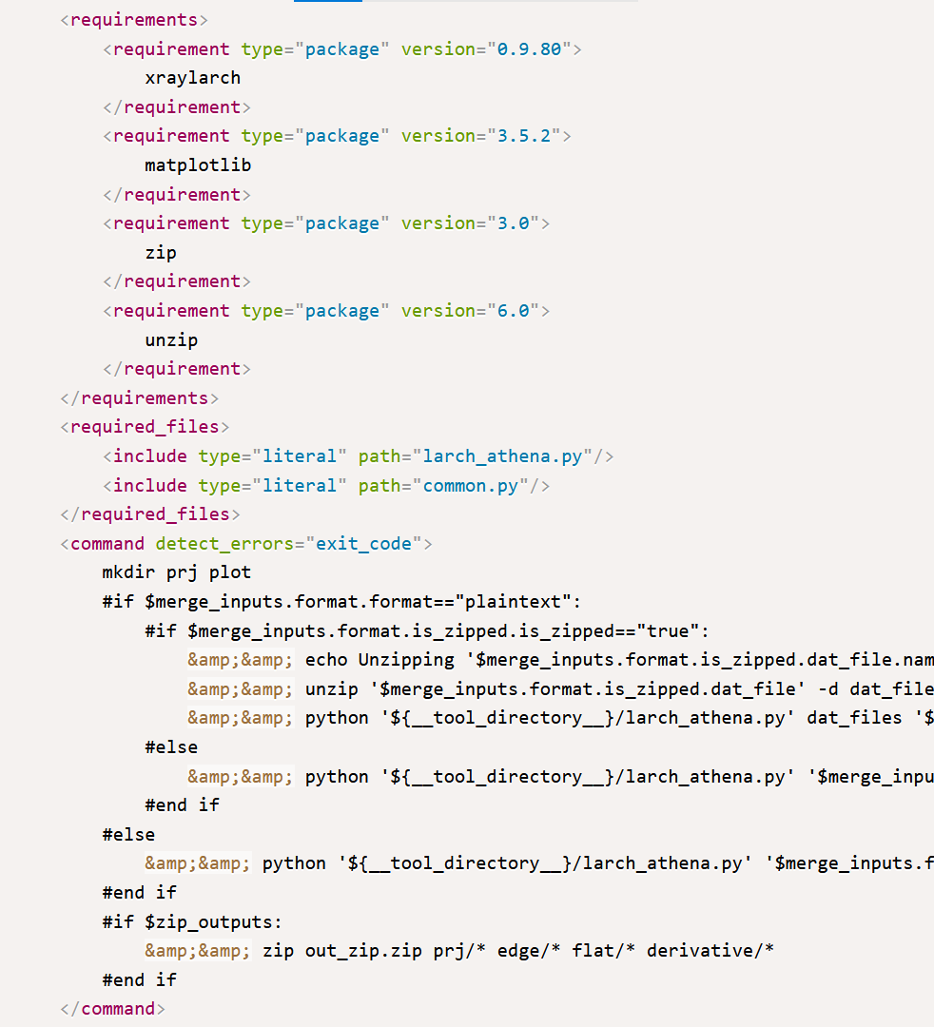


mulled-v2-faa6168dd05886095a7a71ef89b1d6747fbe25ea:4550e6260cd0ebb95353ee6345703453f0ce769b
Notes:
You also specify the dependencies, and commands to be executed.
This is run in a version specific container.
Simplest for existing command line interfaces, but if needed it’s possible to do some Python scripting.
For us, calling functions from the Larch library.
In general though, it’s best for the tool wrapper to do as little as possible.
The functionality should be in, and versioned by, the underlying software.
But the details depend on your use case.

Slide 9
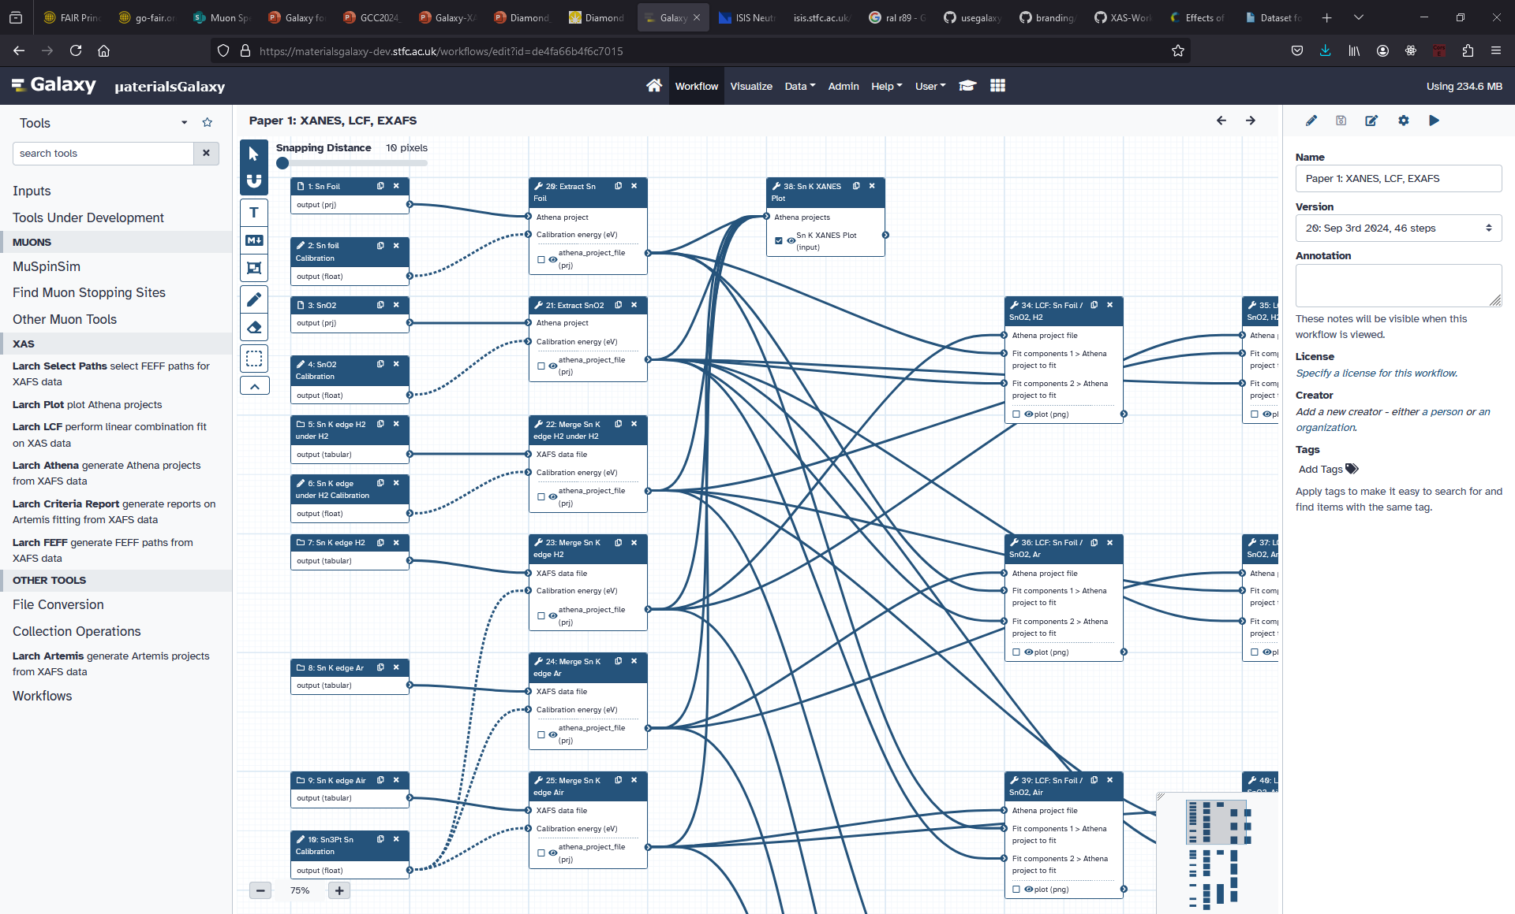
Copy
Quisque sagittis purus sit amet volutpat consequat mauris nunc.
Congue nisi vitae suscipit tellus mauris a diam maecenas sed enim ut sem viverra aliquet eget sit amet tellus cras adipiscing enim eu turpis egestas pretium aenean pharetra magna ac placerat vestibulum lectus mauris ultrices eros in cursus turpis massa tincidunt dui ut ornare lectus sit amet est placerat in egestas erat imperdiet sed euismod nisi porta lorem mollis aliquam ut porttitor leo a diam sollicitudin tempor id eu nisl nunc mi ipsum faucibus vitae aliquet nec ullamcorper sit amet risus nullam eget felis eget nunc lobortis mattis aliquam faucibus purus.
Notes:
Once you’ve developed tools, you then need to assemble those tools into a workflow.
It’s possible to do this ahead of time.
A user can drag and drop individual tools, connect input and output datasets, and set parameters.
Alternatively you can run tools one by one (using the UI on the previous screen),
Then, extract a workflow automatically based on your past actions.
Workflows can either belong to individual users or made public,
and they can be specific to your individual analysis or act as a general “all purpose” workflow.

Slide 10
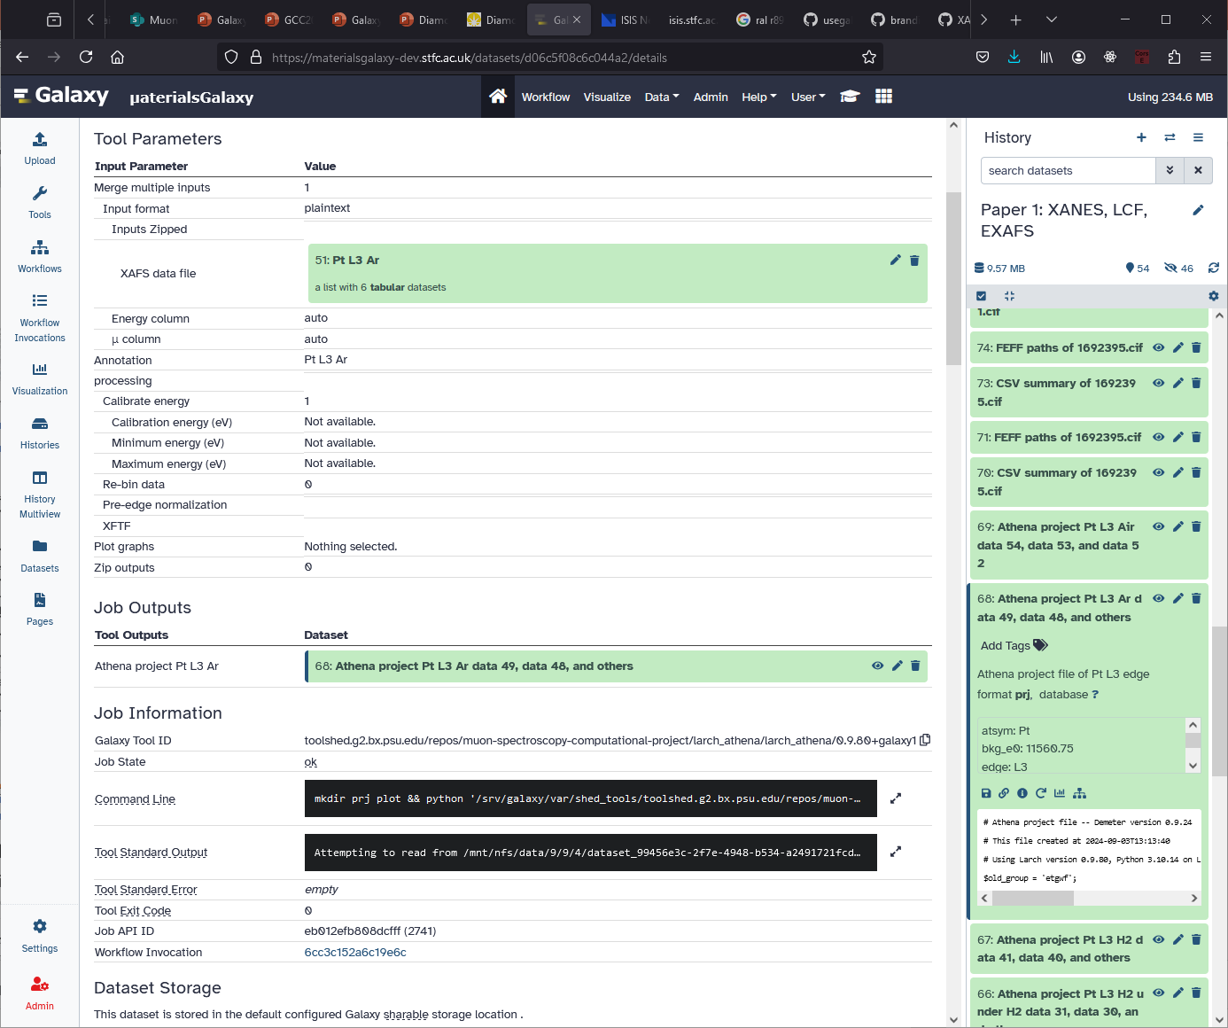
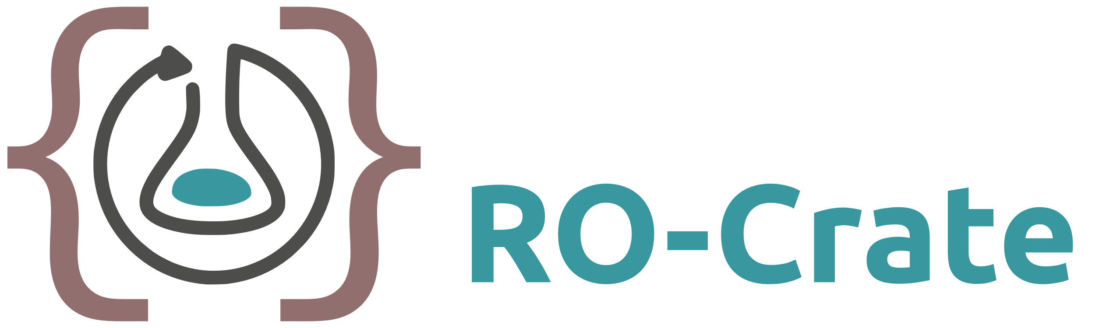
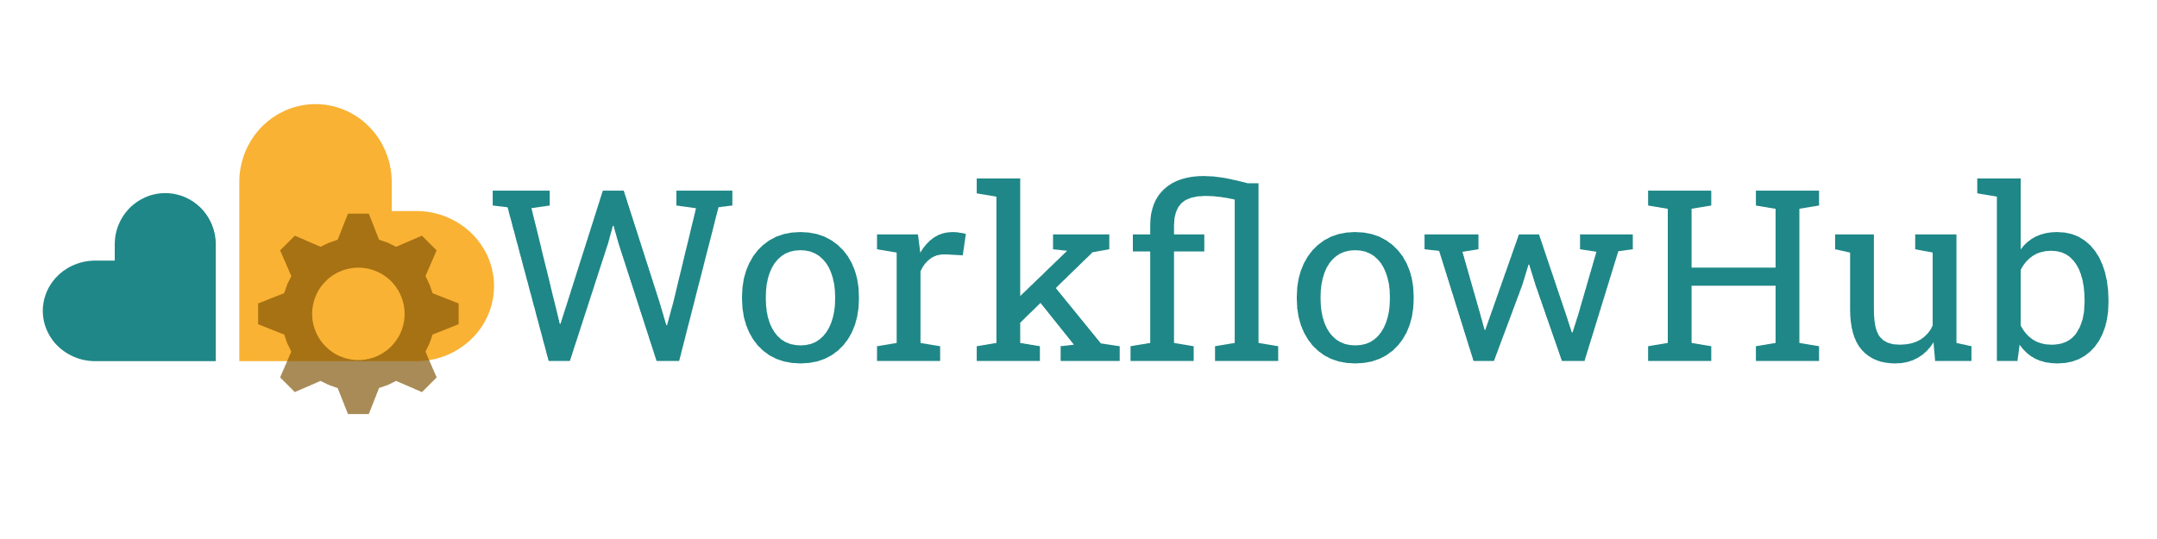
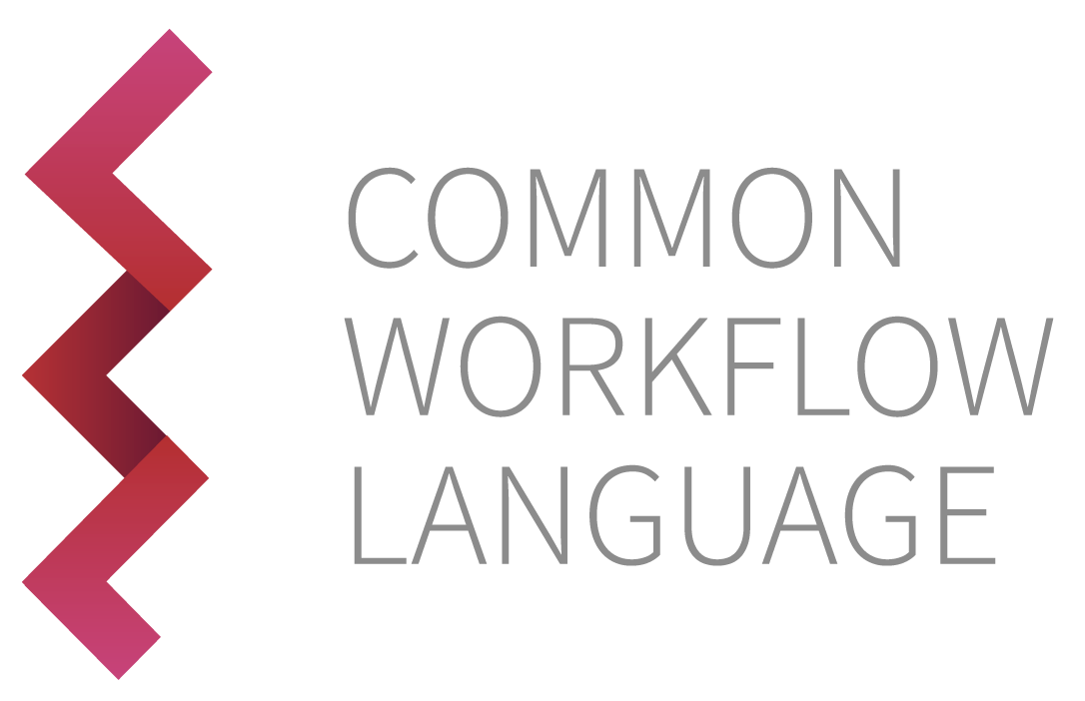
Notes:
Going back to our original motivation for all this
which was to capture missing (meta)data that prevents Interoperability and Reuse.
Regardless of how you run the tool, Galaxy captures the parameters and relationship between datasets in a “History”.
Because everything is recorded, you can re-run previous jobs with 3 clicks.
This information can be embedded in a number of interoperable formats.
Export History or History+Workflow as an RO-Crate.
Export workflows to WorkflowHub, supports CWL.
So by using Galaxy, getting all the relevant information into a single object you can include as you supplementary information is easy.

Slide 11
Other work
Hosting instance of Galaxy (optional)
Developing training material (optional)
Development of underlying software (depends on use case)
Understanding of domain science (depends on use case)
Community building (not optional)
Future plans:
Interactive tools
Integrate with existing authentication
Integrate with existing data pipelines
Notes:
That covers most of the technical work of our journey to expand Galaxy into XAS use cases at STFC.
I’ve not spoken about all the work needed, so a quick summary of other things we did:
Host a Galaxy server: gives you more control, but you can rely on the large public instances mentioned earlier
Develop training material: adding tutorials to the Galaxy Training Network is best practice, but not essential to get started
Effort to develop/understand the underlying software will depend on what software you’re working with exactly
Community building is not optional – or easy. Finding early adopters, getting feedback and so on is crucial.
And finally some stuff that we haven’t done, but it’s possible and we’d like to do:
Interactive tools (for example a Jupyer Notebook rather than the static, form based UI) to make tweaking parameters and making custom plots easier
Integrate with facility infrastructure: authentication, data sources to make process more seamless

Slide 12
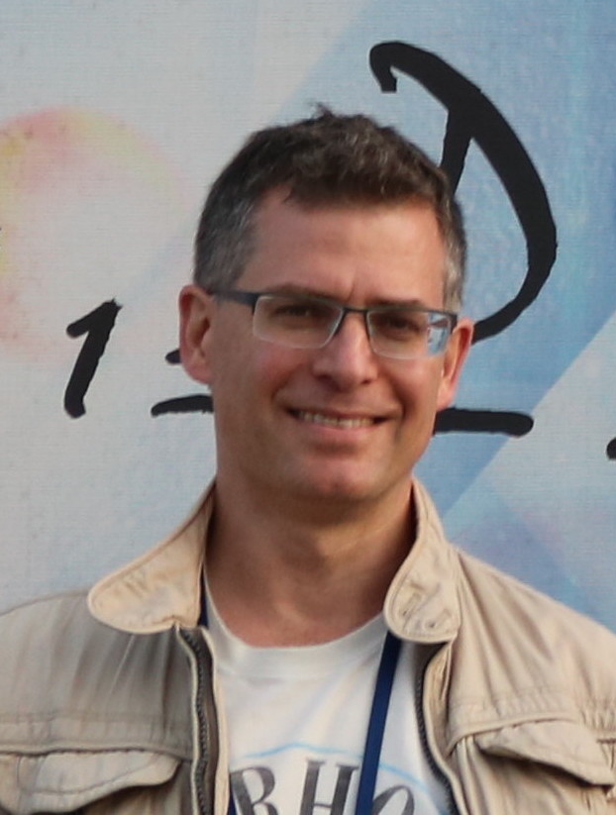
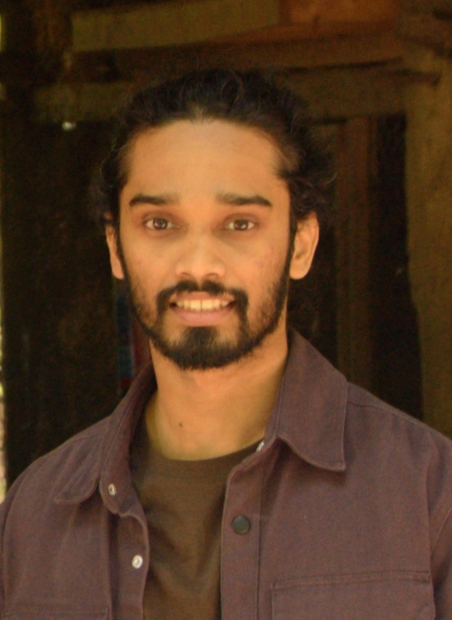



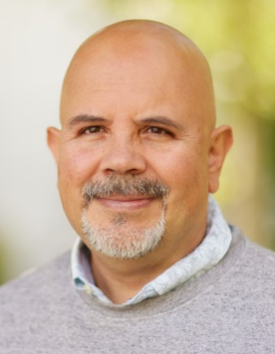
Acknowledgements
LIBORIO
DEVADASAN
AUSTIN
Galaxy Training Network:
training.galaxyproject.org
Galaxy XAS tools source:
github.com/MaterialsGalaxy/larch-tools
Galaxy instances:
materialsgalaxy.stfc.ac.uk (XAS and μSR)
materials.usegalaxy.eu (currently μSR only)
NIEVA DE LA HIDALGA
Notes:
That gives an overview of what it takes to adopt Galaxy, and the practical benefits it can have.
Hope that sharing this is useful to other people considering possible workflow engines.
For general information on Galaxy, there are a lot of existing resources,
and happy to talk about our use case in more detail.
I’d like to acknowledge the rest of the development team.
And our main collaborator at the UK Catalysis hub
In addition, we’ve received funding and support from the other participants in the EOSC ESG project.
and the wider Galaxy community. Wouldn’t be possible without them.
We also receive funding from the ALC and PSDI in the UK.

Slide 13






Science and Technology Facilities Council
@STFC_matters
Science and Technology Facilities Council

Slide 14


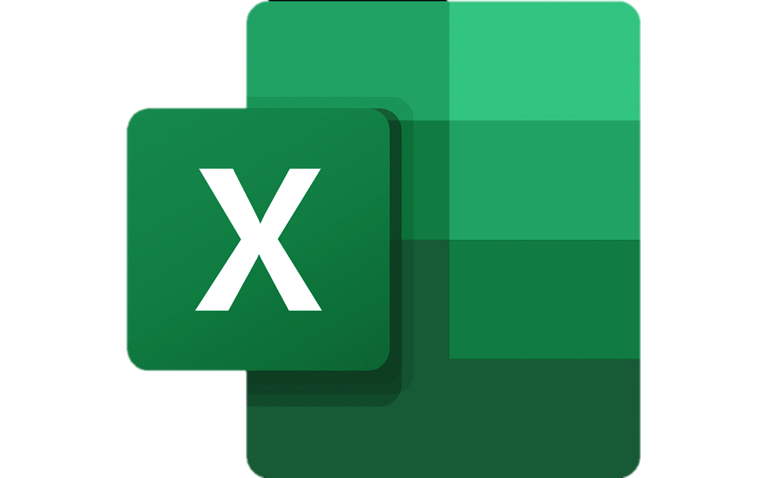
Use case
Data
Metadata
Data
Metadata
Block Allocation Group:
User access and analysis
TAPE
Notes:
One use case we’re involved with is X-ray absorption Spectroscopy data for catalysis experiments run via the UK Catalysis Hub.
Data is gathered at one of the Diamond XAS beamlines, and archived to tape.
Normally users can recall their data themselves using the DataGateway frontend to the ICAT catalogue.
For the Catalysis Hub, multiple users are allocated time as a block.
The data tends to be shared with end users using a combination of Dropbox for the data, and excel to track metadata.
such as which run number is for which sample, and whether it’s worth using or if the noise is prohibitive.
They’re then free to download, analyse, and ultimately publish something.

