Slide 1
Micro Frontends Evolution management of CERN's Accelerator Controls web applications
A. Asko*, S. Deghaye, C. Roderick
On behalf of BE-CSS, CERN
Notes:
Place (ICALEPCS, SA, etc.)
Just say I’m going to talk about micro frontends and move on

Slide 2
Introduction
Micro Frontends - Evolution management of CERN's Accelerator Controls web applications
The CERN accelerators controls domain relies on >30 monolithic web applications
Diverse technology stacks (VueJS, AngularJS, Angular)
Obsolete or unsupported technologies (e.g. AngularJS EoL was on January 2022 & Vue 2 is on December 2023)
Frozen development of new features due to extensive technology migrations
Challenging recruitment of newcomers
Can we transform the process to deliver solutions without long development cycles and repeated migrations?
Notes:
Mention techs but don’t get stack on them. Some of them are obsolete but not in details

Slide 3
Architecture
Micro Frontends - Evolution management of CERN's Accelerator Controls web applications
A new architecture known as Micro Frontends was introduced to tackle the aforementioned issues
Independent applications that can be composed into a greater one
Incremental upgrade and eradication of legacy solutions
Simpler applications with smaller codebases
Autonomous teams with different methodologies/technologies
We evaluated 2 different micro frontend architectures in existing applications
Encapsulation/Composition of modules in SPA
Different URI approach (selected solution)
Notes:
Simpler and smaller but mention you have more as well

Slide 4
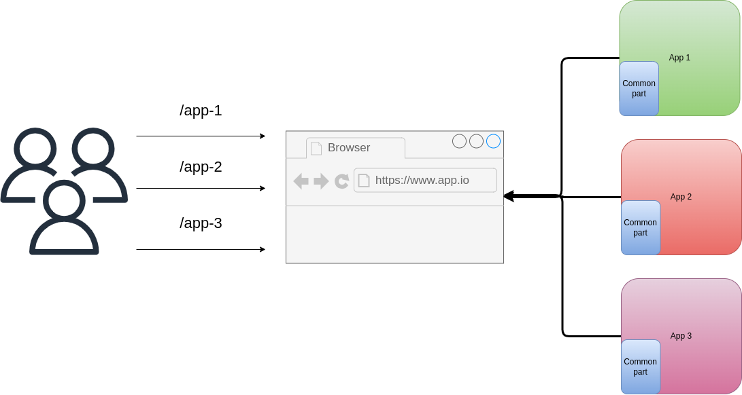
Micro frontend Architecture - Different URIs
Micro Frontends - Evolution management of CERN's Accelerator Controls web applications
Independent and isolated development of each application
Provides granular deployment
Scalability with dynamic loading of each application
Sharing of common functionalities across applications

Slide 5
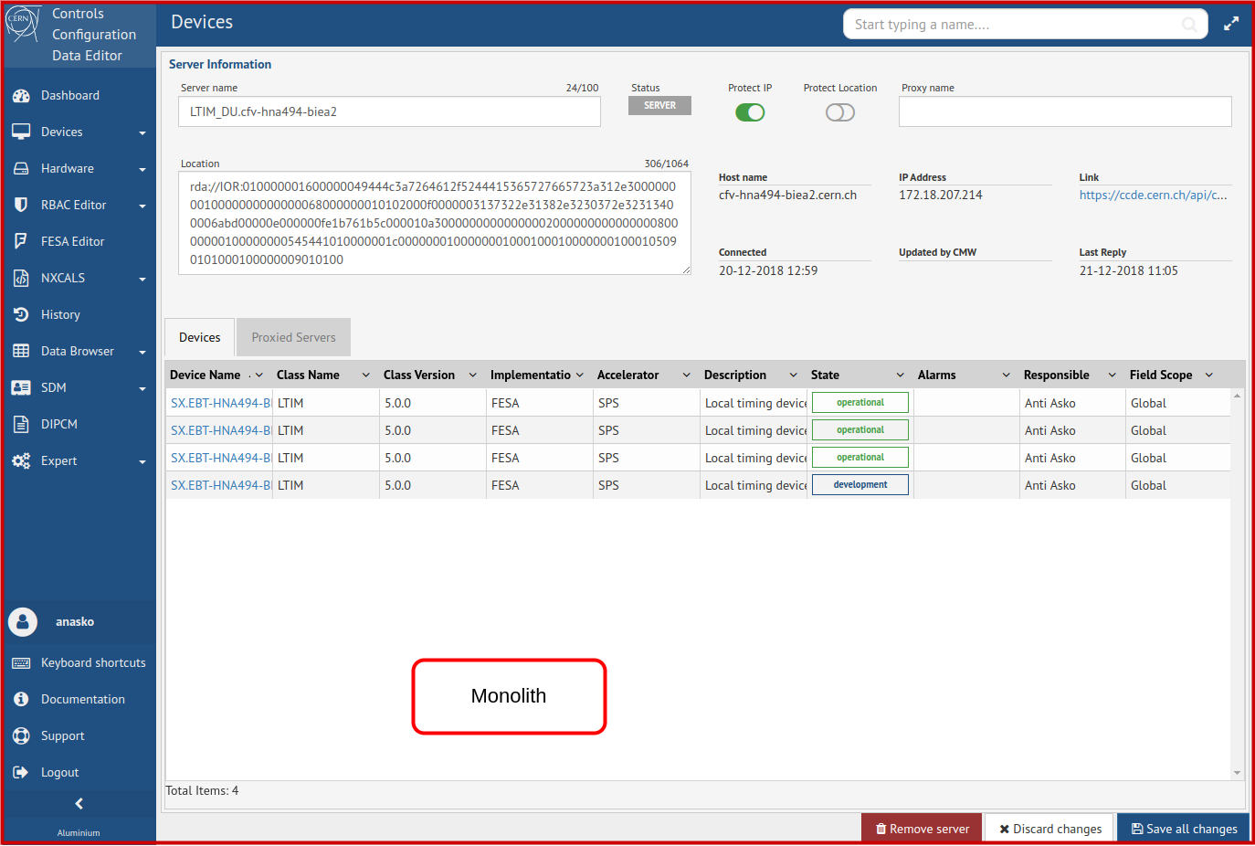
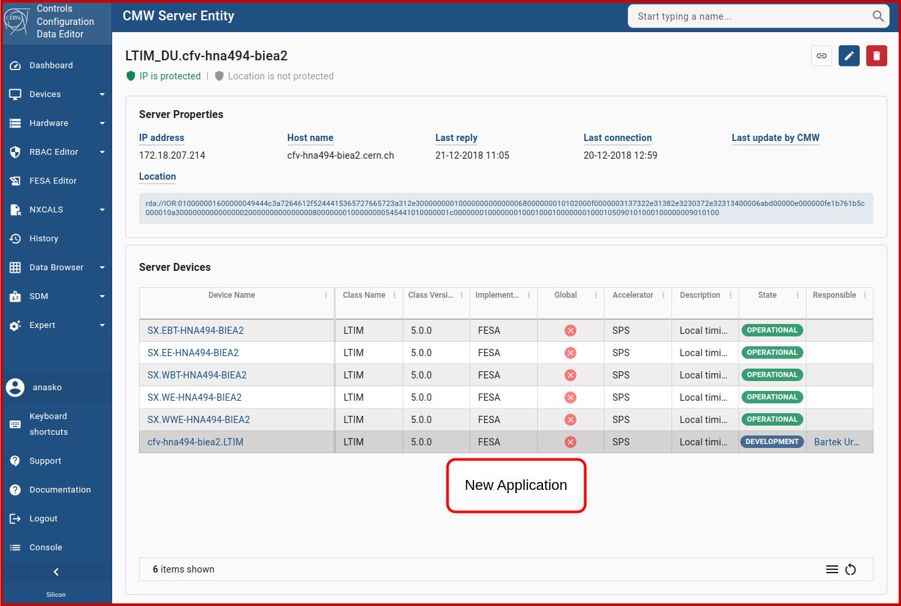
Example - Different URIs
Micro Frontends - Evolution management of CERN's Accelerator Controls web applications
Modules can live as standalone applications
Separation of different applications and teams
Independent deployment and potential lifecycle
Micro frontend URI-based upgrade of CERN’s Controls Configuration Data Editor

Slide 6
Challenges - Size
Micro Frontends - Evolution management of CERN's Accelerator Controls web applications
Application size nearly doubled due to the multiple frameworks under the same application
Caching of the static content on the client’s side After first load, display of the micro frontends is instant
Compression of the static content during transmission Faster loading times depending on the network bandwidth (5.2 MB -> 1.3 MB) 24 seconds -> 1.5 seconds
Improvements are visible on both Monolith and Micro frontends

Slide 7
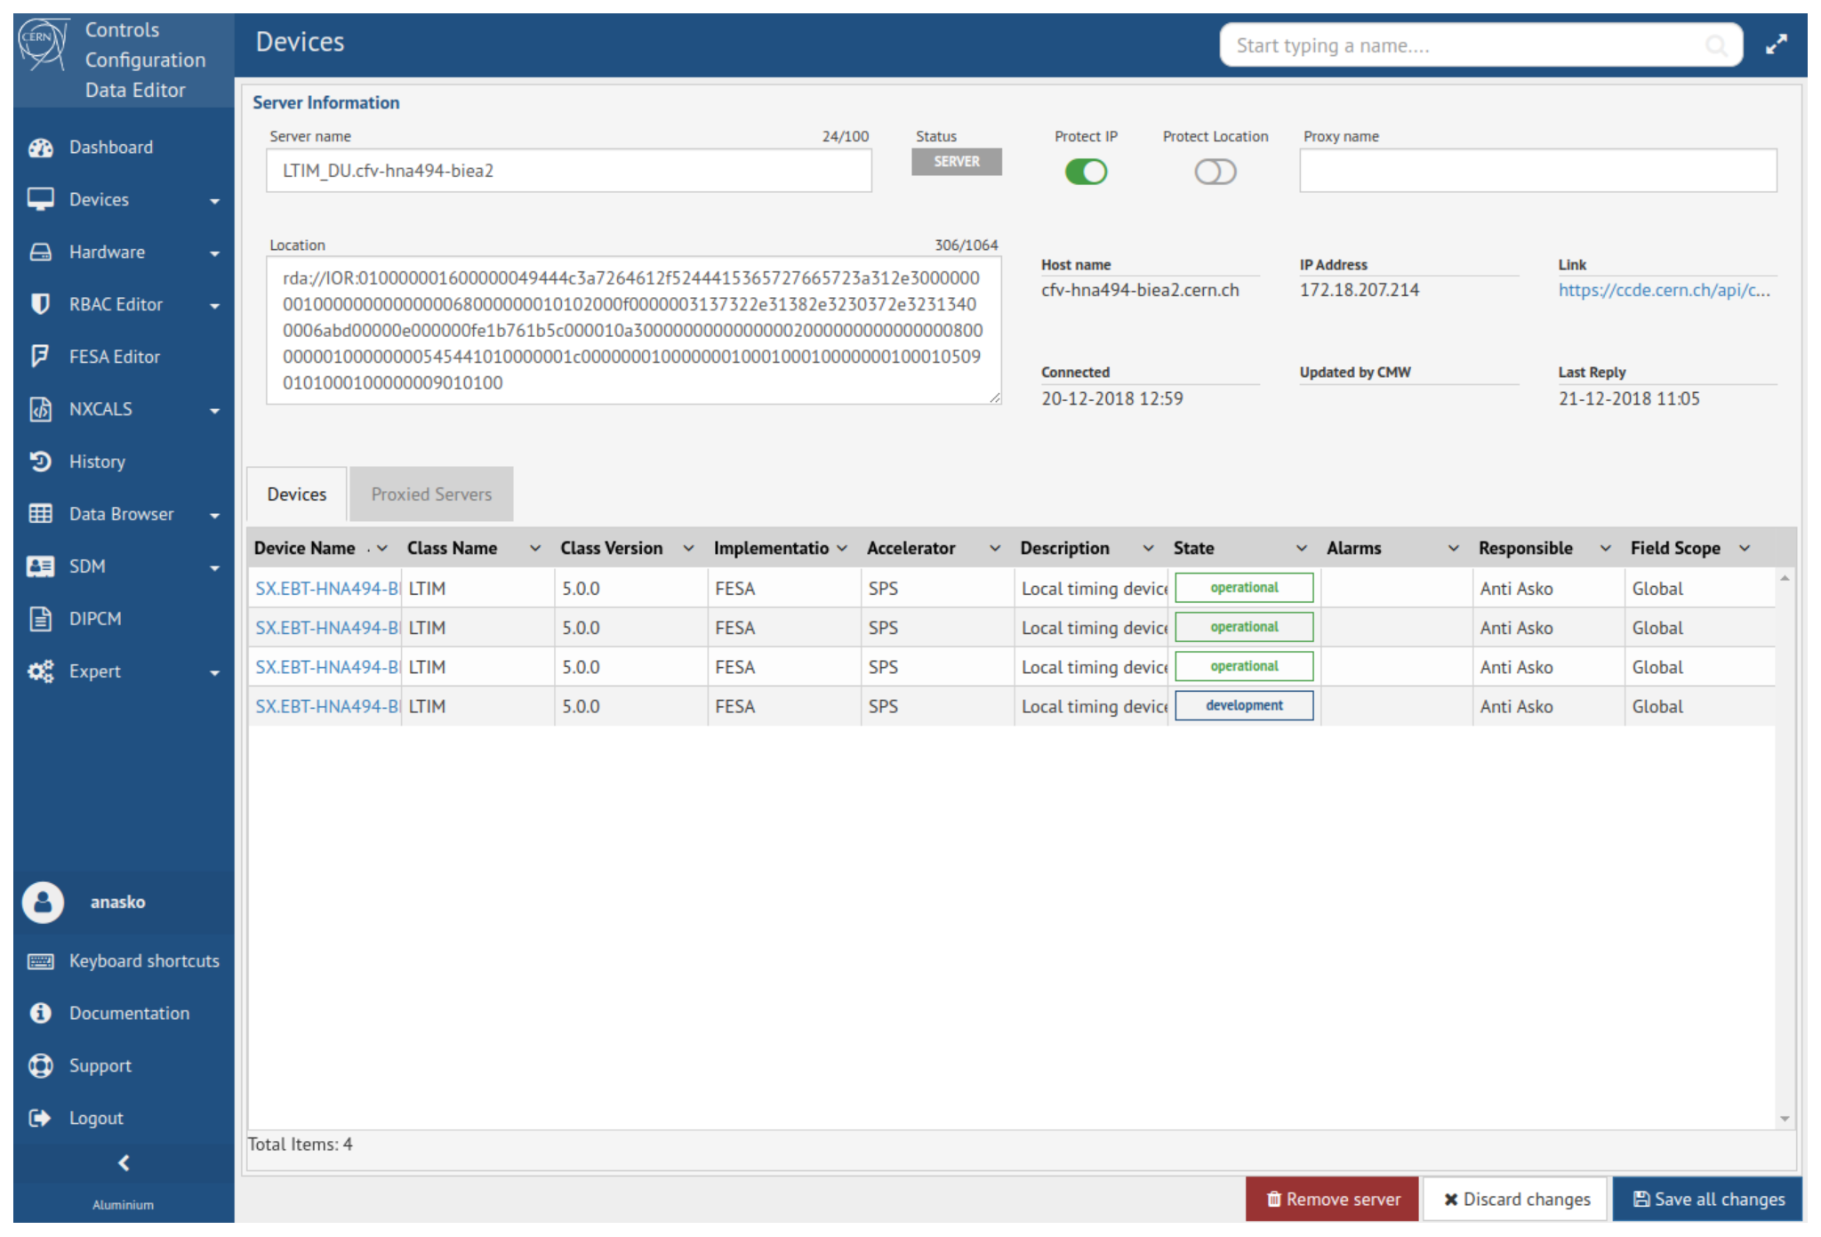
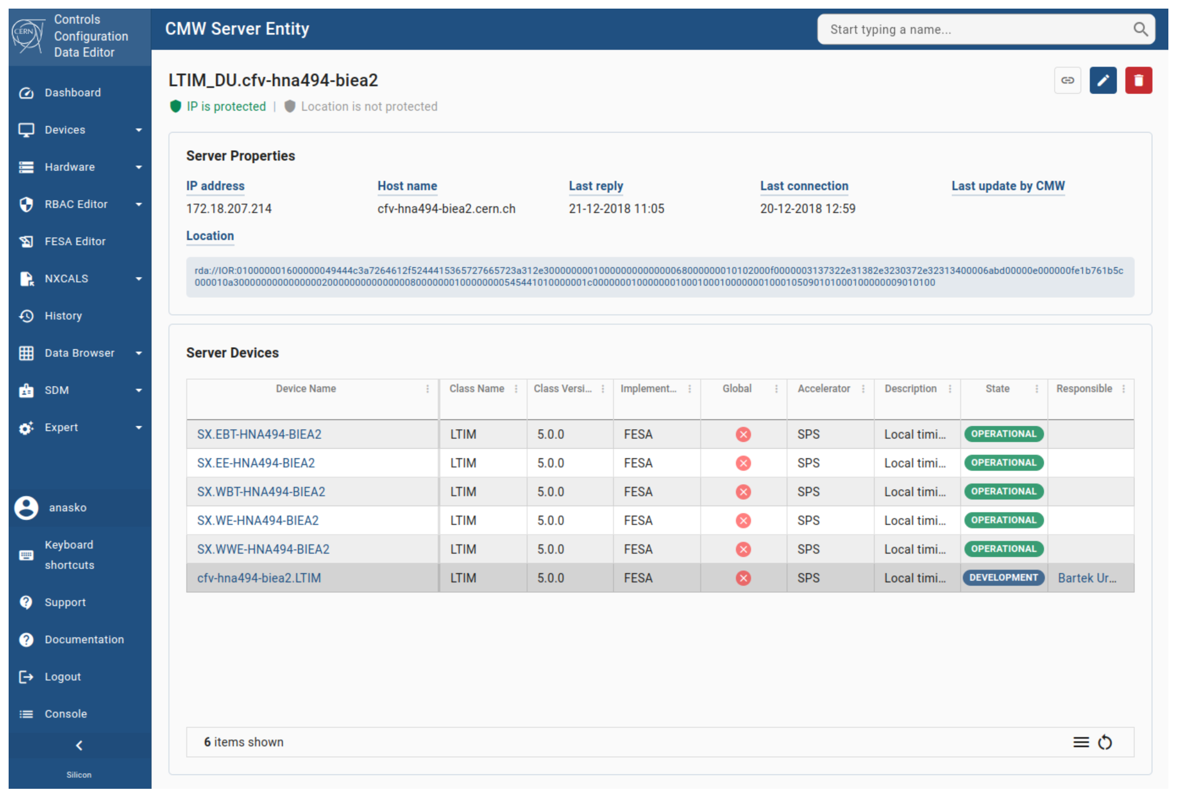
Challenges - Look & Feel
Micro Frontends - Evolution management of CERN's Accelerator Controls web applications
Aim to minimize the differences as much as possible
Provide enhancements in the usability and ergonomics
Micro frontend URI-based upgrade of CERN’s Controls Configuration Data Editor

Slide 8
Challenges - State management
Micro Frontends - Evolution management of CERN's Accelerator Controls web applications
Communication between the applications becomes more challenging due to unawareness of each other
Create rules early and use standard solutions Use standard HTML events (onclick, oninput etc.)
Minimise communication as much as possible Hyperlinks communication
State management is a complicated matter and there is no perfect solution

Slide 9
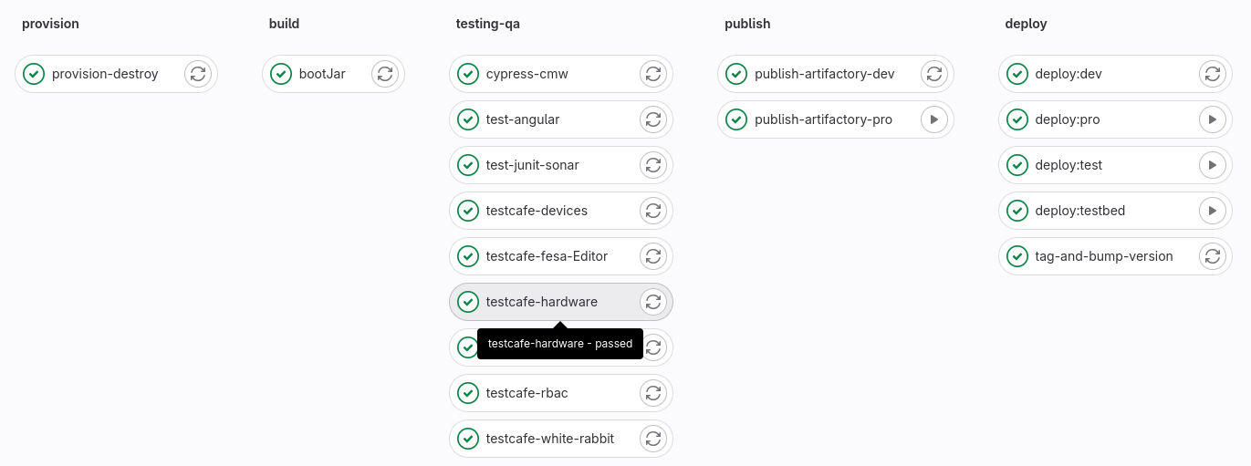
Challenges - Development & Testing
Micro Frontends - Evolution management of CERN's Accelerator Controls web applications
Standardizing testing processes throughout the full stack 80% unit/component testing and 20% integration/e2e testing
CI/CD throughout the whole development lifecycle Complete automation of the process, minimizing human interaction

Slide 10
Development Workflow - Evolution
Micro Frontends - Evolution management of CERN's Accelerator Controls web applications
A task force team was established to work on multiple projects in an iterative approach
Focused development on requested features
Quick iteration between projects (3 to 4 three-week sprints)
Domain knowledge provided by the different Product Owners
Preparation is key before initiating development of a new micro frontend application
Technical knowledge transfer is facilitated through the team while accessing multiple domains

Slide 11
Development Process - Contribution
Micro Frontends - Evolution management of CERN's Accelerator Controls web applications
Establishing a common set of technologies in all micro frontend applications and minimising delivery time has increased collaboration with other teams
Contribution of new application modules following our common standards
Knowledge transfer between the different teams
High return on investment with solutions quickly provided to users
Synergies are facilitated and willingness to contribute has increased

Slide 12
Conclusions
Micro Frontends - Evolution management of CERN's Accelerator Controls web applications
After 2 years of experience we have solidified our micro frontends development process
Lessons learned:
Establish a standardized set of tools/frameworks and processes
Some code duplication is inevitable between the old and new applications
A well-defined application scope should be defined early on
Aim for lightweight solutions if possible with the bulk of the business logic in the backend
Micro frontends help to embrace inevitable changes in the web development ecosystem

Slide 13
Technology stack
Micro Frontends - A new migration process for monolithic web applications (FR2BCO04)
Frontend:
Angular a mature, feature-rich framework
Angular Material a powerful UI component library
Backend:
Spring boot ecosystem a Java based, enterprise framework
Gradle an advance build automation tool

Slide 14
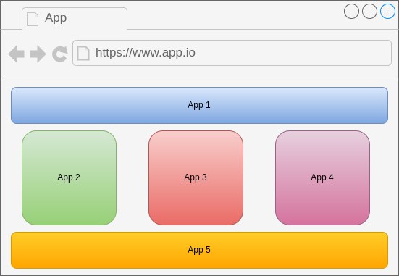
Micro frontend Architecture 1 - Single Page Application
Micro Frontends - A new migration process for monolithic web applications (FR2BCO04)
Encapsulation of specific functionality and reusability
Impose isolation to prevent unintended conflicts with other components
Interoperability allowing integration of multiple libraries and frameworks

Slide 15
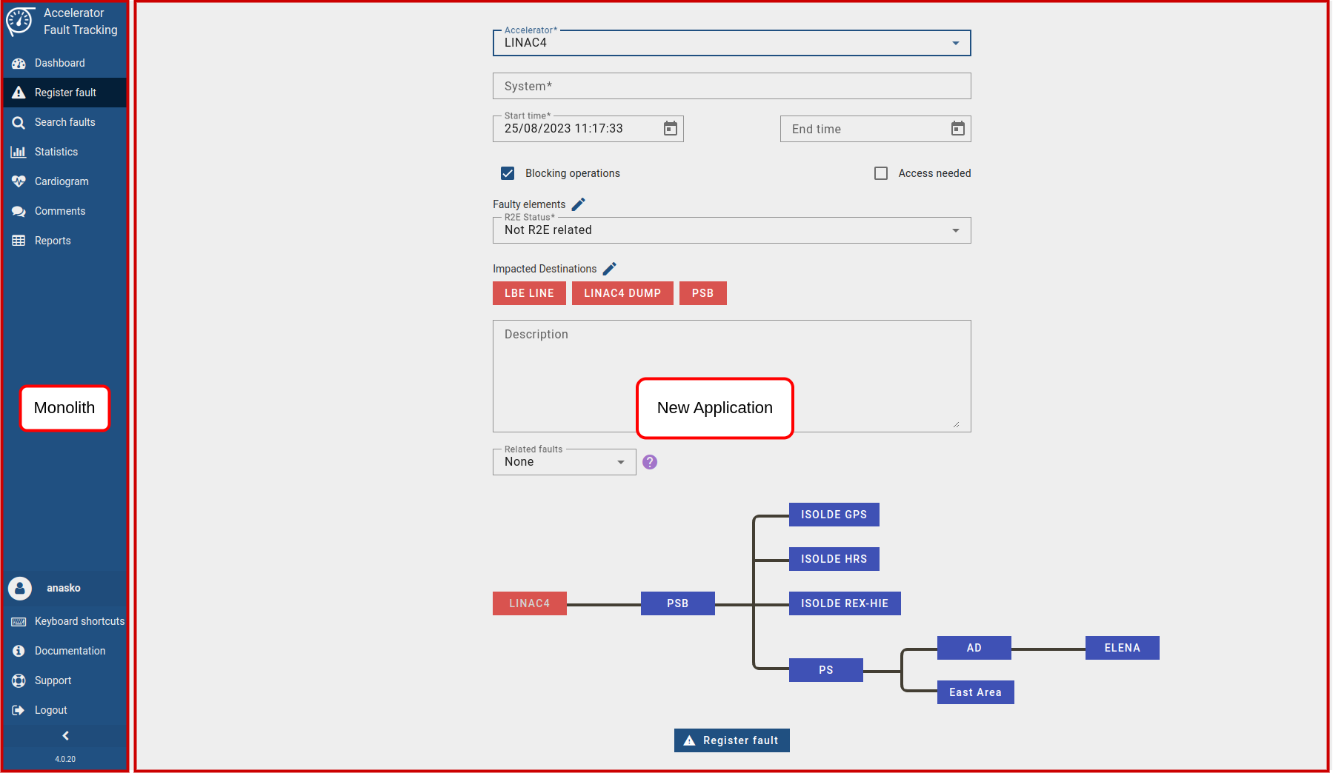
Example - Single Page Application
Micro Frontends - A new migration process for monolithic web applications (FR2BCO04)
Your micro frontends are within a Single Page Application
Integration & communication between the different applications
Urgent development of small features
Micro frontend SPA-based upgrade of CERN’s Accelerator Fault Tracking (AFT) system

