Slide 1
Web Applications to Support X-ray Spectroscopy Experiments
Jacob Filik

Slide 2
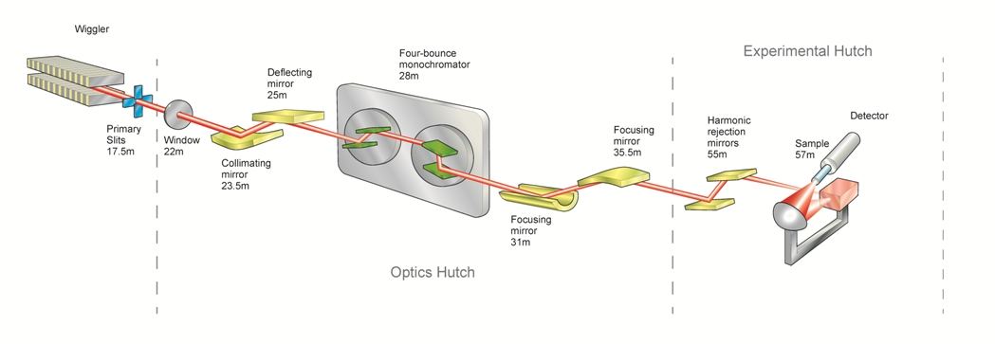
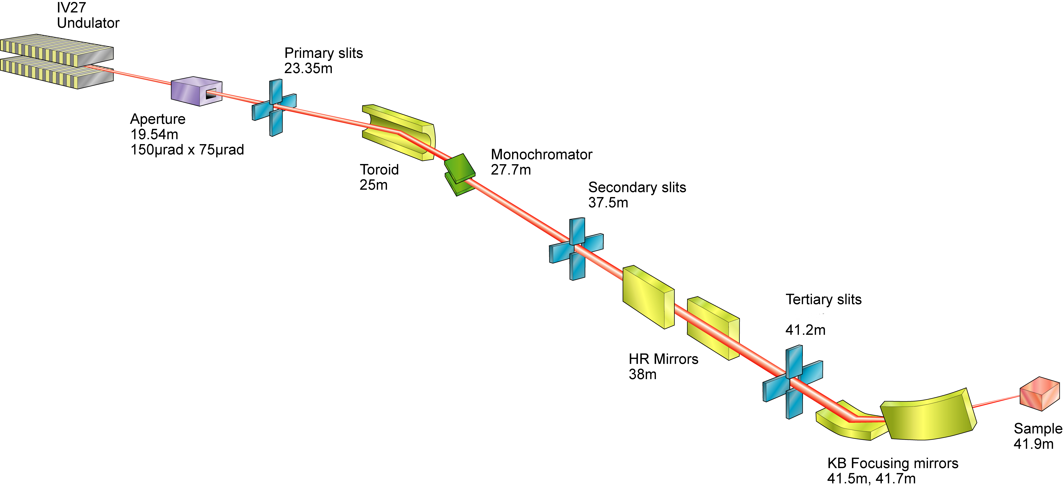
Spectroscopy Group
B18-Core XAS High Throughput Operando Experiments
I20-Scanning XAS on Challenging Samples, XES
I18-Microfocus μ-XRF, μ-XAS, μ-XRD
Adding the time resolution:
Fast scanning (Quick-EXAFS)
Needed to study dynamic phenomena
SWIFT – Coming soon(-ish)…

Slide 3
Web Applications?
Simulation as a Service
Web-CONEXS
(Yet Another) Reference Data Database
Yes, I know about xaslib, NIMS-MDR, FAME-SSHADE, CLS-xasdb, Farrel Lytle, RefXAS…

Slide 4
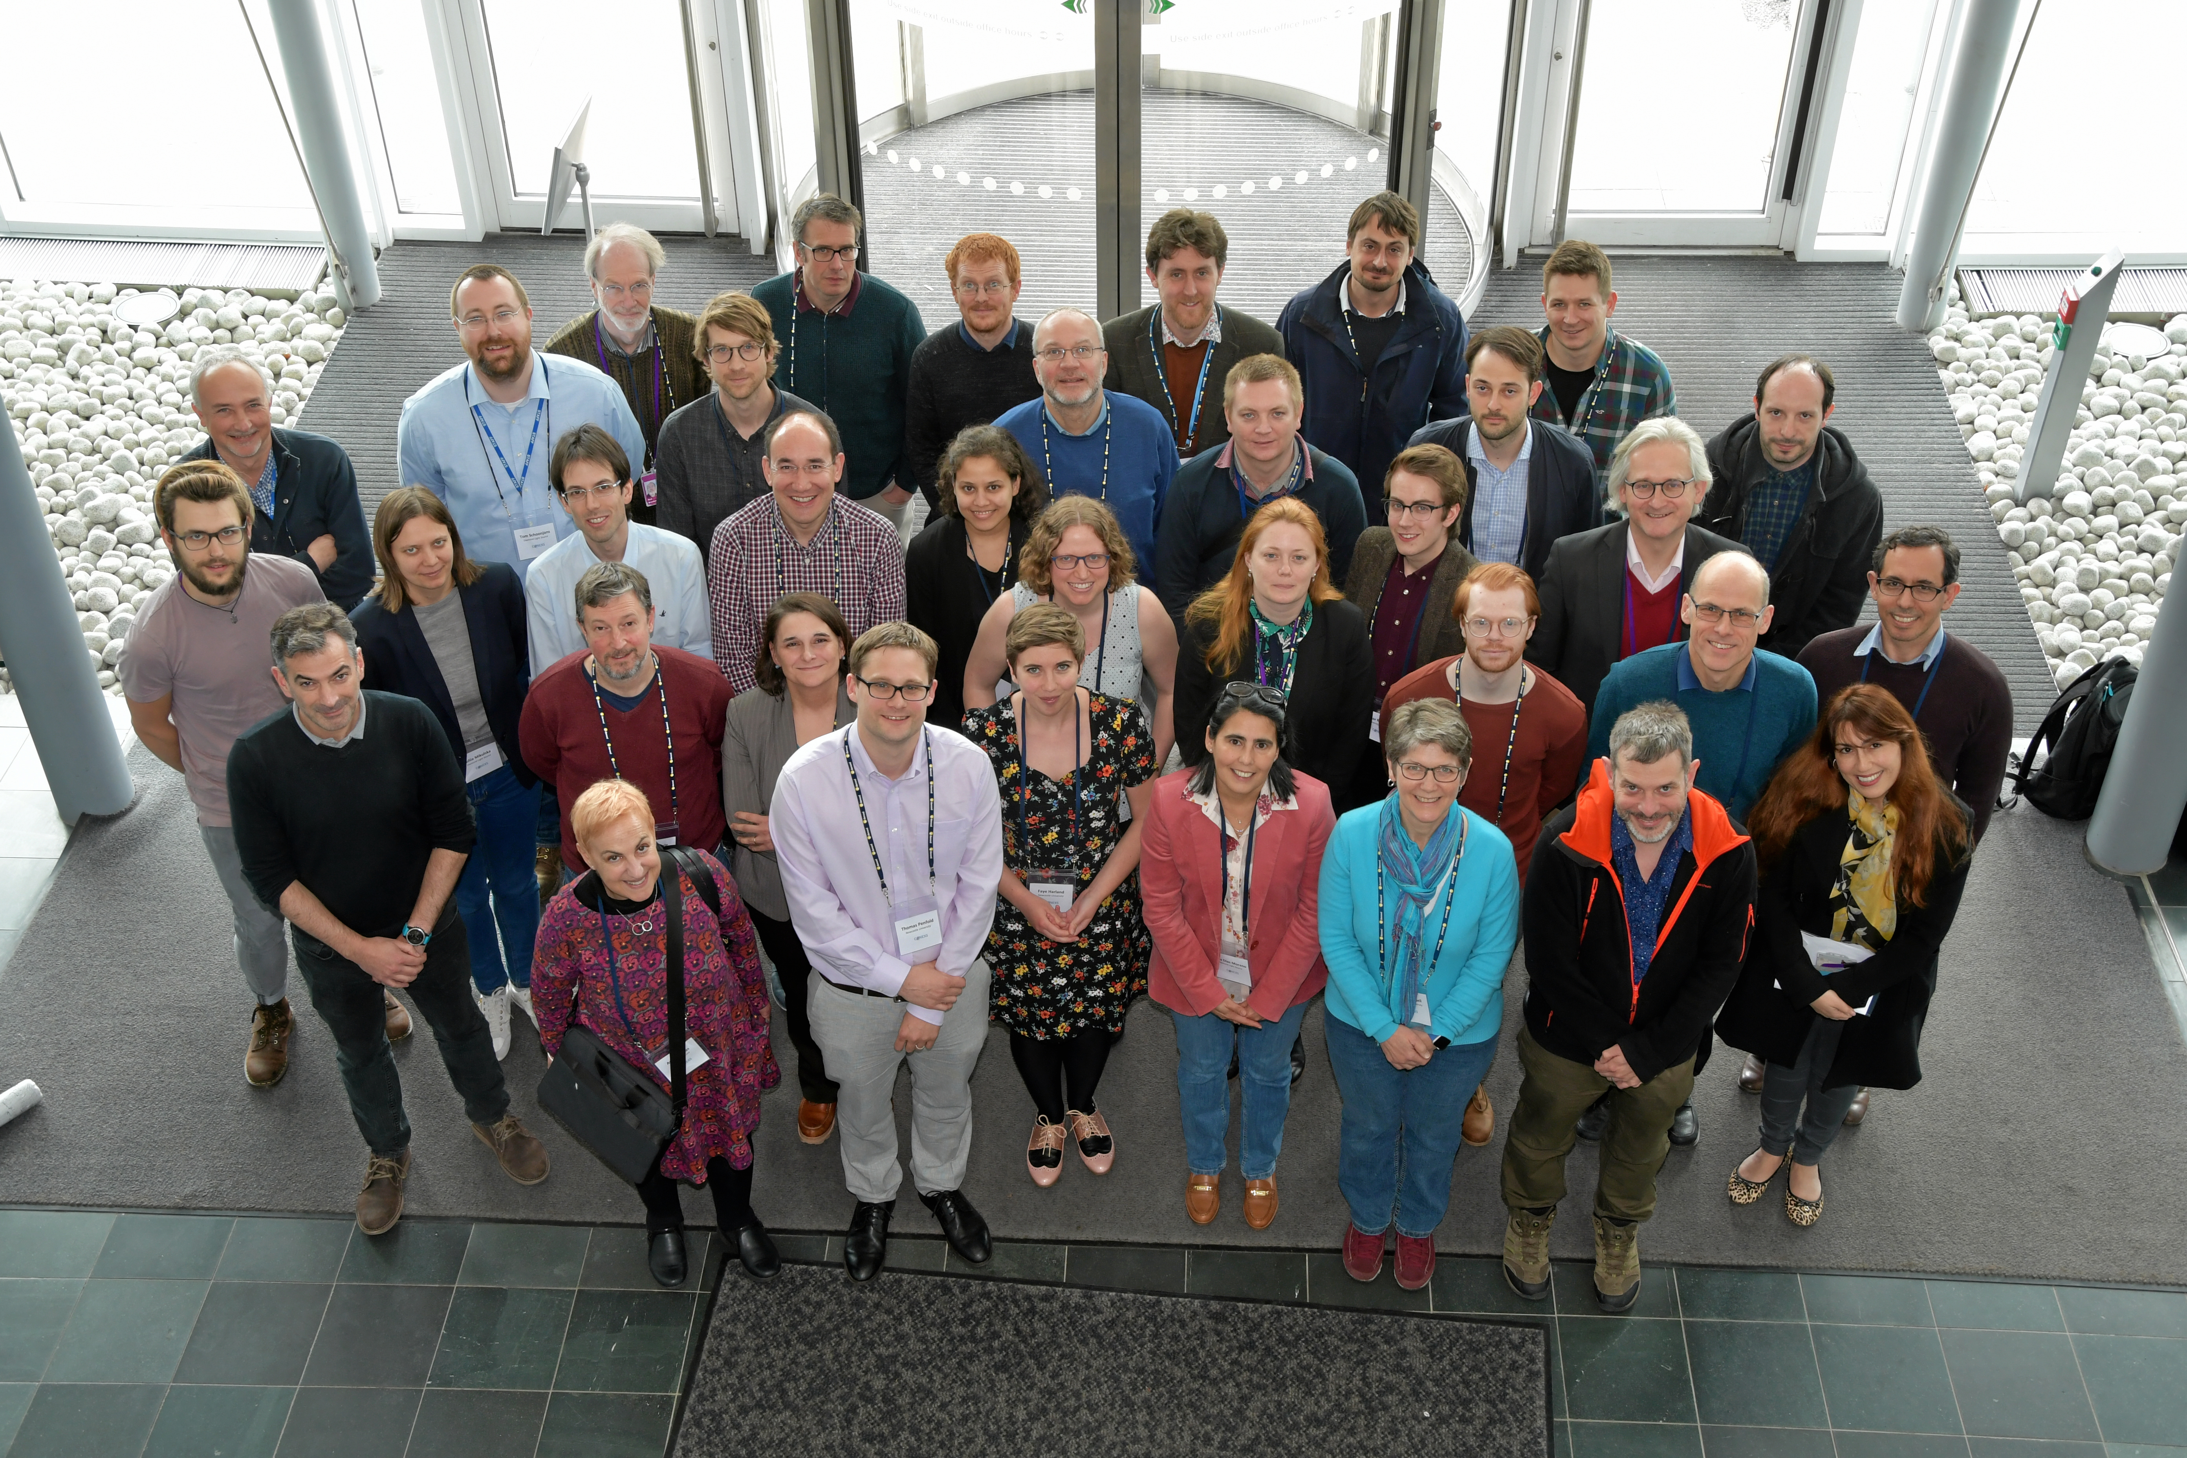
CONEXS: COllaborative NEtwork for X-Ray Spectroscopy (2019)
(T. Penfold, S. Diaz Moreno) https://research.ncl.ac.uk/conexs/
An EPSRC-funded network supporting synergy between experimentalists and theoreticians in X-ray spectroscopy.
Hosted four Conferences and three (hands-on) training workshops from 2019 to 2023, a webinar series and is responsible for the creation of the Web-CONEXS platform
HPC-CONEXS (2023)
(T. Penfold, S. Diaz Moreno, J. Elliott, A. Regoutz, R. Maurer, C. Rankine, R. Ingle)
UK High-End Computing Consortium for X-ray Spectroscopy, successor to the CONEXS network grant
Provides access to introductory (Web-CONEXS) and Tier 1 & 2 HPC facilities for X-Ray spectroscopy calculations.
Dedicated expansion to the Web-CONEXS platform.
Grant Nos. EP/S021493/1, EP/S022058
Grant No. EP/X035514/1

Slide 5
Web-CONEXS
https://www.ispyb.diamond.ac.uk/conexs
Web-CONEXS: an in-road to theoretical X-ray absorption spectroscopy, J. D. Elliott et al. J. Synchrotron Radiat. (2024) 31 1276

Slide 6
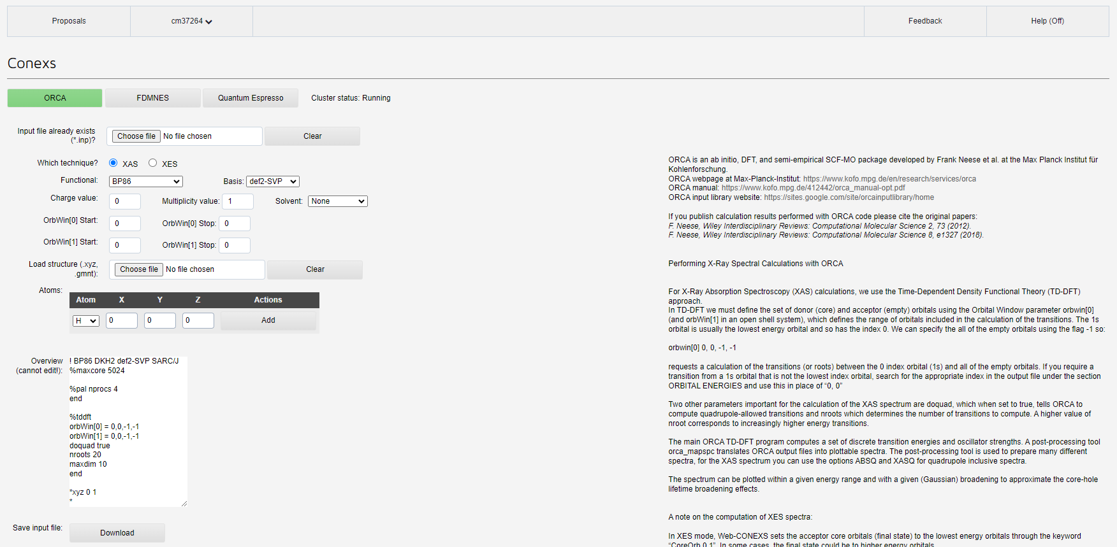
Web-CONEXS

Slide 7
Strengths
Simple MVP
Deployed for ~ 2 yrs
Reuses existing systems, quick to produce, easy(-ish) to maintain
Weakness
UX isn’t great…
Hard to update/extend
Service integration could be better

Slide 8
Web Application Policy @ DLS
The future is likely to hold many web applications…
Policy & Guidelines documenting standards and recommended technologies
Approved technologies
Auth/Auth
Rest API/Service design/GraphQL
User Interfaces
Web Access Firewall Policy

Slide 9
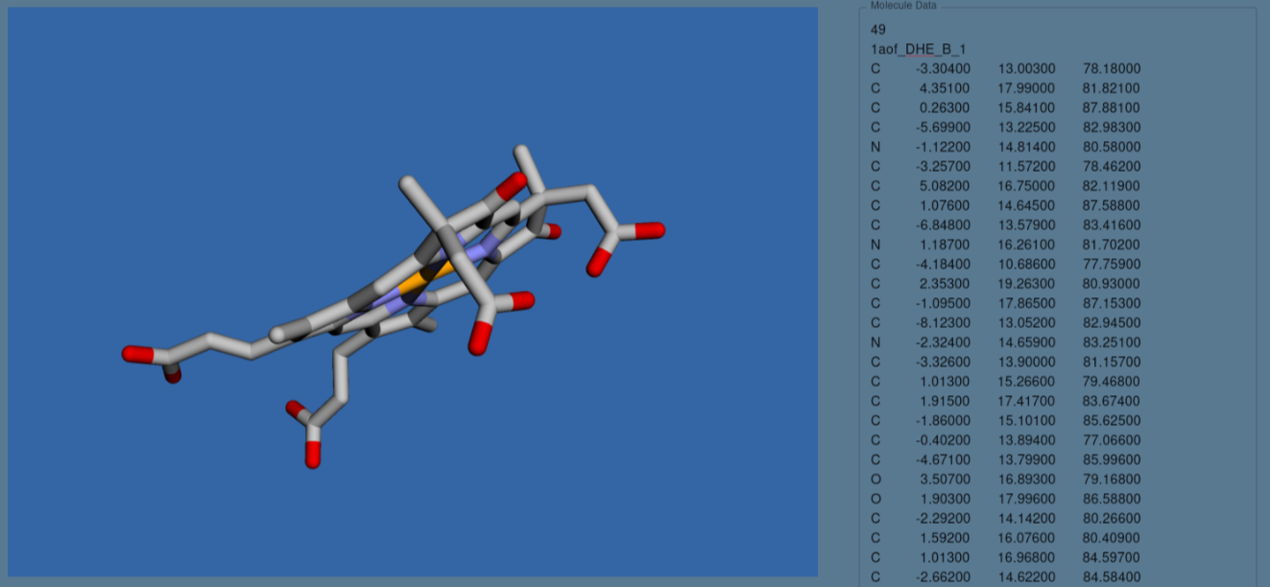
Web-Conexs v2
React, MUI, FastAPI, PostgreSQL, OIDC, Slurm, Kubernetes, Helm…
Tentative steps towards new UI in progress
Create, validate and view molecular/crystal structure
Monitor output file as calculation progresses
Simple viewer for simulated XAS result

Slide 10
Web-CONEXS v2
https://www.conexs.diamond.ac.uk
/auth
/api
/

Slide 11
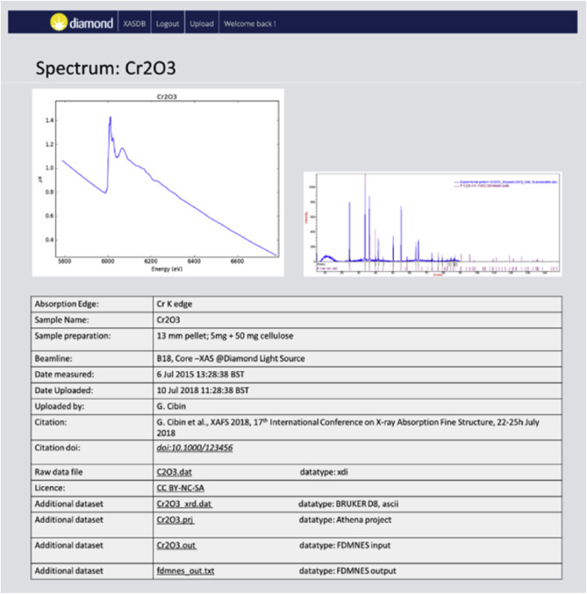
Open Access, Integrated XAS Data Repository
There are lots of XAS reference data repositories…
https://xafs.xrayabsorption.org/databases.html
DLS version – XDI, Django, SQL, Identity provider… - Deployment hard
See previous slide on DLS policy
An open access, integrated XAS data repository at Diamond Light Source, G. Cibin et al. Radiat. Phys. Chem. (2020) 175 108479

Slide 12
XAS Data Repository v2
https://www.xasrefdata.diamond.ac.uk
/auth
/api
/

Slide 13
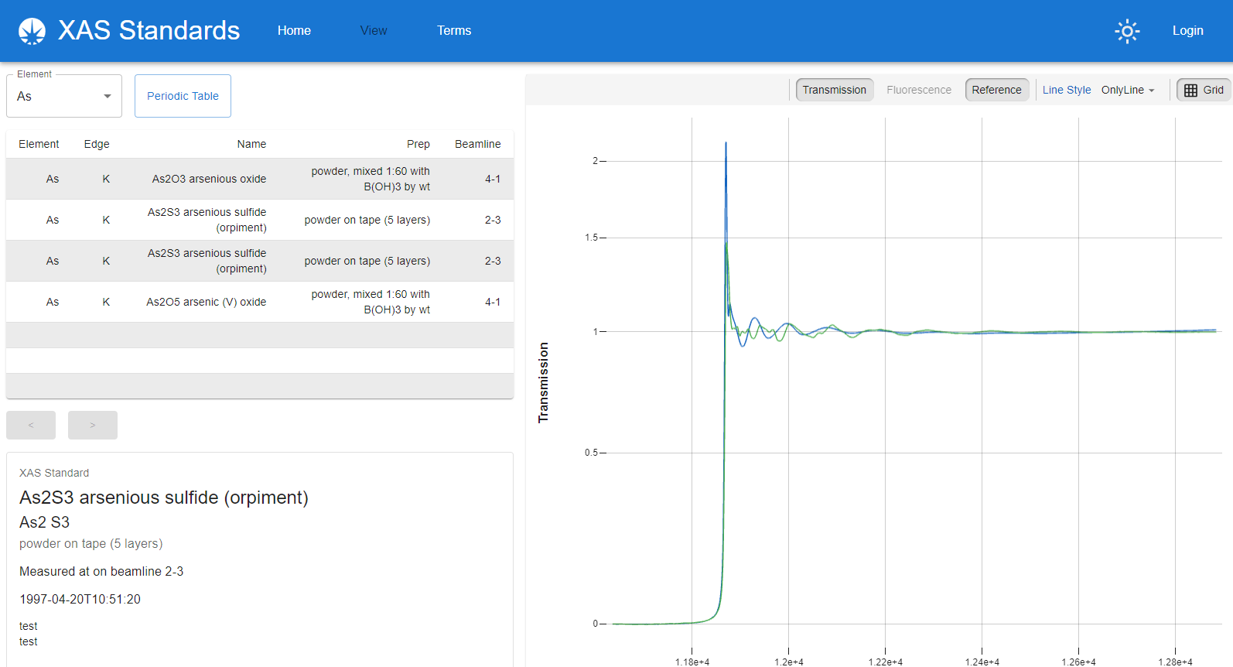
XAS Data Repository v2
This is a lot to maintain to have a UI in front of “an indexed repository of text files”…
https://github.com/DiamondLightSource/xas-standards-app

Slide 14
XAS Data Repository v3

Slide 15
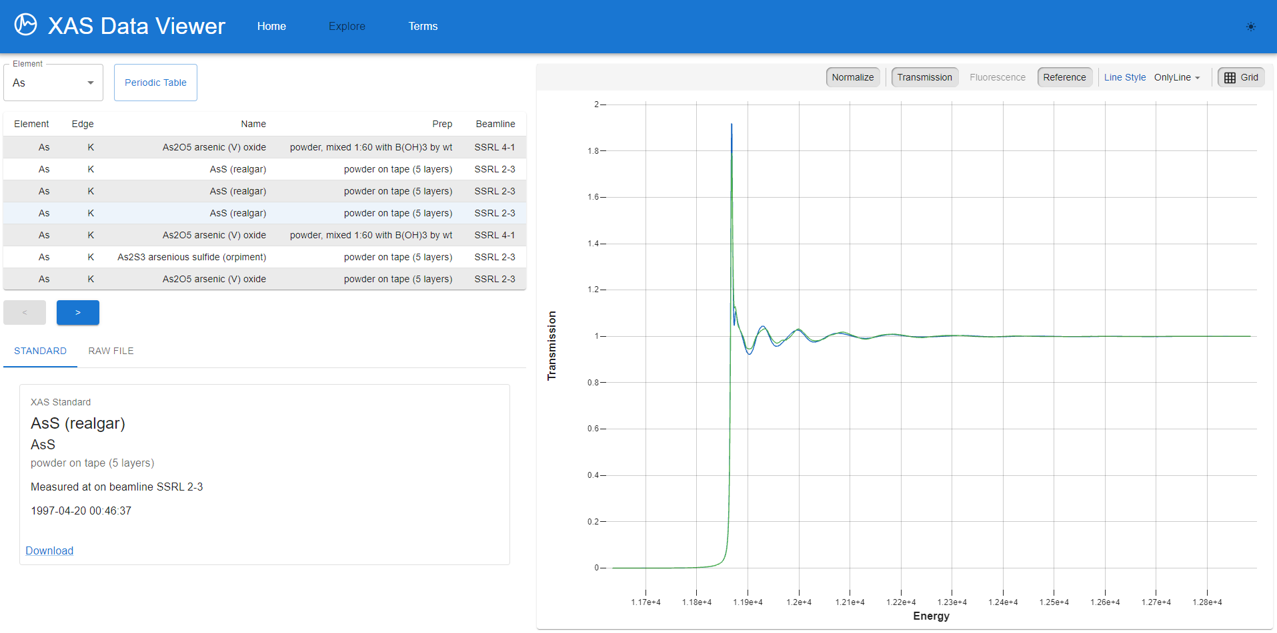
XAS Data Repository v3
React, MUI… GitHub? – XDI is just text after all…
Repo for XDI data
Repo for React UI code
GitHub Action builds UI, adds data to distribution, generates index and uploads to GH pages
https://github.com/jacobfilik/webxdiviewer http://jfilik.com/webxdiviewer

Slide 16
Summary
We are making/updating our spectroscopy web applications
We are following central DLS policy and guidelines
Web-CONEXS
Simulation as a Service
Currently tightly tied to DLS
Version 2.0 should be better/more friendly/deployable elsewhere
XAS Data Repository
Version 2 - “Full Stack Deployment” internally on DLS Kubernetes, code on GitHub
Version 3 - “GitHub Pages Deployment” – with data from XASDataLibrary on my GH pages
Version 2 vs Version 3 decision with the scientists

Slide 17
Acknowledgements
Sofia Diaz-Moreno, Giannantonio Cibin, Joshua Elliot, Thomas Penfold
Victor Rogalev, Mihai Duta, Chris Reynolds, Garry O’Donnell, Karl Levik, James Hall, Tamoor Shahid, Tom Schoonjans, Nigel Wilson…

