Slide 1
The High-throughput Data I/O framework for HEPS
Fu Shiyuan
IHEP, CAS

Slide 2
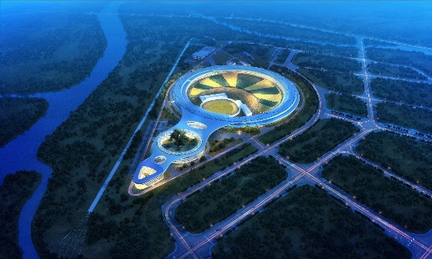
Introduction for HEPS
HEPS：High Energy Photon Source
Include multi beamline
HEPS will generate a huge mount of data
In which the data volume generated by B7 is the most
The huge mount of data will give great pressure to storage and computing

Slide 3
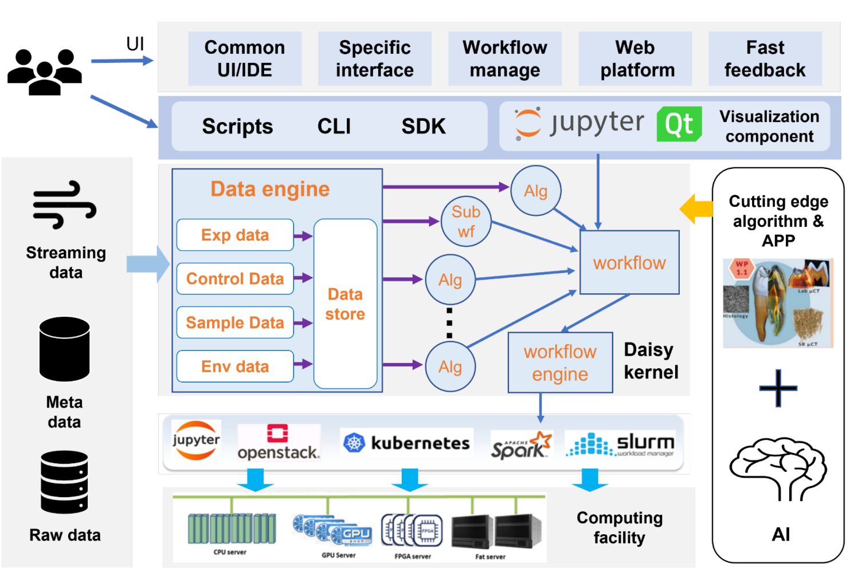
About Daisy
Daisy is a data analysis software framework designed for HEPS
Derivative technology modules to meet the data processing requirements of advanced scientific facilities
Data object management module for high-throughput data I/O, multimodal data exchange, and multi-source data access.
Scalable cluster computing power support for data processing with different scales, different throughputs, and low latency.
Interface and developing environment for scientific software integration and development.

Slide 4
Daisy Data Engine
Daisy
Workflow
Data engine
Data Source
Provide a unified interface for different applications.
HDF5
Goal: Unified + Optimized
Different application interface parameters
Different data formats
Different application IO method libraries
Different parallelism levels
Different data sources
Asynchronous/parallel /prefetching...
Task
schedule
read
alg_B
alg_A
write
Read data from different sources and in different formats.
Write data in multiple formats to disk.
TIFF
Compute engine
Support parallel computing.
Resource request
Task
assignment
Status
monitor
……
Data
Metadata
Read the data required by the computing nodes.
Write the results of the computing nodes to disk.
Use Sniper's DataStore to register and access intermediate data during the computing process.
Compute cluster
Data stream
Heterogeneous computing resources

Slide 5
Daisy Data Engine
Design and implement HEPS I/O optimization methods, and integrate them with Daisy.
To address the diverse applications of HEPS, shield the differences in underlying data (source, format) → unify the I/O interface
Alleviate the severe IO bottleneck issues in HEPS-related applications and accelerate scientific processing → Batch Processing Acceleration & Parallel Acceleration
Avoid I/O bottlenecks caused by data writing and reading on disk→ stream processing I/O support.
1
IO Interface
3
DAQ
2
Stream Processing
Batch Processing
Storage

Slide 6
Unified I/O interface
Unified different applications' IO parameters, different file formats, and different data sources.
Different applications can quickly adapt to data IO through configuration.
It can automatically identify the IO methods corresponding to file formats, allowing the same application to read different data formats without changing the IO interface.
It provides tools for converting between different data formats.
1
before
Different applications
after
Infile
Outdir
BatchSize
Roi
…
Different applications
Different format
TIFF IO
DaisyIO
LoadData/
SaveData
HEPSCT
HEPSCT
Daisy IO Interface
HDF5
2
DaisyIO
ConvertData
HDF5 IO
TIFF
3
UFO
UFO
DaisyIO
LarchIO
……
4
Storage
Dat
XAS
Larch IO
XAS
……
Storage
Storage
Different IO lib

Slide 7
Speedup batch processing
Batch processing I/O optimization for computational acceleration
optimizing for different data formats
HDF5 direct I/O
Pre-allocate memory to avoid additional time
consumption for memory copying.
multi-threading acceleration for TIFF
Specific applications’ I/O optimization
asynchronous I/O for HEPSCT (increased by 25%).
Data prefetching strategy
based on producers and consumers module.
HEPS application can determine the data being read.
Set a prefetch queue to control the amount of data being read.
Using Python to call the .so file and read TIFF data with multiple threads.
Compile a .so file for use in Python.
Using Cython to call C++ function
Implementing multithreading in C++.
ReadTiff.pxd
ReadTiff.h
ReadTiff.py
ReadTiff.so
ReadTiff.pyx
ReadTiff.cpp
read
Preprocess
reconstruction
postprocess
write

Slide 8
Parallel computing
Issues to address:
How to partition data (split by rows, by frames, block sizes for partition)
How to access data to the corresponding computing nodes
How to interface with the computing engine
How to ensure the sequential order of computation results in a distributed environment

Slide 9
Parallel computing
partition data access work with computing engine result store
Introduce the dimension parameter axis and batchsize to determine the splitting method and block size.
Way 1: batchsize is the amount of data that a single process needs to read.
Way 2: batchsize is the total amount of data that all processes need to read. √
- This approach allows for a more concise user setting that is not influenced by the number of processes.
original
after partition

Slide 10
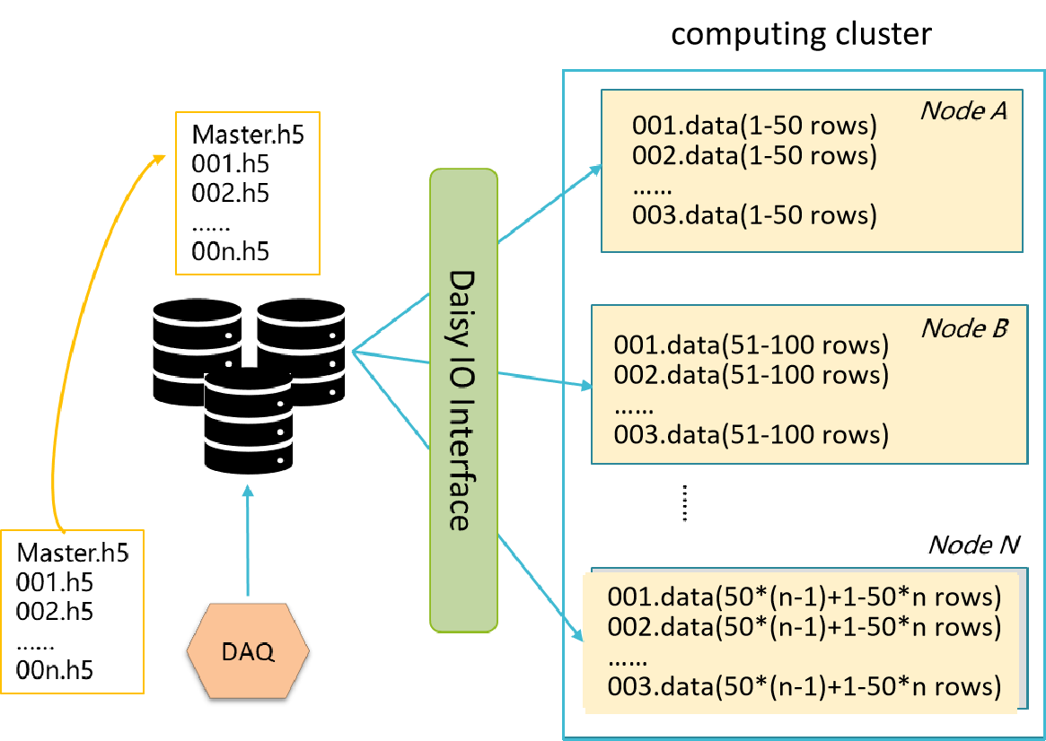
Parallel computing
partition data access work with computing engine result store
Set global process count and current process index.
Determine the splitting method based on axis, batchsize, and the global process count.
Identify the data block that needs to be returned based on the index.

Slide 11
Parallel computing
partition data access work with computing engine result store
The computing engine passes the global process count during the initialization phase of LoadData.
Do not change the original interface usage method, only add parameters to the configuration dictionary.
define workflow
LoadData
define workflow
LoadData
LoadData.exec()
Node 1
LoadData.exec()
Node 2
init
LoadData.init()
init
Parameters related to parallel computation are passed in
LoadData.init()
LoadData.exec()
Node 3
Master
run
LoadData.exec()
Node 0

Slide 12
Parallel computing
partition data access work with computing engine result store
For writing files, support file name templates to ensure consistency in the writing interfaces for HDF5 and TIFF files.
Ensure the ordering of parallel writes: add the process index as prefix of the file names.
Providing workflow templates and basic IO functionality examples for continuous improvement to facilitate the integration of new workflows by users/developers.

Slide 13
Daisy Stream I/O
Background:
Data is processed after being written to disk.
Issues:
IO bottlenecks may significantly impact the efficiency of scientific computing.
There is a need for quick visualization of small amounts data.
Goal:
To avoid IO bottlenecks caused by writing data to disk and then reading it by implementing a data streaming approach.
Methods:
Design and implement the streaming data processing
Define data stream interface parameters
Develop the unified modules for streaming data access, parsing, management, and retrieval.
IO Interface
DAQ
Batch process
Storage
Distributed Memory
IO Interface
DAQ
StreamProcess
BatchProcess
Storage

Slide 14
Daisy Stream I/O
To meet the needs of HEPS, a streaming data processing based on Flink and Alluxio has been designed.
Flink is responsible for receiving data streams from different DAQ systems, parsing arrays, assembling, and performing some simple processing.
Alluxio is responsible for temporarily storing the data processed by Flink for access by the computing platform.
Stream-process Job A
Daisy IO
Daisy computing engine
json
dict
result
1.dat
DAQ A
Path_A
json
dict
result
2.dat
DAQ B
Stream-process Job B
all.dat
Path_B
DAQ C
Stream-process Job C
1.dat
Path_C

Slide 15
Daisy Stream I/O
Develop a unified module for streaming data access, parsing, management, and retrieval.
Access: Receiving data streams from the DAQ
Parsing: Parsing the data stream into a dictionary format
Management: Defining the data storage path
Retrieval: Providing functionality for data retrieval and metadata listing
Clarify the rules for integrating the new stream processing.
Design the Daisy streaming data structure
Establish mapping relationships with the DAQ streaming data structure
Automate parsing
Building multiple stream data access based on ZeroMQ.
Parsing streaming data based on different beamline configurations.
Buidl path based on beamlineName/
Beamtimeid…
A data access API designed for computational tasks.
DataRec
DataPrase
/path/A.dat
Read()
DAQ
DataRec
config
/path/B.dat
ls()
Stream Processing
DataRec

Slide 16
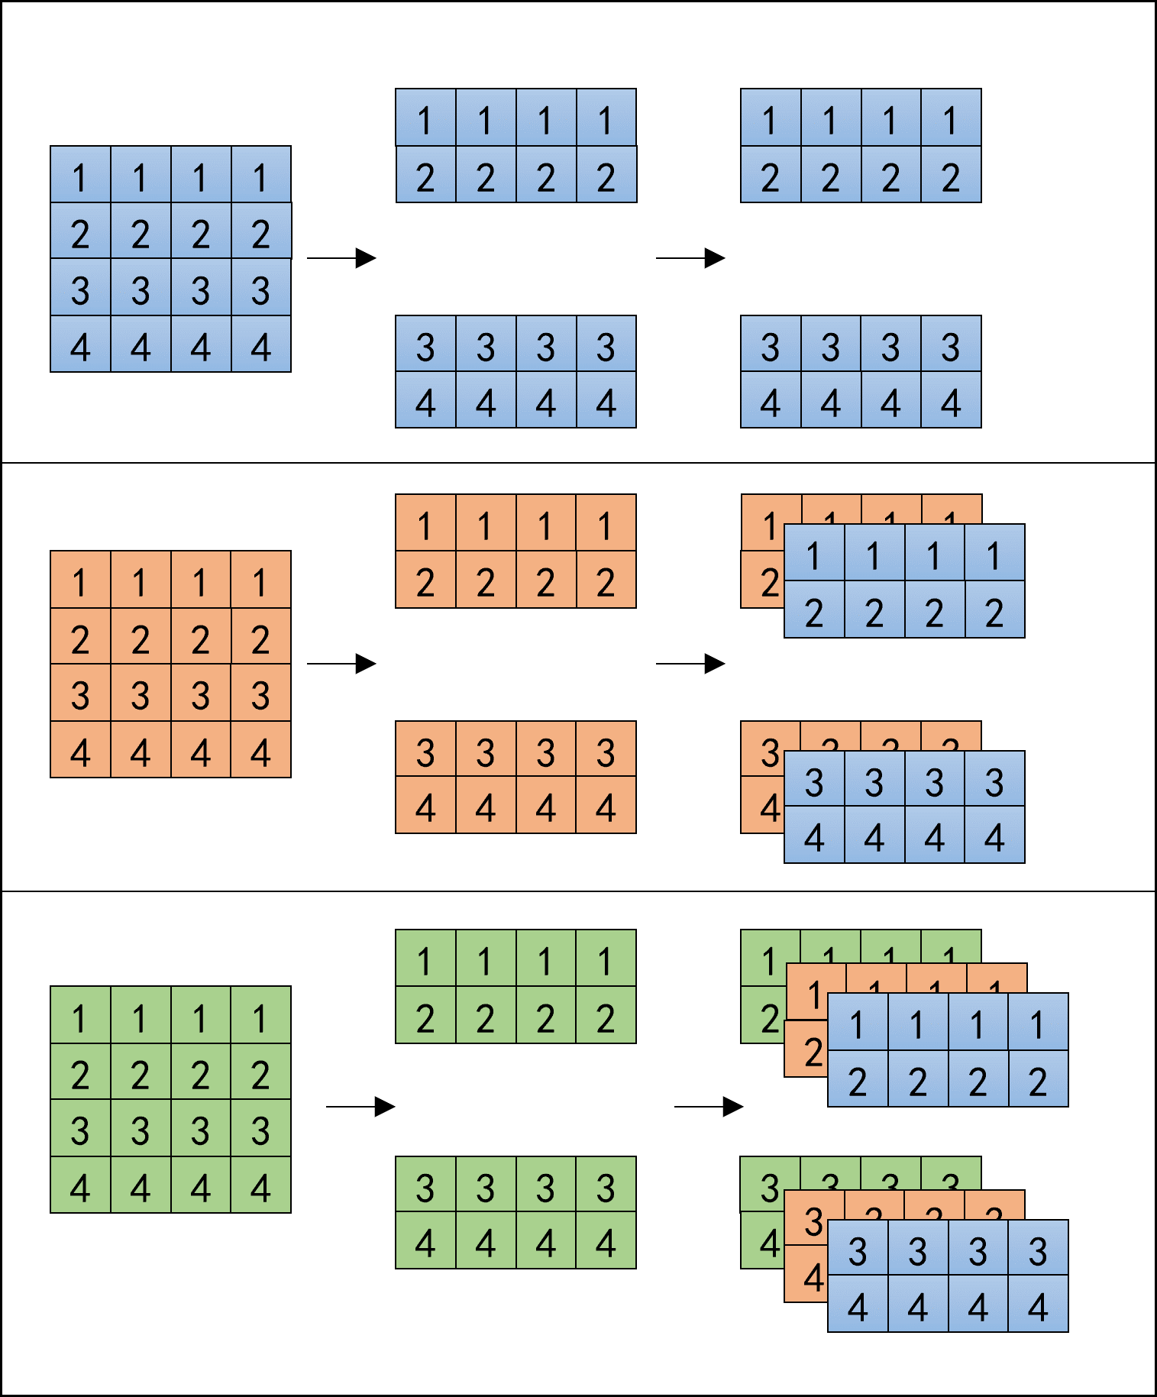
Daisy Stream I/O
receive store access
Control the number of partitions and the number of data streams contained in the file through two parameters to avoid frequent small data reads and writes.
For XAS, no partitioning is needed, with each stream in a separate file.
For HEPSCT, partitioning is possible, with multiple streams in one file.
stream A
stream B
recevie data
stream A
prase
stream B
split by row
stream C
stream C
connect by frame
write to alluxio

Slide 17
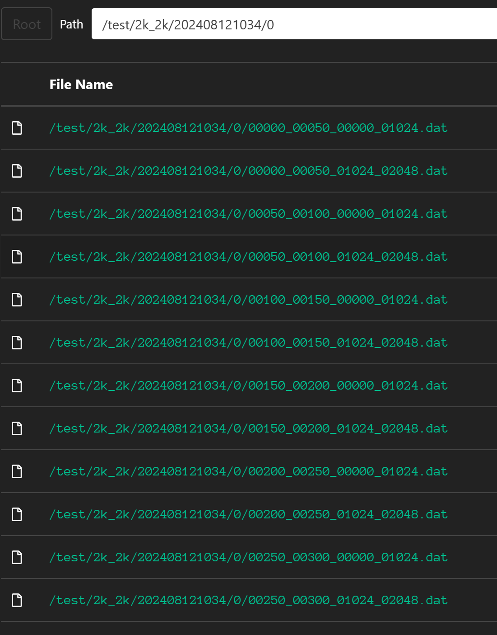
Daisy Stream I/O
receive store access
Mix deployment of Alluxio and Flink
For better wirte speed
Agree on the construction strategy of file paths and file names in Alluxio
computine cluster
Flink master
master
Alluxio master
worker01
worker02
Alluxio & Flink
cluster
Flink worker01
Alluxio worker01
Flink worker02
Alluxio worker02
Alluxio worker03

Slide 18
Daisy Stream I/O
receive store access
STEP 1. Search for files
Obtain data chunk information from the initial stream data.
Determine the list of file names to be read based on beamlineID, beamtimeID, scanID, and batchsize.
Read files sequentially, waiting if a file does not exist.
STEP 2 . Read the file.
Fetch the corresponding file to the computing node's memory and then trim.
Add related keys to the configuration dictionary of the Daisy IO interface
Ensure the consistency of the Daisy IO interface.

Slide 19
Conclusion
Provide a unified I/O interface to the computation, effectively shielding the underlying data format differences
Speedup batch process by parallelizing/prefetching/asynchronously
Use stream data I/O to avoid the I/O bottleneck and support online processing
1
IO Interface
3
DAQ
2
Stream Processing
Batch Processing
Storage
Thanks for your attention!
Q&A

