Slide 1
Nobugs 2024
ESRF/ILL, 25 Sep 2024
Challenges and Changes of Data Analysis
at China Spallation Neutron Source
CSNS-II
Junrong Zhang
China Spallation Neutron Source
Institute of High Energy Physics, CAS

Slide 2
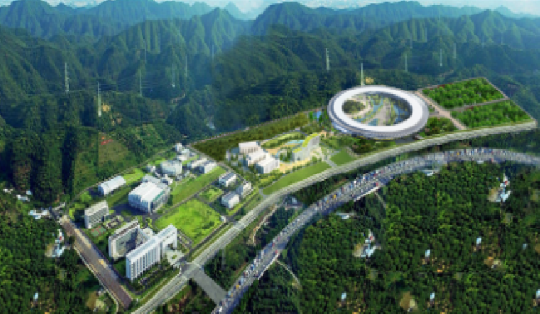
Photon, Neutron and Muon sources
1+1>2
China Spallation Neutron Source (CSNS)
Southern Advanced Poton Source (SAPS)
SAPS
CSNS
ESRF
ILL

Slide 3
NOBUGS is My University!!!
2013
2018
2024
2029
-Kickoff
NOBUGS 10
NOBUGS 12
NOBUGS 14
-Open User
-CSNS II
Do not Reinvent the Wheel.

Slide 4
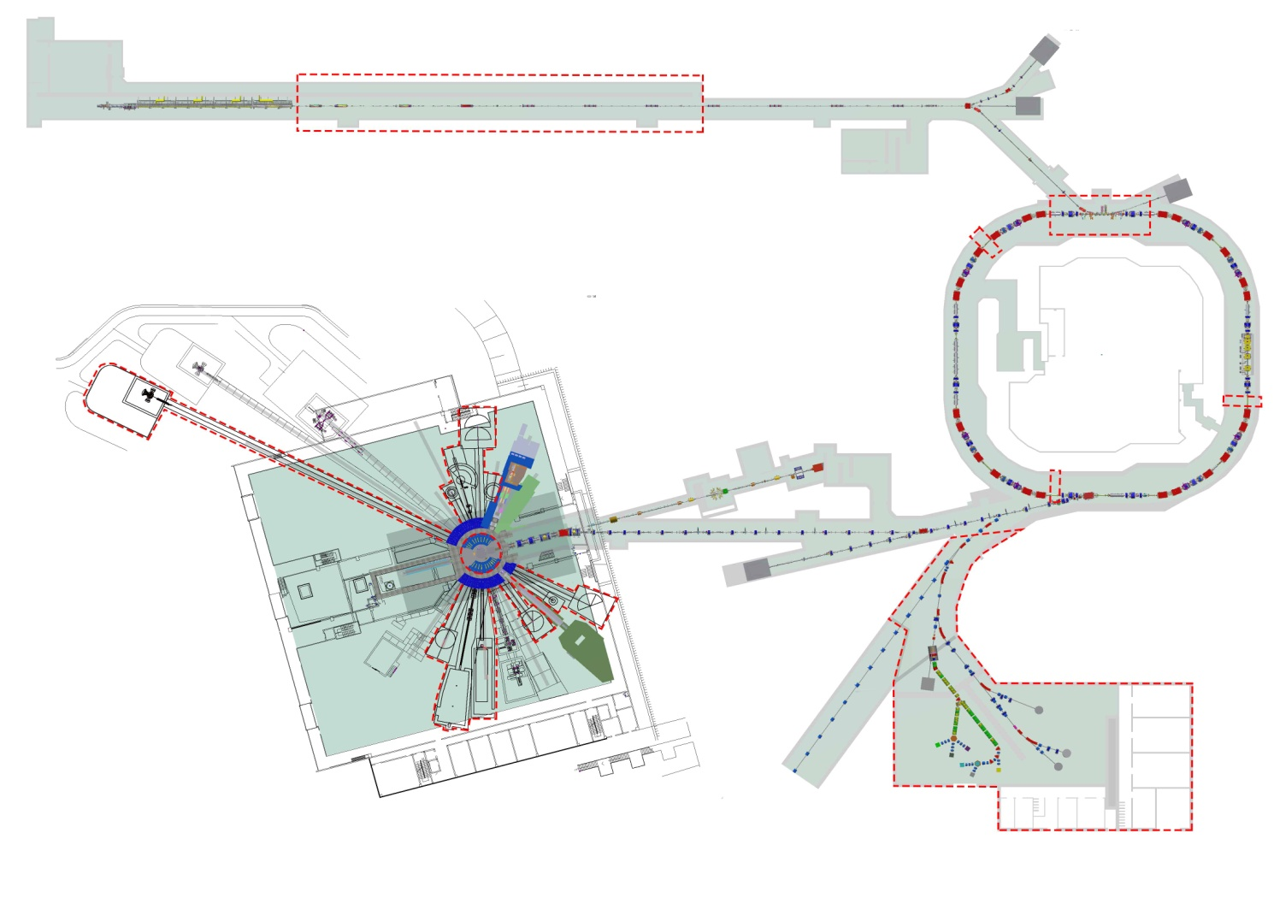
China Spallation Neutron Source, CSNS-II
 |  | CSNS-I | CSNS-II
Neutron | Diffraction | 5 | 5
 | SANS | 2 | 2
 | Relectometry | 1 | 2
 | SingleX | 0 | 2
 | Imaging | 1 | 1
 | Inelatic | 1 | 5
 | Others | 2 | 5
Proton | Radiation | 0 | 1
Muon | uSR | 0 | 2
Sycrotron | 2025-2031? | 10
Neutron
Proton
Muon

Slide 5
Challenges and Changes
2013
Design
2018
CSNS I
2029
CSNS II
2030
SAPS

Slide 6
Challenges and Changes
Receipt 1
Fancy Functions
to
Low-Maintenance
User Beamtime

Slide 7
Fighting with Beam Scientists
2018:From “Software Development” to “Data Analysis” Group
Data Management
Not only Engineering
As 1/2 Scientists
Software
Reduction
Commissioning
Diagnosis
Analysis
Software Development
Reduction and Analysis
Diffraction, Reflection, SANS, INELASTIC,IMAGING
Monte Carlo Simulation
First Principle Computation

Slide 8
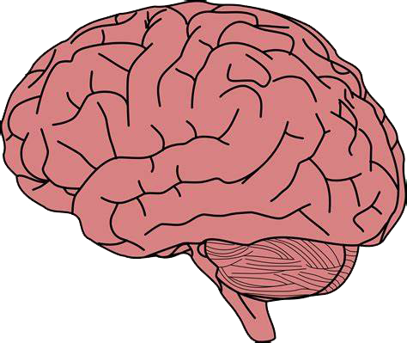
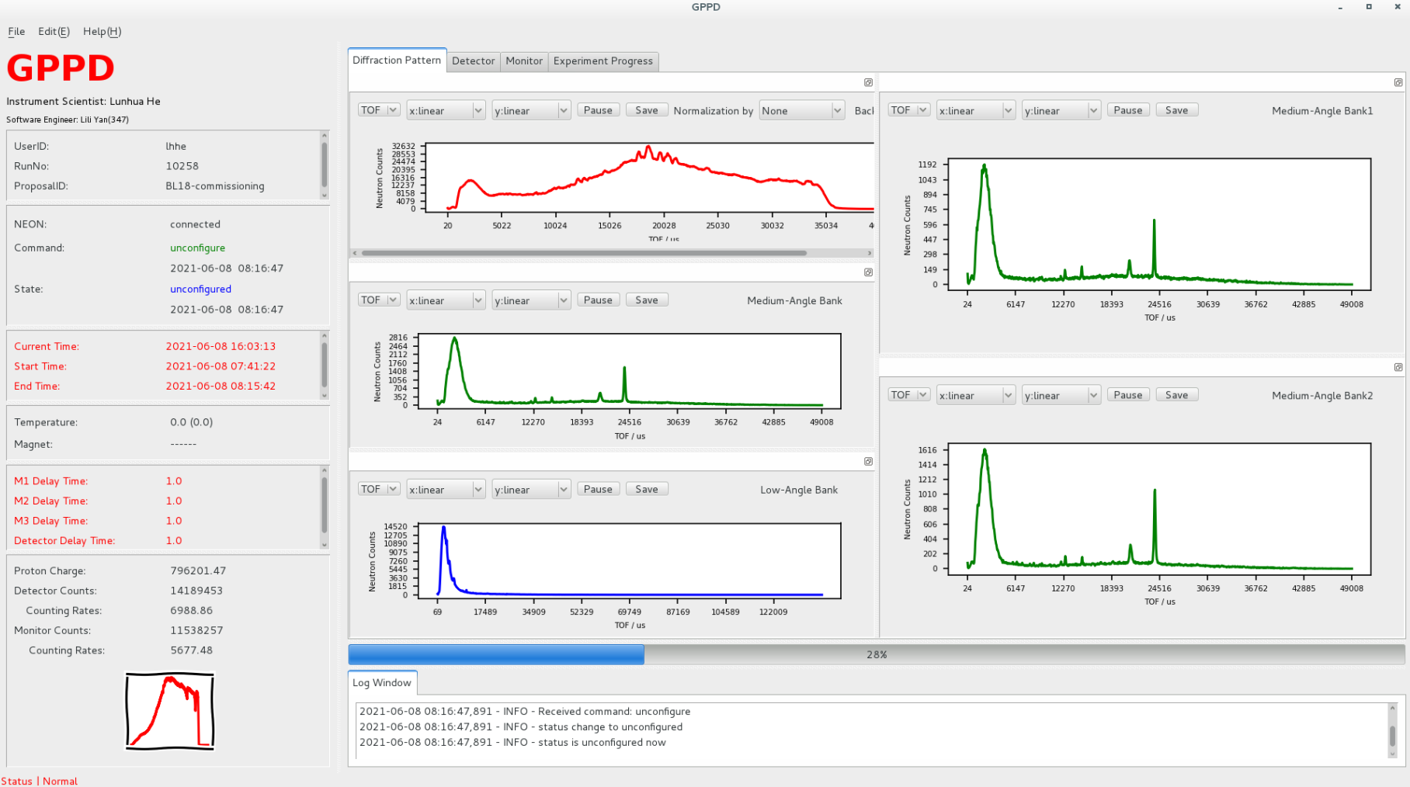
Occam's Razor
Data Analysis and Visualization
Cockpit
Troubleshot
Kafka
Streaming
Process
Data Visualization
Data Reconstruction
Data Reduce
Data Analysis
da@10.1.37.241
10.1.37.246
10.1.37.247
R DU C++/python

Slide 9
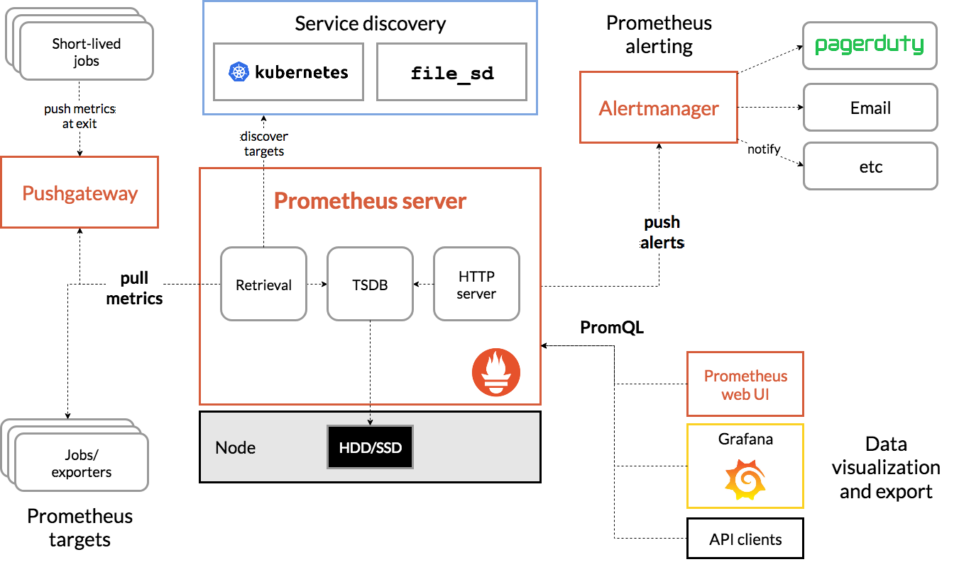
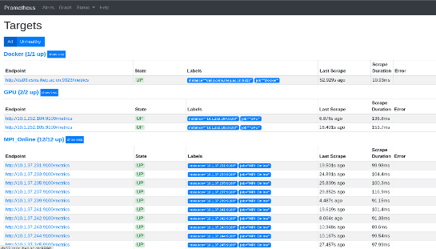
Plan B didn't Work
Device Diagnosis
Issues Alarm
Data Assert
Prometheus + Grafana + AlertManager + Node Exporter
M TANG C++/python

Slide 10
Occam's Razor
Data Analysis and Visualization
Kafka
Streaming
Process
Data Visualization
Think Everything
Work Independently
Data Reconstruction
Data Reduce
Data Analysis
da@10.1.37.241
10.1.37.246
10.1.37.247
R DU C++/python

Slide 11
Challenges and Changes
Receipt 2
For good and all
to
Code all the time

Slide 12
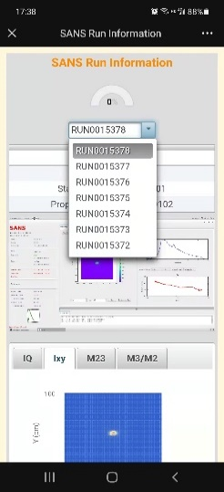
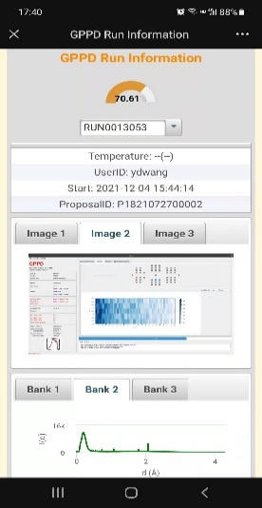
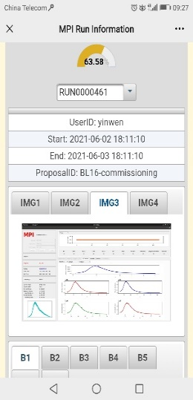
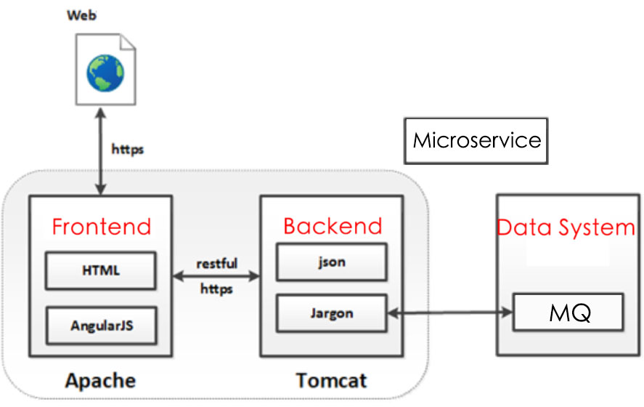
Access Easily
No Client Download
Seemless Login
Data Permission Control
Python + Primefaces + HighCharts

Slide 13
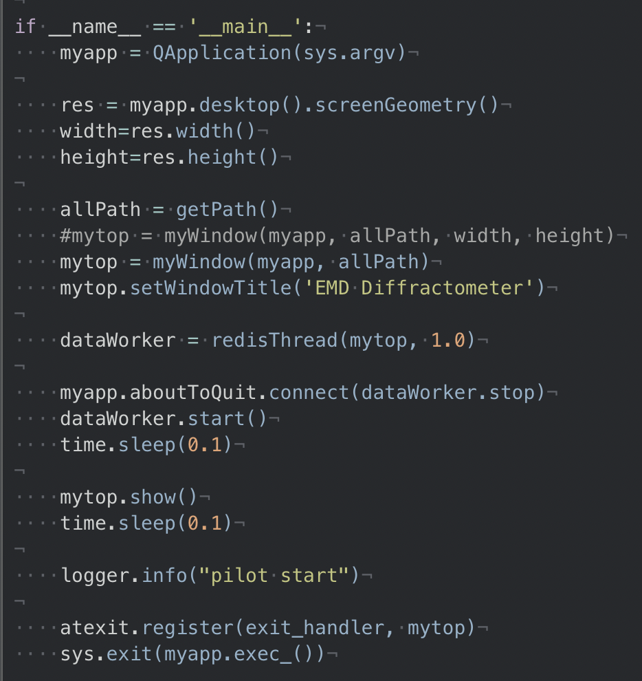
Debug Anytime and Anywhere
No IDEs
Terminal+VIM/EMACS/NANO
Python/Java/C++/Qt5
pyCharm
Visual Studio
qtCreator
Clion

Slide 14
Challenges and Changes
Receipt 3
Rich APPs
to
Computer Resources

Slide 15
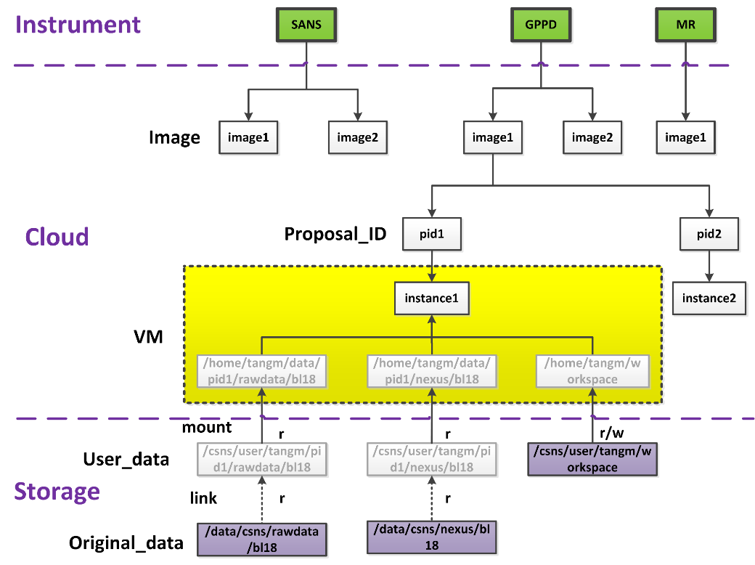
Cloud Analysis: Light and Transparent
Data Modeling and Simulation
Auto upgrade software version (CVMFS)
Auto mout user data (no download)
Auto login (LDAP)
Auto match analysis enviroment (iCAT)
Auto identify calibration data (iCAT)
OpenStack + Ubuntu + Cloud-Init
M TANG Openstack

Slide 16
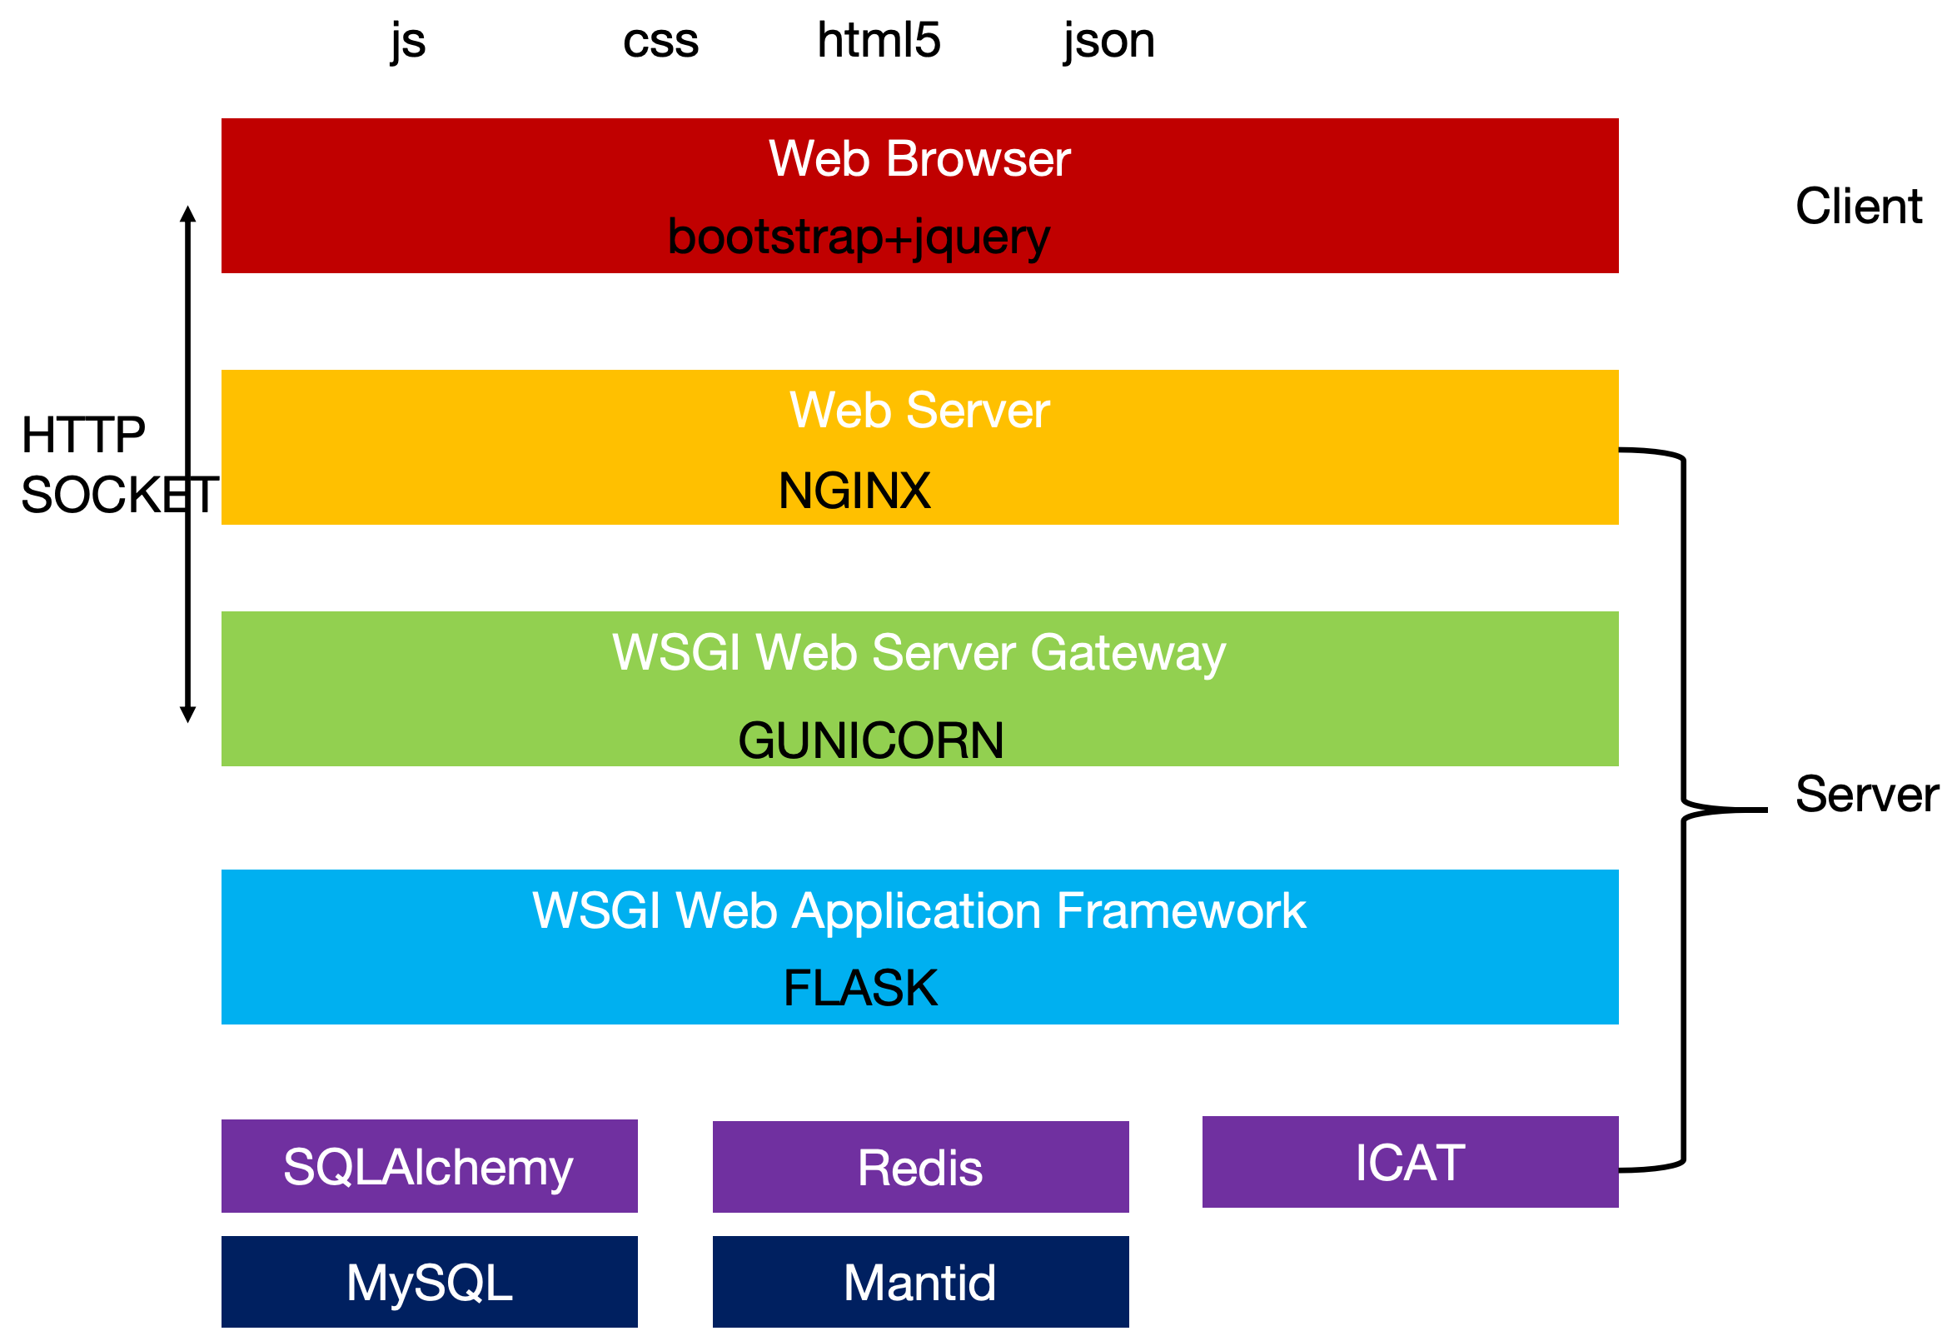
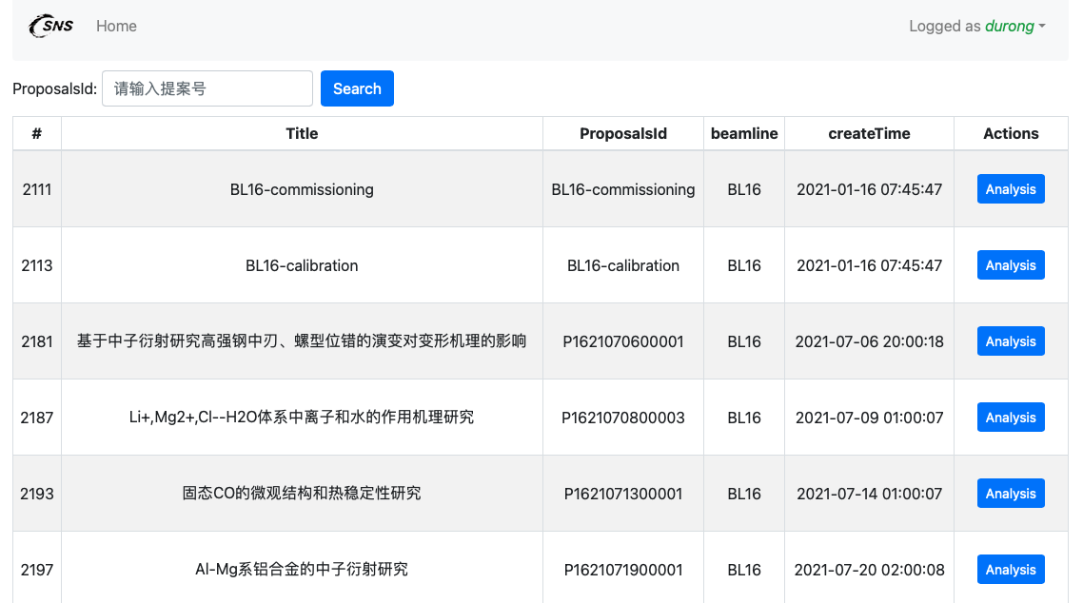
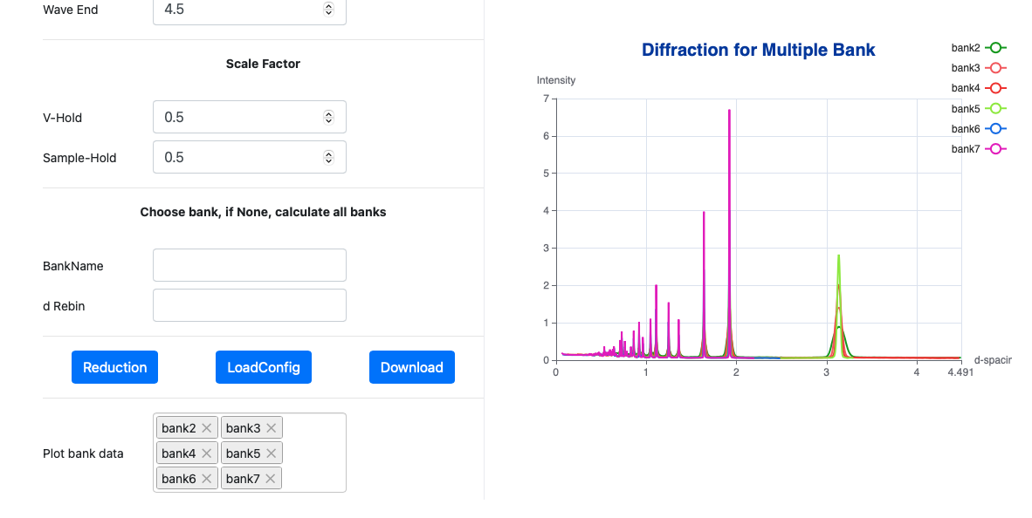
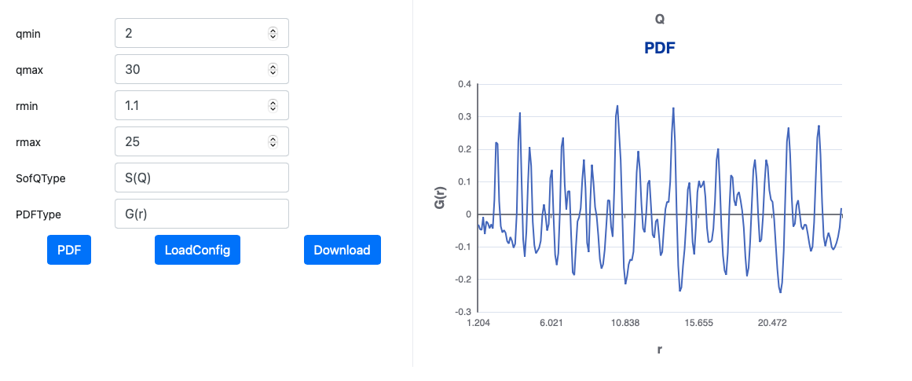
“Neutron Everything in Web”
Data Modeling and Simulation
As services
Reduction：Mantid
Analysis：GSAS, SasView, GenX，etc
js/python

Slide 17
Challenges and Changes
Receipt 4
Solid
to
Flexible

Slide 18
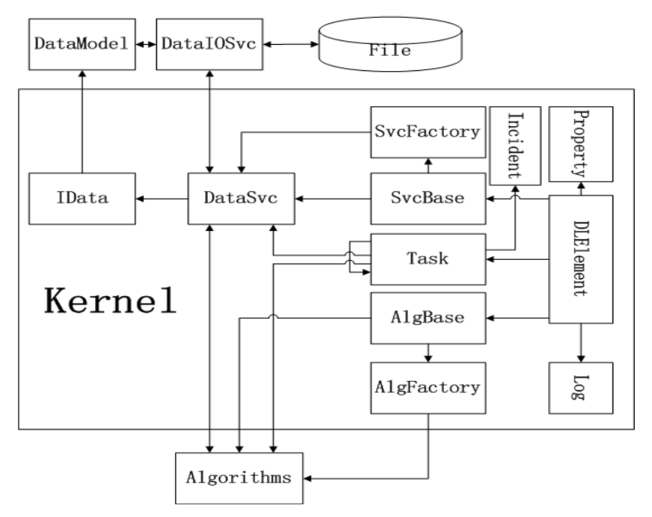
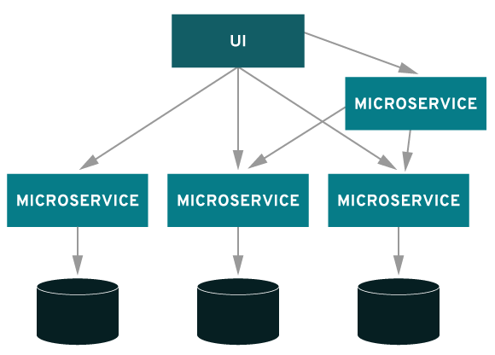
Task Manager: How to Define a Task
Data Analysis
DroNE：Factory Pattern
highly definition
iMAC：Microservice
flexible distribution
XX CAI C++

Slide 19
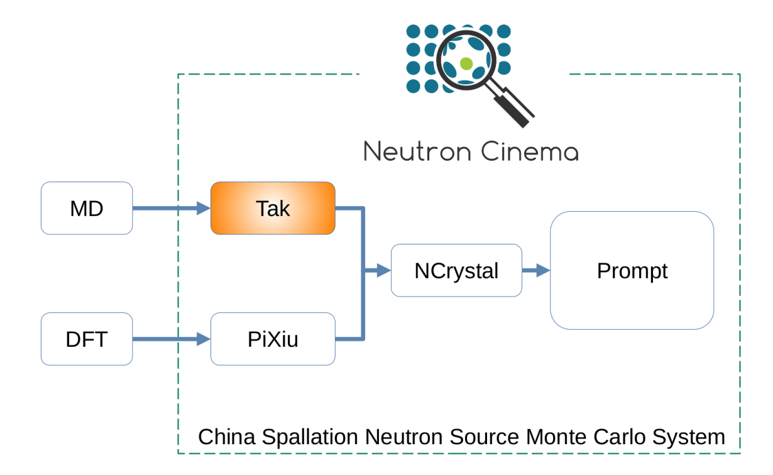
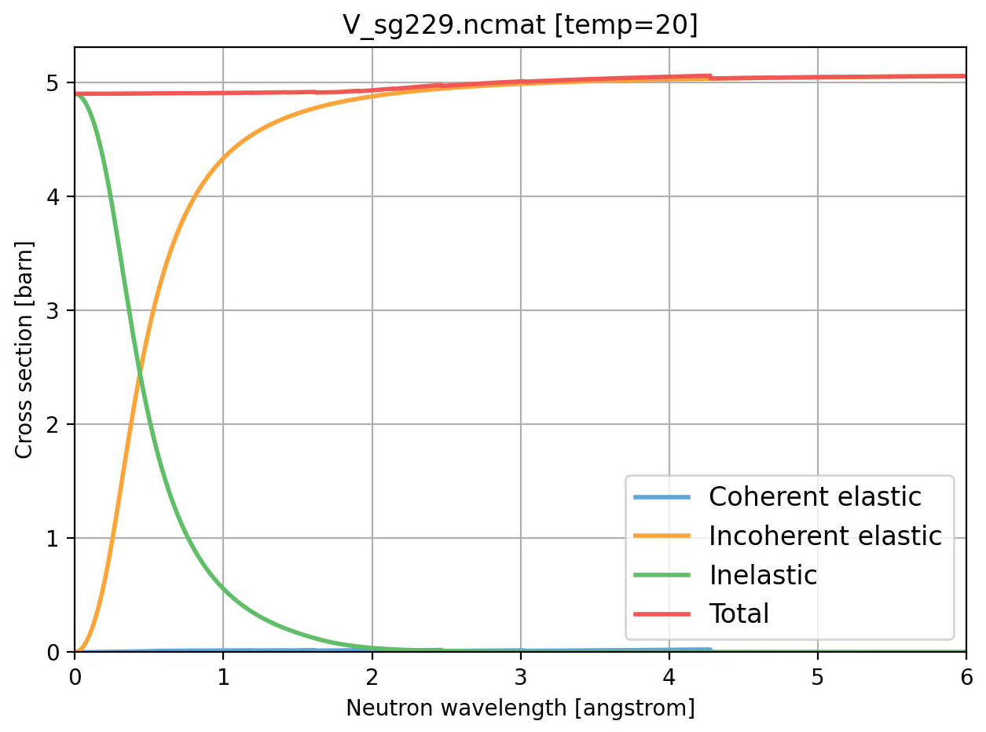
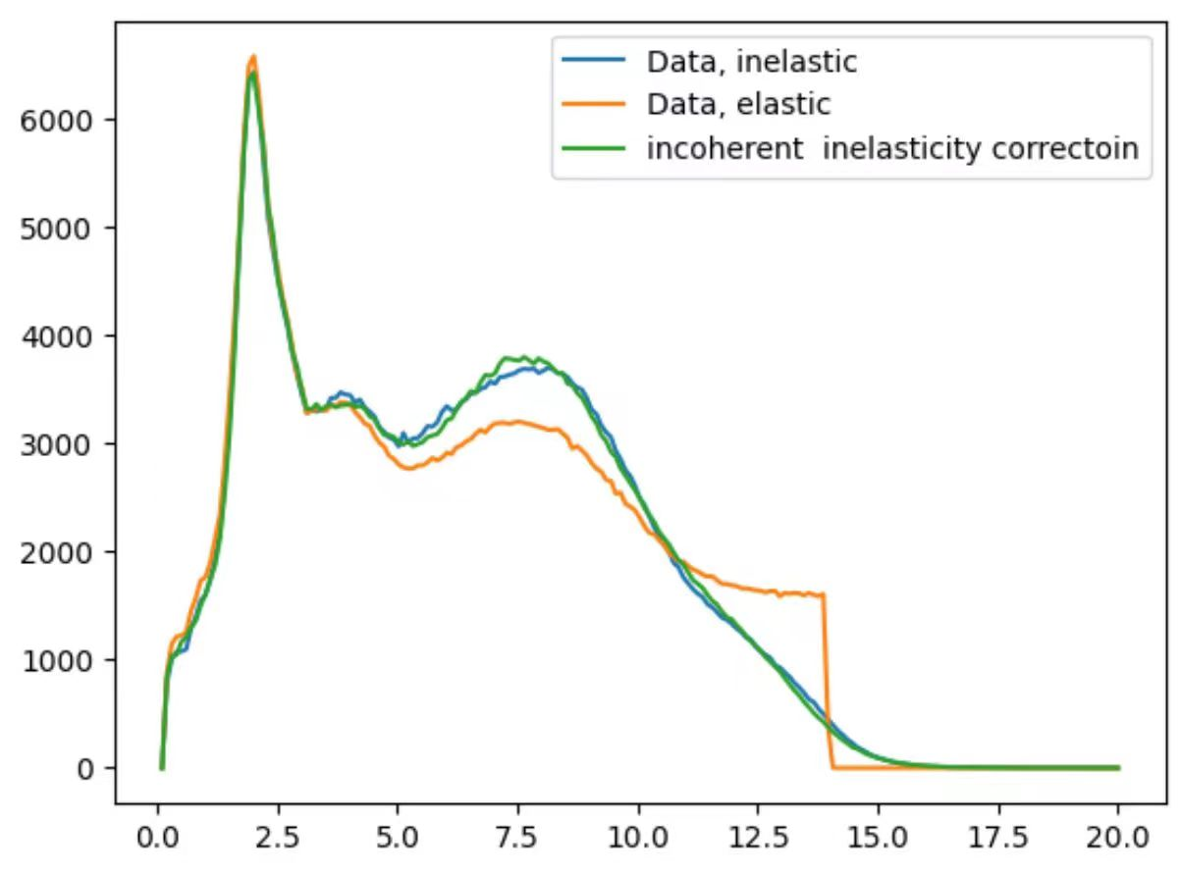
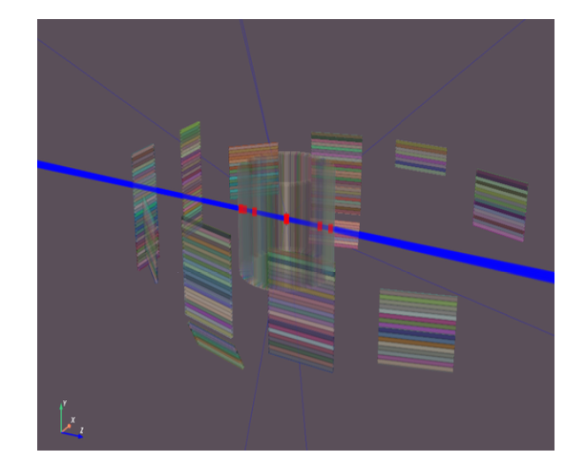
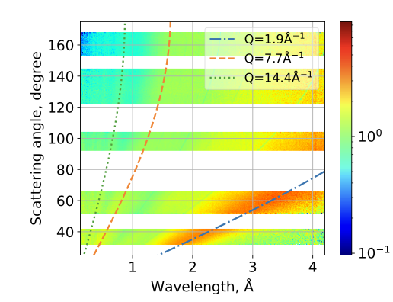
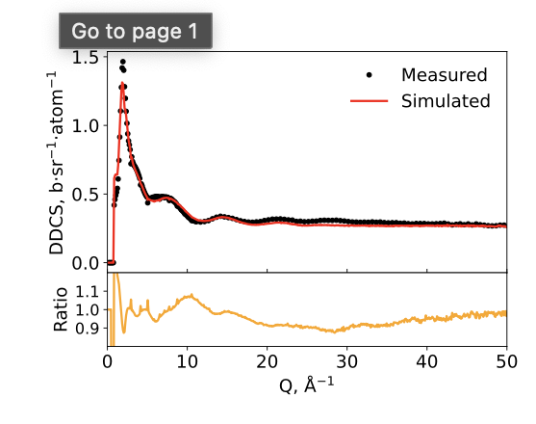
Beyond Fitting
Data Simulation
Coherent/Incoherent Elastic and Inelastic
Hydrogen Contained & Multiple Scattering
Prompt
Reproduction of Neutron Experiments
All Cross-section
Monte Carlo SImulaiton
XX CAI C++

Slide 20
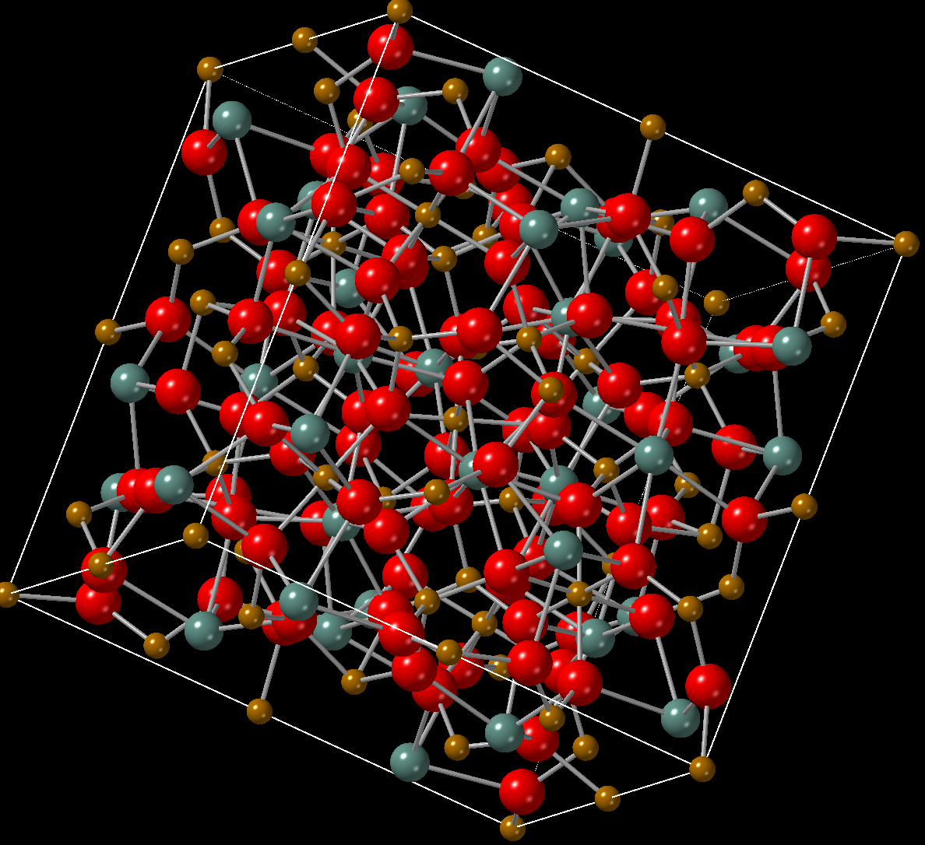
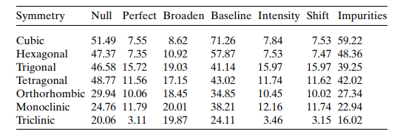
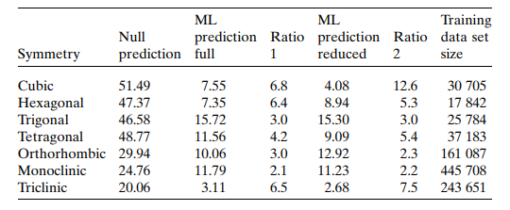
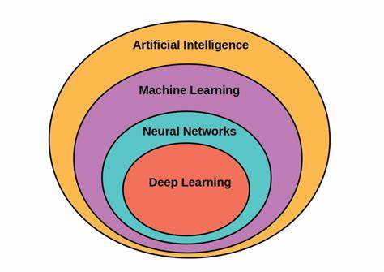
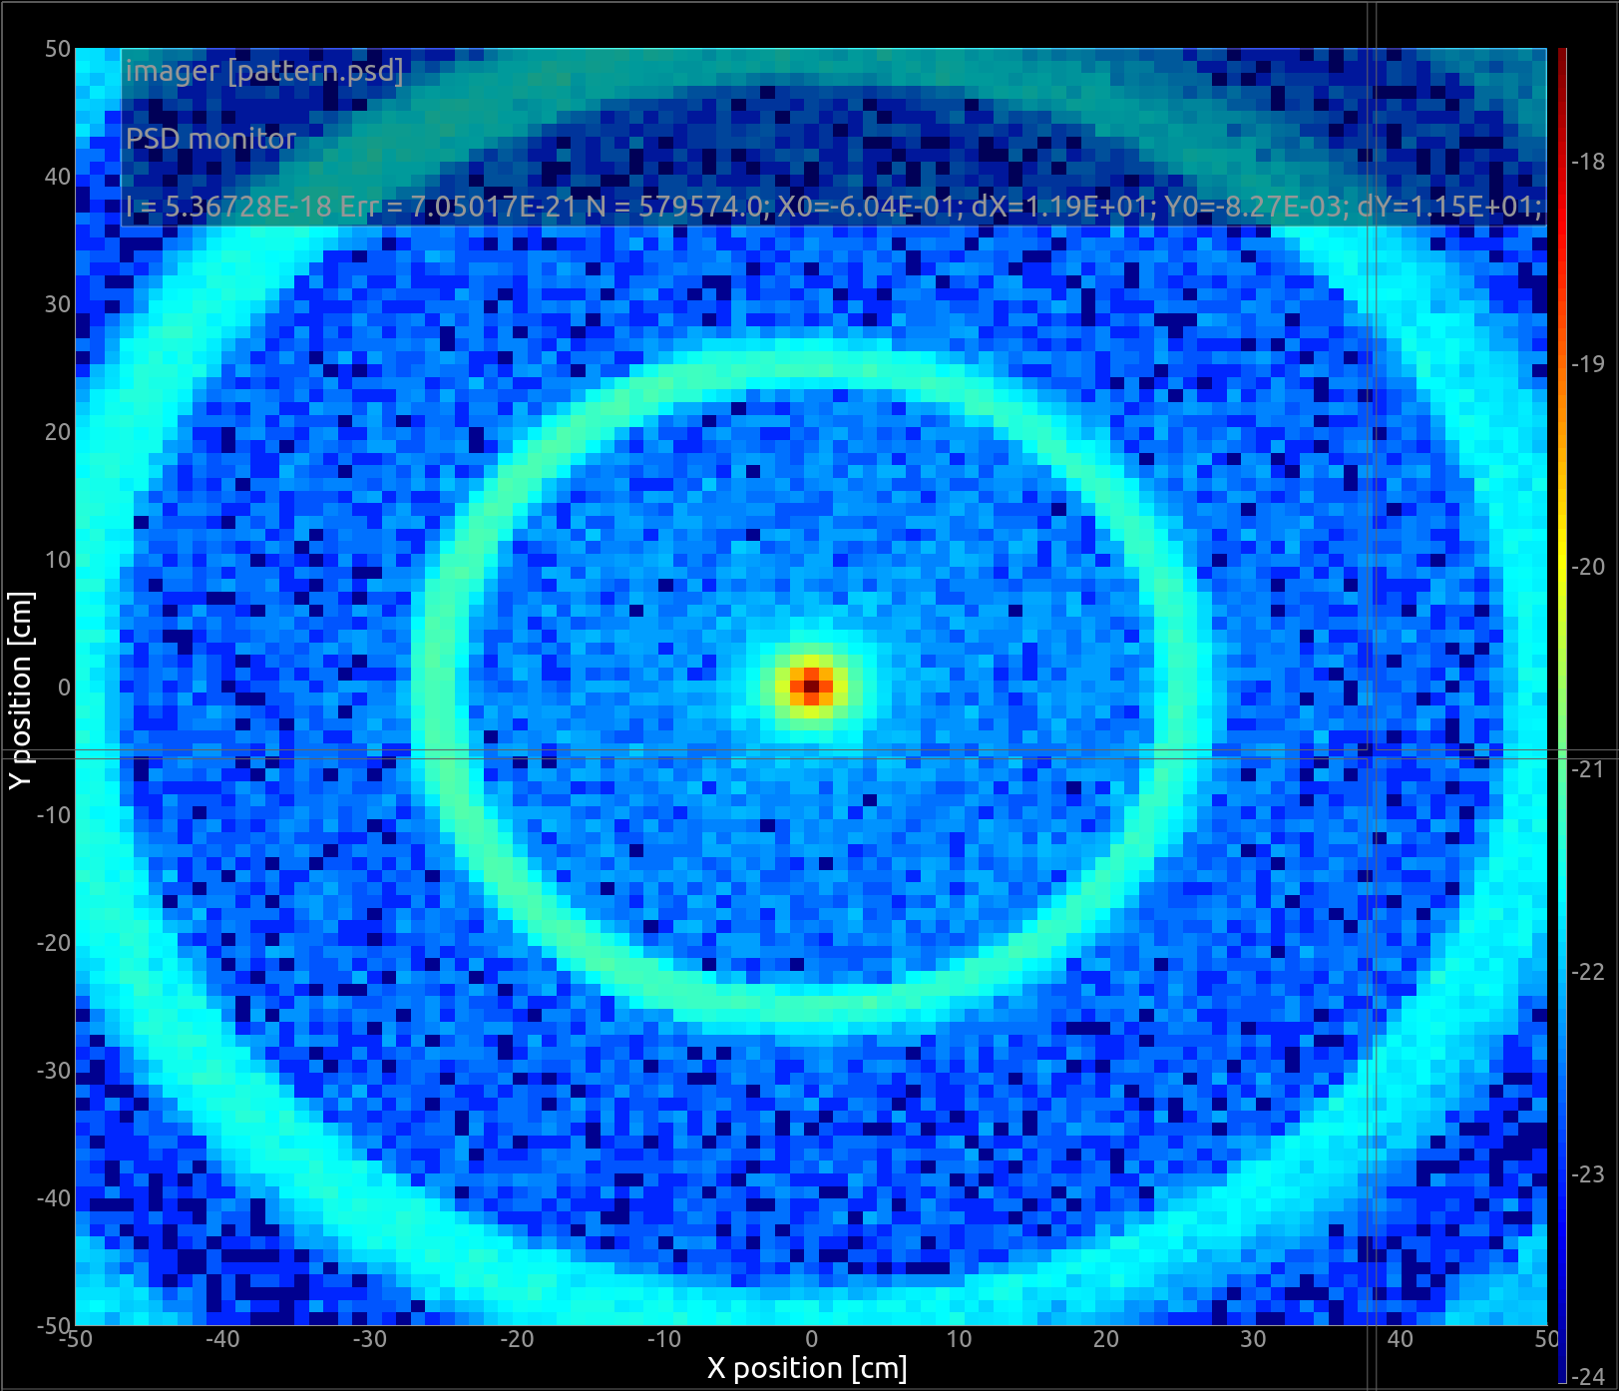
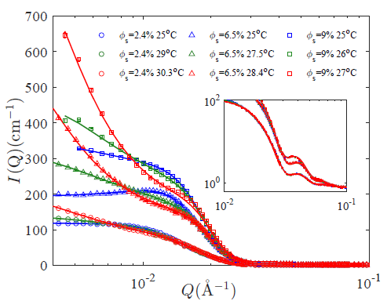
Everyone Talking About AI
Machine Learning -> Deep learning -> Artificial Intelligence
Structure Determination and Prediction with Diffracition
CSNS AI workgroup
Machine learning
largge Model
Model Prediction for High Dimension and Low statistics SANS data
Python

Slide 21
Everyone Talking About AI
Dataset: Collection->Quality Filtering
Receipt 4
Collection
Web Spider
to
AI Large Model
Sample Infomation
Analyzed Data
Structure Results
Properties
Database
M TANG

Slide 22
Summary
High Reliable Operation
Fancy Functions VS. Low-Maintenance
For good and all VS. Code all the time
Various Requirements from Instruments and Users
Stable VS. Flexible
Continously Increasing Computer Requirements
Cloud VS. Services
Complex Analysis from new technologgy
Fitting VS. Simulation VS. Mearchine Learning

Slide 23
Publication
Data
Proposal
MERCI
Idea
Love this story?
jrzhang@ihep.ac.cn
/14

