Slide 1
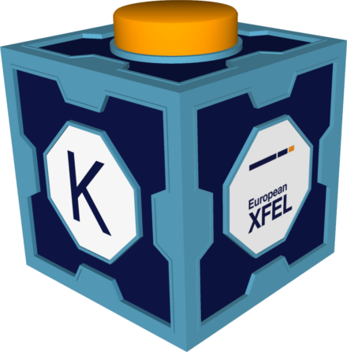
Karabo goes AMQP: Replacement of the Core Communication Broker
Dr. Gero Flucke
for the Controls group @ European XFEL GmbH
September 25th, 2024

Slide 2
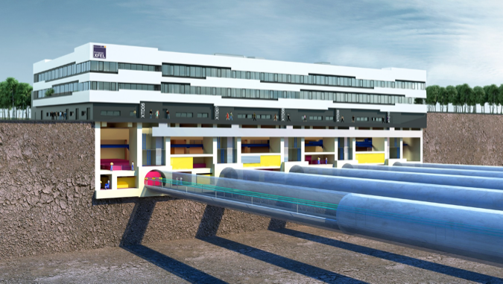
Outline
Karabo: Supervisory Control and Data Acquisition at the beamlines and instruments of the
European XFEL (Hamburg Metropolitan Area)
Karabo Communication Basics
Struggles with the original JMS broker implementation
Refactoring Strategy
Timeline
Refactoring
Deployment
Issues on the way
Summary

Slide 3
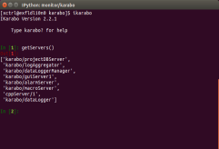
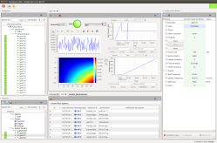
Karabo: Device Based Communication via a Message Broker
Interface for Users and Operators
Equipment
Control
Self-describing Karabo Devices
Equipment control, e.g. motors, valves,…
Detectors
e.g. cameras
Online data analysis
Data Logging
Other system services
GUI entry point
DAQ for big/scientific data (not shown)
Command Line
Interface
Graphical
User Interface
GUI Server
e.g. motor, pump, valve, sensor
DAQ
Equipment
and other service devices like configuration manager
Message Broker
Data Logging
Node
Analysis
Node
e.g. commercial camera
TCP/IP data pipelines for
big/fast data
e.g. calibration, image processing
storage of control data and configurations

Slide 4
Karabo Communication Patterns
1-to-1: Request and reply
Device registers methods as “slots”.
Request from remote with up to four arguments
Reply if done with up to four values.
Requester can suppress reply (fire-and-forget)
1-to-all: Broadcast (for system purpose only)
Always fire-and-forget
Still costly, so used rarely:
System topology: instance new and gone
Problematic device states (UNKNOWN, ERROR)
Request
slot
Device1
Notify
Device2
Notify
Reply
Device2
Device3
Notify
Notify
Device1
Call slot
Notify
Device4
Notify
…
Notify
DeviceN

Slide 5
Karabo Communication Patterns (ctd.)
Publish/subscribe
Devices (2 & 5) subscribe slots to a remote “signal”.
When signal is “emitted”, all subscribed slots are called.
No publishing overhead for “popular” devices
Karabo framework is completely event-driven: regular polling obsolete.
Device2
Notify
Device3
Device1
Emit
signal
Device4
Notify
Device5

Slide 6
Karabo APIs
C++:
“First language” of Karabo
High performance framework devices (GUI server, data logging) and digitizers, some cameras
Python “Bound”:
Python bindings on top of C++ (now using pybind11)
Communication completely covered by C++
Many similarities with C++ ➔ not very Pythonic
Python “Middlelayer” (MDL):
Pure Python (early use of asyncio library, single thread)
Nowadays most popular API, not only for middlelayer devices
Karabo installation size e.g. about:
2700 devices
400 k properties
1.2 kHz message rate to broker
4.3 kHz message rate from broker
(13 such installations at EuXFEL)

Slide 7
Original Karabo Broker Implementation
Device2
Notify
Device3
Device1
Emit
signal
Broker: Java Messaging System (JMS) – OpenMQ
Client library: OpenMQc
C/C++ library also directly called from pure Python API (MDL)
Each device subscribes once to a Karabo “topic” (e.g. for one of the EuXFEL instruments)
Broker filters messages according to target device ids in message header
message header carries target information
signal subscription not on the broker, but on Karabo device emitting the signal
Device4
Notify
Device5

Slide 8
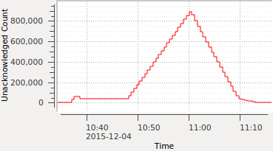
Problems with JMS Broker and OpenMQc Library
Global message backlog
Messages not consumed kept on broker
If max. reached, broker refuses messages:
No communication anymore!
Causes:
Badly behaving processes
Many receivers in one process
Message drop
Hacked into the code as last rescue
Triggered memory leak in OpenMQc
OpenMQc library not maintained
Memory leak problem fixed only four years after we reported in 2015
Rates: all 370 receivers
4 Hz
10 Hz
1 Hz
Problems worked around over years:
Except backlog from badly behaving processes
Closely monitoring backlog
On-call staff hunting process to kill
Failed very few times per year
(potential loss of few hours of beamtime)

Slide 9
Refactoring Strategy I
Broker communication is critical:
Need to be able to switch back to old broker at any time
Allow switching back and forth by just changing the environment variable $KARABO_BROKER
Introduce abstract base class for broker communication (both APIs: C++ and MDL)
Concrete class for each broker protocol supported
Dynamically choose concrete class according to protocol part of broker address
tcp://somehost:7777 - tcp ➔ JmsBroker
amqp://anotherhost:5672 – amqp ➔ AmqpBroker
…
Long timeline of project:
No long lived feature branch in git (fear of divergence)
But merge smaller changes
always keeping JMS communication intact

Slide 10
Refactoring Strategy II
Tests, tests, tests!
Continuous integration
Unit test of communication class SignalSlotable runs for all supported brokers
Integration tests are repeated for JMS and most promising new broker
Big test suit of our TestPortal for each release candidate and intermediate alpha releases
Includes tests beyond Karabo framework (device packages)
Integrated new stress tests
high data rate
message order

Slide 11
Timeline of Refactoring
Autumn 2015: Worrying rate tests with message loss (data logging)
Nov. 2016: Karabo 2 released
To commission the facility
Sept. 2017: First EuXFEL instruments go into production
2018: First serious studies of alternative brokers
Mainly studies concerning MQTT protocol
April 2020: Official start of internal project to investigate broker protocols
MQTT: Liked for IoT applications
AMQP: Wall Street proven
Nov. 2020: Broker base class released in all APIs

Slide 12
Timeline of Refactoring (ctd.)
May 2021: Experimental MQTT broker support
Caveat: MQTT does not keep messages in order if sent from A to B via different routes
Karabo operation requires order, but signals and direct slots cannot use the same route
complicated and fragile custom code needed to keep order
Oct. 2021: Experimental AMQP and Redis broker support
Message order integration test on CI
2022: Work on
Robustness
“Fail-over” for cases of lost broker connection

Slide 13
Timeline of Deployment
SXP, CTRL and DAQ staff March 2023
March 2023: Deploy use of AMQP at first instrument SXP
RabbitMQ broker provides ready-to-use monitoring
Smooth start:
Just like a normal Karabo deployment!
July 2023: Instrument with biggest control installation follows
Oct. 2023: Fix of a race condition in Karabo’s AMQP code
Lead occasionally to crashes
Dec. 2023: Deploy AMQP facility wide (JMS @ EuXFEL is history!)

Slide 14
Issues and Actions after Full AMQP Deployment
Jan. and April 2024: Crash of one RabbitMQ broker process (not Karabo)
Fixed with hardware replacement and RabbitMQ upgrade
“Fail-over” did not work
Spurious missing broker subscriptions
If many subscriptions are run concurrently (e.g. if a data logger starts)
Repeated crashes when many devices in a single process start concurrently
➔ Spring 2024: Decision to rewrite the Karabo C++ interface to AMQP from scratch
Incl. unit tests with concurrency situations
Released June 2024
Deployed for Karabo “backbone” and DAQ in July 2024
“Fail-over” postponed to November release

Slide 15
Issues and Actions after Full AMQP Deployment (ctd.)
Apr./Sept. 2024: AMQP Broker monitoring shows message queues for devices
Identified as a CPU problem
Overloaded host or Python (MDL) process
No danger for communication in full installation (as the backlog of the JMS broker was)
Each message queue on the broker has a limit
Problem stays local

Slide 16
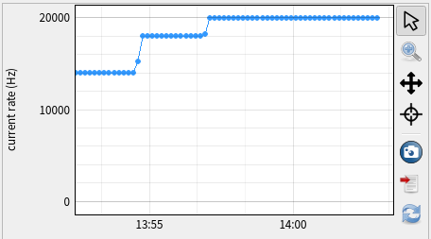
Performance Reached
C++
Single device on a server
Withstands receiving small messages: 20 kHz
Can send small messages at 17 kHz
Server withstands simultaneous high sending and receiving rates
Single receiver device 9.0-9.5 kHz
20 kHz sending rate (latencies < 100 ms)
200 senders at 100 Hz each
1000 senders at 20 Hz
Note: Much contingency
Even GUI servers and data loggers receive less than 1 kHz
MDL (i.e. single threaded Python)
Can send and receive in total ≥ 2 kHz
Side effect: now pure Python broker client library ➔ simplifies distribution

Slide 17
Summary
Karabo control system communicates via a message broker
Some deficiencies of the originally used JMS broker and OpenMQc client library spotted early
Replacing core technology in a used system is delicate
Always need to be able to switch back
Requires confidence in test coverage
About five years from first serious studies to full AMQP deployment
There are always short term goals that prevent more rapid progress
Some things need to be iterated
The effort was worth it:
No global danger for communication in a Karabo installation (less emergency call)
Higher performance
RabbitMQ broker ready for encryption

