Slide 1
Tiled at Beamlines: Enhancing Data Access for Machine Learning-Driven Scientific Workflows
Dylan McReynolds
Data Management Lead
ALS Computing Program
NOBUGS September, 2024
Notes:
thank you for this opportunity to talk about many of the efforts that the Compute Group is working on. Many of these efforts deal with handling data, moving data, and processing data.

Slide 2
A Collaborative Machine Learning Platform for Scientific Discovery: MLExchange
LBNL: Alexander Hexemer APS: Nicholas Schwarz NSLS II: Dan Allan
LCLS: Apurva Mehta CNMS: Rama Vasudevan CNM: Subramanian Sankaranarayanan
Scientific Achievement
Deploy complex machine learning (ML) algorithms directly to beamline and assist the scientists in their data analysis using a ‘plug and play’ model.
Significance and Impact
Assisting ML researchers in deploying directly to beamline users helps both the ML researchers, who get quick feedback from users, and users themselves, who gain access to cutting-edge data analysis tools.
Research
ML for image labeling, image processing and segmenting, scattering, 1D to 4D scientific data labeling and feature identification, simple deployment of ML infrastructure, and ML models tracking and rating
Models
Deployment
Labels
Data

Slide 3
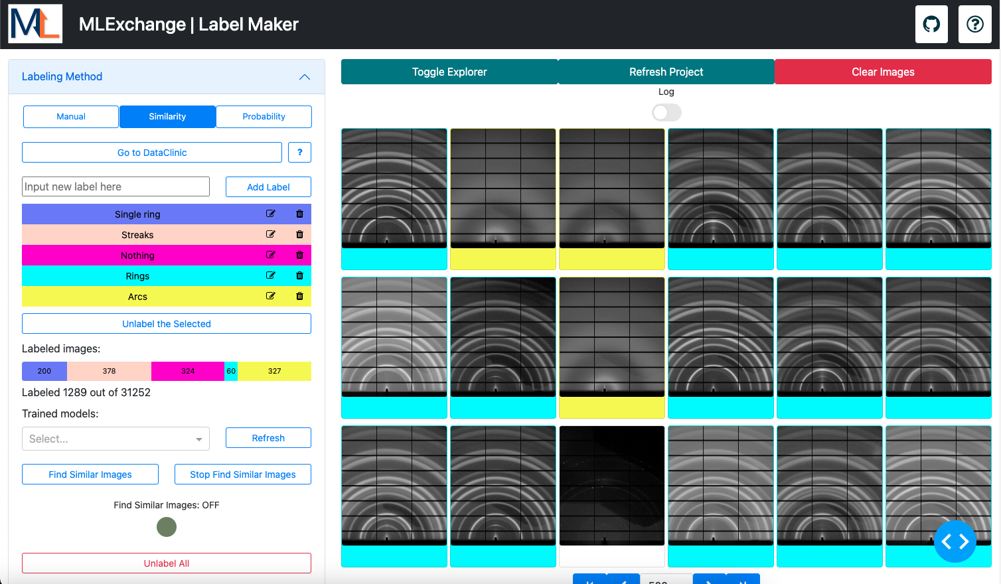
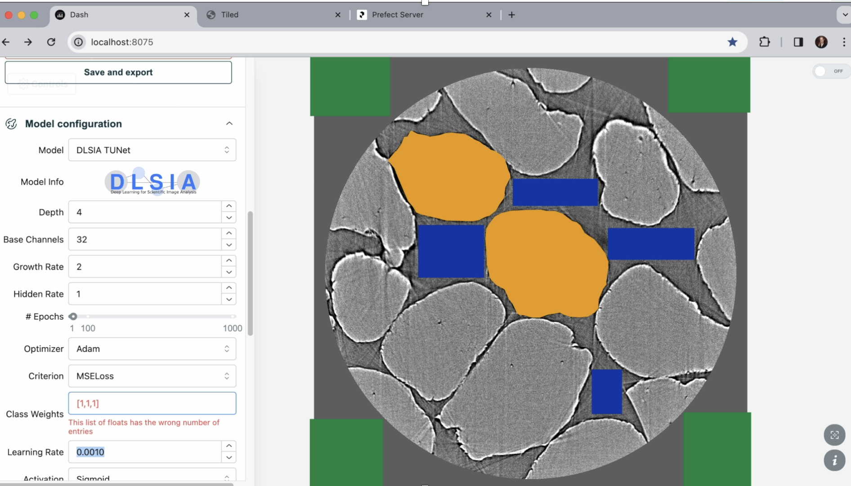
MLExchange Apps
Web Based Apps using a variety of technologies including: Prefect, Dash, Pytorch, Tensorflow
Transitioning to using Tiled, resulting in less data format customization

Slide 4
"Tiled in the Context of Data and Metadata Services"
Dan Allan, FAIR Data Management Thursday 9:40

Slide 5
"Tiled in the Context of Data and Metadata Services"
Dan Allan, FAIR Data Management Thursday 9:40
Elliot Gan NIST, NSLS-II

Slide 6
"Tiled in the Context of Data and Metadata Services"
Dan Allan, FAIR Data Management Thursday 9:40

Slide 7
Evolution of Bluesky Data Access
Databroker
Python library for access and data analysis
Application requires direct Mongo and Filesystem access
Tiled
Data Service over HTTP
Web and remote friendly
Ideal for Browser-based Apps
Python client for accessing data
Not necessarily tied to Bluesky's control system ecosystem!

Slide 8
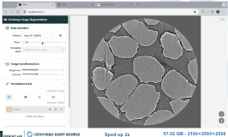
AI-Enhanced Segmentation Framework
Prefect Server
Browser App
function
function
Prefect Worker
Petrus Zwart
Data Server
data
data
Transitioning to using Tiled, resulting in less data format customization ocde

Slide 9
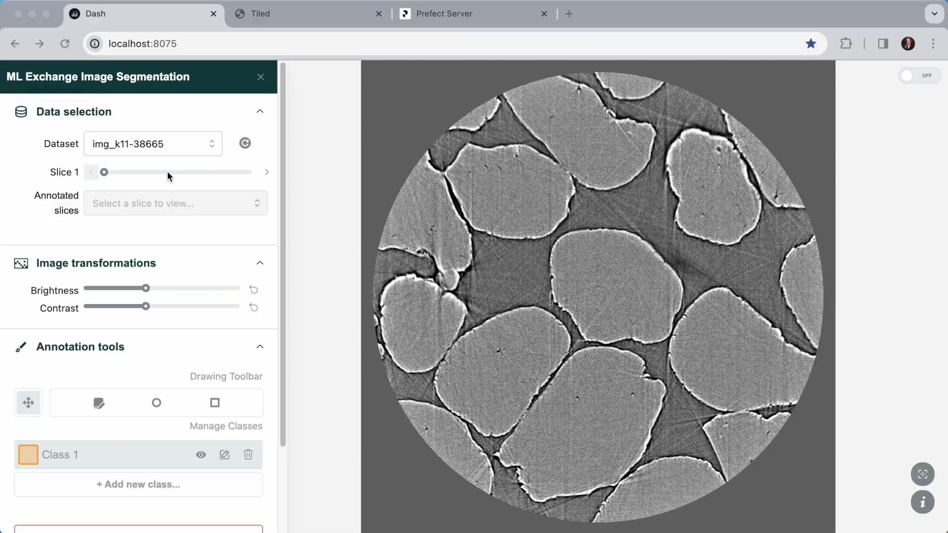
57.02 GB - 2160 × 2560 × 2560

Slide 10
Example: Segmentation
Application
Tomography Reconstruction
Train model on a few frames (UNet, MSD)
Segment Entire Dataset
Share a trained model across instruments
Tiled
Serves reconstruction, masks and segmented reconstruction
Stores masks and segmented reconstruction
Notes:
Tomography reconstruction, a stack of frames
UI tool to add class labels
Label a few frames
Train on the entire dataset

Slide 11
Tiled Data Flows
Browser App
ML Agent
Frames for Display
Masks (frame mapping classes to pixels)
Frames for Training and Inference
Masks
Masks (frame mapping classes to pixels)
Segmented Frames

Slide 12
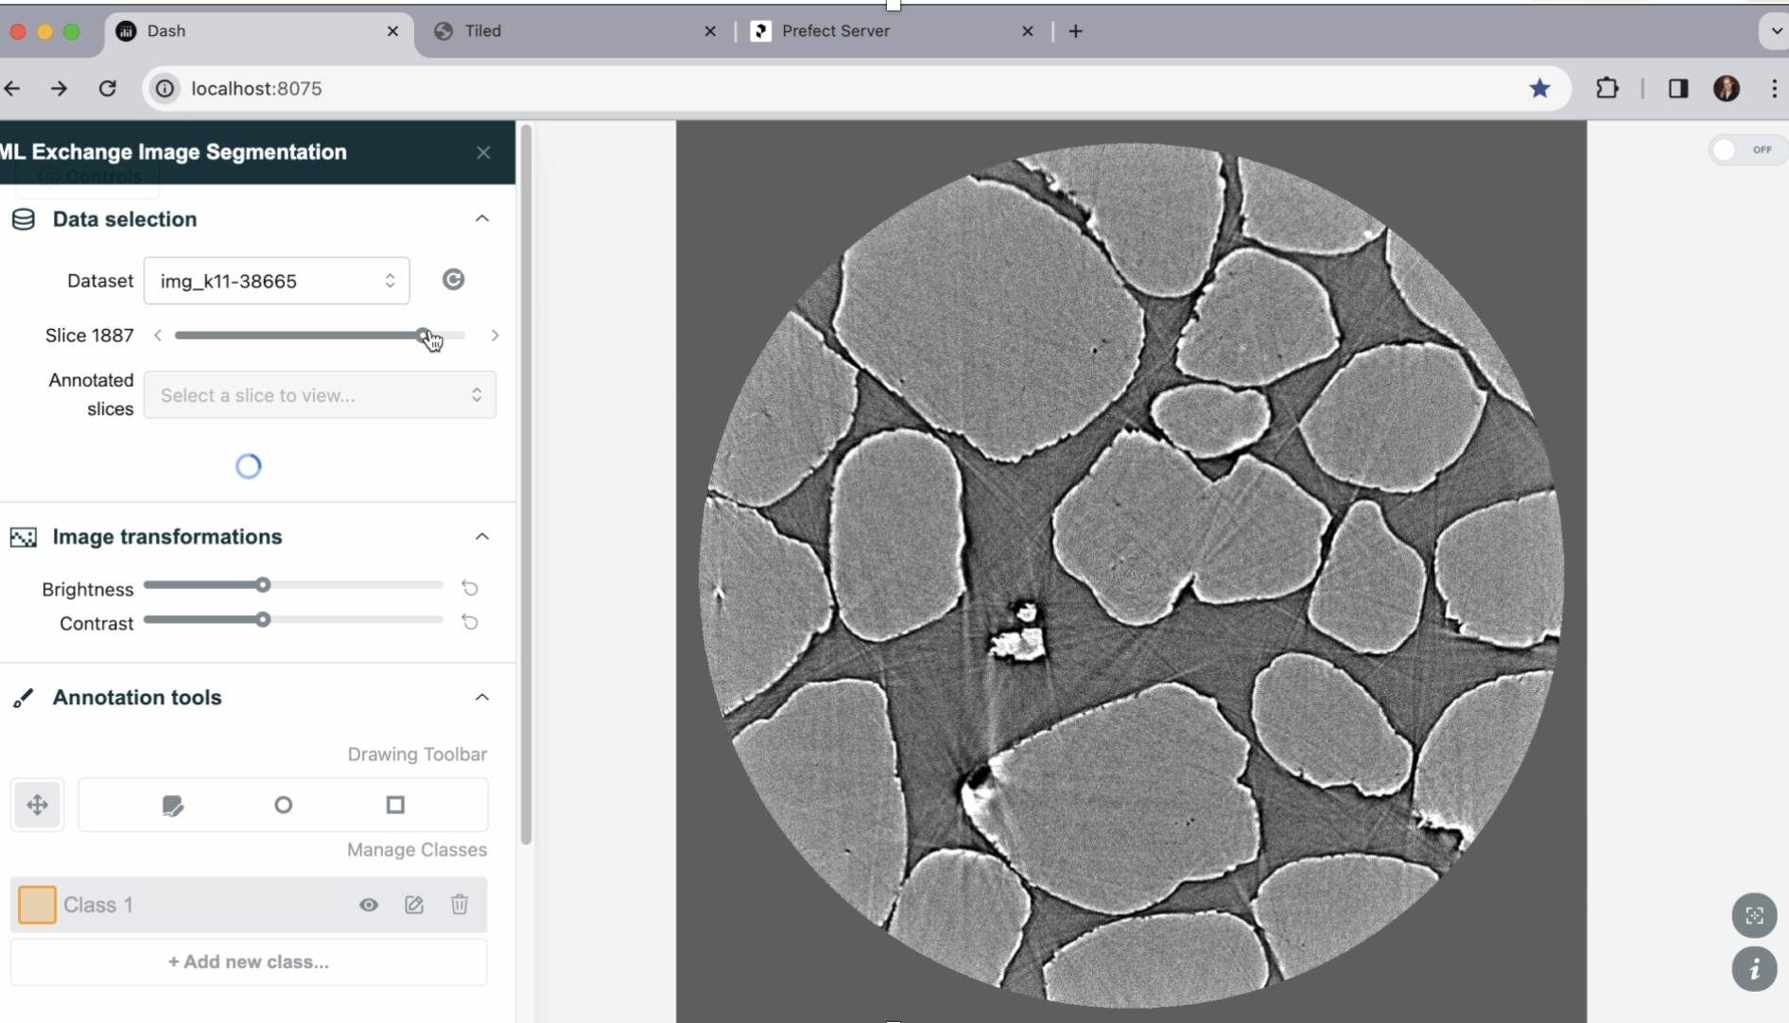
Segmentation Cross facility Learning
ALS:
Alex Hexemer
Dylan McReynolds
Tanny Chavez
Xiaoya Chong
Tibbers Hao
Raja Vyshnavi Sriramoju
Wiebke Koepp
Giselle Lu
Dula Parkinson
Diamond Light Source:
Sharif Ahmed
Tim Snow
Jacob Filik
NSLS-II:
Nghia Vo
CAMERA
Petrus Zwart
Special thanks to:
Dan Allan (BNL), Liam Perera (DLS), Alberto Leonardi (DLS), and the Plotly team
APS: Planning test runs as soon as beam comes back
Notes:
Tomography reconstruction, a stack of frames
UI tool to add class labels
Label a few frames
Train on the entire dataset

Slide 13
Getting Data into Tiled
Direct Filesystem
Files external process
Index message needs to be sent to Tiled through the client
Through HTTP
Files Tiled writes to file system, options to preserve format or let Tiled choose a preferred format.
Index Tiled creates the index

Slide 14
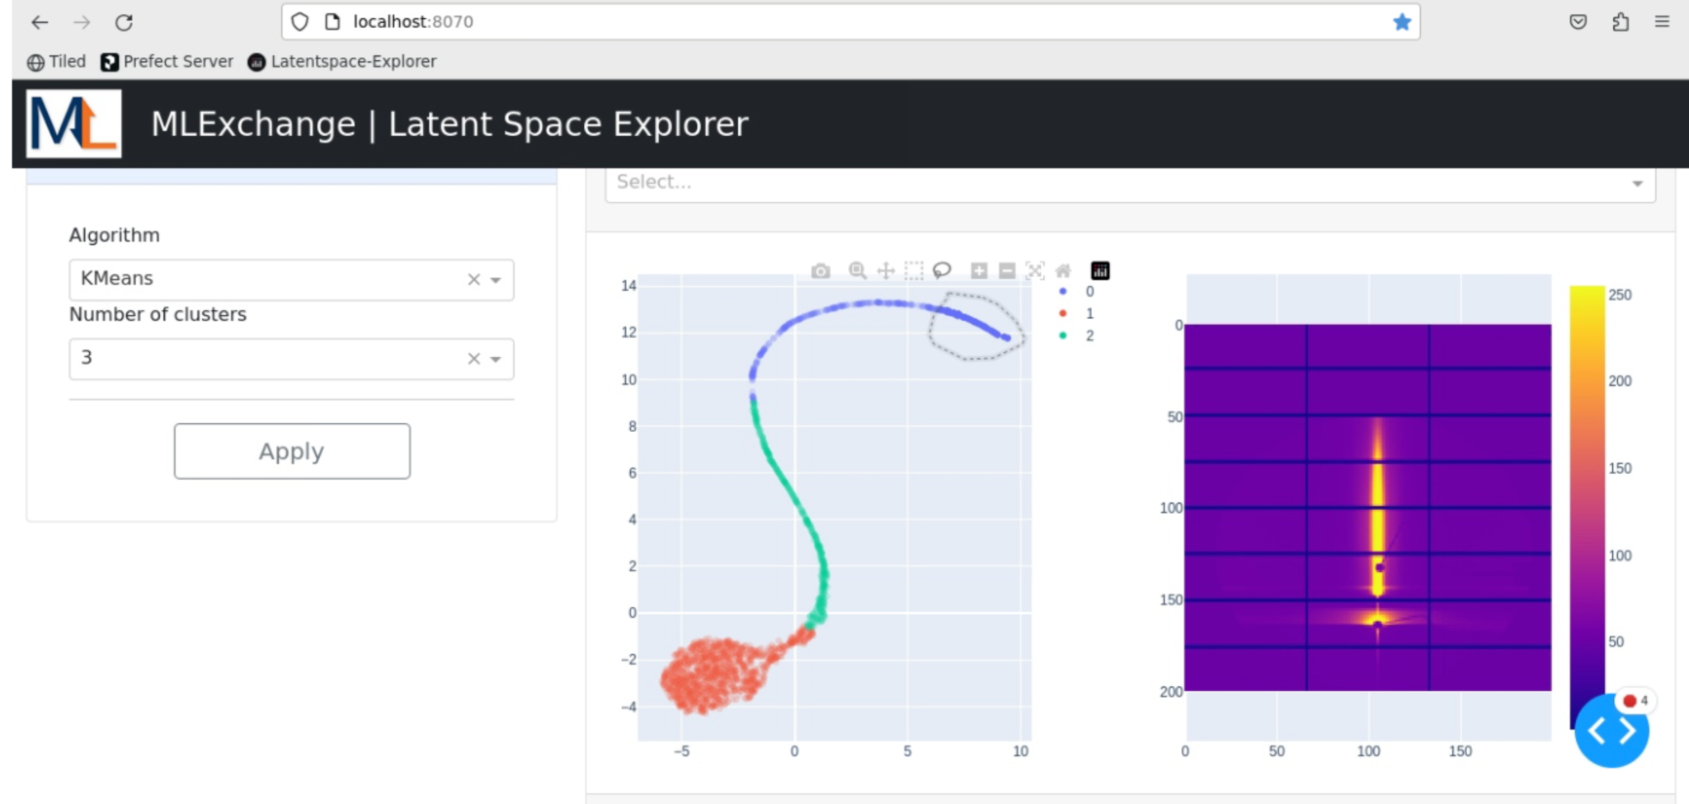
Example: Latent Space Explorer
Application
Train autoencoder on full data set
Display clustered feature vectors
Display clusters and frames
Tiled
Serves data for inference
Stores and serves feature vectors
Runbo Jiang, Petrus Zwart, Tanny Chavez

Slide 15
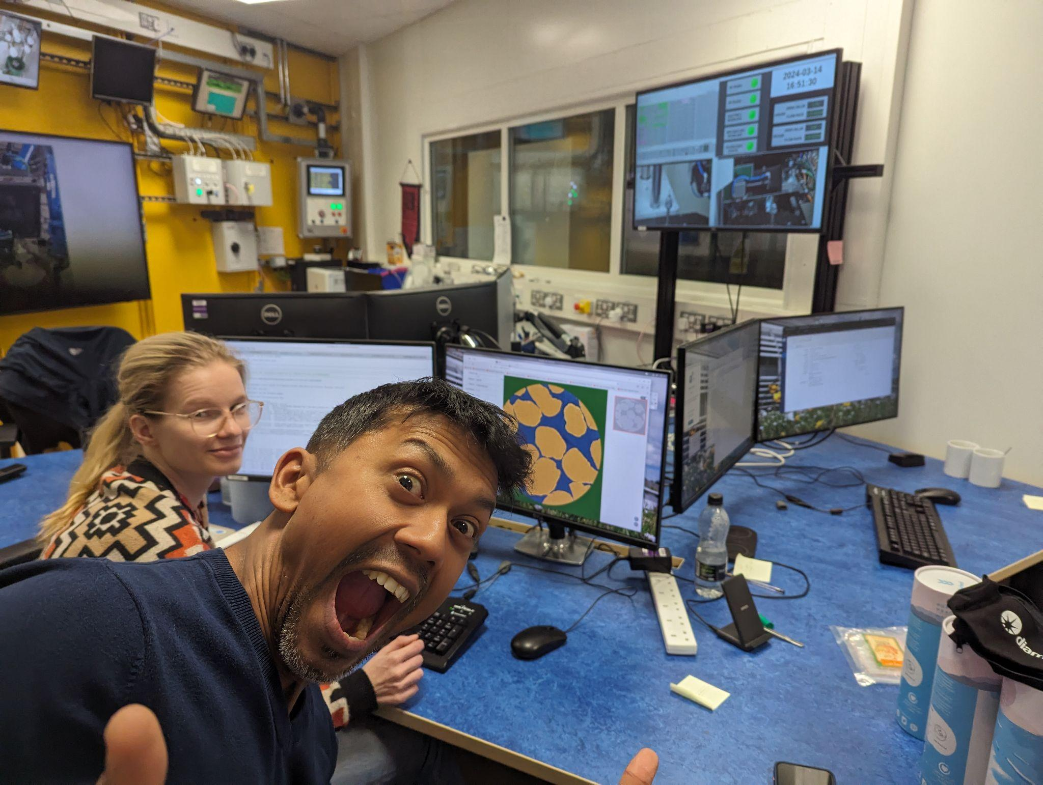

Slide 16
Future Work
Authentication
MLFlow Integration
Prefect workers for more types of environments
conda
podman/docker/k8s
containers
HPC
containers in HPC
containers in HPC with conda installed

Slide 17
Acknowledgments
Monika Choudhary
Tibbers Hao
Runbo Jiang
Anas Nassar
Zhuowen Zhou
Alex Hexemer
Tanny Chavez
Raja Vyshnavi Sriramoju
Xiaoya Chong
Seij De Leon
ALS
Eric Shaible
Chenhui Zhu
Aidan Coffey
Dula Parkinson
David Shapiro
ANL
Nicholas Schwarz and team
Subramanian Sankaranarayanan and team
DLS
Sharif Ahmed
Tim Snow
Liam Perera
NERSC
Bjoern Enders
Deborah Bard
ORNL
Maxim Ziatdinov, Rama Vasudevan and team
Postdocs
(multiple projects):
Karthik Balasubramanian
Suvo Banik
Rohit Batra
Oliver Hoidn
Aditya Koneru
Eric Roberts
Howard Yanxon
CAMERA
James Sethian
Peter Zwart
Daniela Ushizima
Hari Krishnan
Ron Pandolfi
Marcus Noac
SLAC
Apurva Mehta and team
DESY
Stephan Roth and team
NSLS-II
Dan Allan

