Slide 1
Crashproofing HDF5 NOBUGS24
Grenoble, France
24 September, 2024
Vailin Choi, Neil Fortner, Matt Larson
Dana Robinson, Glenn Song
The HDF Group

Slide 2
Contents
A very quick overview of HDF5
Why crashes can corrupt HDF5 files
Crashproofing HDF5

Slide 3
A very high-level and quick overview of HDF5

Slide 4
Binary, Self-Describing, Open File Format
HDF5 File
An HDF5 file can be thought of as a hierarchical file system in a file
HDF5 file objects include:
Groups, which hierarchically organize objects
Datasets, which are n-dimensional typed arrays
Stored Datatypes (not shown)
Each of these can have typed attributes attached to them
Can be thought of as a "binary file format construction kit"
/
group1
group2
group3
dataset 1
attr1
attr2
attr1

Slide 5
Internal Metadata
HDF5 File
Just like in a file system, in addition to the HDF5 objects that you see in a file, there's a lot of internal metadata (B-trees, etc.) you don't see!
This metadata is used to locate and describe objects in the file and, if corrupted, can make the file unreadable
/
group1
group2
group3
dataset 1
attr 1
attr 2
attr 1

Slide 6
No Server
Unlike a typical database, there is no "HDF5 server"
HDF5 I/O is typically performed using a library linked to your application
NO ❌
YES ✅
Process
Application
"hdf5d"
Application
hdf5 files
hdf5 files
libhdf5

Slide 7
Everything you need to know about HDF5 library internals in one slide*
Each file has its own metadata cache
This is NOT a write-through cache
Therefore, some state is maintained ONLY in memory until the library or the user (via H5Fflush(), etc.) flushes the metadata
libhdf5
File
HDF5
File
Per-File
Metadata
Cache
* For the purposes of this talk, anyway

Slide 8
HDF5 Files and Writer Crashes

Slide 9
The Problem: Distributed, Volatile State
File state in a process writing HDF5 files is:
Distributed across both the physical file and caches in the HDF5 library
Volatile when stored in a library cache
File State (Writing)
Metadata
Cache
Physical
File

Slide 10
The Problem: Distributed, Volatile State
After a crash, anything stored in the library's caches is lost forever and anything not written out will be missing in the file.
Manual surgery might be able to fix this, but it's difficult, there are no tools for this, and it may not even be possible.
File State (After Crash)
Physical
File

Slide 11
The Problem: Inconsistent State
Missing data is a problem, but an even bigger problem is inconsistent data.
Consider a tree where node A refers to node B.
If node A was flushed to storage, but B was not, there will be garbage in the file at node B's location.
When the library attempts to traverse the tree, it will encounter the garbage at B and emit an error or crash.
Consistent
A
B
Inconsistent
A
?

Slide 12
The Result
Lost data
Crashes when reading corrupt files
Wasted time and money

Slide 13
Crashproofing HDF5

Slide 14
Proposed Solution: Write-Ahead Log (WAL)
Log of batched metadata writes
Ensures metadata written to the file is in a consistent state
Can be replayed after a crash
Metadata Cache
WAL Module
I/O & VFD Layers
HDF5 File
WAL File

Slide 15
How Does It Work?
Metadata accumulates in the cache, as usual
Evicted metadata is written to the WAL
When it's time to flush, there are two kinds of flushes:
A log flush operation (WAL only)
A checkpoint flush operation (WAL and HDF5 file)

Slide 16
Log Flush Operations
Flushes the entire metadata cache to the WAL file
Does NOT write to the HDF5 file
Creates a consistent metadata checkpoint in the WAL file
Configurable as to when this happens
Amount of metadata written
Time interval
Flush API calls

Slide 17
Log Checkpoint Operations
First perform a log flush, dumping the cache to the WAL
Write all data from the WAL to the HDF5 file then truncate the WAL
Updates the HDF5 file
Controls WAL growth
Similarly configurable like the log flush operation
This is also what happens when you call H5Fflush()

Slide 18
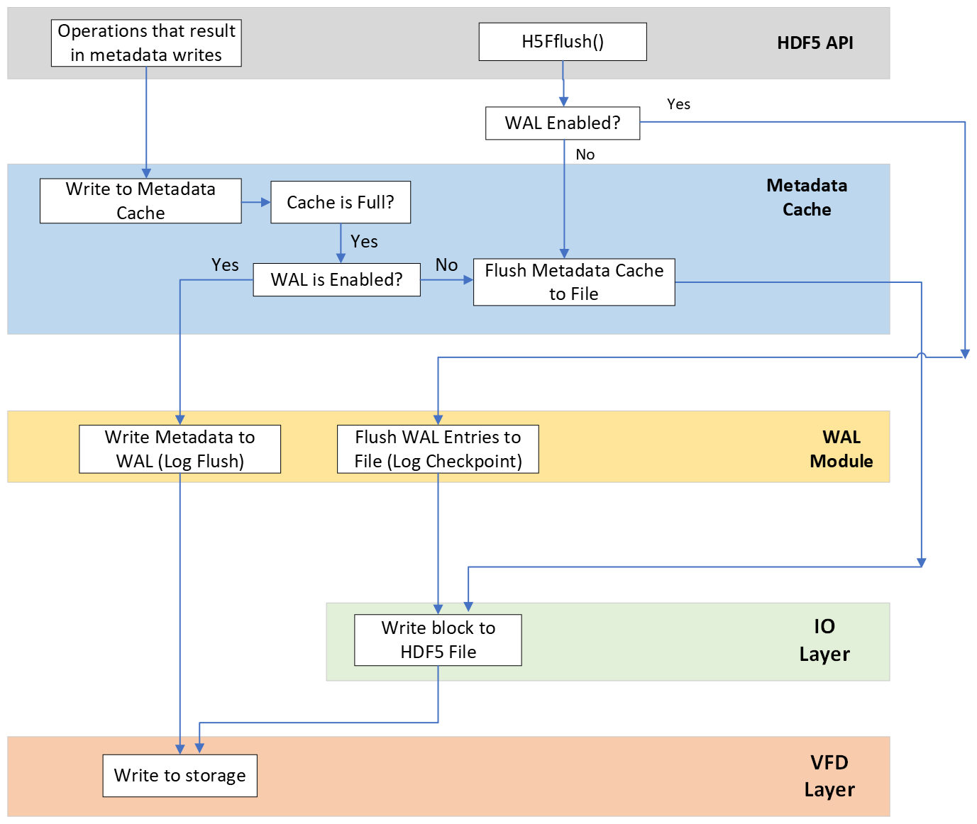
Flowchart

Slide 19
WAL File Format
The WAL file consists of a superblock, followed by a stream of WAL entries
Entries contain offset in the HDF5 file and length of the metadata block
An entry can also be a log flush marker, indicating that the HDF5 file will be consistent if the WAL is replayed to this marker

Slide 20
Scope
Metadata only (exception: compact datasets)
Variable-length and reference data will be treated as data and not logged in the WAL, even though they are partially stored in metadata objects
Will work with:
Parallel HDF5 (a critical use case!)
Single-writer/multiple-readers (SWMR) I/O
Page buffering / metadata accumulators

Slide 21
Recovery
If a crash occurs, file repair can be done in two ways:
Automatic
We will write the name of the WAL file to the HDF5 file's superblock on file create/open and remove it on file close
If a WAL file location is found in the file, and the WAL file exists, the library will automatically invoke the WAL repair code
With a separate h5repair utility
Distributed with the library as a command-line tool (like h5dump)

Slide 22
Recovery Algorithm
When opening with write access:
Scan WAL to find most recent (last in the file) log flush marker
Starting from the beginning, read each WAL entry and write the metadata block to its location in the file
Stop upon reaching the most recent log flush marker
Remove the superblock WAL message if the WAL is no longer needed
Delete all entries in the WAL
When opening with read-only access:
Basically the same, only create stub entries in the cache for each metadata entry in the WAL
Do not modify or delete the WAL file

Slide 23
New API Calls
Set/get WAL usage and parameters
H5Pset_wal(hid_t fapl_id, ...)
H5Pget_wal(hid_t fapl_id, /*out*/ ...)
Set/get automatic recovery flag for dealing with corrupt files
H5Pset_wal_auto_recovery(hid_t fapl_id, ...)
H5Pget_wal_auto_recovery(hid_t fapl_id, /*out*/ ...)
Perform a log flush (write entire metadata cache to the WAL file)
H5Fwal_flush(hid_t file_id)
Notes:
Good use case (some basic fields, to read from a single field without touching others)
Bad use case (Many layers deep nested, arrays and vlen strings)

Slide 24
Summary
With the crashproofing feature:
Corrupt files should be a thing of the past
You will be less likely to lose data after a crash
If data are lost, this loss will be minimized

Slide 25
Current Status
Currently at the design level. We have written an RFC and are seeking funding to implement it.
RFC: https://github.com/HDFGroup/hdf5doc/blob/master/RFCs/HDF5_Library/WriteAheadLog/RFC_WriteAheadLog.pdf
We have also adapted the library to simulate WAL workloads to get a handle on the performance implications of this feature. We are still investigating the behavior, but the overhead seems reasonable (a few %) for workloads that are not very metadata-intensive.

Slide 26
Support Our Non-Profit Mission
To ensure efficient and equitable access to science and engineering data across platforms and environments, now and forever.
THESE DON'T COST YOU A DIME
🙋 Help Desk Support
🛠️ Sustaining Engineering
🩺 HDF Clinic, Working Group
📅 Webinars, User Events
🤝 HDF User Forum
📢 Community Outreach
🛡️ Assured Longevity of HDF Technologies
HELP US TO KEEP IT THAT WAY
Become a Code Owner
Consult with Us
Purchase Custom Development
Get HDF Software Priority Support
Donate or be a Sponsor
Collaborate with Us on a Proposal
Become an HDF Advocate
Contact: info@hdfgroup.org
https://www.hdfgroup.org/donate
Notes:
Briefly explain each of the free services that The HDF Group provides (table on the left) and where to get more information/access those services (www.hdfgroup.org). Next, discuss how the activities/services listed in the table on the right help us to continue to support and provide the free services. If they have any questions they can send an email to info@hdfgroup.org.

Slide 27
THANK YOU!
Questions & Comments?

Slide 28
Benchmarks
Created file driver and standalone program to simulate overhead of WAL
Modified file driver performed and timed occasional file syncs to simulate log checkpoint operations, and created an intermediate log of metadata operations
Standalone program read this intermediate log and wrote a dummy WAL file with the correct sizes of pieces of metadata. The WAL write was timed, and it performed occasional file syncs on the WAL file to simulate log flush operations
Not perfect, but should give general idea of performance
Notes:
Good use case (some basic fields, to read from a single field without touching others)
Bad use case (Many layers deep nested, arrays and vlen strings)

Slide 29
Benchmarks
Benchmarks A and B are metadata heavy, single rank; benchmark C is raw data heavy, 4 ranks
Found that the overhead was generally very small, except for log checkpoint operations
If log checkpoints can be completely avoided (only performed when closing file), overhead is minimal
Y-axis is overhead, X-axis is log checkpoint interval (log flush interval is 1/16 of log checkpoint interval)
Notes:
Good use case (some basic fields, to read from a single field without touching others)
Bad use case (Many layers deep nested, arrays and vlen strings)

Slide 30
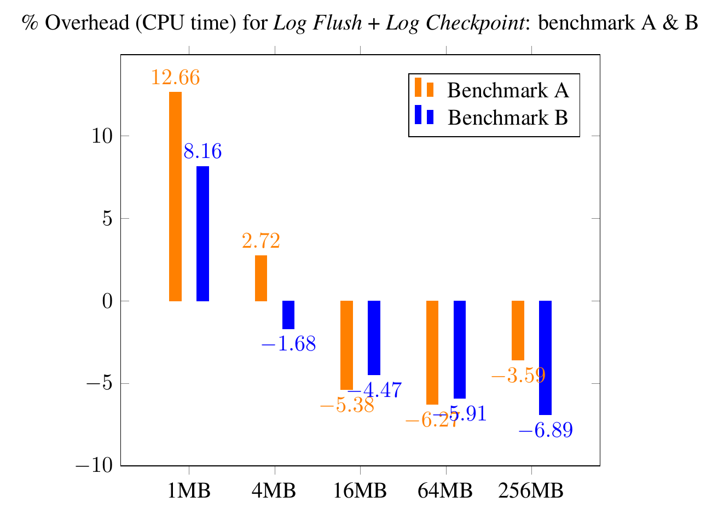
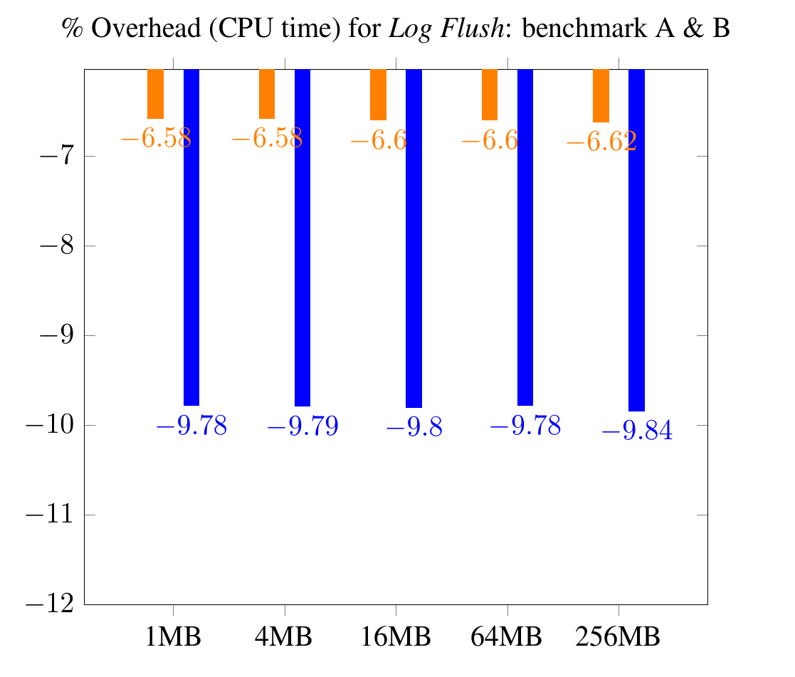
Benchmarks: Metadata Heavy, CPU Time
Notes:
Good use case (some basic fields, to read from a single field without touching others)
Bad use case (Many layers deep nested, arrays and vlen strings)

Slide 31
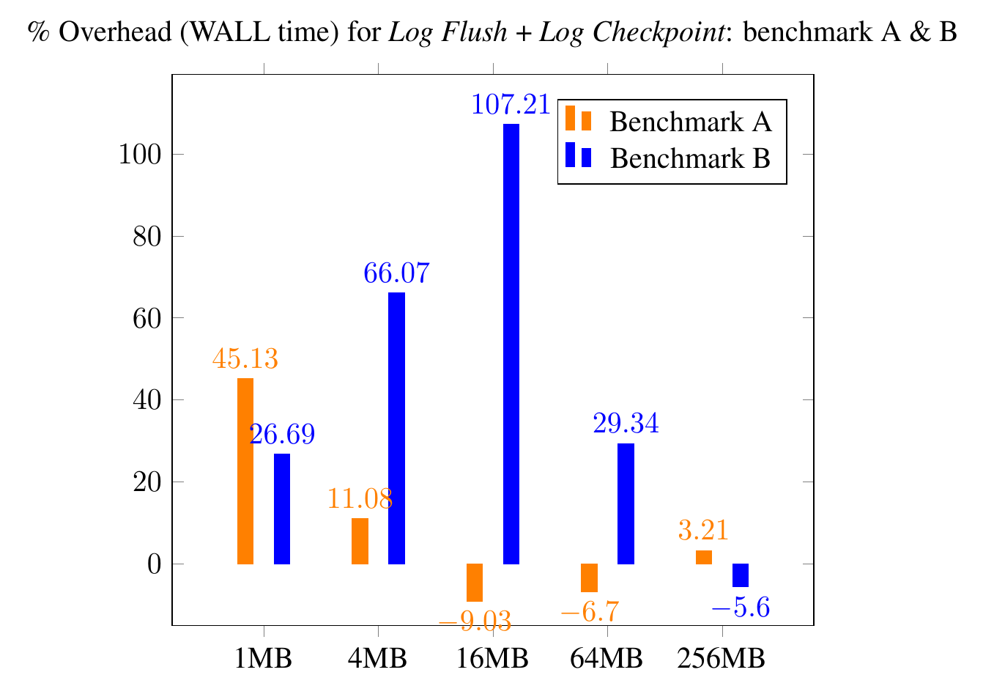
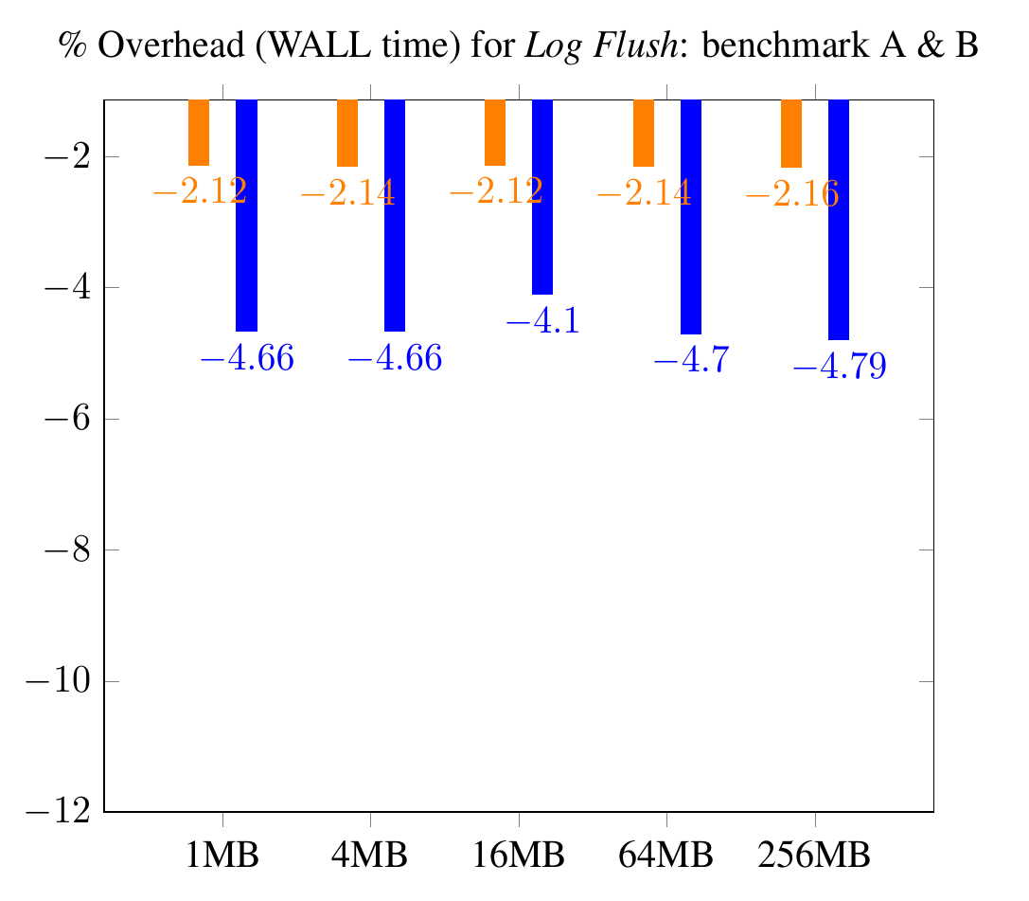
Benchmarks: Metadata Heavy, Wall Time
Notes:
Good use case (some basic fields, to read from a single field without touching others)
Bad use case (Many layers deep nested, arrays and vlen strings)

Slide 32
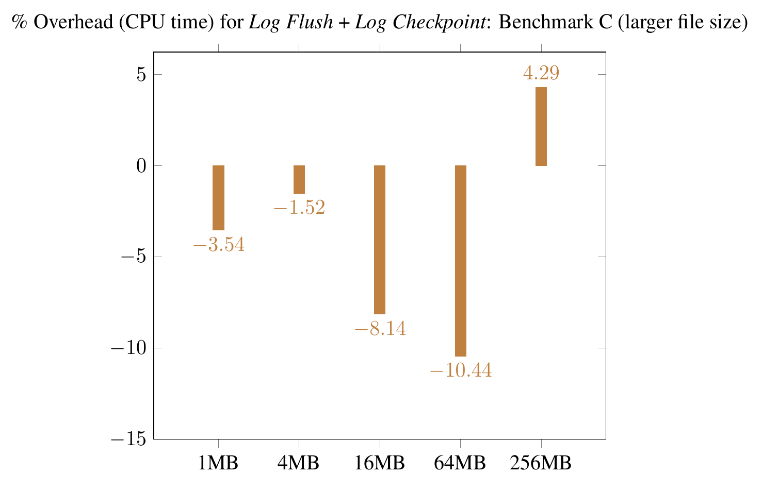
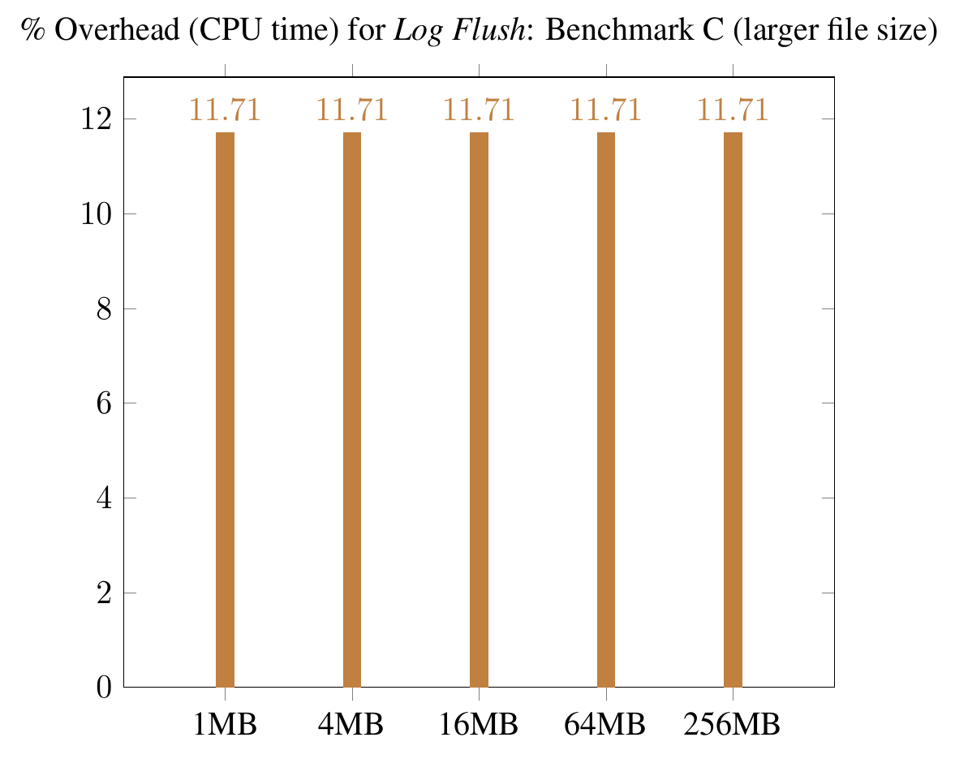
Benchmarks: Raw Data Heavy, CPU Time
Notes:
Good use case (some basic fields, to read from a single field without touching others)
Bad use case (Many layers deep nested, arrays and vlen strings)

Slide 33
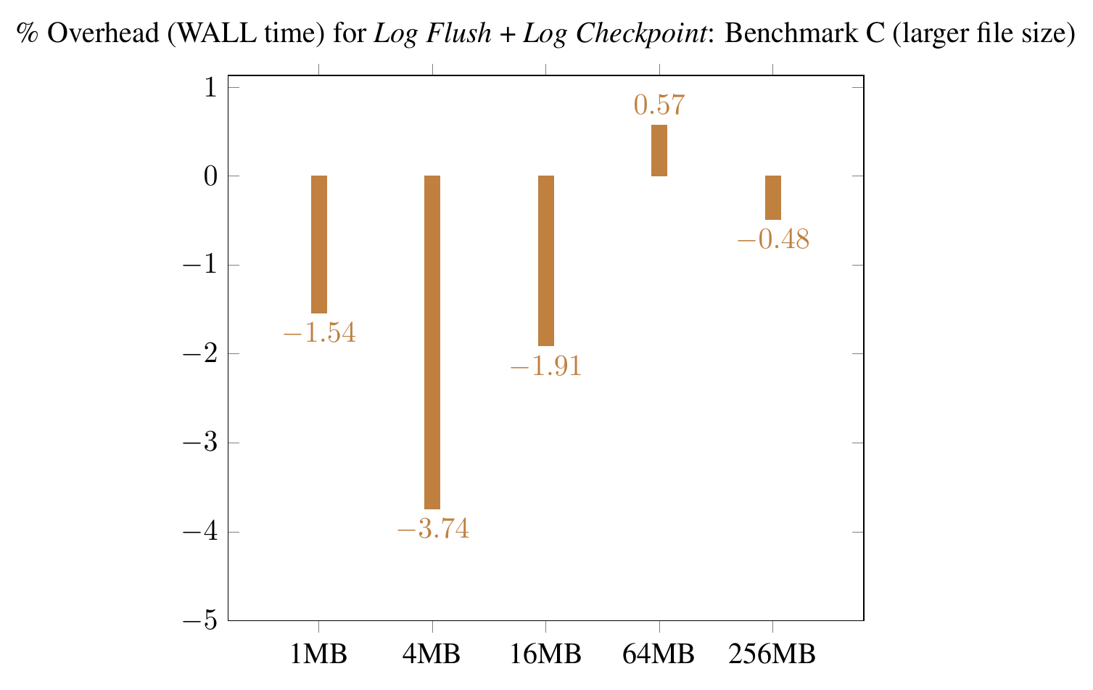
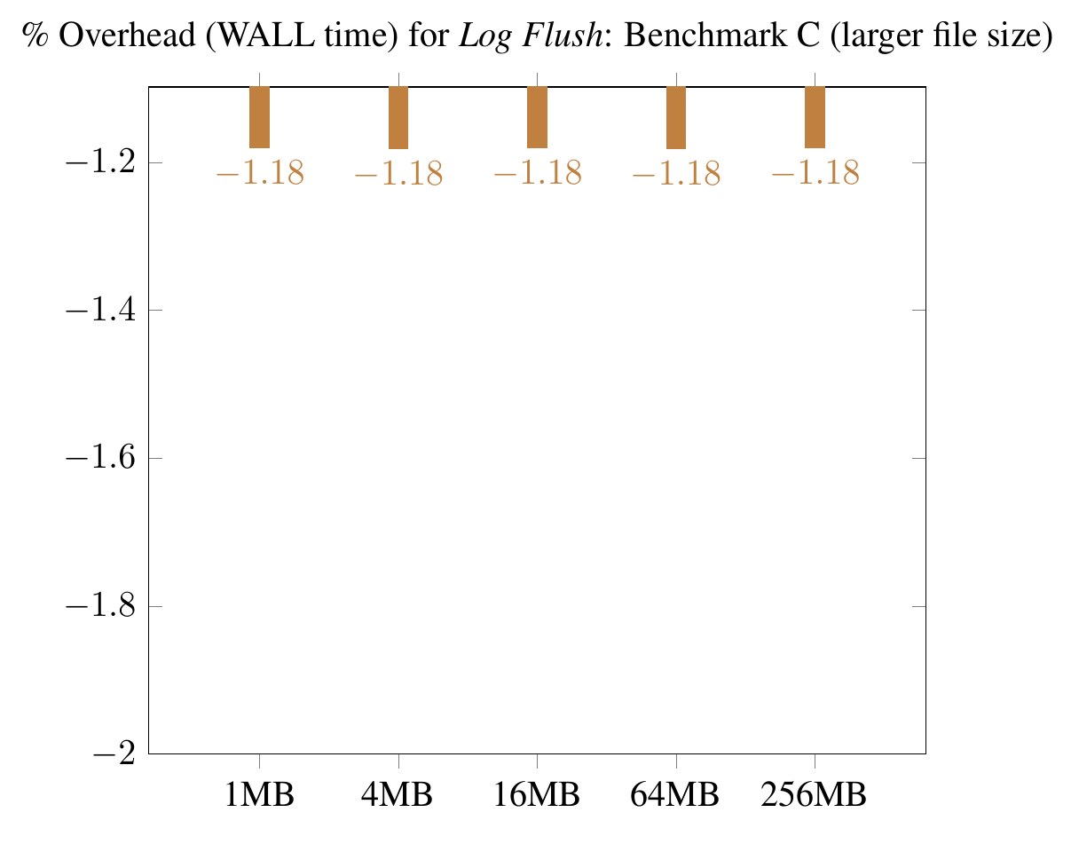
Benchmarks: Raw Data Heavy, CPU Time
Notes:
Good use case (some basic fields, to read from a single field without touching others)
Bad use case (Many layers deep nested, arrays and vlen strings)

