Slide 1
Scientific Computing Strategy Developments at the Upgraded Advanced Photon Source
New Opportunities for Better User Group Software (NOBUGS) 2024
Nicholas Schwarz
Principal Computer Scientist Group Leader
Scientific Software Engineering & Data Management
X-ray Science Division

Slide 2
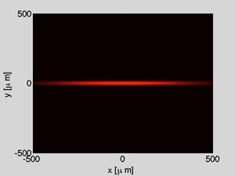
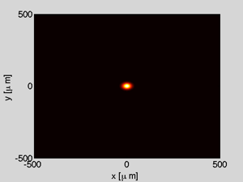
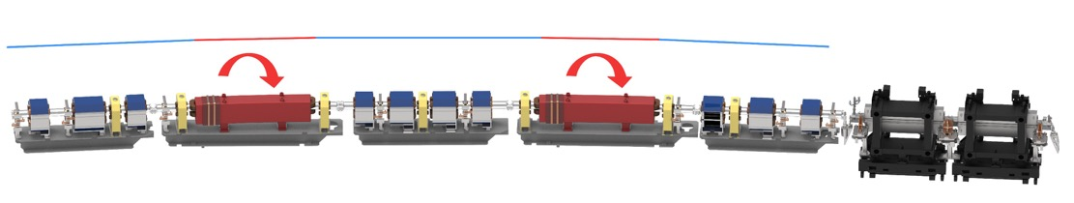
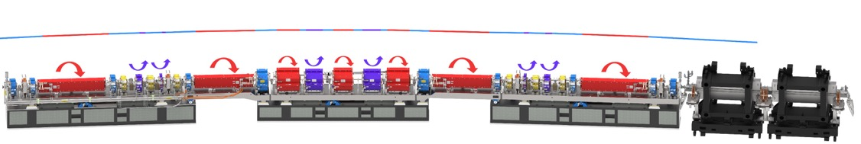
APS Upgrade: The Ultimate 3D Microscope
APS Today
APS Upgrade
ε_{ο} = 3100 pm
ε_{ο} = 42 pm
Replace the storage ring to dramatically decrease electron source size
Notes:
Current source is about 10x270 µm New source ~3x14 µm

Slide 3
APS Upgrade: The Ultimate 3D Microscope
A next-generation synchrotron light source for science and industry
Completely new storage ring, 42 pm emittance @ 6 GeV, 200 mA
New and updated insertion devices
Combined result in brightness increases of up to 500x
9 new feature beamlines (green)
15 beamline enhancements (red)
$815 M project to update and renew the facility
Re-uses $1.5 B in existing infrastructure

Slide 4





APS Goal: Harness the power of computing, and the value contained in data to elevate the overall scientific impact and boost the operational efficiencies of the APS beamlines and accelerator complex
Tactical Activities:
Upgrading network architecture and infrastructure
Deploying state-of-the-art systems for controls, data acquisition, and detectors
Expanding the capabilities and use of common data management, workflows, and science portals
Utilizing local and remote high-performance computing infrastructure to meet data processing needs
Developing high-speed data reduction and analysis software, and applying new algorithms and mathematics
Leveraging AI/ML
Expanding collaborations
1. Enable High-Speed Discovery
Harness the unprecedented power of computing and data science expertise at Argonne to reduce the time to science
2. Unlock Exceptionally Challenging Experiments
Apply Argonne’s strengths in AI/ML and autonomous experiments, large-scale simulations, and x-ray experiments to unlock otherwise unreachable complex scientific solutions
Take advantage of the opportunities created by the explosion of data at the APS coupled with AI to advance new science that is only achievable using combined knowledge
3. Leverage Data for New Science
4. Empower Users to Realize the Full Potential of the APS
Provide APS users with the cutting-edge tools needed to produce world leading science
5. Expand Collaborations
Leverage partnerships and initiatives to amplify the impact of Argonne and APS resources

Slide 5
Network Infrastructure
State-of-the-art network performance, and security and resiliency
3-tier network infrastructure: facility, sector, enclosure
Supervisory control and data acquisition (SCADA) architecture to better support controls, data, and regular network traffic
Installed new fiber plant for all APS beamlines; 768 pairs of new single-mode fiber from the APS computer room to beamlines
Upgraded the APS ↔︎ Argonne Leadership Computing Facility (ALCF) network connection to 4 x 100 Gbps
  Plan to upgrade to a terabit/s network
New switches for APS sectors capable of multiple 100 Gbps links
New core network switches capable of multiple 400 Gbps links

Slide 6
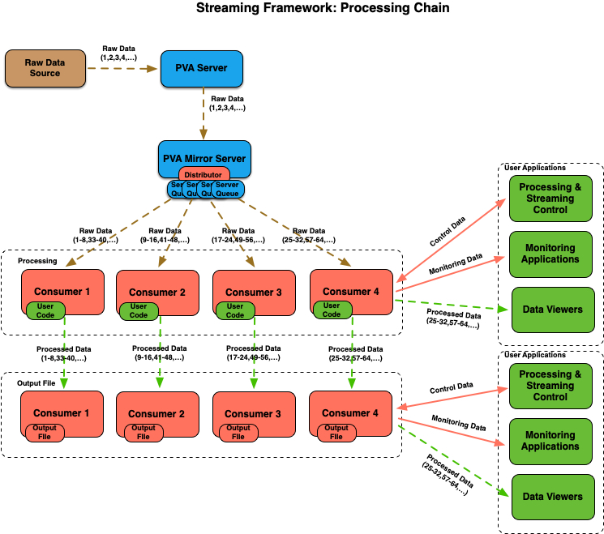
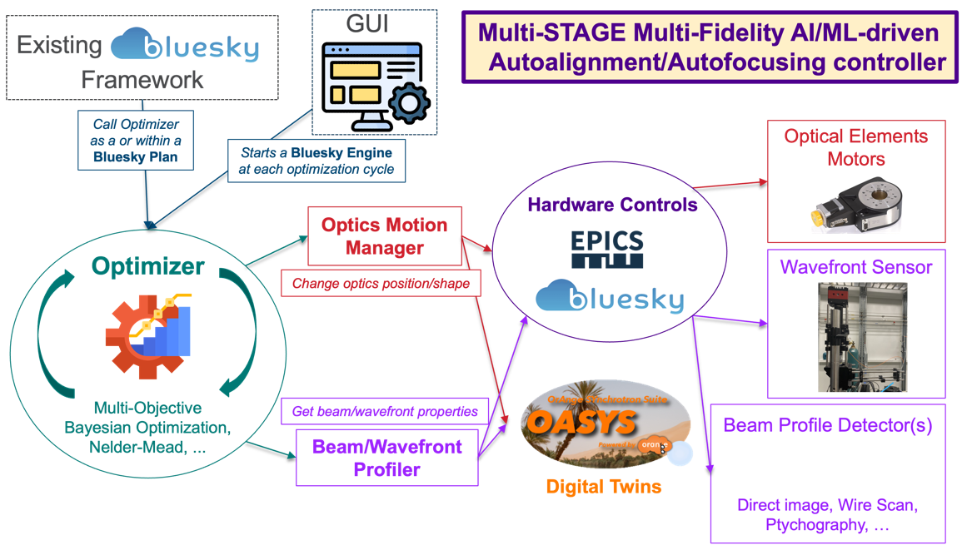
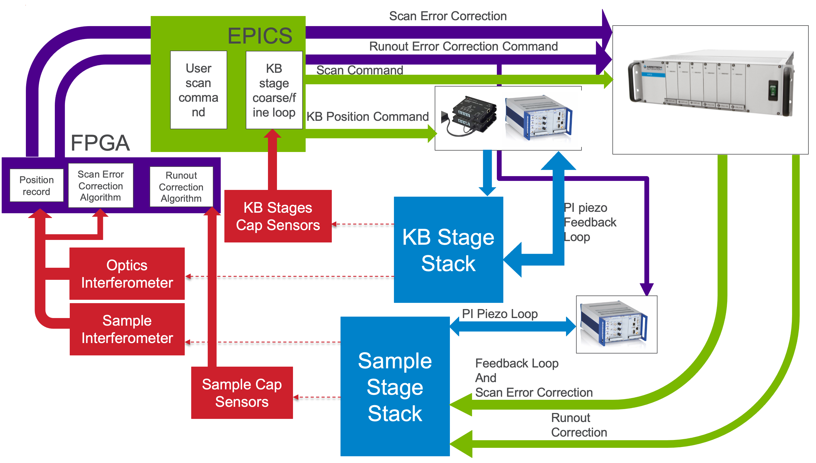
Controls, Data Acquisition, and
Detector Integration
Refer to talks:
Generalized Scientific Measurements with Bluesky & Workflow Automation
Presenter: Eric Codrea
Implementing Bluesky at APS: A Strategy for Enhanced Data Acquisition and Collaboration
Presenter: Fanny Rodolakis
Fast Scanning and Feedback
Fast Detector Data Handling
Experiment Control
New instruments, especially the nano- and micro-probe scanning instruments, require fast scanning and feedback capabilities
APS-developed softGlue Zynq provides configurable FPGA capabilities for hardware-level data acquisition and feedback
  D-TACQ FPGA device that integrates signal acquisition and firmware feedback is being tested
High data-rate detectors will generate thousands of frames per second and up to tens of GB/s of bandwidth
EPICS v7, areaDetector, and the newly developed pvaPy streaming data framework can process data at thousands of frames per second
Integrated with the APS Data Management System and Globus
New beamlines and experiments require experiment control tools that can handle complex data acquisition and asynchronous event-based sources
Bluesky is being deployed at APS beamlines to provide an approach to experiment control that enables next-generation experiments
Schematic of fast scanning and interferometry on the APS-U ISN Feature beamline
pvaPY streaming framework: https://github.com/epics-base/pvaPy
Schematic of Oasys digital twin integrated with a beamline via Bluesky and the Bluesky Adaptive framework

Slide 7
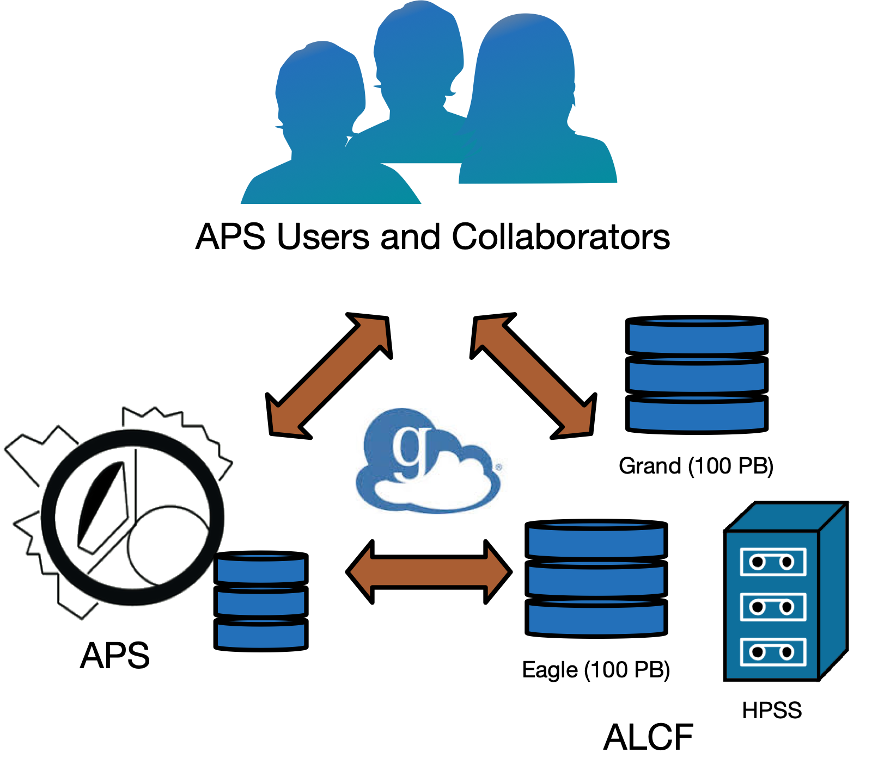
Data Management, Workflows, and Science Portals
Refer to talks:
Linking Scientific Instruments and Computation: Patterns, Technologies, Experiences
Presenter: Ian Foster
Streamlining Scientific Discovery with Data Pipelines at the Advanced Photon Source
Presenter: Hannah Parraga
Tools for predicting and responding to anomalies in experiment data streams
Presenter: Justin Wozniak
The APS Data Management System — facility-wide software and hardware for managing data and computing workflows
Tools to automate transfer of data between acquisition devices, computing resources, and data storage systems
Data from detectors is written directly to central storage or to local storage and transferred after acquisition; long-term storage on tape
Access permissions are granted to the users signed-up to perform a particular experiment
Workflow tools automate data processing via plug-ins and integration with Globus Compute
Users can download data at their home institutions using Globus Transfer (globus.org)

Slide 8
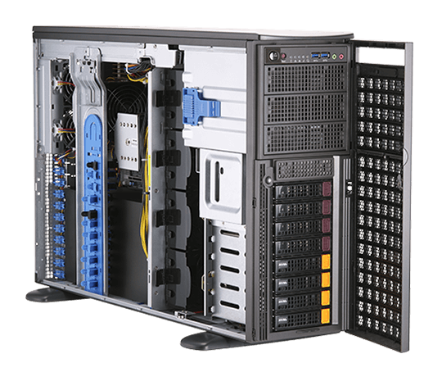
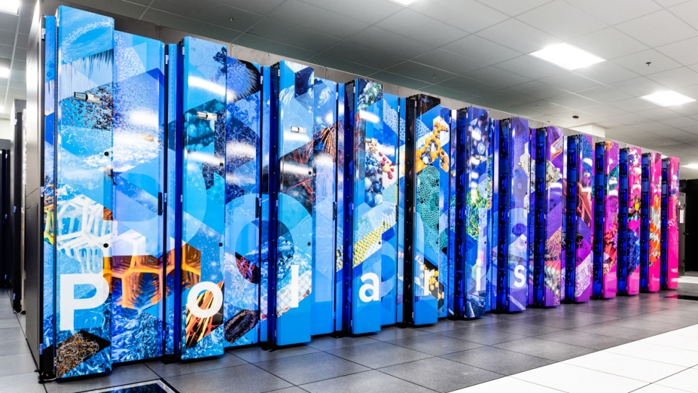
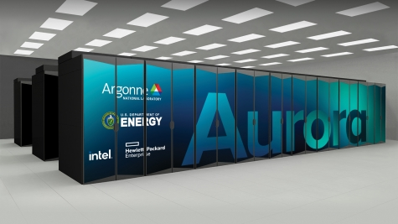
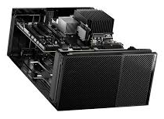


Computing Infrastructure
Multi-tiered approach to computing from beamlines to supercomputers
Argonne Leadership Computing Facility (ALCF)
Instrument / Beamline
APS
Compute Infrastructure
Edge Devices
Workstations
GPGPU-equipped
Polaris Supercomputer
44 petaflop/s (4 petaflop/s for on-demand)
Aurora Supercomputer
>1 exaflop/s
Local Cluster
~20 TFLOP/s CPU cores
Eagle
(100 PB)
Voyager
(~8 PB)
Storage infrastructure
New Data Buffer
(~50 PB)
Grand
(100 PB)
HPSS
Tape Storage
New beamline and instrument networks; new Tier 2 and 3 switches
(in progress)
New APS fiber plant and Tier 1 switches
(completed)
Terabit per second
APS <-> ALCF network
(planned for 2025)
New high-speed ALCF network
(planned for 2025)
Network infrastructure

Slide 9
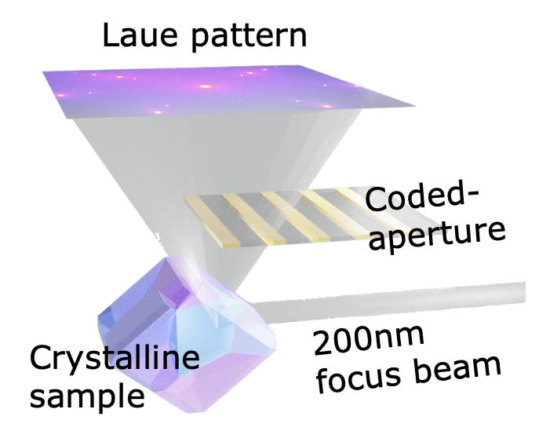
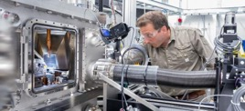
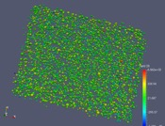
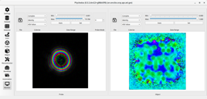
Data Reduction and Analysis Software
X-ray Photon Correlation Spectroscopy
Laue Depth Reconstructions
Measure the dynamics of equilibrium and non-equilibrium processes
Processed 10s of thousands of datasets; keep up with processing data at rates of at least 2 kHz
Beamlines: CHEX, CSSI, XPCS
Structure of materials with sub-micron spatial resolution in all three dimensions; local crystallographic orientations, orientation gradients, and strains
Continuously utilized 56 nodes on Polaris during beamtime
Beamlines: 3DMN
X-ray Ptychography
High-Energy Diffraction Microscopy
Imaging technique that combines benefits of scanning microscopy and CDI; quantitative phase and absorption contrast
The workflow reconstructed ptychography scans over a day of data acquisition without human intervention
Beamlines: ATOMIC, CHEX, CSSI, HXN, ISN, Polar, PtychoProbe, 2-ID
Combined multiple diffraction and imaging techniques to produce crystalline grain structure and orientation
Facilitates automated data processing of multi-modal data during beam time
Beamlines: HEXM, 1-ID

Slide 10
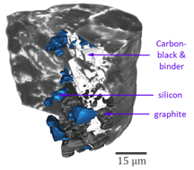
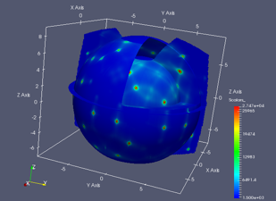

Data Reduction and Analysis Software
X-ray Fluorescence Mapping
Bragg CDI
Spectroscopy technique that identifies the elemental composition of samples
Beamlines: CHEX, Polar, HXN, ISN, PtychoProbe,
2-ID, 25-ID
“Lensless” imaging technique for 2D or 3D reconstruction of nanoscale structures
Beamlines: ATOMIC, CHEX, HEXM
X-ray Tomography
Reciprocal Space Mapping
Map detector pixel locations from diffractometer geometry to reciprocal-space units, and then on to a 3D reciprocal-space grid
Beamlines: 3DMN, ATOMIC, CHEX, HEXM, 6-ID, 7-ID, 30-ID, 33-ID
Imaging technique using X-rays to penetrate objects and generate projections that are combined to form a 3D object.
Beamlines: 2-BM, 7-BM, 32-ID, HEXM, ISN, Polar, PtychoProbe
Müller, et al. Nature Communications 9 (2018).

Slide 11
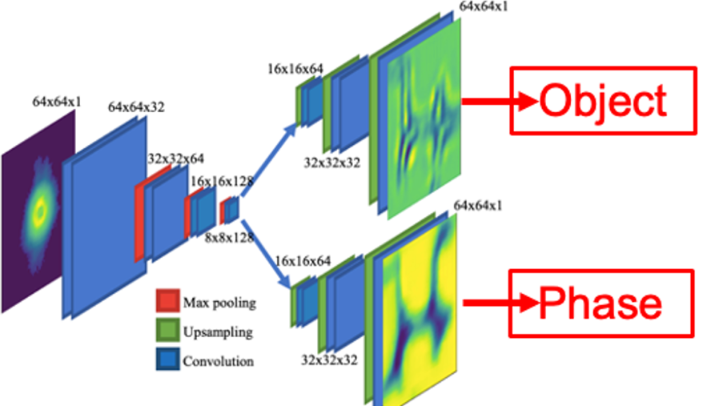
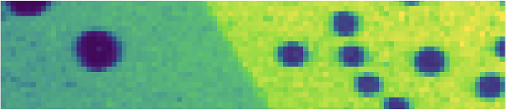
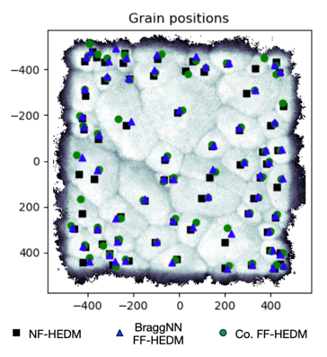
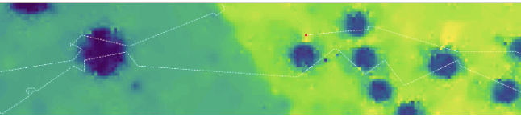
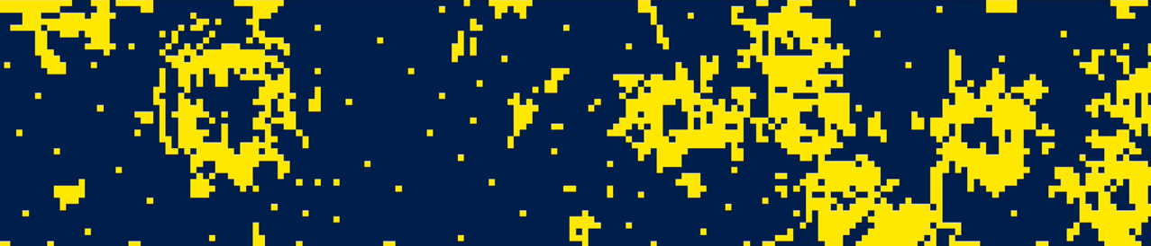
Artificial Intelligence / Machine Learning (AI/ML)
Data Reduction
Experiment Steering
Knowledge Extraction
PtychoNN: Machine learning ptychography reconstruction
100s of times faster and requires up to 5 times less data than conventional iterative approaches
Smart Data Acquisition: Machine learning optimizes acquisition scanning path in real-time
Using Google OR-Tools, AI calculates next points to scan
Motor movement is reduced by 80%
Generating interatomic potentials: Unsupervised machine learning generated interatomic potentials for a refractory oxide
Diffraction measurements initialize an active-learner that iteratively improves an ML model
Full-resolution, ‘ground truth’
AI-guided acquisition
BraggNN: Machine learning method for determining Bragg peak locations from far-field high-energy diffraction microscopy data
>200 times faster than conventional pseudo-Voigt profiling approach
Scan points
A. Babu, T. Zhou et al., Nature Comm., 14, 7059 (2023) .
Liu, Z., Sharma, H., Park, J. S., Kenesei, P., Miceli, A., Almer, J., Kettimuthu, R., Foster, I., “BraggNN: fast X-ray Bragg peak analysis using deep learning,” IUCrJ 9, 104-113 (2022).
S. Kandel et al., Nature Comm., 14(1), p.5501 (2023).
Sivaraman, G., Gallington, L., Krishnamoorthy, A. N., Stan, M., Csányi, G., Vázquez-Mayagoitia, Á., Benmore, C. J., “Experimentally driven automated machine-learned interatomic potential for a refractory oxide,” Physical Review Letters, 126(15), 156002 (2021).

Slide 12
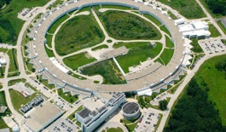
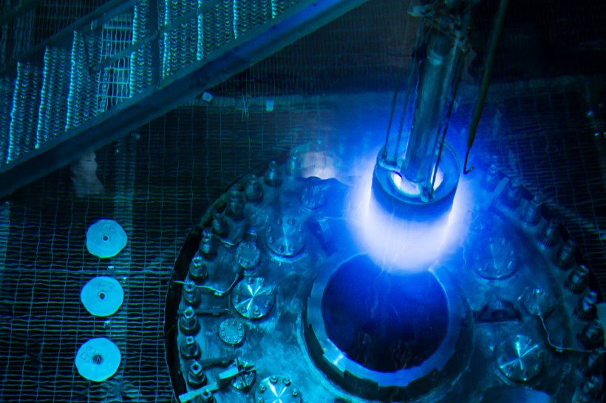
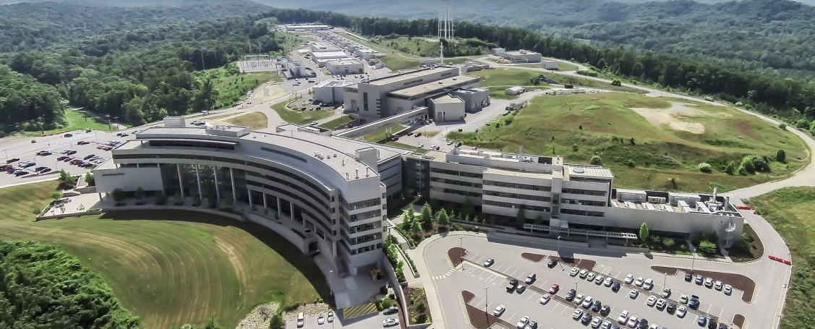
6-Way Collaboration Working Group
Working group across the US Department of Energy (DOE), Office of Science, Basic Energy Sciences light and neutron sources
Advanced Light Source (ALS) / Lawrence Berkeley National Laboratory
Advanced Photon Source (APS) / Argonne National Laboratory
Linac Coherent Light Source (LCLS) / SLAC National Accelerator Laboratory
National Synchrotron Light Source II (NSLS-II) / Brookhaven National Laboratory
Stanford Synchrotron Radiation Lightsource (SSRL) / SLAC National Accelerator Laboratory
Spallation Neutron Source (SNS) and High Flux Isotope Reactor (HFIR) / Oak Ridge National Laboratory
Develop and maintain a strategic plan in the area of computing and data, and assist in the coordination and execution of related work
Developed reports and guidance on data and computing needs, and a common data policy template
Coordinated on proposals for many DOE funding calls and awards

Slide 13
Funded Data & Computing Projects
The light and neutron sources have developed a strong portfolio of collaborative data & computing projects
Artificial Intelligence and Machine Learning at DOE Scientific User Facilities
Advanced Scientific Computing Research for DOE User Facilities
^{APS} A Digital Twin for In Silico Time-Resolved Experiments
^{APS} Actionable Information from Sensor to Data Center
^{APS} Collaborative Machine Learning Platform for Scientific Discovery: MLExchange
^{APS} Integrated Platform for Multimodal Data Capture, Exploration and Discovery Driven by AI Tools
Intelligent Acquisition and Reconstruction for Hyperspectral Tomography Systems
^{APS} Machine Learning for Autonomous Control of Accelerators
Machine Learning for Improving Accelerator and Target Performance
4DCamera Distillery: From Massive Electron Microscopy Scattering Data to Useful Information with AI/ML
^{APS} ILLUMINE - Intelligent Learning for Light Source and Neutron Source User Measurements Including Navigation and Experiment Steering
SLAC, ANL, BNL, LBNL, ORNL
^{APS} X-ray & Neutron Scientific Center for Optimization, Prediction & Experimentation (XSCOPE)
ANL
The Center for Advanced Mathematics for Energy Research Applications (CAMERA)
LBNL
^{APS} Data Solution Task Force Pilot Project
Pilot project to develop common software for data acquisition, management, and analysis across the 5 DOE SC light sources
LBNL, ANL, BNL, SLAC

Slide 14
Exciting Opportunities in Emerging Collaborations, Projects, and Initiatives
Integrated Research Infrastructure (IRI) Program
Aim: Provide researchers with seamless interoperability of DOE’s unique data, user facilities, and computing resources
Potential address needs at the light and neutron sources for common building blocks of an interoperable computing fabric that enables facility integration
APS and other facilities are identified as Pathfinder projects
High-Performance Data Facility (HPDF) Project
New state-of-the-art facility for data science and research currently in planning stage
Potential to provide seamless access to interoperable, scalable, and resilient computing resources for real-time processing, post experiment refinement, and simulation
Potential to provide data catalogs and storage connected to computing resources, especially for AI/ML and digital twins efforts
Frontier AI for Science, Security and Technology (FASST) Initiative
Opportunity to harness the unique capabilities of the light and neutron sources and the User community with AI to unlock new science
The light and neutron sources would be both contributors to and beneficiaries of advanced AI/ML efforts

Slide 15
Acknowledgements
Anakha Babu
Antonino Miceli
Arthur Glowacki
Arvind Ramanathan
Ashish Tripathi
Barbara Frosik
Brian Toby
Brian Robinson
David Leibfritz
David Wallis
Deming Shu
Denjamin Blaiszik
Dennis Trujillo
Doga Gursoy
Fang Zhang
Felix Lacap
Francesco De Carlo
Franck Cappello
Hannah Parraga
Hanna Ruth
Hemant Sharma
Henry Smith
Howard Yanxon
Ian Foster
Jeff Kirchman
Jini Ramprakash
John Weizeorick
John Hammonds
John O'Connell
Jonathan Tischler
Jonathan Almer
Joseph Sullivan
Justin Wozniak
Keenan Lang
Kevin Peterson
Kurt Goetze
Kyle Chard
Lahsen Assoufid
Luca Rebuffi
Mark Engbretson
Mathew Cherukara
Max Wyman
Miaoqi Chu
Michael Papka
Michael Prince
Michel Van Veenendaal
Mike Hammer
Nicola Ferrier
Orlando Quaranta
Peco Myint
Pete Jemian
Pete Beckman
Prasanna Balaprakash
Rajkumar Kettimuthu
Roger Sersted
Ryan Chu
Ryan Milner
Salman Habib
Sebastian Strempfer
Sinisa Veseli
Skip Reddy
Stefan Wild
Steven Henke
Suresh Narayanan
Sven Leyffer
Tejas Guruswamy
Tekin Bicer
Thomas Uram
Ti Leggett
Tim Mooney
Todd Munson
Tomas Walsh
Valerie Taylor
William Allcock
Xianbo Shi
Xuli Wu
Yudong Yao
Zichao Di
And many, many others…

Slide 17
The submitted manuscript has been created by UChicago Argonne, LLC, Operator of Argonne National Laboratory (“Argonne”). Argonne, a U.S. Department of Energy Office of Science laboratory, is operated under Contract No. DE-AC02-06CH11357. The U.S. Government retains for itself, and others acting on its behalf, a paid-up nonexclusive, irrevocable worldwide license in said article to reproduce, prepare derivative works, distribute copies to the public, and perform publicly and display publicly, by or on behalf of the Government. The Department of Energy will provide public access to these results of federally sponsored research in accordance with the DOE Public Access Plan. http://energy.gov/downloads/doe-public-access-plan.

