Slide 1
Sample lifecycle management and experimental data catalog roll out
How we introduced IT architecture activities at SOLEIL
G.Abeillé – ISAC (Acquisition & Control Systems Engineering)
On behalf of SOLEIL DSSI (Information System Strategy Direction)

Slide 2
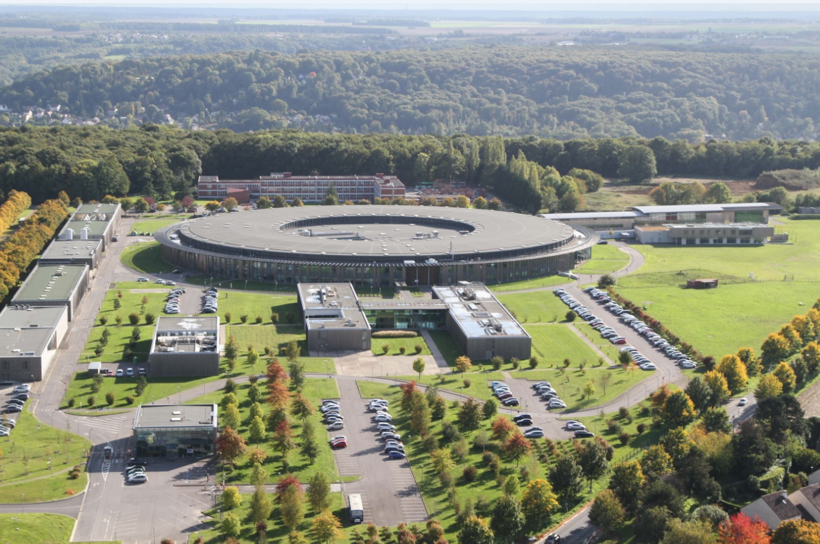
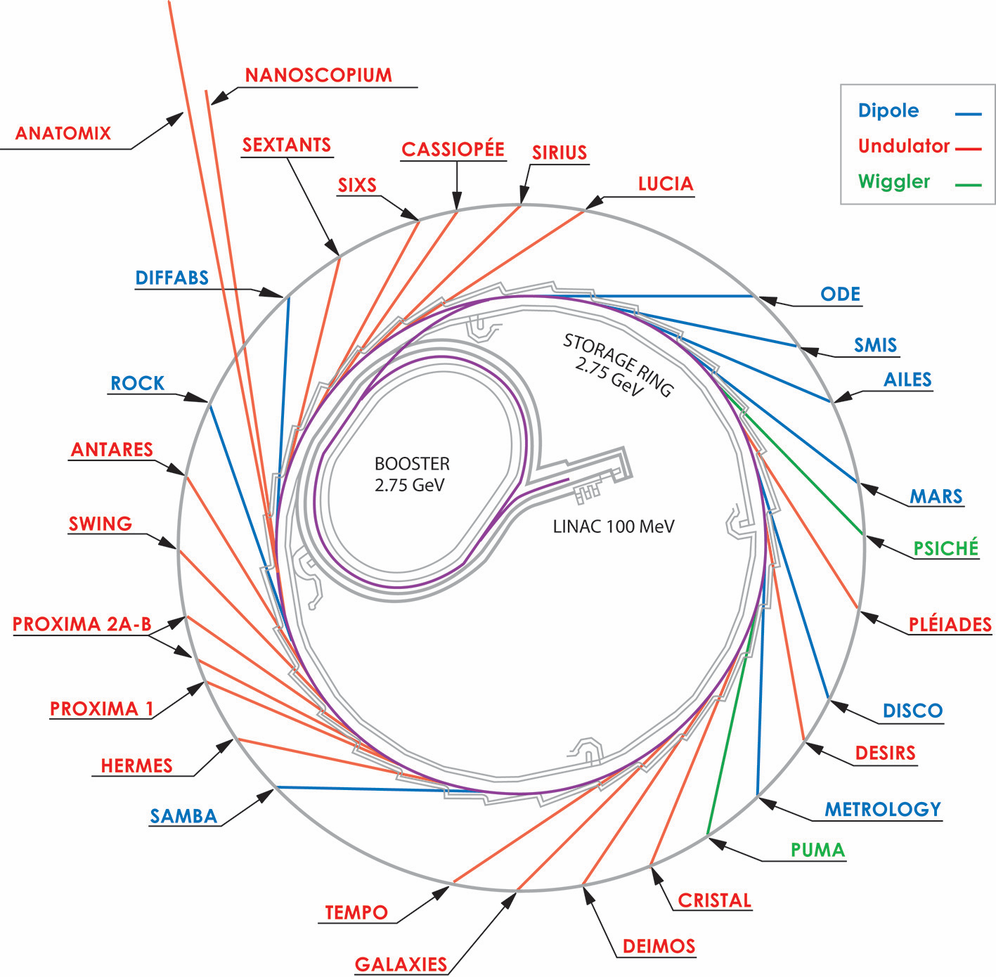
Synchrotron SOLEIL
French installation, near Paris
29 beamlines
Opened to external users since 2008
Energy from far IR to hard X-rays
Storage ring 354m, 2.75GeV
~ 450 staff members / ~ 40 computing & electronics

Slide 3
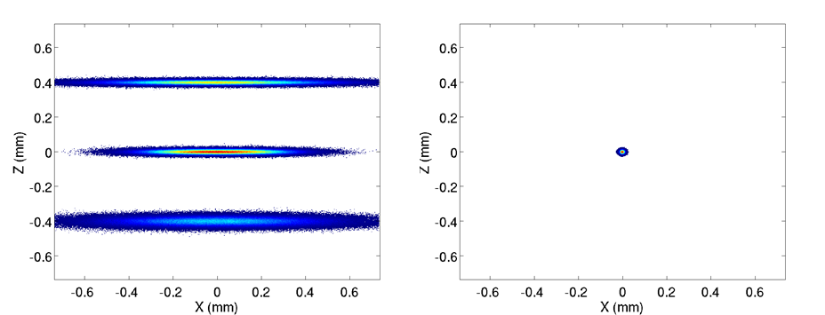
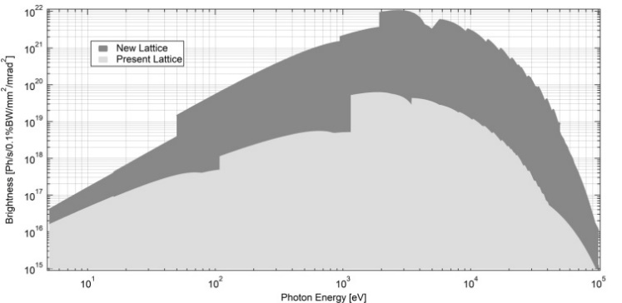
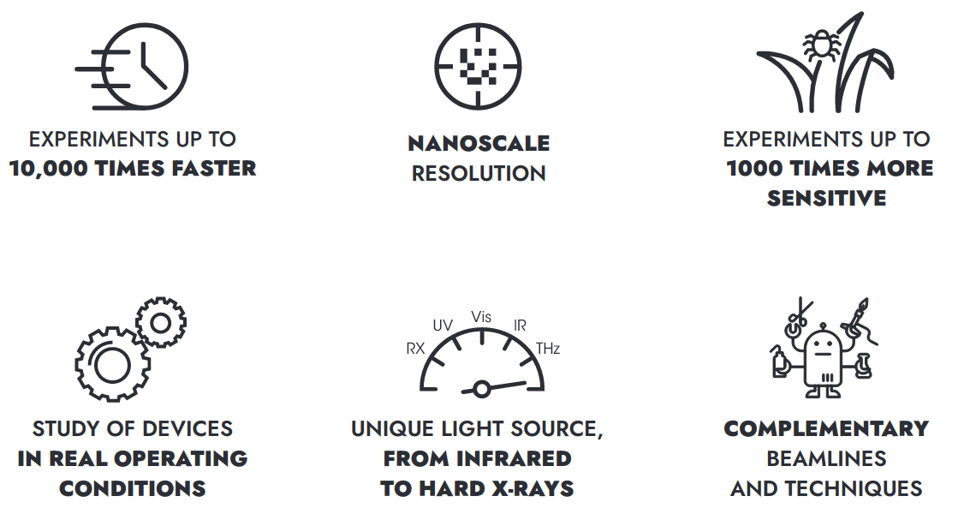
Towards SOLEIL II
Beam sizes
New booster
New storage ring
SOLEIL
SOLEIL II
SOLEIL II
10 µm
400 µm
SOLEIL
Emittance < 100 pm.rad.
Brightness
https://www.synchrotron-soleil.fr/en/future-soleil-soleil-ii-project
Dark period
Phase 1: Construction
Phase 2: Towards full performance
Budget
Machine parameters
Infrastructure & buildings
Beamlines implementation
Project organization
New machine assembly
Shutdown and installation
Restart of 7/10 upgraded + 19/22 adapted beamlines
New machine commissioning
Instrumentation R&D
Beamlines optimisation and upgrade
Laboratories modernization
Instrumentation R&D

Slide 4
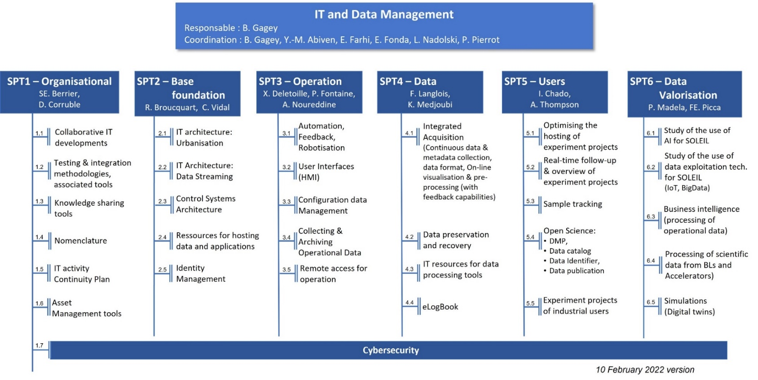
TDR program for IT
UX & UI
Open Data
User experience
Data
driven
IT architecture
Operational excellence
IT strategy alignment &
Teams' cooperation
Continuous improvement
Smart Processes & Systems
Performance
Agility
Reliability
Teams training & shared culture
Security
Monitoring
&
Observability
Maintaibility
This presentation highlights the collaboration between:
Sample lifecycle management
Experimental data catolog
IT Architecture
> 50 people involved from Experiences, Accelerators and IT
> 30 work groups or projects

Slide 5
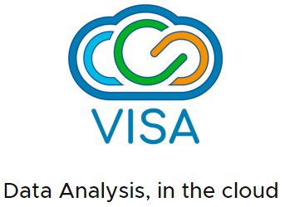
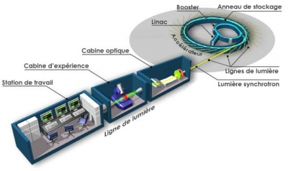
A more complex IT future
Quality Tools
Users & Projects
Control Systems
Sample Life Cycle
FAIR Data Policy
Data Processing
e.g.
Now
Future
Heterogeneous
Siloed solutions
Cross-functional processes
Digital everywhere

Slide 6
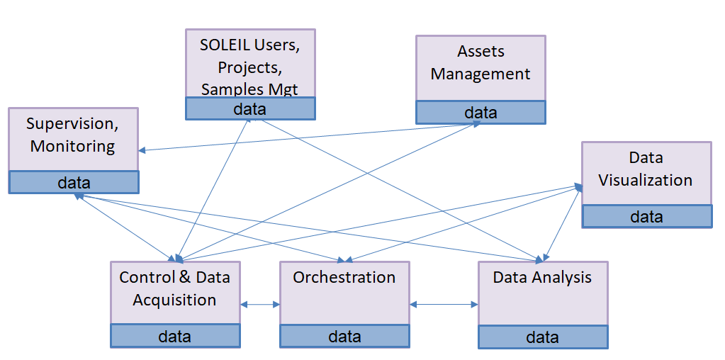
SOLEIL’s IT architecture initiative
3 workstreams:
An architecture committee
A technical platform for data exchange
Rolling out
Sample lifecycle & Data catalog
Avoid the “spaghetti plate effect”
Notes:
workstream

Slide 7
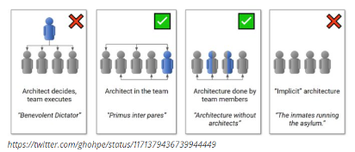
Architecture committee
Foster and review projects architecture
For new projects
or major refactoring
Dialog between architects, project managers, experts…
Validate the application of the principles or agree on temporary derogations
Started one year ago
Leaded by SOLEIL IT strategy director
Includes 1 person per IT team
Set of architectural principles
Common consensus
Design guide
Applied proactively
Evolving
INTER
OPERABILITY
PERFORMANCES
SECURITY
BY DESIGN
…

Slide 8
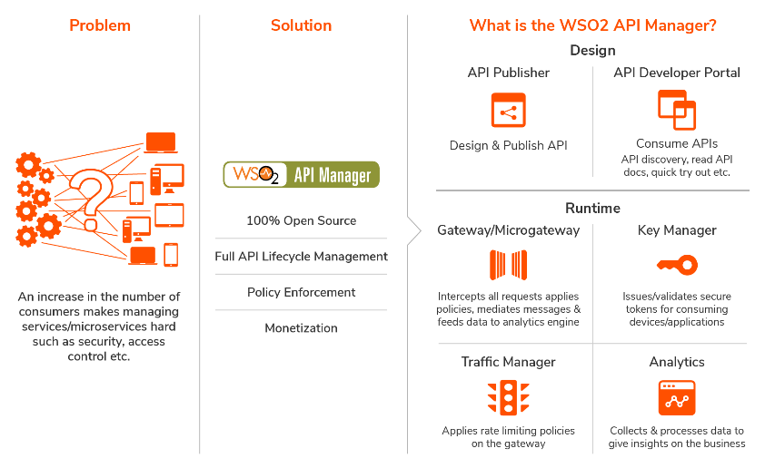
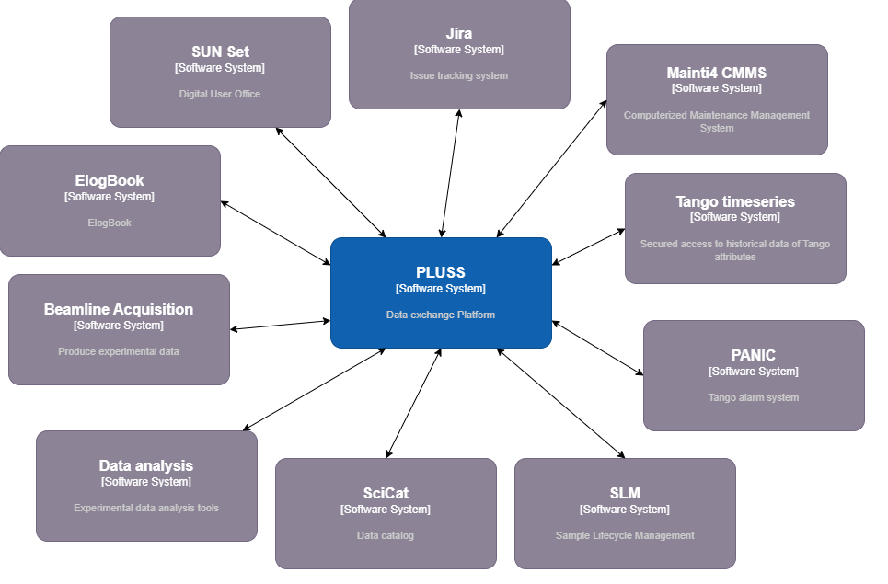
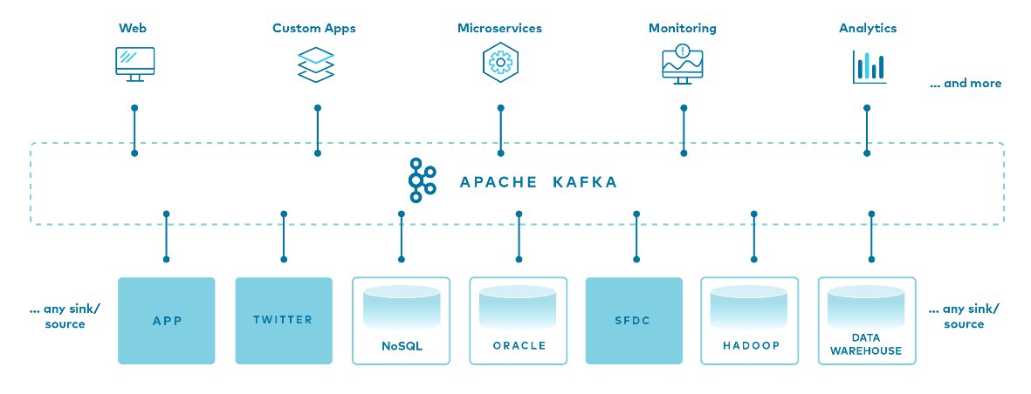
Technical platform: PLUSS
Provide a technical platform called PLUSS to exchange data between applications based 2 complementary solutions:
PLUSS
API Manager with WSO2
Provide a catalog of Web APIs (Open API/ REST, SOAP, GraphQL, …)
Control API usages (security, quotas…)
Event bus with Apache Kafka
HA, scalable, high throughput
Decoupling between producers and consumers
Schema registry
Data transformation
Large nr of existing connectors
PLUSS:
Information System’s Architecture PIatform for SOLEIL.
(Plateforme d’Urbanisation du Synchrotron SOLEIL)

Slide 9
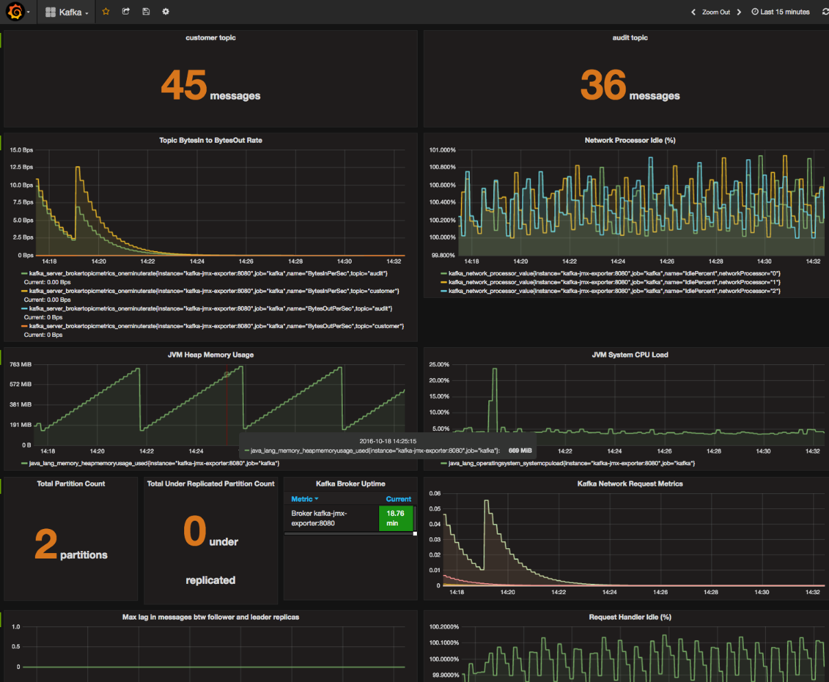
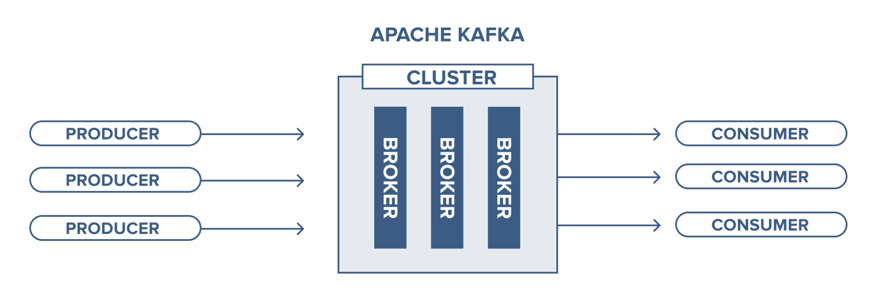
PLUSS status
WSO2 API Manager used in operation for one use case
Apache Kafka used in dev environment
Apache Kafka soon deployed in production env:
3-nodes cluster on Docker
Monitoring w/ Prometheus/Grafana

Slide 10
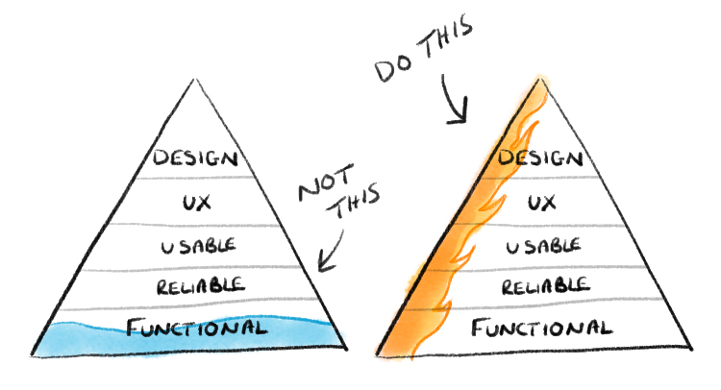
Sample lifecycle management (SLM)
Build a new solution from scratch:
No generic solution at SOLEIL (ISpyB for only MX/AutobioSAXS beamlines)
SLM application demands many interconnections
We started designing an architecture based on PLUSS
Develop an MVP of a Web application: minimal functionalities but fully operational
“The Sample Lifecycle Management (SLM) application centralise, organise sample information and make them available for the rest of the information system of SOLEIL (control systems, data catalog, etc.). It includes:
Sample unique identification and description (UUID, DUO proposals and beamtime sessions description, sample’s components… )
Tracking of geographical locations
All transformations and measures performed on the sample
All pertinent sample information stored in the elogbook ”
Minimum Viable Product

Slide 11
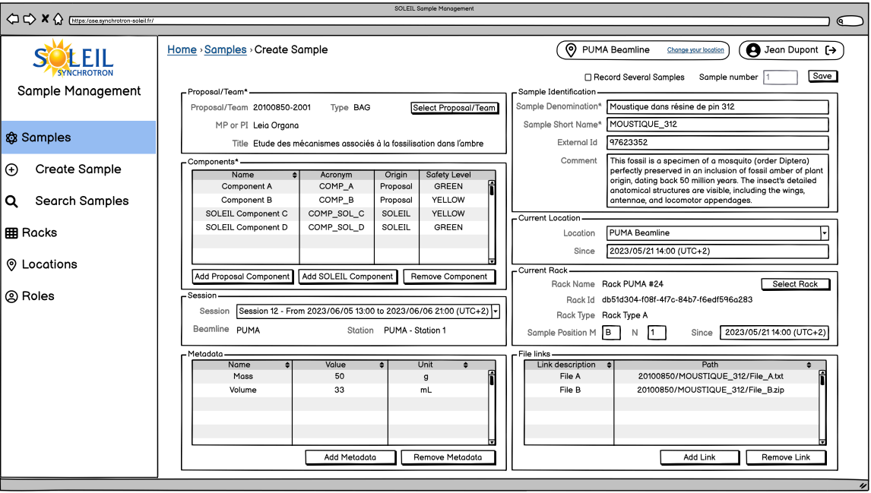
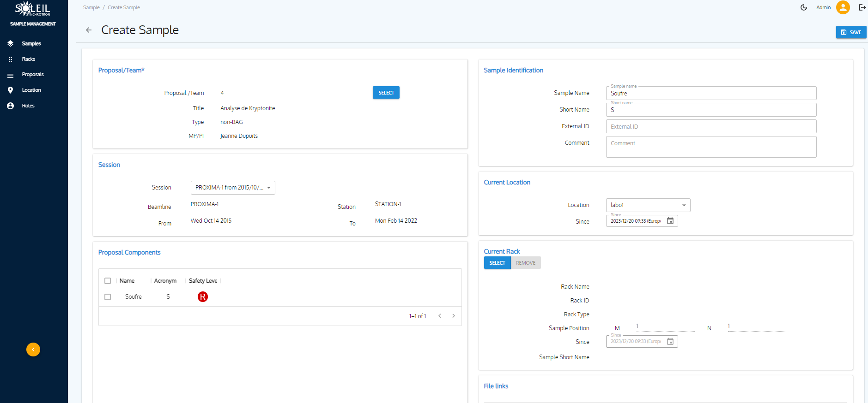
SLM: a Minimum Viable Product
Wireframe mockup and many exchanges/demos for user feedbacks before developing the real front end:

Slide 12
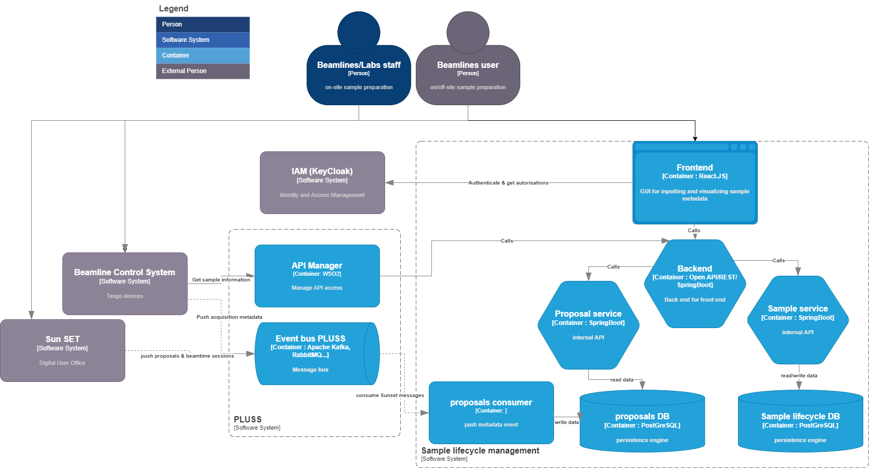
SLM MVP internal architecture
MVP development finished:
PostGreSQL databases
REST APIs /Java Spring Boot
Frontend in React.JS/Refine
KeyCloak connector for authentication and authorisations
Interconnections with PLUSS:
Kafka for our DUO (SUN Set) proposals
API Manager to expose sample data on control systems
C4 architecture modeling https://c4model.com/

Slide 13
SOLEIL Data catalog
SOLEIL has to provide a public access to experimental data-> provide a data catalog
A SOLEIL project team is currently working on deploying SciCat (Collaboration PSI, ESS, MAX IV, DESY, MLZ, ALS, RFI, ...)
Starting with a few beamlines with basics functionnalities
Rely on PLUSS to exchange data with the rest of the information system
Similar needs as the SLM application

Slide 14
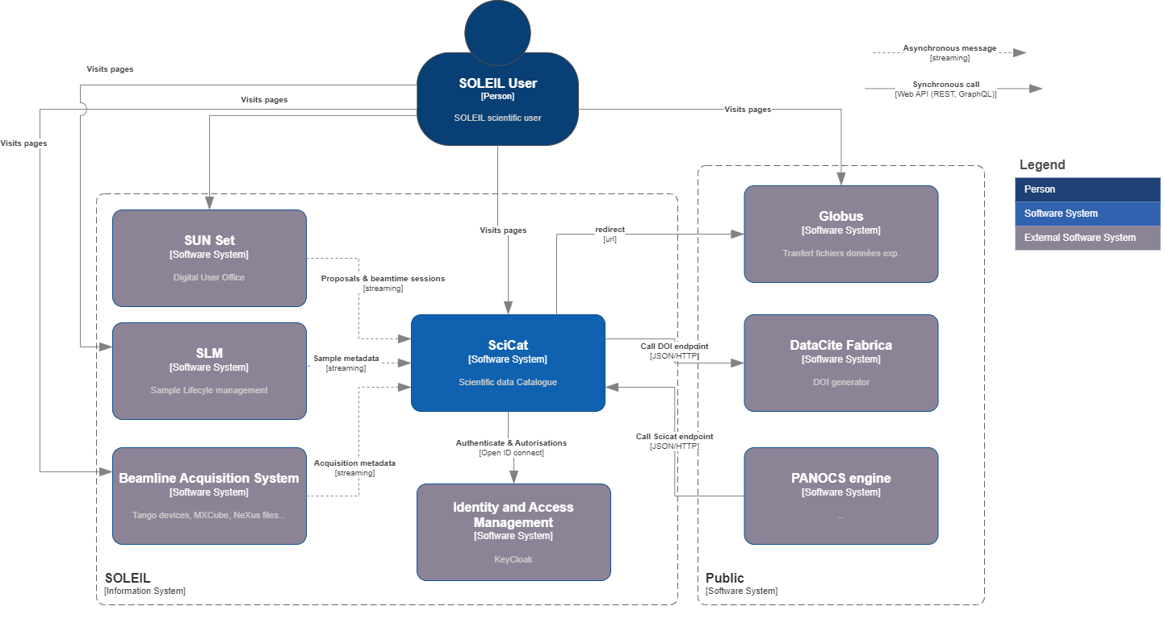
SOLEIL SciCat integration
Kafka for getting :
proposals from our Digital User Office
ingestion of acquisition metadata from beamlines’ control systems

Slide 15
Rolling out
Demands a lot of coordination:
Many prerequisites, many projects, involving a lot of people, many meetings!
PLUSS API Manager deployment
Today.
SLM
deployment
On 2 beamlines
Kafka training & POCs
Kafka cluster deployment
MVP SLM development
SciCat integration
SciCat
Deployment
On 2 beamlines
Central IAM
SUN Set interconnections
Control system interconnections
PLUSS project
team
SciCat
project
team
Infra
team
SUN Set
team
Controls
team

Slide 16
Lessons learned
Using an MVP approach for Sample Lifecycle application has been efficient
A simple framework that allows a close collaboration between IT and end-users
Allowed starting the development even the needs were not fully cleared
We have faced some initial issues, but the following projects will benefit from it:
There was no SOLEIL central IAM service (several directories)
Tackling new technologies
A combined organizational and technical approach is mandatory for information system consistency.

Slide 17
Future steps
Implement new interconnections upon PLUSS:
Future elogbook (evaluation of different solutions in progress)
New dedicated Digital User Office for industrial users
Data exchanges for SOLEIL II accelerators testing benches (Vacuum, Diagnostics, Magnets, Alignment)
Ramp up the architecture committee:
By adverting architecture practices among SOLEIL teams
By refining the architecture principles

Slide 18
Acknowledgments
SOLEIL:
B.Gagey, P.Pereira, J.Perez, YM.Abiven, I.Chado, P.Madela, F.Potier, Y.Tayeb, A.Buteau, A.Vandenbossche, F.Beloncle
EMOXA company:
Specialized in architecture, API Management, Apache Kafka
P.Grojean, C.Rognon, V.Szyndler, F.Quillien

Slide 19
“Programming without an overall architecture in mind is like exploring a cave with only a flashlight:
You don’t know where you’ve been,
you don’t know where you’re going,
and you don’t know quite where you are.”
Danny Thorpe
[In order for an architecture to be successful] it is very much about ensuring that conversations that are needed to be happening are happening - not always initiating them, nor always helping to focus or navigate them, but ensuring they do happen […] and guiding when needed
Ruth Malan

