Slide 1
MDT 27th August 2023:
badger + Xopt lifetime optimization
S.Liuzzo, N.Carmignani, L.Carver, L.Hoummi, T.Perron, J.-L. Pons, S.White, ESRF
R.Roussel, Z.Zhang, A.L.Edelen , SLAC

Slide 2
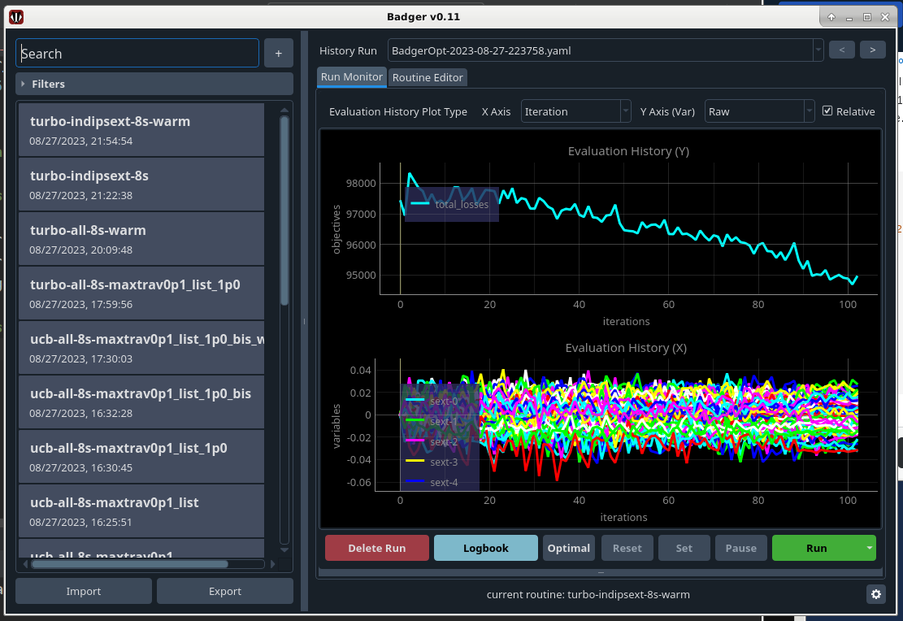
Badger + Xopt for lifetime optimization
EASY INTERFACE
EASY SETUP
EASY INSTALLATION
MANY DIFFERENT OPTIMIZERS
https://github.com/ChristopherMayes/Xopt
https://github.com/slaclab/Badger
https://github.com/SLAC-ML/Badger-Plugins

Slide 3
10-15 minutes instead of 100 minutes for equivalent optimization
Badger + Xopt
https://christophermayes.github.io/Xopt/examples/single_objective_bayes_opt/turbo_tutorial/
”run by hand”
Trust Region Bayesian Optimization (TuRBO)
normalized
Standard Lifetime optimization procedure
Scripts for pyHDB plots in: /machfs/liuzzo/EBS/beamdyn/MDT/2023/2023_08_27/badger

Slide 4
Other findings
Other findings in the MDT:
Upper confidence bound (UCB) optimization Bayesian optimization is as fast as simplex
TuRBO is faster than UCB
TuRBO is reproducible (3 consecutive runs)
TuRBO is robust: starting from large amplitude random sextupole sets
TuRBO and UCB can be « informed » with data from prior optimizations starting from the same initial conditions.
TuRBO and UCB show smaller variations of losses along the process of optimization (smaller variations of magnet strengths between steps).
APPLICATION IS USM READY
PROCEDURE BEING DETAILED

Slide 5
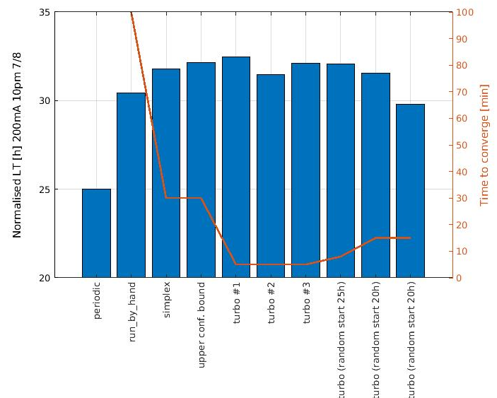
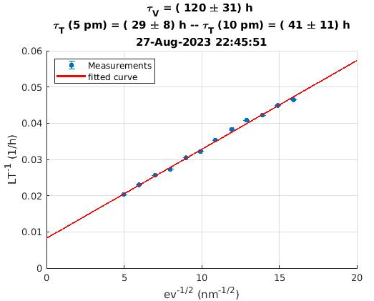
Lifetime comparison for all the observed cases
Set in operation
Vacuum 120 ± 30h
Touschek 41 ± 11h
26THAUG STANDARD PROCEDURE
27THAUG TuRBO + BADGER
BEST observed since MAY 2021

Slide 6
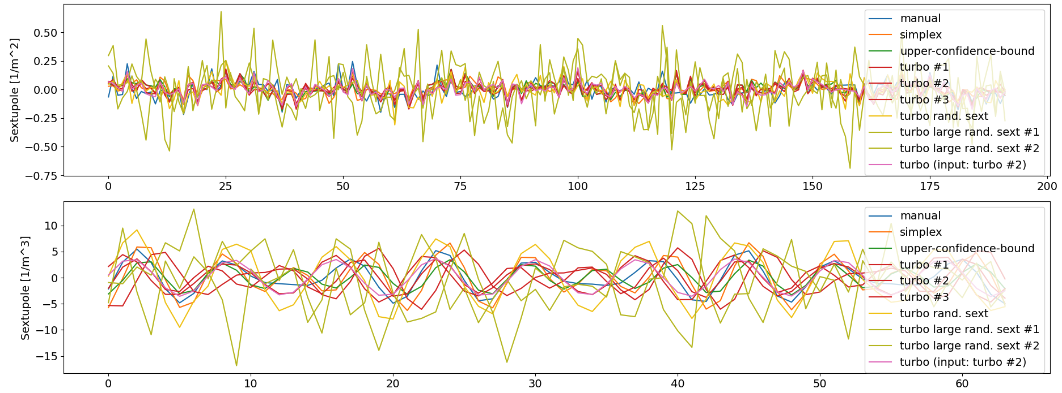
Final sextupole and octupole correction patterns
octupole

