Slide 1
MDT 4th September 2023
Injection efficiency and Dynamic Aperture optimization
Using Badger and Xopt by R.Roussel and Z.Zhang (SLAC)
S.Liuzzo, P.Raimondi, N.Carmignani

Slide 2
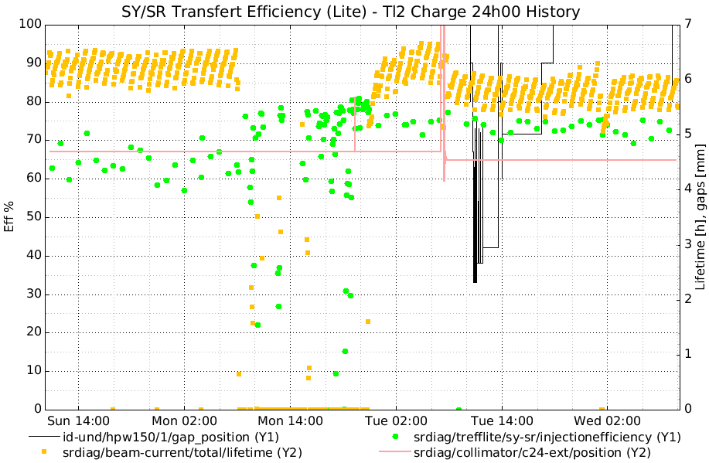
Injection efficiency optimizations
TuRBO optimization
~75%
Wiggler closure
Last week 65%
Optimizations
Up to 82%
Collimators new operation point has no impact on I.E., but reduced lifetime compared to previous run
Lifetime drop, collimators new set point

Slide 3
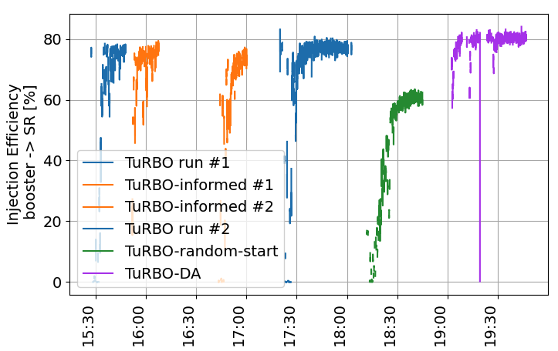
Optimizations runs
debugging
TL2 quads, steerers, septa, KE
SR sext. and oct. Dyn.Ap. knobs
TL2 quads, steerers, septa, KE. Random start

Slide 4
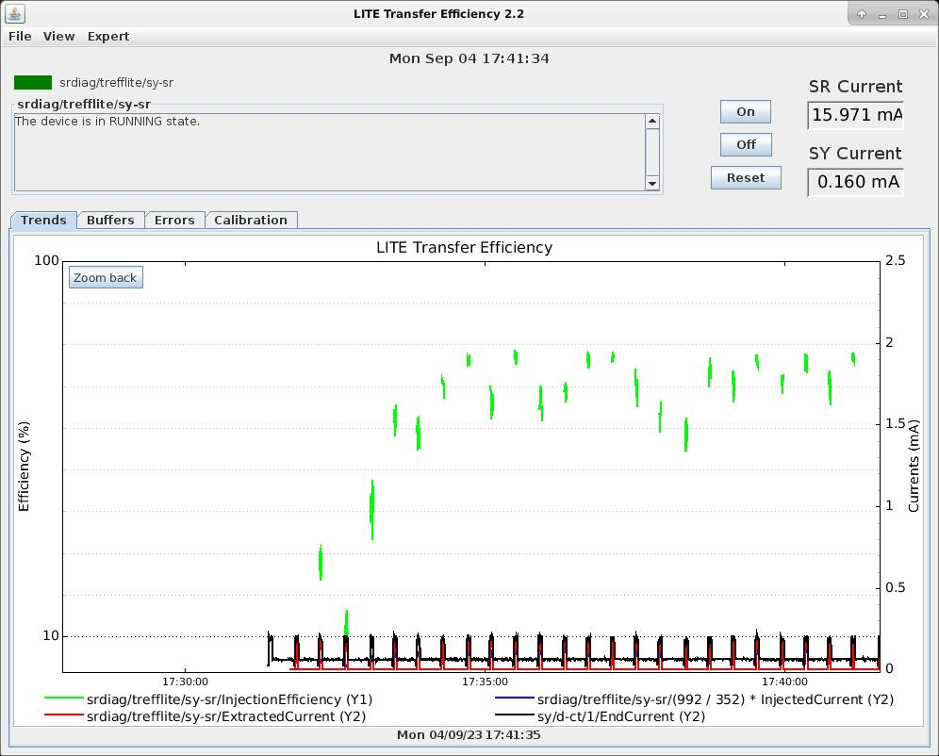
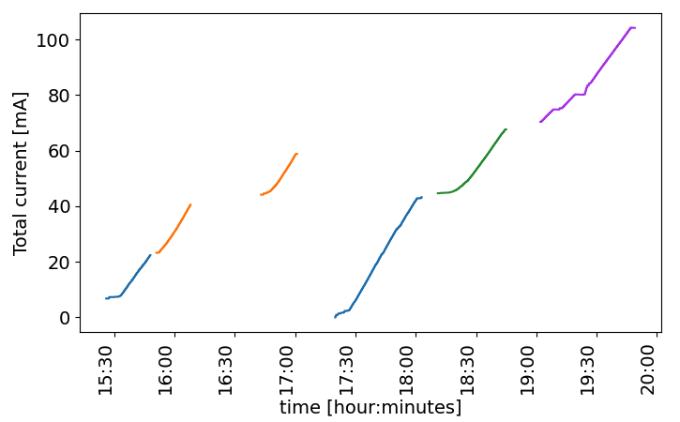
Injection only “on-demand”: minimal injected charge, minimal use of RIPS (booster PS)
40mA injected charge for the longest optimization (30min)
Change settings
Beam in booster only when needed
8h MDT < 200mA injected for 6 optimization runs

Slide 5
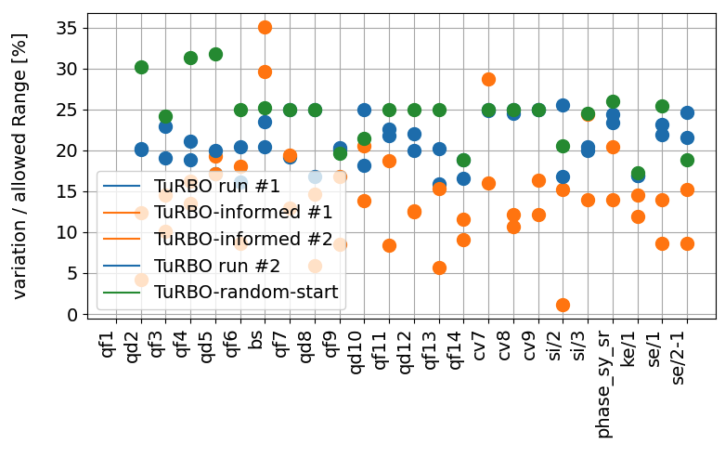
Maximum Variation of the parameters observed compared to the total range allowed

Slide 6
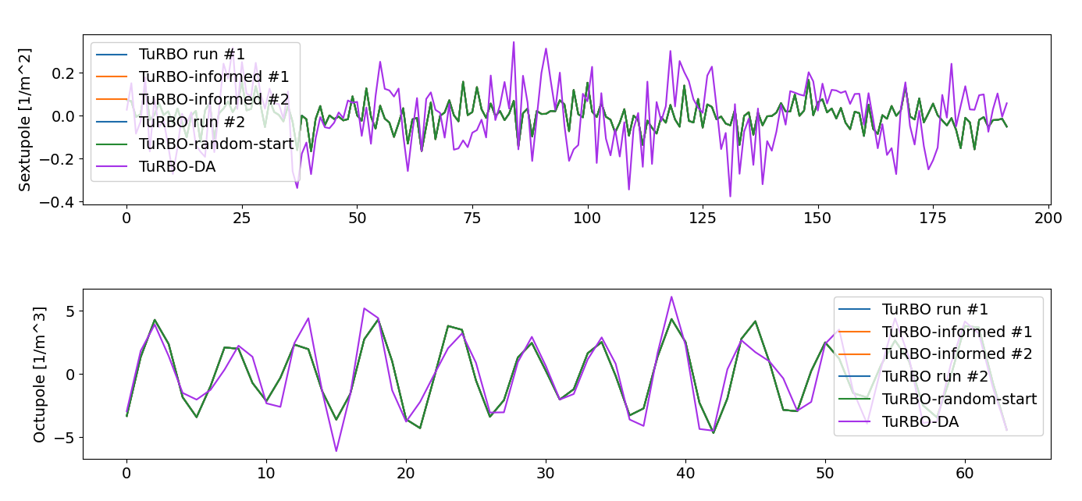
Dynamic aperture optimization

Slide 7
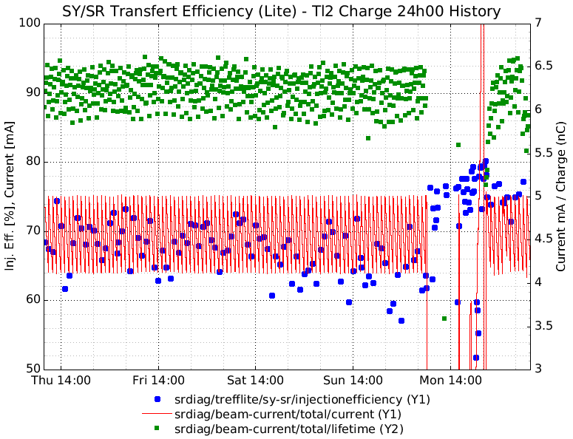
Optimizations
Up to 82%
Last run ~ 65%
TuRBO optimization
~75% (-20min lifetime)

Slide 8
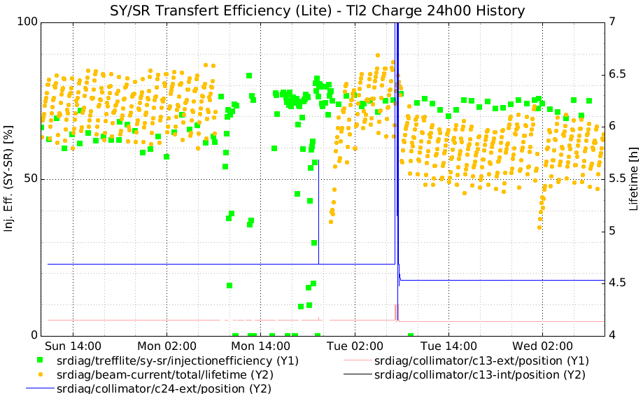
A more recent figure
Optimizations
Up to 82%
LAST RUN ~65%
TuRBO optimization
~75% (-20min lifetime)
Collimators new operation point has no impact on I.E., but reduced lifetime compared to previous run

