Slide 1
Data and work in : /machfs/liuzzo/EBS/S28F_DL_DQ_sextupoles
Multipoles in EBS Dipoles
S. Liuzzo, J. Chavanne, G. Le Bec
July 2023

Slide 2
DL multipoles from J.Chavanne
Arbitrary units (x factor for display)

Slide 3
DQ sextupole from G.LE BEC
Please find below the values of the integrated sextupole in the DQ magnets, averaged over all magnets and normalized to the quadrupole at 7 mm: DQ1 : 5.1 x 10^-4 DQ2: 13.0 x 10^-4 These values come from the wire measurements on a straight line, corrected to give the value integrated on a parabola.
Email 13th July 2023

Slide 4
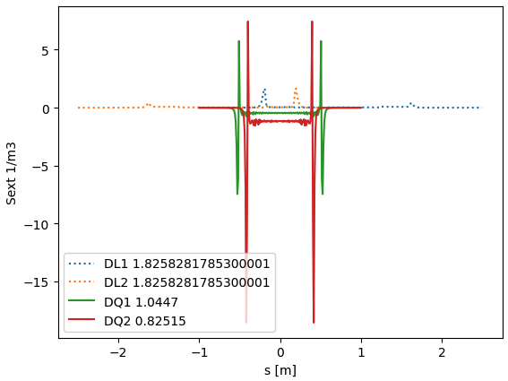
Sextupoles
Slice lattice at 1mm (~845000 elements) field extends far from edges, impacts drifts, quads, sext…
Scale curves for DL2 and DQ1 from above data
Assign sextupole fields to each slice along the lattice
JL dipoles at injection are ignored.
DL1 and DL2 are considered identical (strongest module is different in reality)
Compare detuning with mom and with ampl
DL1
DL2
DL2
DL1
DQ
DQ
DQ
Coarse slicing (5cm) to check correct location of multipoles
Main SEXT

Slide 5
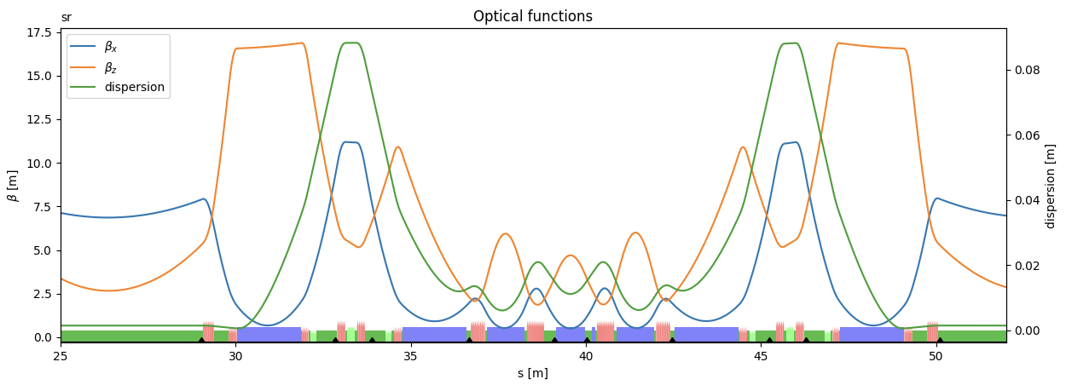
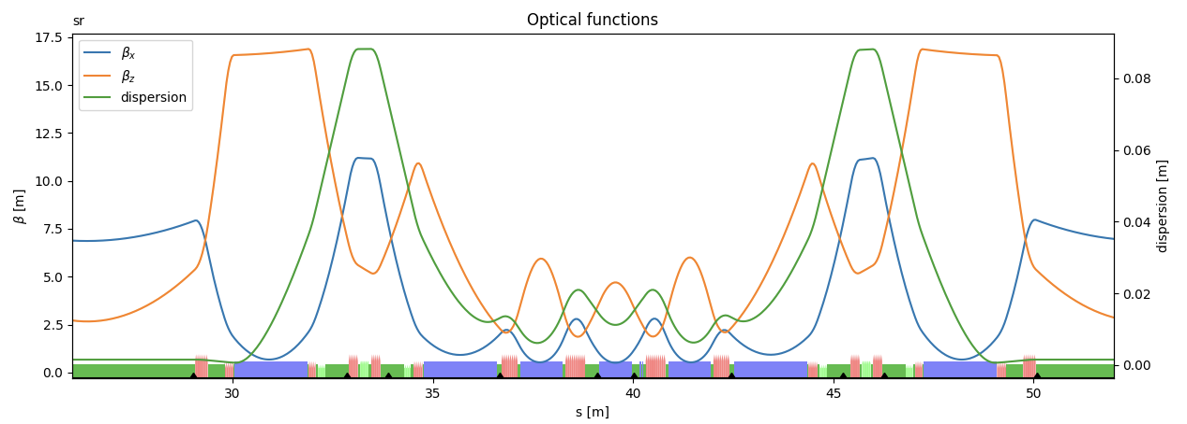
Lattice slicing and introduction of SEXTUPOLES
One cell, but whole lattice is considered
S28F
S28F
Sliced ~87000 elements
OK. No change compared to thick optics
Here 5cm, 1mm in reality, but too many elements for plot (845000)
S28F
Sliced (87000)
SEXTUPOLES
OK. No change compared to thick optics. (only sextupoles)

Slide 6
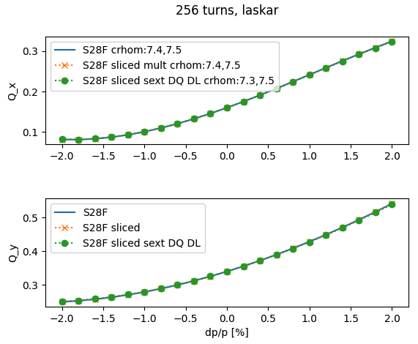
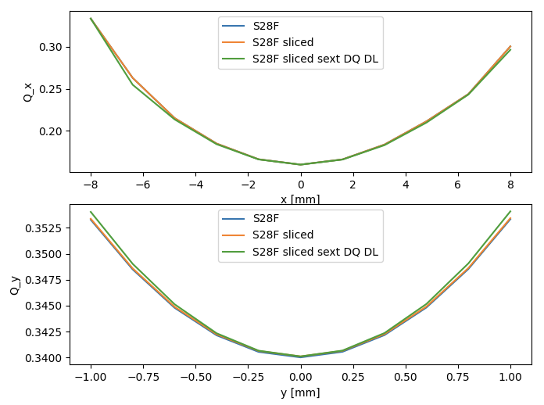
Detuning with amplitude and momentum (1cm slices)
No clearly visible impact of the additional sextupoles. Only a small variation for dQy/dy

Slide 7
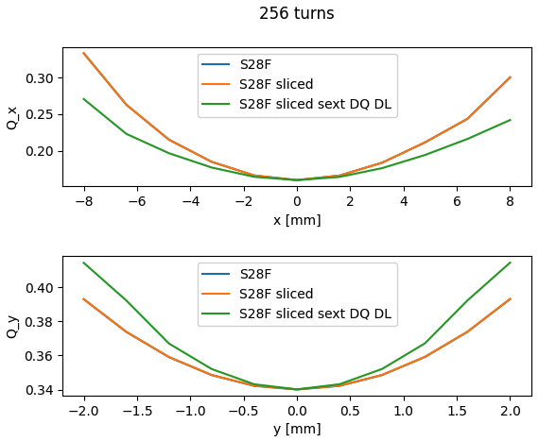
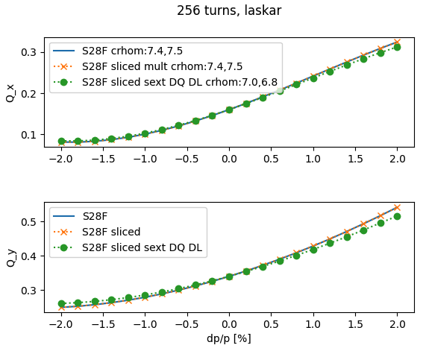
Detuning with amplitude and momentum (1cm slices) SEXT. x10
10 times larger sextupoles starts to produces visible effects.

Slide 8
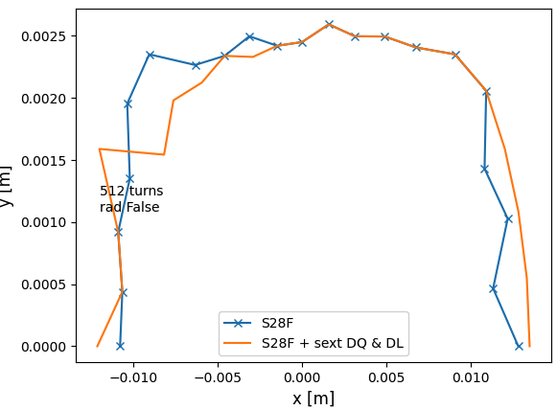
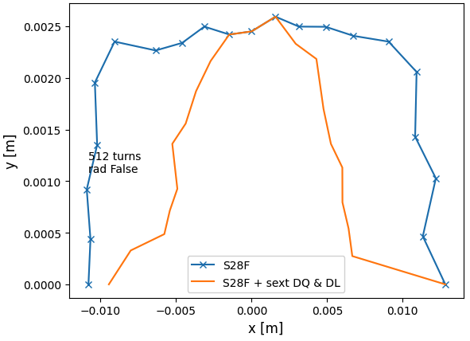
DA for sextupoles x1, x2 and x10
x2
x10

Slide 9
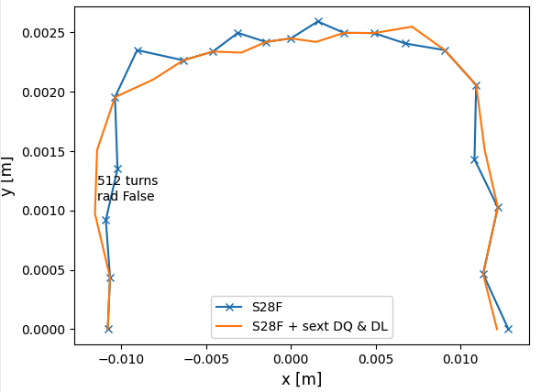
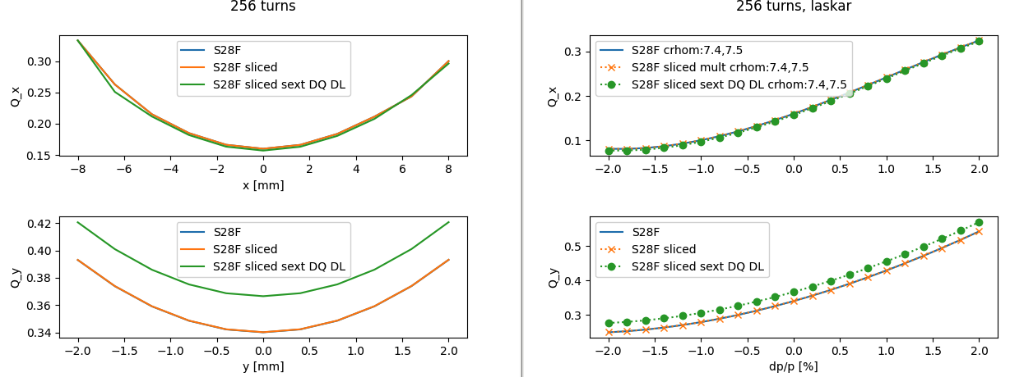
DL including quadrupole, octupole, decapole… 20-pole from J-Chavanne
Dipole is more complicated. DL1 data is not simply rescaled to DL2 data, must work a bit more for that, see later slides. HERE ONLY Quad. Sext., … to 20-pole in DL
DA unchanged
Quadrupole in DL = +0.02 ver tune

Slide 10
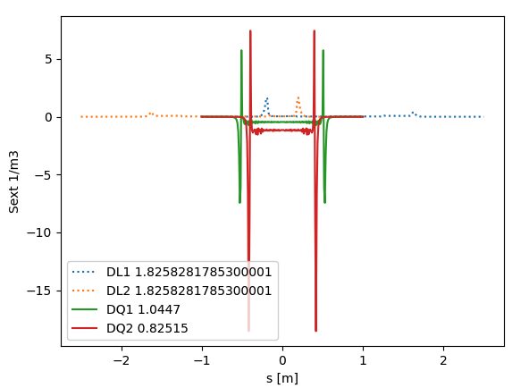
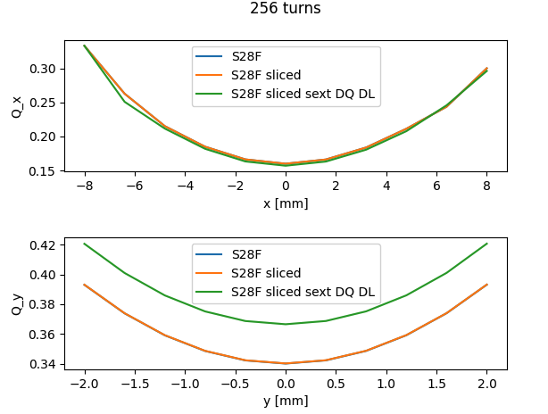
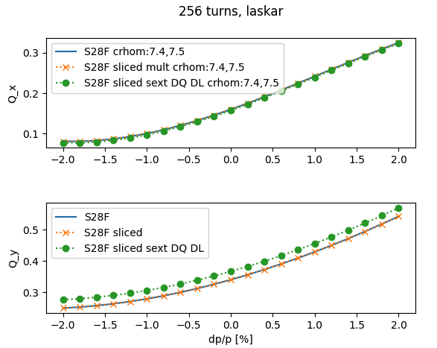
DQ2 3x larger sext than DQ1
values of the integrated sextupole in the DQ magnets, averaged over all magnets and normalized to the quadrupole at 7 mm: DQ1 : 5.1 x 10^-4 DQ2: 13.0 x 10^-4
No visible impact on performances

Slide 11
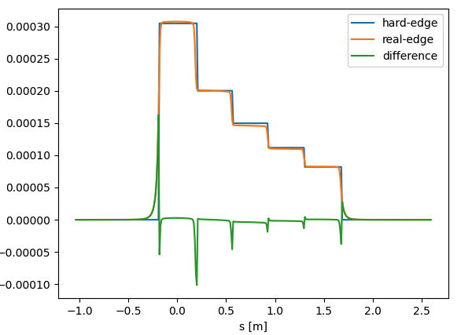
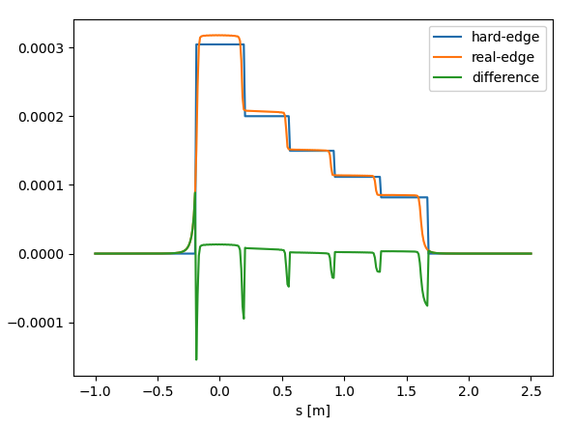
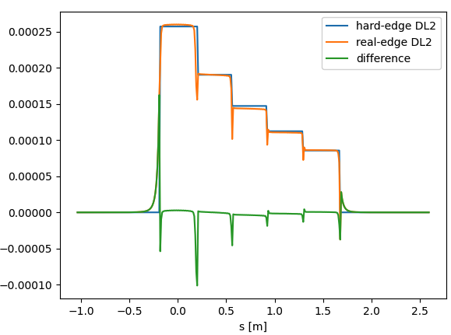
Dipole DL longitudinal components
Scale Bending angle data to have same integral as the hard-edge DL1 / DL2
Strange factor needed
1.037 on the length off all elements in the DL data. Magnetic lengths? Sagitta contribution is 0.0000001
Sum(ang) = 0.031712385
Sum(ang) = 0.031712385
Raw data, missing length
Data only for DL1. DL2 different dipole distribution. Instead of scaling, add delta)

Slide 12
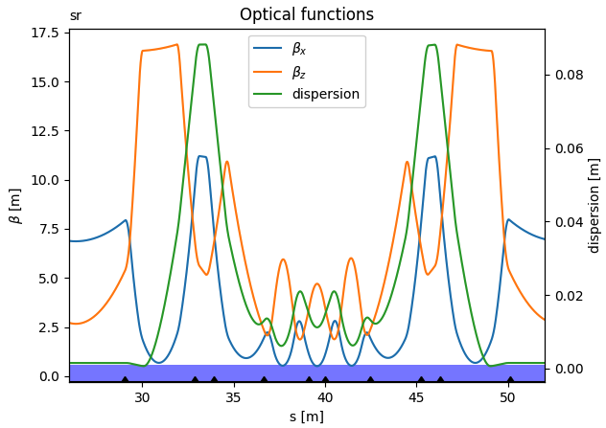
SR Lattice made of only dipoles
S28F lattice where all magnets have been transformed in dipoles.
Hard-edge fields.
/machfs/liuzzo/EBS/S28F_DL_DQ_sextupoles/SlicedLattice_all_all_mult_dip_Sext_10.0mm.mat

Slide 13
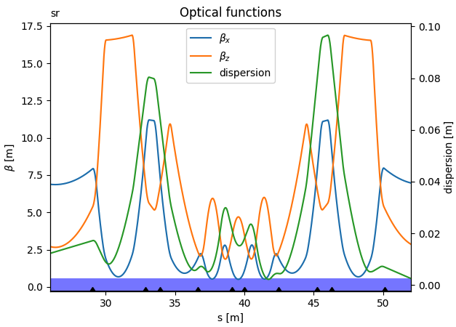
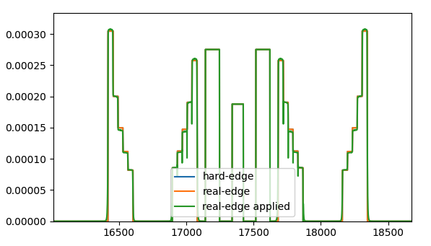
Dipole longitudinal pattern setting
solved this error
solved this error
solved this error
Final dispersion is visibly distorted

Slide 14
Some
effect on chromaticity
Some effect on chromaticity, but not enough to get to 8-10 as measured in CTRM.

Slide 15
DA with all multipoles DL longitudinal profiles: dipoles, quad., sext., … 20-pole and DQ sext
No impact on DA.
Multipoles fields data units are checked, and seem ok.

Slide 16
Further steps
None of the above explains the discrepancy with the model: lower MCF, chromaticity not matching with model expected one.
Use integral values from measurement of individual magnets (data available for DQ, not sure for DLs) instead of average for all with simulated profile.
Sextupole cross talks. Main sextupole field reduction + sextupole in neighbouring magnets.
Check DL entrance/exit angles and fringe effects.
Add DQ dipole longitudinal profile.
New matching of lattice cell with DL and DQ bending angle longitudinal profiles.

