Slide 1
Efficiency of emittance blow-up
as a function of chromaticity
Eurizon diagnostics meeting
September 2023
Nicola Carmignani

Slide 2
Introduction
At several workshops people were asking questions about our use of the white noise to blow-up vertical and horizontal emittance and in particular about the efficiency of this method at low chromaticity.
We first did some simulations showing that at low chromaticity the blow-up is less efficient and then we measured the effect on Monday 12/06/2023.

Slide 3
Measurement procedure
Switch the BPMs in TBT mode and synchronization.
10 mA in MB 1/3 filling mode.
At nominal chromaticity, scan the the emittance blow-up: vertical at 0, 20, 40, 60, 80, 100, 120 pm and horizontal from 130 pm to about 400 pm in 7 steps.
For each value of emittance acquire the BPM TBT buffer for 10000 turns 5 times.
Measure the apparent emittance from the coherent oscillations visible in the BPMs and compare it to the emittance measured by the camera.
Repeat the same for lower chromaticity.
Only the spark BPMs have been used because they have better resolution.

Slide 4
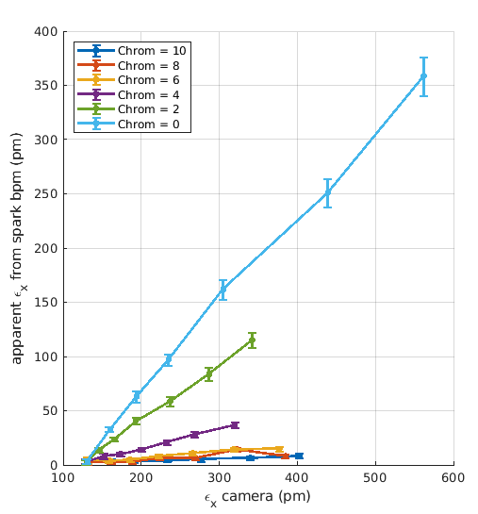
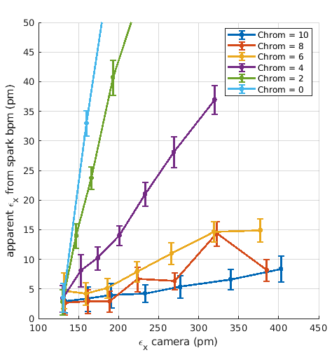
Result of the measurement in the horizontal plane

Slide 5
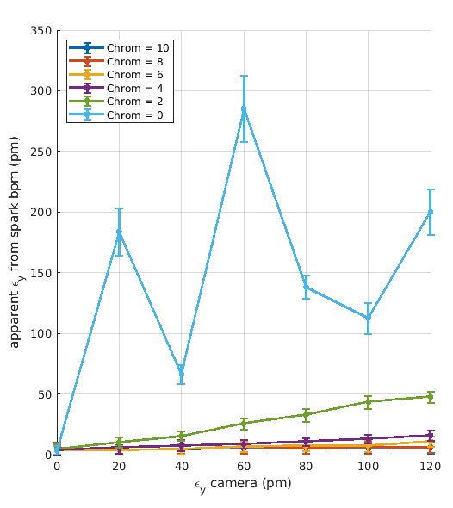
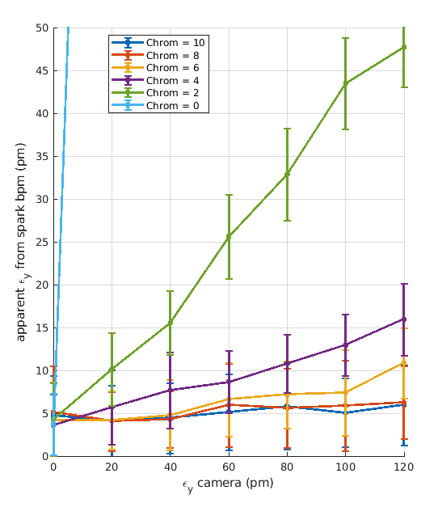
Result of the measurement in the vertical plane
At chromaticity 0 we had strong vertical instability and the emittance feedback was not really working, so the data has to be almost ignored.

Slide 6
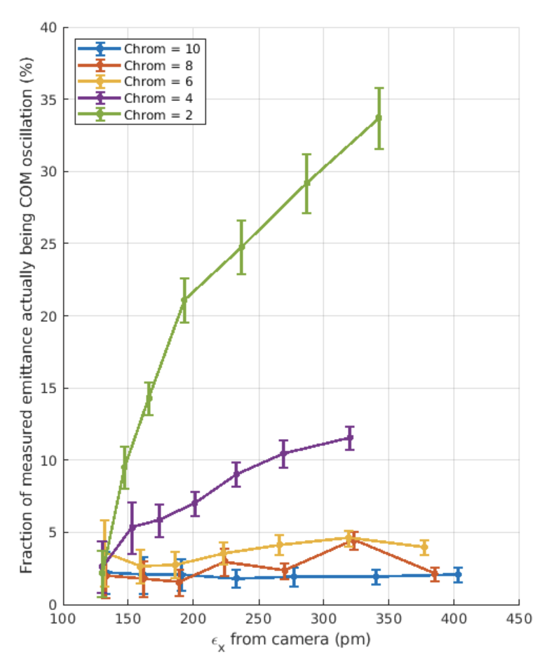
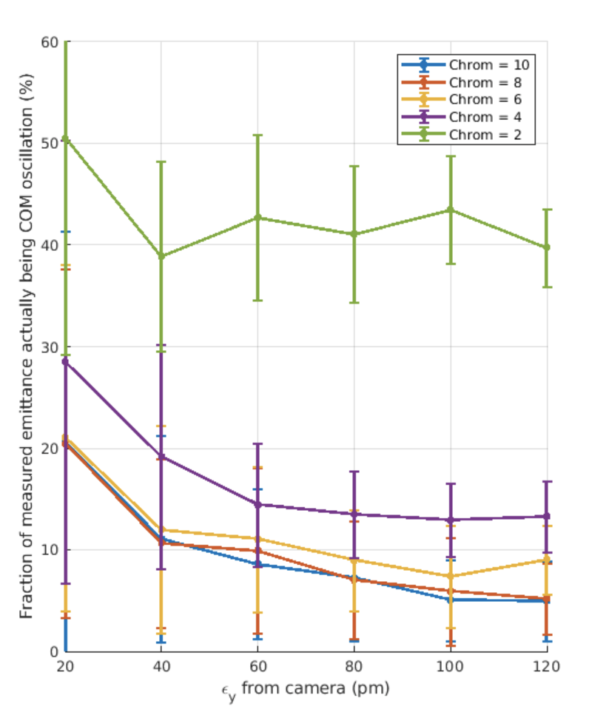
Fraction of emittance actually being centre of mass oscillations
Horizontal
Vertical

Slide 7
conclusion
The blow-up technique works well at high chromaticity (more than 6) and very bad at almost zero chromaticity.
With chromaticity 4 about 15% of the measured emittance from the camera is centre of mass oscillations.
With chromaticity 2 about 40% of the measured emittance from the camera is centre of mass oscillations.

