Slide 1
Emittance blow-up simulations
Nicola Carmignani
January 2023

Slide 2
Blow-up simulation with at
The simulation is performed using the atfastring function.
The fast ring includes:
RF cavity
Linear matrix for the full ring with radiation damping
Nonlinear element with chromaticity and amplitude detuning
Quantum diffusion
Shaker
The noise sent to the shaker is generated by Benoit Roche. It is a white noise in a range of frequencies including the transverse tune and with 40 kHz bandwidth (or more in some simulations) and 10 Hz, 100 Hz or 500 Hz repetition frequency.

Slide 3
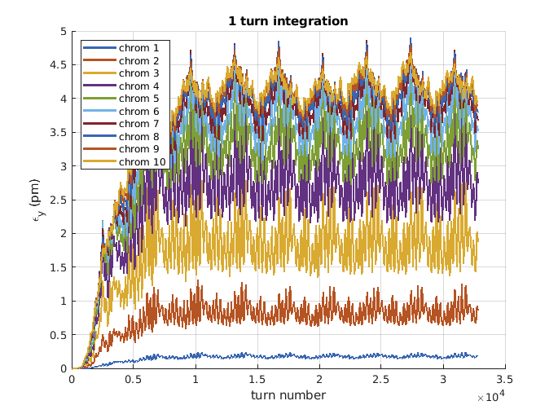
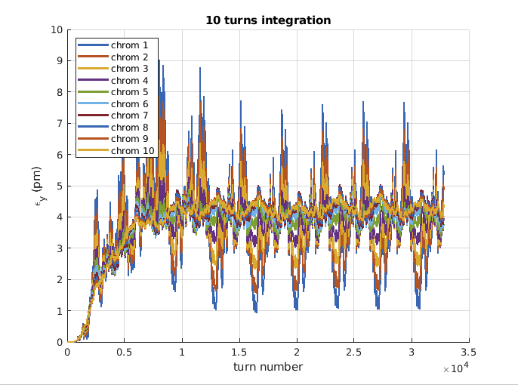
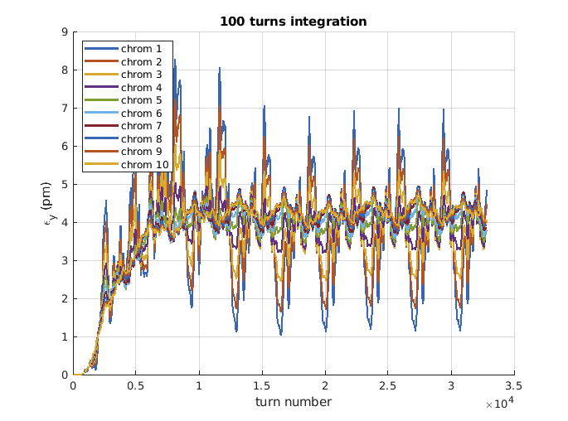
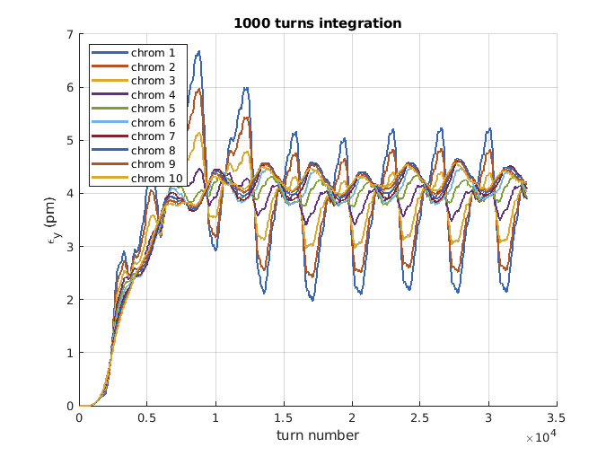
Emittance at different chromaticity, with different integration time
The repetition frequency of the noise signal is 100 Hz and the bandwidth of the noise is 40 kHz centred around the vertical tune.
At low chromaticity there is almost no emittance blow, but only coherent oscillations.
When the integration time is long enough, the coherent oscillations can be wrongly interpreted as blow-up.
The emittance oscillations are due to the 100 Hz repetition frequency of the noise.

Slide 4
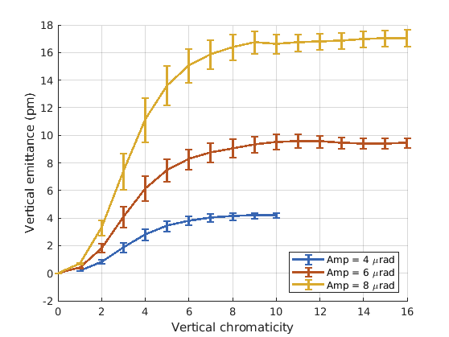
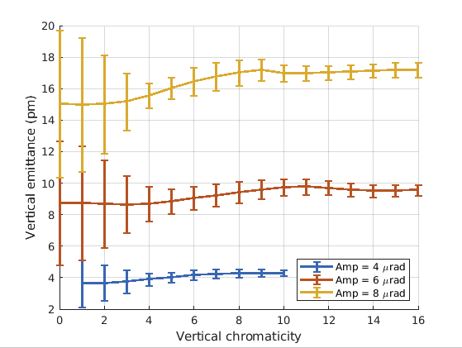
Vertical emittance as a function of chromaticity for three different shaker amplitudes
Turn by turn
10 turns integration
Error bars are the standard deviation of the emittance measurements in the last 10000 turns of the simulation.
The blow-up works well for chromaticity more than 8.
At chromaticity=6, emittance is about 10% less
At chromaticity=4, emittance is about 35% less
At chromaticity=2, emittance is about 80% less

Slide 5
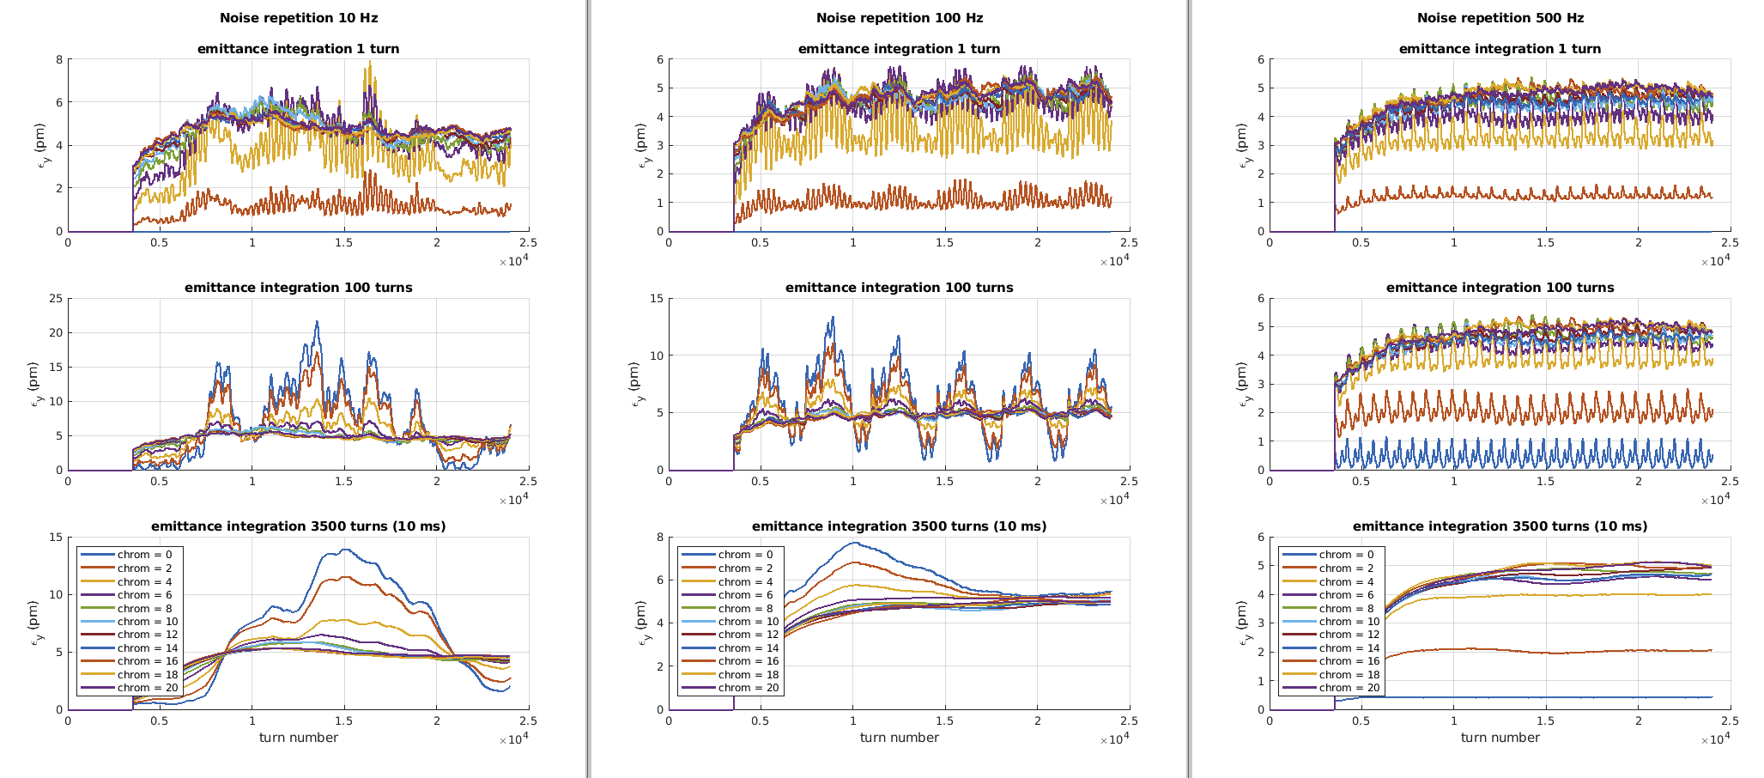
Effect of noise repetition frequency
With different repetition frequency of the noise, the emittance oscillations have different frequency.
The bandwidth here is larger than in the previous simulations, but the effect is similar.
The integration time of 3500 turns (10 ms) is what we use in operation for the emittance measurement with the pinhole camera.
operation case

Slide 6
conclusion
The beam blow-up with a magnetic shaker is effective only in presence of some decoherence from chromaticity.
To have about 90% of the measured blow-up as real blow-up, chromaticity has to be at least 6.
The repetition frequency of the noise causes an emittance oscillation at the same frequency.
An MDT should be planned to measure the blow-up efficiency as a function of chromaticity.

