Slide 1
HFD booster optics

Slide 2
Lattice by Pantaleo Raimondi + Matching scripts

Slide 3
In order to get a booster for ESRF
Convert lattice from MAD8 (ok)
Convert matching (difficult, but done by S.White)
Match geometry : shorter straight sections, rematch optics
Make quadrupole gradients <50T/m
Optimize optics

Slide 4
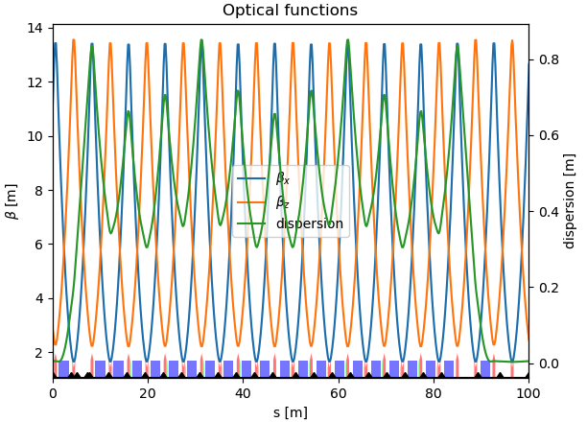
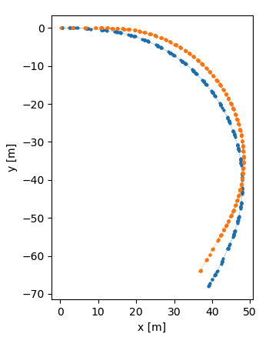
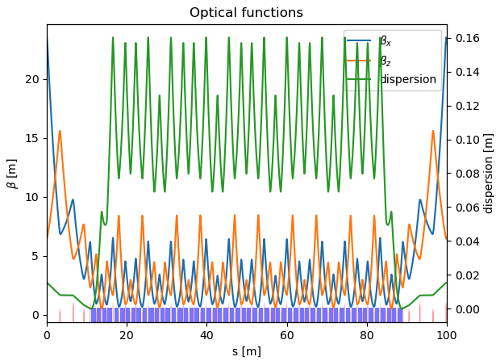
Geometry matching
Need:
shorter straight section
correct X-Y at end of sector
present
HDF

Slide 5
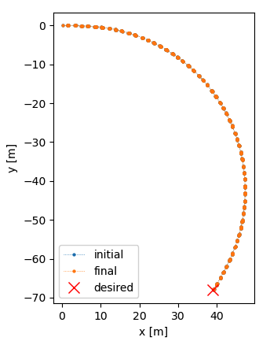
Use 3 drifts or 2 Drifts and Dipole lengths
dl_len 1.100000e+00 1.419325e+00 3.193246e-01
dr2_len 7.500000e-02 7.500000e-02 0.000000e+00
drl0_len 1.200000e+00 1.200000e+00 1.200000e-10
Start coordinates = ([0.], [0.], [0.])
Initial end coordinates = (array([39.11404631]), array([-68.00732313]), array([-2.0943951]))
Final end coordinates = (array([39.11404631]), array([-68.00732313]), array([-2.0943951]))
Desired end coordinates = ([39.00152548], [-68.07227979], [-2.09439562])
Longer dipoles, better for Emittance
Name Initial Final Variation
dr_len 7.500000e-02 2.079543e-01 1.329543e-01
dr2_len 7.500000e-02 7.500000e-02 0.000000e+00
drl0_len 1.200000e+00 1.200000e+00 1.200000e-10
Initial end coordinates = (array([39.11404372]), array([-68.00731863]), array([-2.0943951]))
Final end coordinates = (array([39.04549867]), array([-67.88859513]), array([-2.0943951]))
Desired end coordinates = ([39.00152548], [-68.07227979], [-2.09439562])

Slide 6
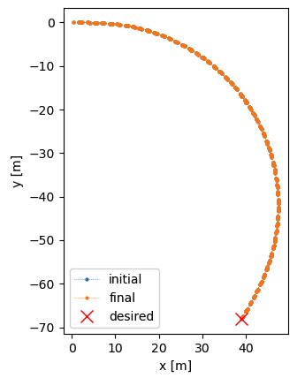
Match geometry lengthening quads (NEEDED in any case)
qfd_len 0.075 → 0.2278
dr2_len 7.500000e-02 7.500000e-02 0.000000e+00
drl0_len 1.200000e+00 1.200000e+00 1.200000e-10
Start coordinates = ([0.], [0.], [0.])
Initial end coordinates = (array([38.88360863]), array([-68.13739054]), array([-2.0943951]))
Final end coordinates = (array([38.88360863]), array([-67.60819334]), array([-2.0943951]))
Desired end coordinates = ([39.00152548], [-68.07227979], [-2.09439562])
Length of quadrupoles = 3 x initial.
Exactly what is needed for gradient.
All quads in the lattice have the same length (some are split in 2)

Slide 7
Final lattice is shorter by 5 meters
Lengthen drifts to recover 299.51m length.

Slide 8
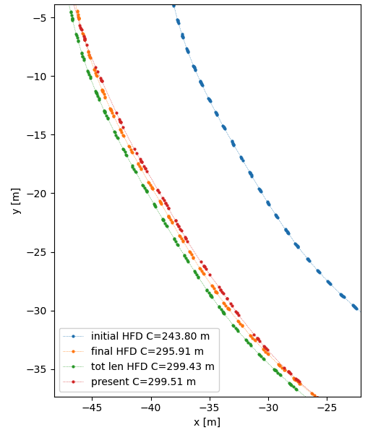
2 options: total length fixed (same RF), or same position of Straight sections

Slide 9
Decide to keep a longer straight section
Present booster
The existing booster has 4 dipoles free sections of about 3.5m each.
The new layout as a continuous straight section of ~14m.
HFD booster

Slide 10
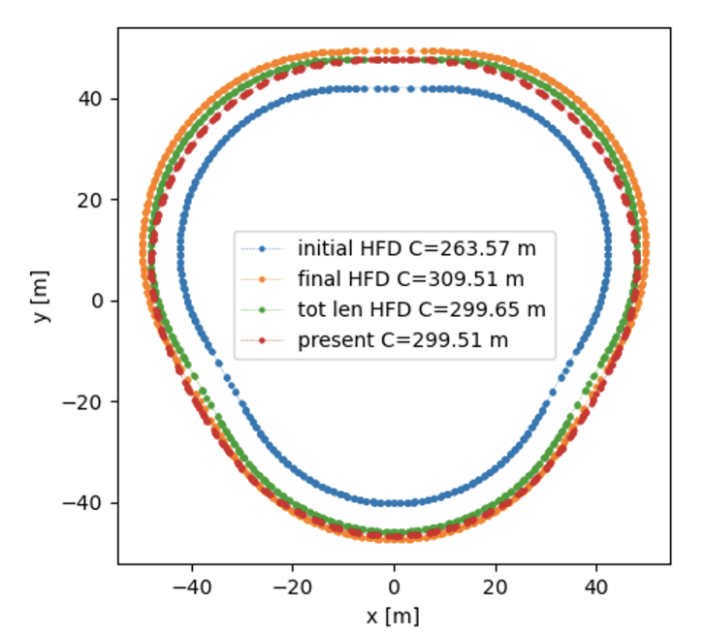
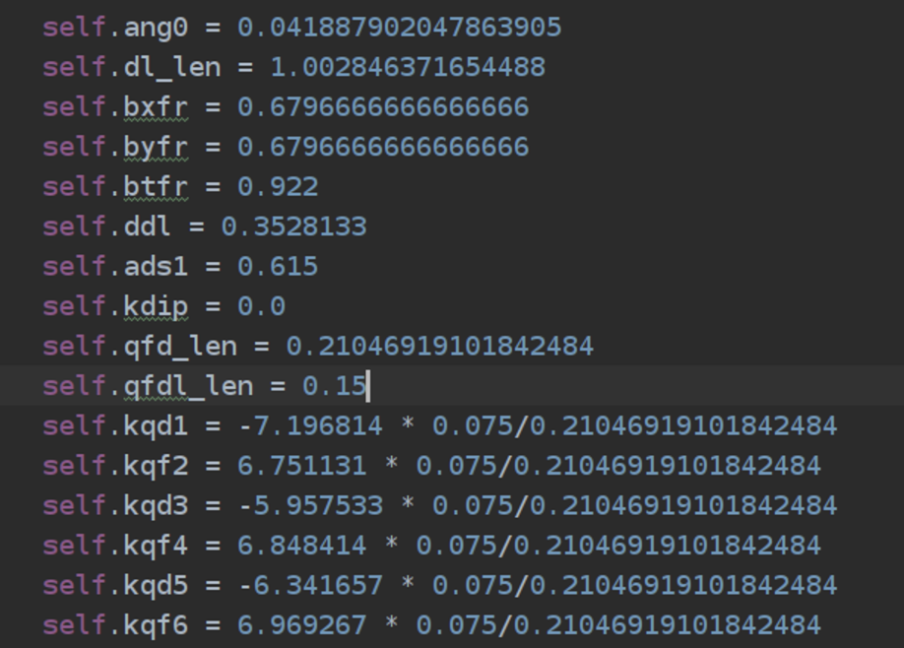
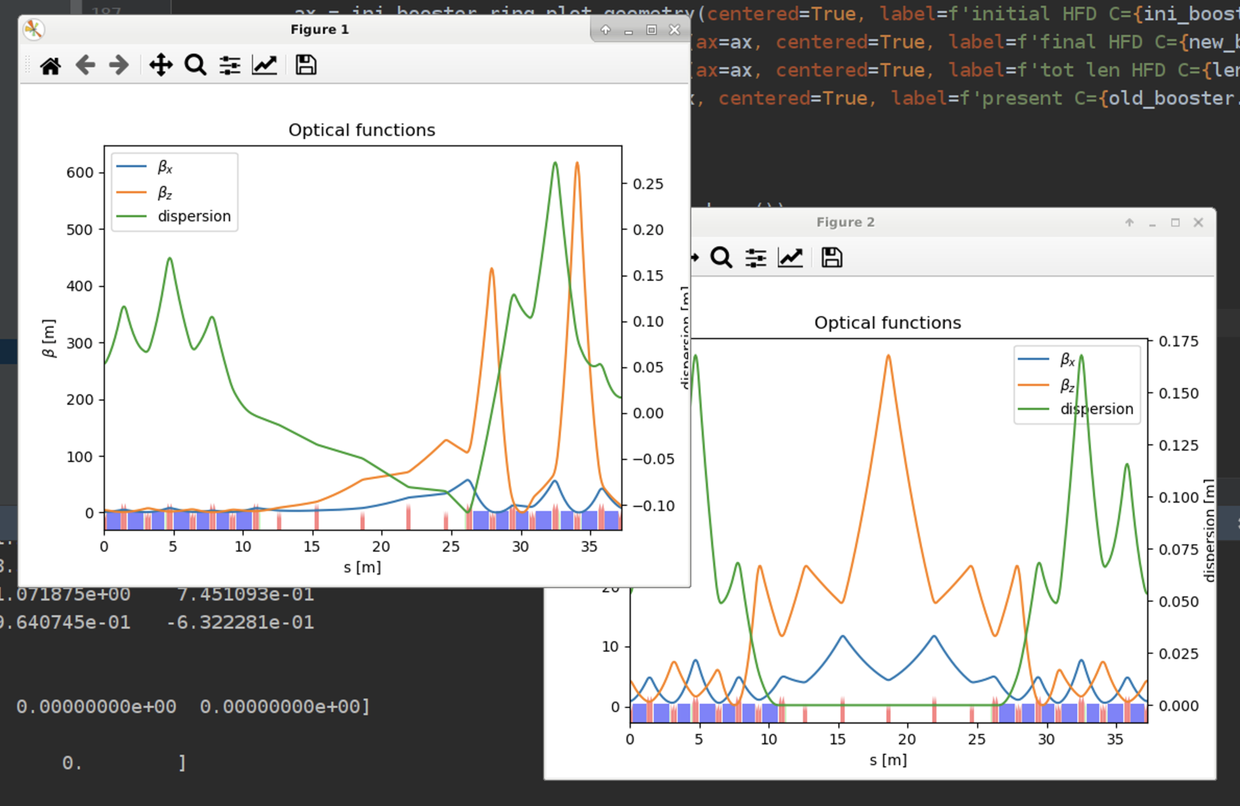
Procedure to
Modify at will build_lattice.py (for example change self.dl_len or sextupole lengths)
Run match_booster_geometry.py (changes quad lengths)
Copy printed parameters in build_lattice_layout.py
Dived all quadrupole gradients by ratio of lengths in build_lattice.py and in build_lattice_layout.py
run study_lattice.py (match optics)
Look at figures and data

Slide 11
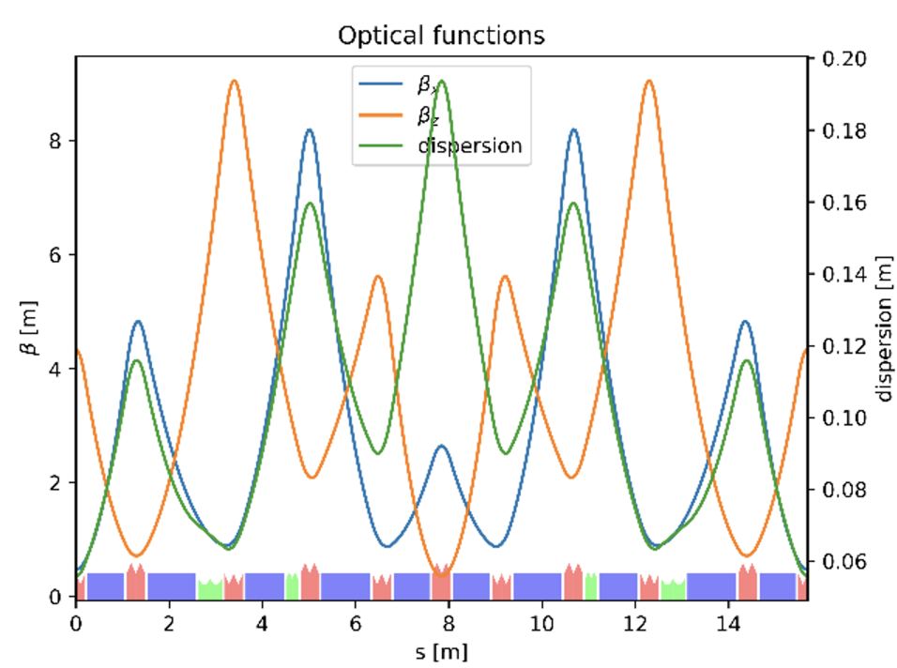
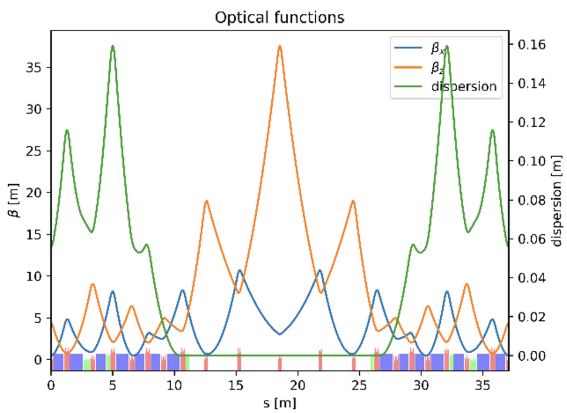
Matched Optics with corrected layout and quadrupole/sextupole lengths

Slide 12
parameters
HFD booster parameters
Circumference [m]: | 299.630326
Hor. Emit. [nmrad]: | 13.31
Tunes | 25.21, 15.34
Momentum compact. factor: | 2.04e-03
Energy loss / turn | 5.17e+06 eV
Damping partition numbers: | [0.99536411 1. 2.00463589]
Damping times: | [0.00233262 0.00232181 0.00115822] s
Energy spread: | 0.00110014
Bunch length: | 0.00930561 m
Unstable. ZERO DA
SW suggests to do DA 4D only
Max |K1L| = 55.6837 T/m
Max |K2L| = 1038.20 T/m^2
A ring made only of the unit cell has also <1 damping partition.
The issue originates at the level of the unit cell optics.

Slide 13
Preliminary DA / MA

