Slide 1
Updates on the detuning with amplitude
Nicola Carmignani

Slide 2
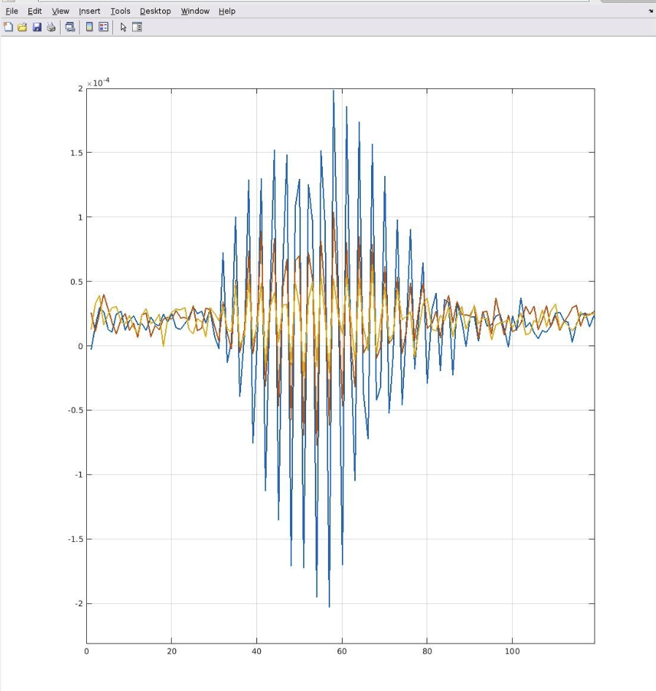
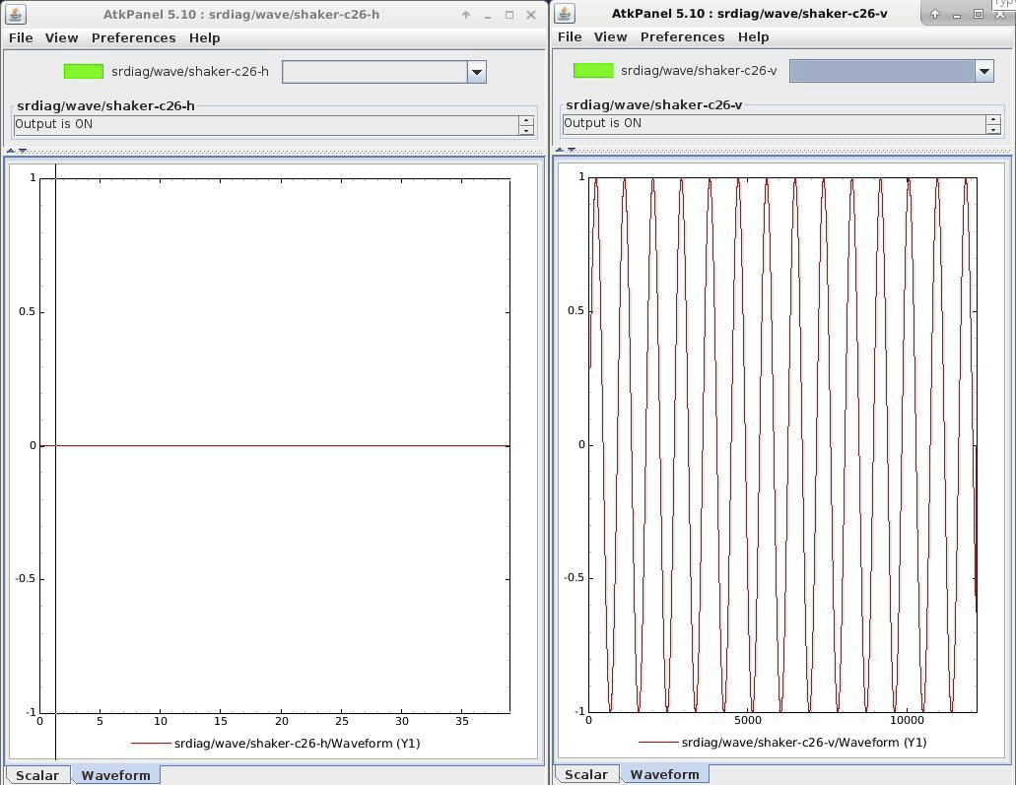
How to excite vertical oscillations only?
We can excite vertical oscillations sending a sinusoidal signal to the shaker at the frequency of the vertical tune, using the injection perturbation correction system.
Signal in bpm 1 for 3 different shaker amplitudes.
The oscillations start at turn 31 and have their maximum after 30 turns, then the driven excitation ends.
Horizontal
Vertical

Slide 3
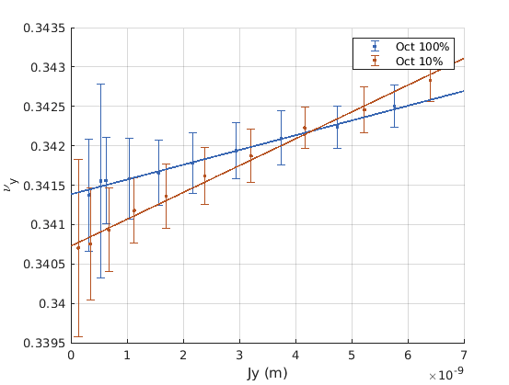
Vertical detuning with vertical amplitude
Once the vertical oscillations can be generated, even if with much weaker amplitudes, we can measure the vertical detuning with vertical amplitude.

Slide 4
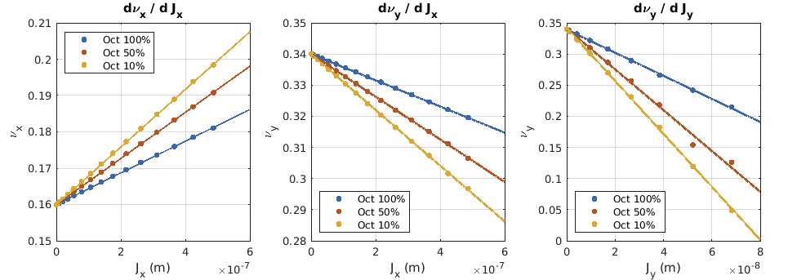
MAC Slide was wrong!
Measurements
Oct % | dν_{x}/dJ_{x} (10⁴ m⁻¹) | dν_{y}/dJ_{x} (10⁴ m⁻¹) | dν_{y}/dJ_{y} (10⁴ m⁻¹)
10% | 9.3±0.3 7.93 | -18±2 -8.95 | 34±3 -420
50% | 7.1±0.3 6.35 | -14±1 -6.84
100% | 4.7±0.2 4.35 | -10.9±0.3 -4.20 | 19±2 -180
Simulations
Values from simulations in orange
Vertical detuning with vertical amplitude is measured positive and is supposed to be negative in simulation. Maybe the measurement is not good.

Slide 5
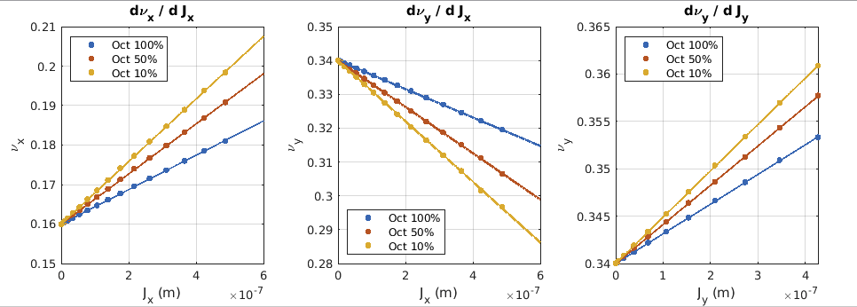
This is how it was supposed to be!
Measurements
Oct % | dν_{x}/dJ_{x} (10⁴ m⁻¹) | dν_{y}/dJ_{x} (10⁴ m⁻¹) | dν_{y}/dJ_{y} (10⁴ m⁻¹)
10% | 9.3±0.3 7.93 | -18±2 -8.95 | 34±3 +4.90
50% | 7.1±0.3 6.35 | -14±1 -6.84
100% | 4.7±0.2 4.35 | -10.9±0.3 -4.20 | 19±2 +3.13
Simulations
Values from simulations in orange
Vertical detuning with vertical amplitude is still in disagreement with theory, but at least the sign is correct.

Slide 6
Detuning with full sextupolar knobs
Our sextupole knobs have little effect (purple vs blue lines) in hor-hor and ver-ver, but they have some significant effect in the cross term.
Purple line is what we get with all the sextupole and octupole knobs as they were during last run in operation.

Slide 7
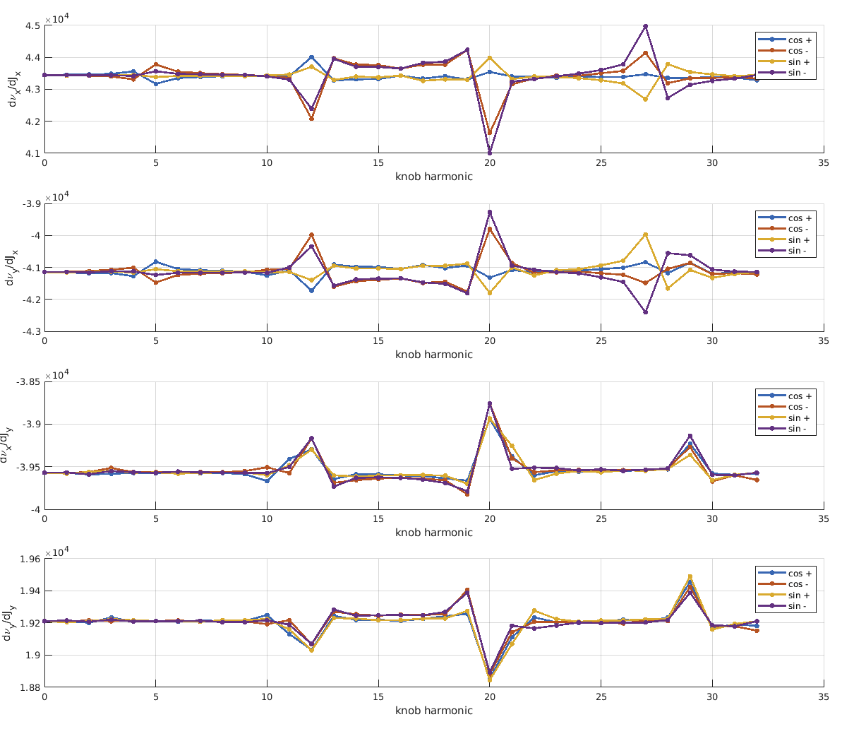
Effect of each SF sine wave knob in the detunings
Some harmonics have big effect on the detunings.
The ones scanned for optimization of operation are: 8, 9,12 and 20.
Maybe we can try to scan all of them with badger and check at the end the detuning with amplitude.

Slide 8
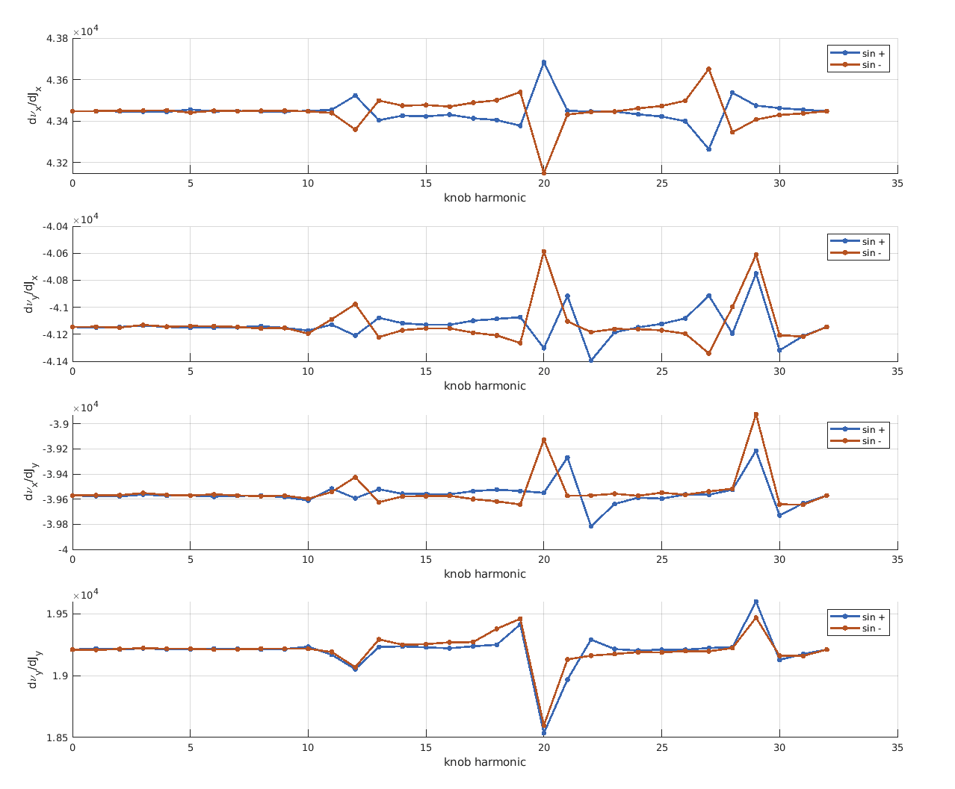
Effect of each SD_AE sine wave knob in the detunings
The ones scanned for optimization of operation are: 3, 9, 23 and 29.

Slide 9
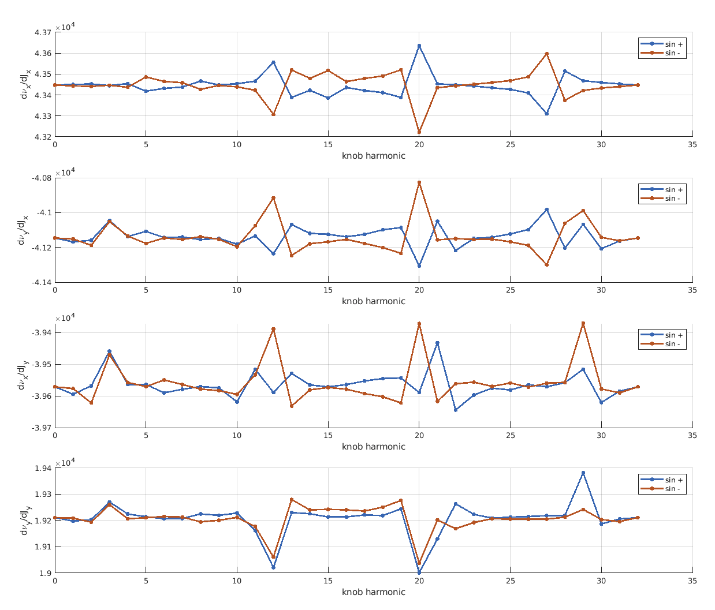
Effect of each SD_BD sine wave knob in the detunings
The ones scanned for optimization of operation are: only the 9.

