Slide 1
Status of emittance shaker and emittance monitor for PETRAIV
Eurizon Task 4.1 Diagnostics Update Meeting
Sven Pfeiffer
Hamburg, 12.06.2023

Slide 2
Time-line
Status update
Outline:
Emittance monitor
Recap of T-MBFB for shaker integration
Stripline kicker as beam shaker
Simulations required for MBFB integration

Slide 3
Emittance monitor selection
The selection and the integration of the emittance monitor from beamline into the emittance control scheme will be in close collaboration with the DESY beam diagnostics group to address following aspects:
Expected resolution of emittance monitor
Expected update rate/time for feed-forward/feedback integration
Expected processing time/latency of the monitor
Update after DEELS WS

Slide 4
PIV – T-MBFB operation requirements
Emittance control using MBFB system
Technical spec.: MBFB is expected to play two major roles in PETRA IV operation
Damping coherent transverse motion, including if any injection oscillations;
Providing an online tool for beam stability monitoring and impedance characterization.
Update to “… three major roles in PETRA IV operation”
Acting as actuator for emittance control in H and V plane
Remark:
MBFB kickers are not intended to be used as an emittance shaker for machine protection during beam dump.
Betatron frequencies f_{x} = 23.4kHz , f_{y} = 35.2kHz

Slide 5
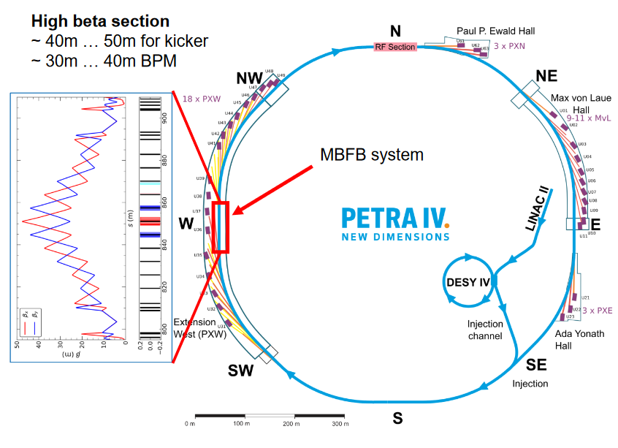
PIV - MBFB technical requirements
Remark: Diagnostics BL in PXW → Intra-room optical link to MBFB system

Slide 6
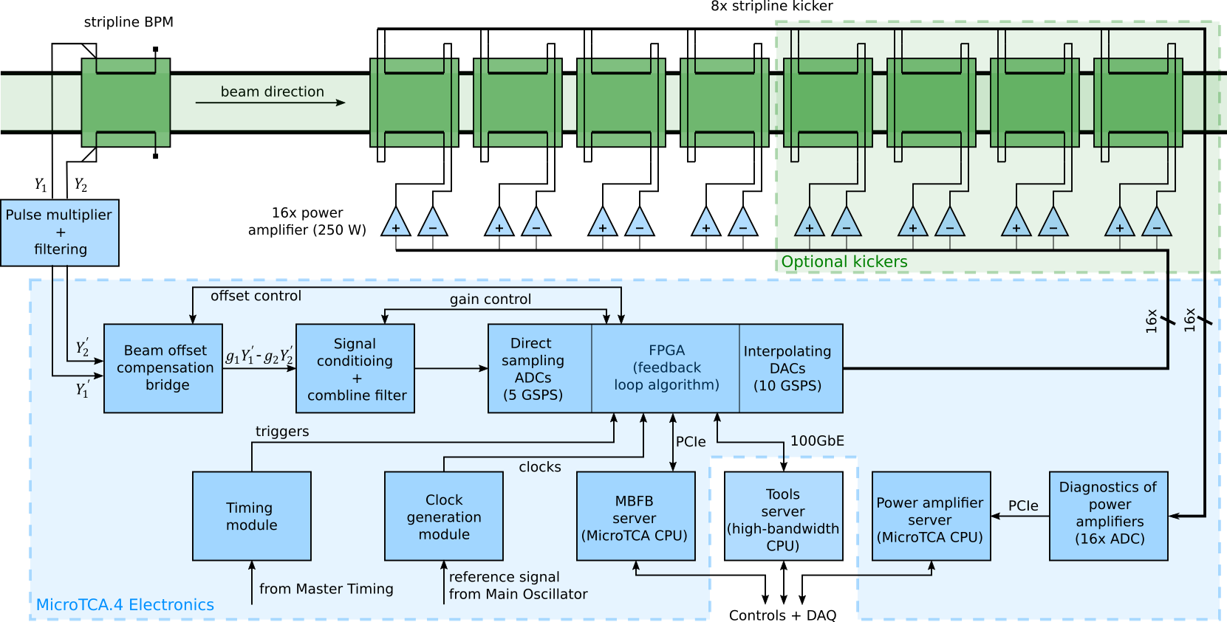
PIV - MBFB architecture
Feedback signal flow and diagnostics
S. Jablonski, H.T. Duhme, B. Dursun, J. Klute, S. H. Mirza, S. Pfeiffer, H. Schlarb, Conceptual Design of the Transverse Multi-Bunch Feedback for the Synchrotron Radiation Source PETRA IV, Proc. of IBIC2022, Kraków, Poland, Sep. 2022.
Feedback signal flow
Stripline BPM (1 GHz)
Pulse multiplier and filtering (increase SNR) (*)
Beam offset compensation bridge
Signal conditioning and combline filter (*)
5 GSPS ADCs
Processing + control
10 GSPS DACs
High power amplifiers (HPAs)
Stripline kickers (DC-250 MHz)
Diagnostics and tools for machine studies
Diagnostics of HPAs
Diagnostics of bunch position, phase, charge
Tune measurement, growth-damp analysis
DAMC-DS5014DR

Slide 7
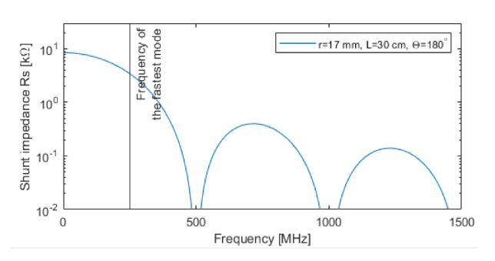
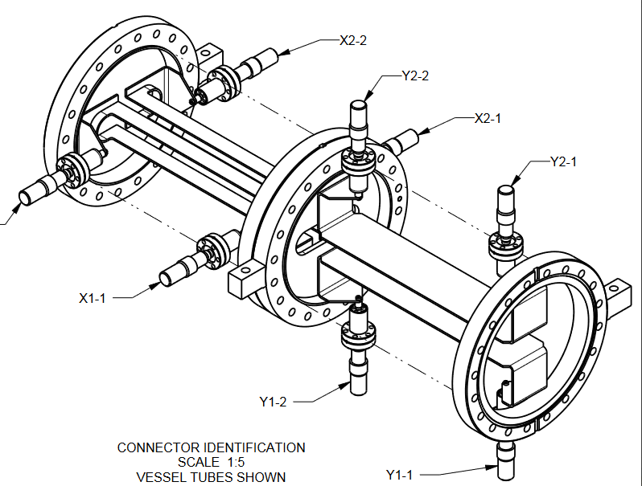
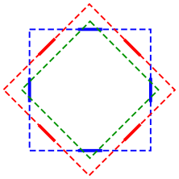
Stripline kicker (design by WP2.14)
Kicking strength (~R_{sh}) maximized from DC to 250MHz
Up to 257nrad per kicker using 2x250W HPA (~350W at kicker)
Act reliably on every single bunch (decay time of the EM field < 2ns)
Zero shunt impedance at multiples of 500 MHz to reduce beam energy coupling
Kicker installation
TAC recommends 45deg tilted
Stronger kick saved some power
Lower impact of the synchrotron radiation
We prefer 0deg installed in straight line (beta optimized) …
Decoupling of planes to avoid potential emittance increase
Better exception handling
Dehler et al, “Current status of the ELETTRA SLS transverse multi bunch FB”, EPAC2000, WEP4A15

Slide 8
Shaker Evaluation and Selection M4.1.5
Simulations required to check if MBFB kicker is sufficient …
For better understanding of the excitation of the beam shaker (underlining concept) a simulation using PETRA IV lattice is required. This simulation, performed by DESY accelerator physics group, should answer the following aspects for PETRA IV ring integration:
What range of excitation do we need for PETRA IV integration in timing / brilliance operation mode?
Amplitude range
Frequency range
What is excited by using a beam shaker – physical concept to evaluate point 3)
Intra-bunch excitation with broadband actuator for emittance control of every bunch?
Bunch-to-bunch excitation using BW-limited actuator for emittance control of all bunches (integrated effect, while single bunch does not change the emittance)?
Combination of the two (a and b)?
Evaluate the interaction of emittance excitation/compensation with the feedback systems.
Interaction with MBFB system
Interaction with FOFB system
MBFB system able to do this?

Slide 9
Outline
Emittance monitor selection after DEELS WS
Simulations using PIV lattice …
or using EBS simulations from Nicola C. and do prediction to PIV ?
Interaction of emittance excitation/control with the feedback systems
FOFB → low/high chromaticity operation (down to 2ns bunch spacing)
orbit smears over time while providing 1 turn orbit (130kHz) to FOFB system
→ more noise expected for BPM input
→ expected resolution degradation
MBFB → few concepts might be used and studied
Degradation of analog signals on frontend side by setting attenuators
Integration of noise generator (white noise, band-limited noise) into firmware
→ Feed-forward / Set-point modulation to avoid MBFB correcting for required distortions

Slide 10
Thank you

Slide 11
Name Surname
Department
E-mail
Phone

